Slide 1
Creating and Maintaining Inclusive Environments
From the Office to the Classroom
ADA Team
Equity, Civil Rights & Title IX

Slide 2
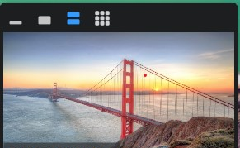
Zoom Tips
To utilize CART captioning services, click Show Captions or Live Transcript.
To change your view to show the speakers and the ASL interpreter, click View in the upper right corner of your screen. Then select the 3rd or 4th icon in the view screen.
You can also pin individuals so you can always see their window. Select the ellipses in the upper right corner of the individual you would like to pin, then select Pin.

Slide 3
Agenda
This workshop will cover:
The ADA Team and our role
General background information on the ADA and its protections
Language etiquette
Inclusive environments & accessible design
Inclusive workspaces and classrooms
U-M & community resources

Slide 4
Please Engage
Questions are encouraged
If you’re thinking about it, chances are someone else is, too!
Submit your questions anonymously via Q&A
This is a safe/brave space
Respect the experiences of others
Opportunities for growth and learning
We’re all learning together

Slide 5
ADA Team & The ADA/ADAAA

Slide 6
The ADA Team
Allison Kushner – (she/her) Director of Disability Equity and ADA Coordinator
Megan Marshall – (she/her) Assistant Director of Disability Equity and Deputy ADA Coordinator
Phil Deaton – (he/him) Digital Information Accessibility Coordinator
Erin Norris – (she/her) Digital Communications Specialist
Sarah Caruso – (she/her) Administrative Specialist
Stephanie Beatty – (she/her) ASL Interpreter
Casie Watson – (she/her) ASL Interpreter
Angie Gruendl – (she/her) Case Manager
Erin Metz – (she/her) Accessibility Specialist
Jordan Funk – (she/her) Accessibility Specialist
(vacant) – Accessibility Specialist
Email - ECRT-ADATeam@umich.edu

Slide 7
Role of the ADA Team
Provide institutional consultation, educational outreach, and advice about accessibility, disability, and inclusion
Promote digital and physical accessibility planning and implementation
Advocate for the inclusion of disability as a critical part of diversity initiatives and planning across all aspects of our University community
Facilitate the Interactive Process for workplace accommodations under the ADA/ADAAA

Slide 8
What is the ADA/ADAAA?
The Americans with Disabilities Act (1990) & the Americans with Disabilities Act Amendments Act (2008)
Prohibit discrimination against a qualified individual with a disability (IWD) in employment
Application procedures, hiring, promotion, discharge, compensation, benefits, training, etc.
Protects individuals from discrimination based on their association with an IWD
Requires state and local governments give IWDs an equal opportunity to benefit from programs, services, and activities

Slide 9
Individuals With Disabilities
1 in 4 adults in the United States
Unemployment rate is 4x higher than for individuals without disabilities
Only group you can join at any time in your life
Over 1 billion IWDs worldwide
Two people can have the same disability, but with different impacts

Slide 10
What is a Disability?
A physical or mental impairment that substantially limits one or more major life activity
Substantial limitation is determined by comparison to an average person in the general population
Major life activities include: bending, breathing, caring for self, concentrating, hearing, interacting with others, learning, lifting, seeing, sitting, speaking, standing, thinking, walking, working, etc.
This includes people who have a record of such an impairment, even if they do not currently have a disability
It also includes individuals who do not have a disability, but are regarded as such

Slide 11
Functional Disability Categories
Visual
blind, low vision
Auditory
deaf, hard-of-hearing
Motor
paralysis
cerebral palsy
missing / damaged limbs
Psychological
anxiety disorder
bipolar disorder
PTSD
major depressive disorder
Seizure / Epilepsy
Cognitive
learning disabilities
dyslexia
traumatic brain injury
Neurodiverse
Autism Spectrum Disorder
Age-related
decreased sensory acuity, dexterity, stamina
Substance use disorders
This list is non-exhaustive

Slide 12
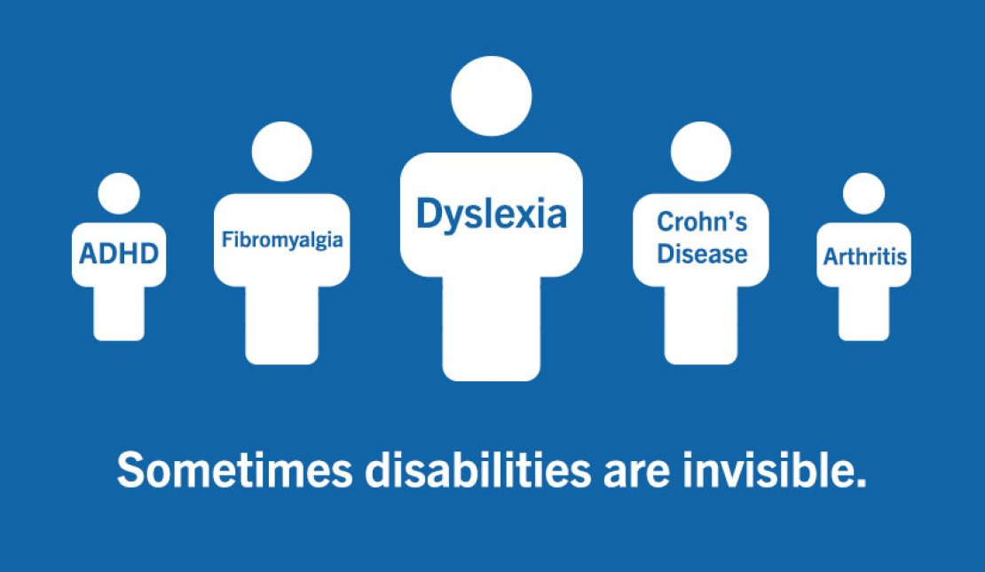
Non-Apparent Disabilities
Allergies
Anxiety disorders
Asthma
Brain injuries
Bipolar disorders
Chronic pain
Chronic fatigue
Crohn’s disease
Diabetes
Fibromyalgia
Heart disease
Inflammatory bowel disease
Lyme disease
Lupus
Migraines
Thyroid disorders
This list is non-exhaustive

Slide 13
Language Etiquette

Slide 14
Ableism
Ableism: the intended or unintended discrimination of and social prejudice against people with (or perceived to have) disabilities based on the belief that typical abilities are superior
Ableism is rooted in the assumption that IWDs require “fixing” and defines people by their disability
Like racism and sexism, ableism classifies entire groups of people as “less than,” and includes harmful stereotypes, misconceptions, and generalizations of IWDs
Devalues and limits the potential of IWDs

Slide 15
Person-First Language
The individual is emphasized ahead of their disability
Aims to recognize humanity first
Disability is just one part of identity
Examples:
Person with a disability
Individual with … epilepsy, an intellectual disability
Person who is … deaf, blind, hard of hearing
Individual who uses a … wheelchair, walker, assistive device
Person who has … depression, anxiety, ADHD

Slide 16
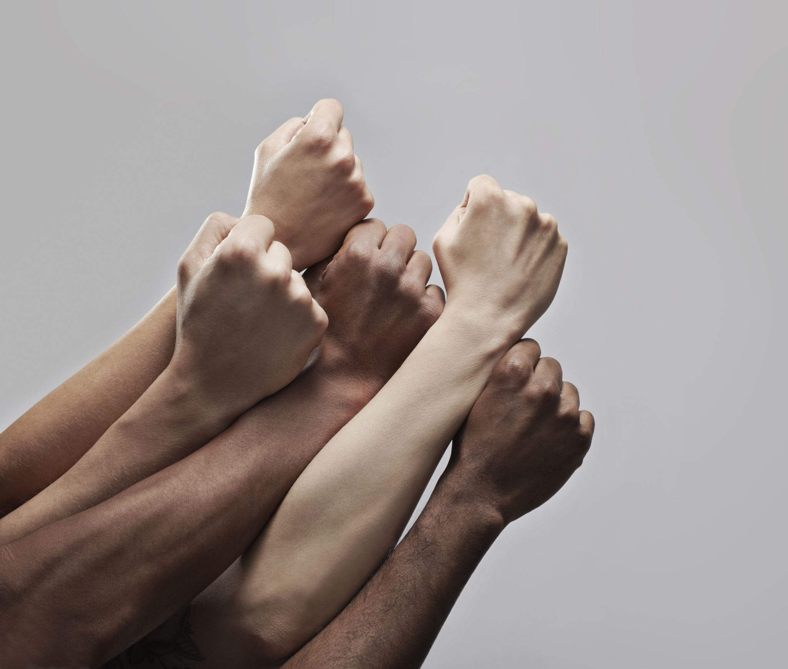
Identity-First Language
Identity-first language challenges negative connotations by claiming disability directly
Acknowledges disability as an integral part of identity
Examples:
Disabled person
Deaf/deaf person (“D” refers to culture, “d” refers to medical condition),
Autistic person
AHEAD (Association on Higher Education and Disability) has adopted Identity-First language

Slide 17
Which is Right?
Person-First language – A Person with a Disability
Identity-First language - A Disabled Person
The short answer:
BOTH!

Slide 18
Keep in Mind…
Disability and disabled are NOT dirty words
Check out resources that are available including specific style guides
Challenge yourself to remove words and characterizations that may be offensive to others
There is no need to use language like “differently-abled” or “specially-abled”
Ask what is preferred, if you are in a position to do so
Pay attention to how someone refers to themselves
Language evolves over time

Slide 19
Language to Avoid
Avoid language that:
Has negative overtones - Stroke victim, afflicted with cerebral palsy, suffering from anxiety, wheelchair bound
Is regarded as a slur - Crazy, slow, the R word
Assumes knowledge about a specific individual’s experience because you “have a friend who” or “know someone who”

Slide 20
Language Swap
Avoid: Handicap
Why: Implies an incapacity
Replace with: Disability
Avoid: Special needs
Why: Euphemistic
Replace with: Person with a disability
Avoid: Wheelchair-bound
Why: Implies a confinement
Replace with: Wheelchair user
Avoid: Mentally ill
Why: Stigmatized and misused
Replace with: Person with a mental health condition

Slide 21
Mind Your Actions
Avoid ableist actions
Choosing an inaccessible location for an event
Standing in front of a push bar/door opener
Using the accessible bathroom stall when you may not need it
Parking/standing in an accessible parking space
Blocking a curb cut
Leaving your bike on the sidewalk
Notes:
We’ve already talked about some language to avoid, now let’s talk about actions we should avoid

Slide 22
Ableist Microaggressions
Questioning whether someone really needs an assistive device
Requiring everyone to participate in group meetings / Zoom calls in the same way
Maintaining eye contact, cameras on, speaking in a certain way
Interrupting or finishing sentences because someone is taking too long/being too slow
Making someone feel “othered”
Using condescending or louder voices to explain things to an IWD
Doing the bare minimum of an accommodation

Slide 23
Replacing Microaggression with Microaffirmation!
Be considerate about how information is processed and received
Provide more than one option, whenever possible
When considering one accommodation request, consider whether you can do it for everyone in the unit
Can everyone have a Zoom link?
Can everyone get a sit to stand desk?
Can everyone use alternative lighting?
Avoid last minute agenda changes or meeting location/time changes
Especially important for many individuals with chronic conditions and various psychological disabilities

Slide 24
Check Your Bias
Our reliance on sight, hearing, and mobility is unconscious
“We don’t know what we don’t know” but it is our job to ask questions and consider the experiences of others
Think back to common functional disability categories and ask:
What can I do to create an inclusive environment for someone in one or more categories during event or meetings?
If I cannot see/have limited motor function in my hands/cannot hear, is there a way for me to access information or participate in the activity?
If I cannot contemporaneously listen to instructions and take notes/discuss information and retain detail, is there a way for me to gather information later?
If I need to frequently move around/take breaks to retain information, will I be able to receive information after I come back? Will I be able to do so without additional scrutiny?

Slide 25
Thinking Inclusively

Slide 26
Disability: An Aspect of Diversity
IWDs experience the world in unique ways
Disability is not a single phenomenon
Informed by personal and socio-cultural factors
Contextualized by the barriers created in society
May be permanent, long-term/ongoing, or temporary

Slide 27
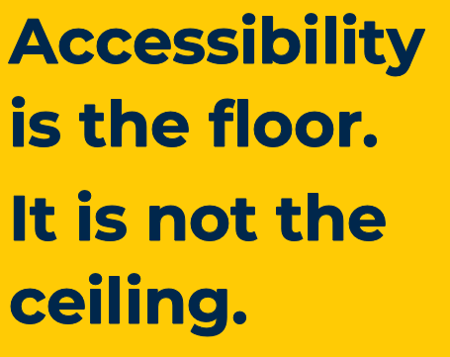
Accessibility is NOT…
Making one-off changes to technology or processes
This is an accommodation, but it is not the goal
A feature or enhancement
Giving an unfair advantage to someone
Conformance with legal standards or guidelines
Arbitrary
It’s not what you think is accessible

Slide 28
Accessibility IS:
Beneficial to nearly everyone
An ongoing and intentional process
Centers unique aspects of different interaction modalities
Being proactive in our approach saves time, expense, headaches
Creating an equivalent, real-world user experience for all
Benefits everyone by reducing / removing barriers
Legal compliance guides this process
Innovative
Considering multiple ways to access technology and information leads to new paradigms

Slide 29
Accommodations Are Needed, but…
Accommodations are not the end goal
Something must be modified to meet specific needs
Created inaccessibly
Single out individuals needing accommodations
Individuals or groups must ask for accessibility
May be costly to modify structural barriers
Each new request requires more changes
Not retroactive
Not timely and may not be possible

Slide 30
The End Goal Is…
Inclusion!

Slide 31
Inclusive Environments & Accessible Design

Slide 32
Employing Universal Design Principles
When thinking about new construction or spaces, or when planning events, meetings, or conferences, when setting up your classroom or workspace - consider every aspect: elevators, stairs, restrooms, water fountains, parking, lighting, signage, etc.

Slide 33
7 Principles of Universal Design
Equitable Use: It is useful & marketable
desk surfaces that can be raised or lowered for individuals of varying heights, or users of wheelchairs
Flexibility in Use: The design accommodates a wide variety of preferences & abilities
captioning of videos to allow people to choose to listen or read
Simple & Intuitive Use: Easy to understand, regardless of experience, or skills
website with clear headings that is well organized
Perceptible Information: Communicates necessary information effectively
videos with voiceover for individuals with visual impairments

Slide 34
Universal Design, continued
Tolerance for Error: Minimizes hazards or adverse consequences for mistakes
hallways kept clear of protruding objects
Low Physical Effort: Use is efficient, comfortable, and with a minimum of fatigue
automatic door openers
Appropriate Size & Space for Approach & Use: Space for approach, reach, and manipulation regardless of size or mobility
variety of seating options including a table or wider chairs
Notes:
Examples: curb cuts, automatic doors, smartphones, voice assistants

Slide 35
Creating Comfortable Spaces
We don’t know what we don’t know
Mistakes are okay
We are learning together
It is always ok to ask questions

Slide 36
Inclusive Workspaces and Classrooms
Notes:
and Recognizing Issues We Need to Address

Slide 37
What Should I Do to Create Inclusive Spaces?
Embrace the desire to see things from different and positive perspectives
“How can I help?:
Use the “thinking cap” of innovation
Foster a mindset for culture shifting
Become a leader
Encourage buy-in from other leaders in making the university accessible for all
Dissuade unconscious bias
Support differences which add value to the workspace

Slide 38
Tips For Creating Inclusive Environments
Create a welcome and diverse department
Employ universal design principles
Allow employees with disabilities to be leaders
Provide and attend training around disabilities, inclusion, and accessibility
Ensure team events and meetings are inclusive
Refer employees to ECRT or other U-M resources
Be prepared to accommodate

Slide 39
Accessibility Tips For Meetings and Events
Ensure all materials, including handouts, are accessible, and provide alternative format printed materials, whenever possible
Make sure there are audio amplification devices or microphones available, and that speakers and presenters use them
Provide a virtual option when possible (not just a recording)
Consider individual mobility limitations and a variety of seating options
Make sure doorways, hallways, and restroom entrances are not blocked
Consider accommodations, interpreters, and CART
Provide information in advance, and avoid late/last minute changes
Access the Accessible & Inclusive Events Resource Guide

Slide 40
Virtual or Hybrid Meeting and Event Considerations
Participants should state their name when speaking
This identifies the speaker to all participants and to captioners and interpreters
Zoom captioning is helpful, but does not meet access standards for accommodation requests
Should be utilized for any event or meeting without a CART option
If utilizing an ASL interpreter, spotlight the interpreter’s video feed
If there are questions in the chat, be sure to read them aloud
Enable your camera when speaking
Reduce background noise and visual distractions

Slide 41
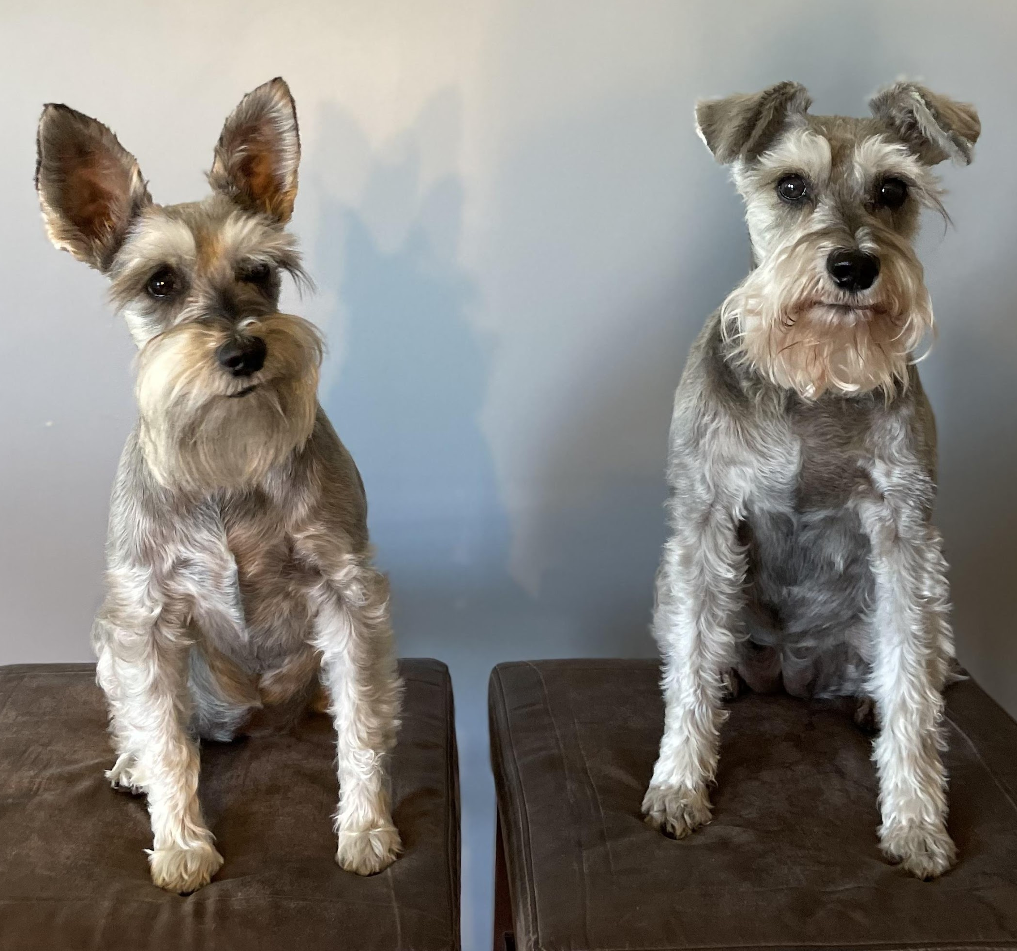
Digital Accessibility Tips
Use alt-text for photos and images
Example: two silver miniature schnauzers sitting on brown stools
Use video descriptions
Use accessibility checkers
Use CamelCase Hashtags
#LilyAndAbbeyAreTheCutest instead of #lilyandabbeyarethecutest
Check color contrast

Slide 42
Employee’s Top Factors Considered Before Disclosing disabilities
If it is a new disability, they may have never needed to advocate for themselves and may not know how
May not know what to ask for
They have concerns about being treated differently or about discrimination
They may have concerns about losing their job
They may have a hard time knowing where to go for access and support
It may be difficult to identify support systems
They may see others who have had poor experiences

Slide 43
Common Employee Complaints
Supervisors and employees not knowing how to communicate about accommodations or access needs
Maintaining confidentiality – who has a need to know?
“Respect the privacy of your coworkers, just as you would like your privacy maintained”
“We’re acting under legitimate business purposes”
“We are fulfilling legal obligations”
Morale and precedent are two words the ADA doesn’t consider
Every accommodation is assessed on an individualized basis

Slide 44
Student’s Top Factors Considered Before Disclosing disabilities
Young students often are new to advocating for their own needs
They may wait to determine the campus climate before disclosing
They may have a hard time knowing where to go for access and support
It may be difficult to identify support systems
They may see others who have had poor classroom and environment experiences

Slide 45
Key Figures
Classroom climate has improved considerably since 1997, but there is a well known and documented reluctance amongst students to seek accommodations
More than half of students eligible to receive accommodations do not request them in higher education
Only 1/3 of students with disabilities graduate from a 4-year college or university within 8 years

Slide 46
Common Faculty Questions Surrounding Student Accommodations
Do I have to provide my slides?
If it is part of the accommodation, yes! Slides are not intellectual property
Is changing the modality of one assignment a material alteration of a course?
Most likely not, but when in doubt, call the ADA Coordinator or SSD
Do I have to turn on captioning even if someone doesn’t have an accommodation?
Technically no, but why not do it anyway? You have the option to not have it appear on your screen, as do any other participants

Slide 47
Common Student Complaints
Professor tells class “Jane has a disability, so everyone needs to turn on their cameras during class”
Professor says “No PowerPoint will be provided ahead of time, regardless of anyone’s disability”
Professor emails student to say they are too busy to turn on captioning and will get it done by the 6th week of class
Professor says they will take creating digitally accessible materials “under advisement”

Slide 48
Classroom & Workspace Tips
Be part of the solution!
Acknowledge receipt of an Accommodation Letter or a request for accommodation
Upon receipt, implement the accommodation promptly, and throughout the entirety of the semester/course/year
Thank the student or employee for sharing their information
This can sometimes be incredibly difficult to do!
It is okay to ask supportive questions
Ask the student how you can help them to succeed
Ask how you can make the environment more accessible
Most importantly – come from a place of “How can I help?”

Slide 49
Resources

Slide 50
U-M Resources
Students:
SSD: Services for Students with Disabilities
Rackham Graduate School – Graduate Student Accommodations
CAPS: Counseling and Psychological Services
Dean of Students
Employees:
Work Connections - 10+ days of missed work due to disability
MHealthy ergonomic evaluations
FASCCO: Faculty and Staff Counseling and Consultation (formerly FASAP)
OCWR: Michigan Medicine Office of Counseling and Workplace Resilience
LTD: Long Term Disability

Slide 51
More U-M Resources
LSA Disability Navigators
Michigan Medicine HR Solutions Center
Digital Accessibility
Digital Information Accessibility Coordinator
ITS
Grounds, clearing accessible routes
Submit a work order
Accessible parking
ADA Team, Parking and Transportation Services
Paratransit

Slide 52
Community Resources
Council for Disability Concerns (CfDC): Community and advocacy group, meets monthly
Job Accommodation Network (JAN): Searchable database of accommodation options and solutions
Disability Network: Washtenaw, Monroe, Livingston
Ann Arbor Center for Independent Living
Michigan Rehabilitation Services (MRS): State agency providing assistance, accommodations, and services
A-Ride: Accessible transportation through AATA
Department of Justice (DOJ)
Equal Employment Opportunity Commission (EEOC)
Michigan Department of Civil Rights (MDCR)

Slide 53
Upcoming Events – all begin @ noon
Tuesday, 10/17: A Supervisor’s Guide to Disability Accommodations
Thursday, 10/19: The Interactive Process – 4 Steps to Accommodation
Tuesday, 10/24: Introduction to Creating Accessible Digital Documents
Thursday, 10/26: Drop-in Hour with the ADA Coordinators and the ADA Team
Tuesday, 10/31: D/deaf Etiquette with the ASL Interpreters
*CART transcription and ASL interpreters are available for each event*

Slide 54
Questions?

Slide 55
Thank You!

