Slide 1
Understanding the Americans with Disabilities Act (ADA)
An Introduction to Disability, U-M Resources, and More!
ADA Team
Equity, Civil Rights & Title IX

Slide 2
Agenda
This workshop will cover:
The ADA Team and our role
General background information on the ADA and its protections
Disability statistics
The Interactive Process
U-M & community resources
Upcoming events

Slide 3
Please Engage
Questions are encouraged
If you’re thinking about it, chances are someone else is, too!
Submit your questions anonymously via Q&A
This is a safe/brave space
Respect the experiences of others
Opportunities for growth and learning
We’re all learning together
Notes:
If you need to speak directly to our interpreter, post in the Q&A and we can turn on your video, or you can utilize the Q&A for any questions

Slide 4
The ADA Team & The ADA

Slide 5
The ADA Team
Allison Kushner – (she/her) Director of Disability Equity and ADA Coordinator
Megan Marshall – (she/her) Assistant Director of Disability Equity and Deputy ADA Coordinator
Phil Deaton – (he/him) Digital Information Accessibility Coordinator
Erin Norris – (she/her) Digital Communications Specialist
Sarah Caruso – (she/her) Administrative Specialist
Stephanie Beatty – (she/her) ASL Interpreter
Casie Watson – (she/her) ASL Interpreter
Angie Gruendl – (she/her) Case Manager
Erin Metz – (she/her) Accessibility Specialist
(vacant) – Accessibility Specialist
(vacant) – Accessibility Specialist
Email - ECRT-ADATeam@umich.edu

Slide 6
Role of the ADA Team
Facilitate the Interactive Process under the ADA/ADAAA
Provide institutional consultation, educational outreach, and advice about the Interactive Process, accessibility and inclusion, and all other accessibility matters
Advocate for the inclusion of disability as a critical part of diversity initiatives and planning across all aspects of our University community

Slide 7
What is the ADA/ADAAA?
The Americans with Disabilities Act (1990) & the Americans with Disabilities Act Amendments Act (2008)
Prohibit discrimination against a qualified individual with a disability (IWD) in employment
Application procedures, hiring, promotion, discharge, compensation, benefits, training, etc.
Protects individuals from discrimination based on their association with an IWD
Requires state and local governments give IWDs an equal opportunity to benefit from programs, services, and activities

Slide 8
Legal Framework
ADA & ADAAA
Title I - Employment
Title II – State and Local Government
Title III – Public Accommodations
Other Federal Laws
Rehabilitation Act of 1973
Fair Housing Act
Air Carrier Access Act
Individuals with Disabilities in Education Act (IDEA)
Other State Laws
Michigan Persons with Disabilities Civil Rights Act
Deaf Persons’ Interpreters Public Act
Public Act No. 75 of 2022 (service animals in training)

Slide 9
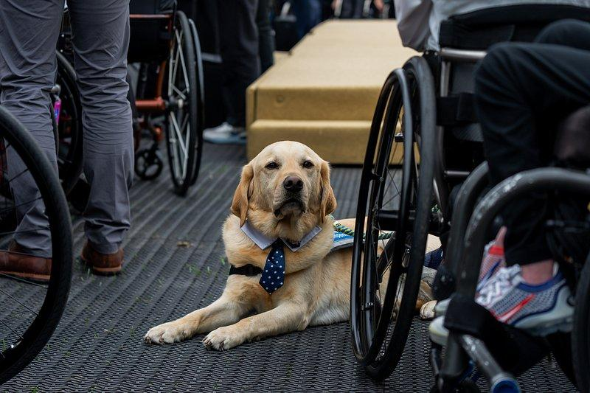
A Few Notes on Service Animals
Only dogs and mini-horses can be service animals
there are psychiatric service animals - not just for apparent disabilities
Trained to perform specific tasks
Can be a reasonable accommodation
Can only ask 2 questions if in public spaces
Is this service animal required due to a disability?
What task or service is it trained to perform?
Care and control of handler at all times
No special vest or certification required

Slide 10
ADA Responsibility
No qualified individual (applicant, employee, student, etc) with a disability shall, on the basis of that disability, be excluded from participation in or be denied the benefits of the services, programs, or activities provided by the University of Michigan
Disability based discrimination
Disability based harassment
Affirmative obligation to provide reasonable accommodations

Slide 11
Who is Protected?
Qualified Individuals With Disabilities (IWDs)
Faculty
Tenured, non-tenured, lecturer, research, clinical, etc
Staff
Temporary, probationary, student-staff, etc
Students
Undergraduate, graduate, online, transfer, etc
Members of the public
Event attendees, visitors, guests, athletics, etc

Slide 12
What is an Accommodation and How is it Requested?
Accommodation: Any modification or adjustment to policy, practice, or environment that provides individuals with disabilities equitable access to the programs, services, or benefits provided at the University of Michigan
Requests do not require magic words and don’t need to be submitted in writing. They do need to put the employer on notice of the need for assistance with essential job functions
“I’m having a hard time with…”
“I need help with…”

Slide 13
What is a Disability?
A physical or mental impairment that substantially limits one or more major life activity
Substantial limitation is determined by comparison to an average person in the general population
Major life activities include: bending, breathing, caring for self, concentrating, hearing, interacting with others, learning, lifting, seeing, sitting, speaking, standing, thinking, walking, working, etc.
This includes people who have a record of such an impairment, even if they do not currently have a disability
It also includes individuals who do not have a disability, but are regarded as such

Slide 14
Disability Models
Legal Model
Defined by the ADA
Medical Model
Considers disability a medical diagnosis of the body or mind
Often leads to a focus on how to “fix” the disabled person
Social Model
Asserts that disability is created by the barriers in society, rather than by individual differences

Slide 15
Functional Disability Categories
Visual
blind, low vision
Auditory
deaf, hard-of-hearing
Motor
paralysis
cerebral palsy
missing / damaged limbs
Psychological
anxiety disorder
bipolar disorder
PTSD
major depressive disorder
Seizure / Epilepsy
Cognitive
learning disabilities
dyslexia
traumatic brain injury
Neurodiverse
Autism Spectrum Disorder
Age-related
decreased sensory acuity, dexterity, stamina
Substance use disorders
This list is non-exhaustive

Slide 16
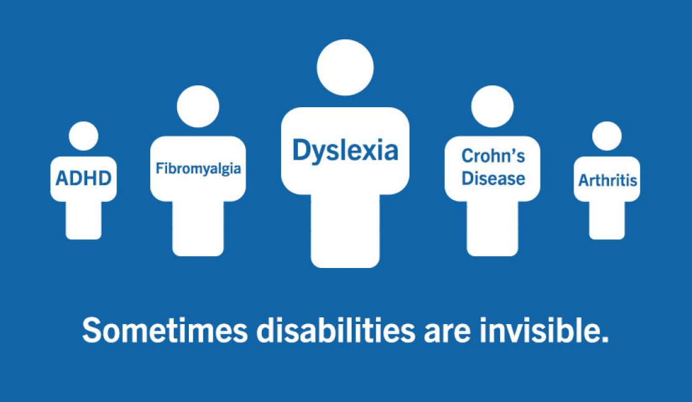
Non-Apparent Disabilities
Allergies
Anxiety disorders
Asthma
Brain injuries
Bipolar disorders
Chronic pain
Chronic fatigue
Crohn’s disease
Diabetes
Fibromyalgia
Heart disease
Inflammatory bowel disease
Lyme disease
Lupus
Migraines
Thyroid disorders
This list is non-exhaustive

Slide 17
Privacy
ECRT is NOT confidential, but we do respect your right to privacy
We are IROs: Individuals with Reporting Obligations
Required to file a report on discrimination, harassment, violation of protective measures, etc
We do not share information about your disability or condition, symptoms, or personal information outside of our office, and not without an explicit need to know
An integral part of the process, and the Equal Employment Opportunity Commission (EEOC) directs, co-workers and colleagues generally do not have a need to know about an accommodation

Slide 18
Disability Statistics

Slide 19
Individuals With Disabilities
1 in 4 adults in the United States
Unemployment rate is 4x higher than for individuals without disabilities
96% of people with chronic conditions live with non-apparent disabilities
Only group you can join at any time in your life
Over 1 billion IWDs worldwide

Slide 20
More Statistics
6 in 10 adults in the US have a chronic health disease, 4 in 10 have two or more
Around 6.5 million people in the US have an intellectual disability
Two people can have the same disability, but with different impacts

Slide 21
How Disabilities Present

Slide 22
The Interactive Process
4 Steps to Accommodation

Slide 23
Step 1: Employee Requests an Accommodation
Submit a request using the online form
Supply medical documentation
This allows the ADA Team to make a disability determination and ensures the employee is eligible for workplace accommodations
Become familiar with policies and procedures

Slide 24
Step 2: Employee Meets With an Accessibility Specialist
Employees will schedule a meeting to discuss their request in detail. This is an opportunity to provide additional information and share lived experiences
This can take place during the workday without using benefit time
Supervisors do not need to be informed of the meeting with the AS (not yet, anyway)
Employees will be asked to provide:
Their job description
Names of immediate supervisor and HR representative

Slide 25
Step 3: Accessibility Specialist Meets With Unit
The AS will meet with the employee’s immediate supervisor and a member of the HR Team
Or another individual who can help to make decisions for the worksite
The unit must provide the employee’s job description and be able to discuss the employee’s essential job functions
The AS may discuss the limitations of the condition but we will not share the employee’s medical condition or disability. The employee’s medical documentation will not be shared, either.

Slide 26
Step 4: Determine and Finalize the Accommodation
The Accessibility Specialist will determine the most reasonable and appropriate accommodation
Taking into account the employee’s lived experiences, medical documentation and provider recommendations, and the needs of the unit
Draft documents will be issued to the unit and the employee
Everyone must acknowledge the draft documents in order to move forward with the Interactive Process
Accommodation documents will be finalized with a copy sent to all parties involved

Slide 27
After the Accommodation is Finalized
Save the accommodation document somewhere secure, but accessible when needed
It should be stored separately from the employee’s personnel file
Create a plan for communication
Determine how the accommodation should be implemented
Create clear and concise expectations
Know who to contact when questions arise
Check in regularly to make sure the accommodation is working as expected

Slide 28
Accommodation Examples
Modify/provide equipment
Sit to stand desk, ergonomic chair, ergonomic phone
Modify a work schedule
Flexible start/end times, altering break schedules
Provide accessible software
Speech to text, large format
Alter a uniform
Allow headwear, allow facial hair, fabric modifications
Provide leave

Slide 29
University of Michigan and Community Resources

Slide 30
Academic Support Options
Services for Students with Disabilities
The University will provide reasonable academic accommodation(s) to otherwise qualified students as required by law to ensure equal access to educational opportunities.
Pregnant and Parenting Students (National Women’s Law Center)
Resources and support for pregnant and parenting students to help them succeed in school.
Accommodations for Graduate Students with Disabilities (Rackham)
U-M is committed to ensuring graduate students receive appropriate reasonable accommodation so all students are supported in all aspects of their educational experience, including their employment related to their graduate education.

Slide 31
Accessible & Gender Inclusive Restrooms
Accessible restrooms on campus
Services for Students with Disabilities (SSD) provides a list of accessible bathrooms across all U-M campuses in the Ann Arbor Area. Search alphabetically by building or by campus.
Gender inclusive restrooms on campus
The Spectrum Center provides several guides for trans students, faculty, and staff, including guides to health care, housing, and gender inclusive restrooms.

Slide 32
Accessible Transportation & Parking
Accessible Parking at Michigan Medicine
U-M Health provides a variety of parking options for patients, including on-site parking structures as well as valet services. Accessible parking spaces are available at all parking structures.
Accessible parking on campus
Learn how to request parking services to accommodate disabilities.
Paratransit Transportation Services
U-M Transportation Services offers curb-to-curb paratransit services for students, faculty and staff (clients) that are unable to used the fixed route campus system. Certification of eligibility for the service is handled through the Office of Services for Students with Disabilities (SSD).

Slide 33
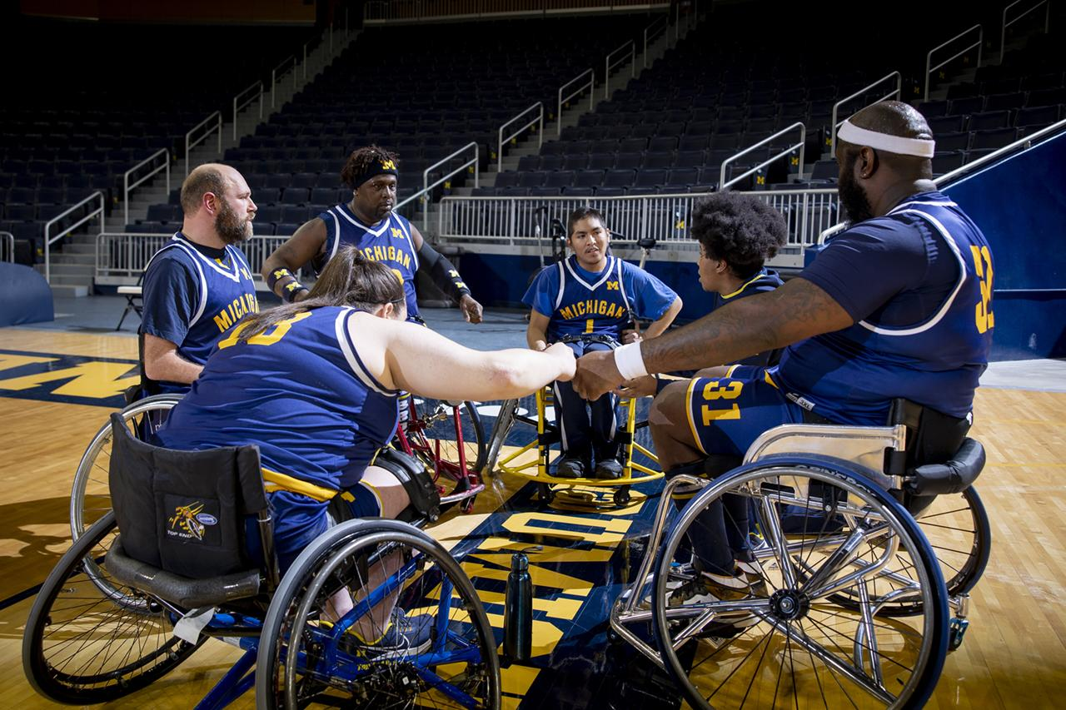
Accessible Options @ U-M Athletics
Accessible ticket policies, accessible parking, and information for guests with disabilities:
Michigan Stadium
Crisler Center
Yost Ice Arena
Wilpon Complex
Phyllis Ocker Field
U-M Soccer Stadium
For information for other locations, contact mtickets@umich.edu

Slide 34
Campus Inclusivity Resources
Inclusive Teaching Resources
The Center for Research on Learning & Teaching (CRLT) supports teachers in creating learning environments where students of all identities and backgrounds can flourish. This page features a range of online resources that define inclusive teaching and provide specific strategies for practicing it.
Library Accessibility
Information on accessibility support and practices provided by the library to create equitable experiences for all individuals.

Slide 35
Campus Maps
Campus Construction Maps
Architecture, Engineering and Construction (AEC) provides maps showing construction zones on campus.
Campus Map
The Interactive Campus Map allows searching for specific buildings, identifying directions from place to place, exploring bus routes, and seeing parking options. The map is also available on the Michigan mobile app, which provides a map and real-time bus information on the go.
Lactation Room Locations
Locations and directions to Lactation and Personal Care Rooms on the U-M Ann Arbor campus and at Michigan Medicine facilities in Ann Arbor.

Slide 36
Counseling Resources
Counseling and Psychological Services (CAPS)
CAPS provides a range of clinical, preventative, and training services consistent with the practices and standards of a nationally accredited university counseling center. Free, confidential services for U-M students. Support 24/7.
Faculty and Staff Counseling and Consultation Office (FASCCO)
For staff, faculty, and their immediate family members; provides short-term counseling, personalized coaching, and educational presentations.

Slide 37
Digital Accessibility
Digital Accessibility
IT Accessibility offers guides and resources to intentionally support a culture and environment of inclusion and ensure that digital technology and content is able to be used by people with disabilities as well as it is by the rest of the community.
Assistive Technology
A list of adaptive software and hardware resources.
Information and Technology Services (ITS)
Information and Technology Services provides innovating, reliable, and user-centric technology services and support for the U-M community.

Slide 38
Equity and Inclusion
Office for Health Equity and Inclusion (OHEI)
The office develops mechanisms for inclusion, diversity, and cultural sensitivity among faculty, students, and staff at Michigan Medicine. OHEI advances clinical care for underserved patient populations through research and education.
Office of Diversity, Equity and Inclusion (ODEI)
The Office leads and supports university-wide initiatives focused on the recruitment of a diverse faculty, staff, and student body, while fostering an inclusive and equitable community at the University of Michigan. ODEI also engages surrounding communities in mission-focused, mutually beneficial partnerships. The vision of the office is to envision a diverse university where all thrive and excel.

Slide 39
Human Resources
Academic Human Resources
Administers and provides consultation related to programs, policies, and procedures for instructional and primary faculty, as well as Graduate Student Instructors, Graduate Student Research Assistants and Graduate Student Staff Assistants. AHR is also responsible for union contract issues and processes for academic employees.
Staff Human Resources
Staff HR Services serves the university, its management, and diverse staffs in the development, implementation, interpretation, and administration of human resources policies, procedures, practices and external regulations related to labor/staff relations, salary administration, compensation and classification, recruiting and employment, and overall University Human Resources functions.

Slide 40
Michigan Medicine
Michigan Medicine Human Resources
Responsible for the administration of the University’s comprehensive personnel programs in six major units.
Michigan Medicine Office of Counseling and Workplace Resilience
Provides 24-hour, no cost, confidential counseling, crisis intervention, and referrals for Michigan Medicine faculty, staff, and immediate family members.
Michigan Medicine Human Resources Solutions Center
Dedicated Leave Management Team assists and guides faculty and staff through life changes such as long illness, injury, and disability.

Slide 41
Ombuds
Faculty Ombuds
A confidential, impartial, informal and independent resource for information or conflict management for tenured faculty.
Student Ombuds
The Office of the Ombuds at the University of Michigan is a place where all students are welcome to come and talk in confidence about any campus issue, concern, problem, or dispute.
Staff Ombuds
The Staff Ombuds Office offers free and confidential conflict management services to help non-bargained-for UM-Ann Arbor and Michigan Medicine staff resolve issues and promote a civil and positive working environment.

Slide 42
Other Disability and Accessibility Support Programs
Council for Disability Concerns (CfDC)
Works towards creating a community that respects disability, honors individual needs, and makes everything accessible.
Disability Navigators
College of Literature, Science, and the Arts (LSA) has dedicated professionals focusing on addressing the needs of employees with disabilities and addressing culture and climate as it relates to those employees.
Medical Ergonomics program
MHealthy Medical Ergonomics provides guidance and assistance at the worksite to facilitate a successful match between the faculty or staff member’s abilities and the work tasks being performed. *Funding available to help purchase equipment (The University Record)
Work Connections
An integrated disability management program developed by U-M to help employees and supervisors when an employee experiences an injury or illness that prevents working.
Notes:
M Healthy – in the Record on 10/3 - $5000 grants available to help purchase equipment or redesign work processes – October is National Ergonomics Month

Slide 43
State and National Disability Employment Resources
Michigan Rehabilitation Services (MRS)
A statewide network of vocational rehabilitation (VR) professionals developing creative, customized solutions that meet the needs of individuals and business. They deliver individualized services that assist potential employees with differing abilities to prepare for, pursue and retain careers.
Job Accommodation Network (JAN)
JAN is the leading source of free, expert, and confidential guidance on job accommodations and disability employment issues.
Employment Resource Hub
The ADA National Network has created the Employment Resource Hub to address specific themes and common questions related to employment and the ADA
Office of Disability Employment Policy (ODEP)
ODEP promotes policies and coordinates with employers and all levels of government to increase workplace success for people with disabilities.

Slide 44
Upcoming Events – all begin @ noon
Thursday, 10/5: NDEAM Meet & Greet and Resources Fair
Michigan League Courtyard Garden: noon to 4:00 pm
Tuesday, 10/10: CfDC - Council for Disability Concerns Monthly Meeting
Thursday, 10/12: Creating and Maintaining Inclusive Environments
Tuesday, 10/17: A Supervisor’s Guide to Disability Accommodations
Thursday, 10/19: The Interactive Process – 4 Steps to Accommodation
Tuesday, 10/24: Introduction to Creating Accessible Digital Documents
Thursday, 10/26: Drop-in Hour with the ADA Coordinators and the ADA Team
Tuesday, 10/31: D/deaf Etiquette
Notes:
Thursday’s meet and greet may move indoors in the event of rain

Slide 45
Questions?

Slide 46
Thank You!

