Slide 1
Accessible Presentations
ADA Team Lunch & Learn Series
Phil Deaton (he/him)
February 21, 2024
Notes:
Hello everyone and welcome to the ADA Team Webinar series. The ADA team is putting on several of these webinars forthcoming, which you can find on our department’s Event page (ECRT). My name is Phil Deaton and I work on the ADA team. My pronouns are he/him and I work as the University’s Digital Information Accessibility Coordinator. I focus on digital accessibility issues, that is, issues that impact accessibility for people with disabilities that involve technology, digital content, etc. This is the second webinar around digital accessibility in our series.
Today I will be presenting on Accessible Presentations. What will that cover? I’ll dive a bit more into that in a second, but generally speaking I will talk about formatting accessible slideshows and delivering information in an accessible format. That doesn’t mean I won’t stumble and make a few mistakes myself, but I hope to provide you with a good framework and some helpful tips to improve your practices in this area.

Slide 2
Access Notes
Use the Q&A feature to submit your questions.
ASL interpretation can be utilized by clicking Interpretation and selecting American Sign Language.
CART transcription can be turned on by selecting Show Captions.
Notes:
Okay firstly I want to talk about this webinar today. If you have questions you can use the Q&A feature. You can also submit questions anonymously. ASL interpretation is provided for today’s webinar. You can turn on the ASL window using the Interpretation feature in your Zoom bar. This method is really helpful because we actually. CART transcription is provided, you can toggle live captioning on using Show Captions.
A short note, this webinar is recorded and will be made available on the ECRT YouTube channel. The slides will also be shared after this webinar. That does mean if you need to hop off a few minutes early you’ll be able to access this content later, so no worries, we appreciate you joining to share your questions and experience for however long you can.

Slide 3
Summary
General accessibility considerations
Designing an accessible presentation
Creating accessible content
Preparing for delivery
Best practices for presenting
Remediating a presentation for accessibility
Advanced questions
Visual complexities
Tables
Media
Notes:
Okay so a quick summary. I’m going to do a recap of General accessibility considerations that we discussed in the first presentation in this digital accessibility series? Why? Because they apply to presentations as well, and I hope you can consider these practices broadly as you interact with information technology and digital content.
Next I’ll talk about designing an accessible presentation, including content creation, getting set up with the content, and some tips for delivering presentations.
Next up is “remediating a presentation for accessibility”. What does that mean? Fixing an inaccessible presentation and making it accessible. I’ll talk about some tips here to help.
Last, I’ll talk with you about complex issues around visuals and tables, and media files.
Okay one thing people sometimes ask before I do presentations on technical topics like this – “how technical will this be?”
That’s hard to answer, but for this presentation I will use a lot of images and descriptions to demonstrate where different features are. At points I will demonstrate a topic that may be very interesting but move to another. My goal is to provide you with enough tools to solve complex accessibility problems in PowerPoints. I hope you will see the recording and PowerPoint for this as a repository of tools you can reach to when you have those questions, and myself as a handy person to ask those more detailed questions about applying techniques.
https://umich.instructure.com/courses/682446/pages/presentations-home?module_item_id=3372909

Slide 4
General Considerations & Specific Practices
The General Considerations list is adapted the University of Michigan’s Quick Non-technical accessibility tests
Focused on document accessibility
Specific Practices will demonstrate things to do or avoid in Word and PowerPoint

Slide 5
General Considerations – Color Contrast (1 of 3)
Color Contrast: have strong contrast between your text and background
In general: Use dark colors on a light background, or vice versa

Slide 6
General Considerations – Color Contrast (2 of 3)
Color Contrast: if using designed colors or colors you are unsure of
Check out:
U-M’s Color Brand Guide
Accessibility site's color contrast guide
Download from the Software Center on MiWorkspace computers: “Colour Contrast Analyser”
WebAIM’s color contrast checker

Slide 7
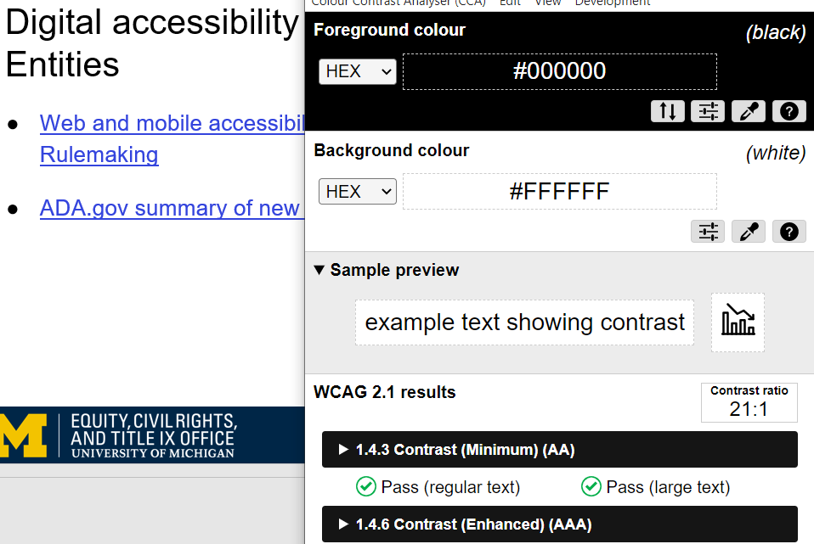
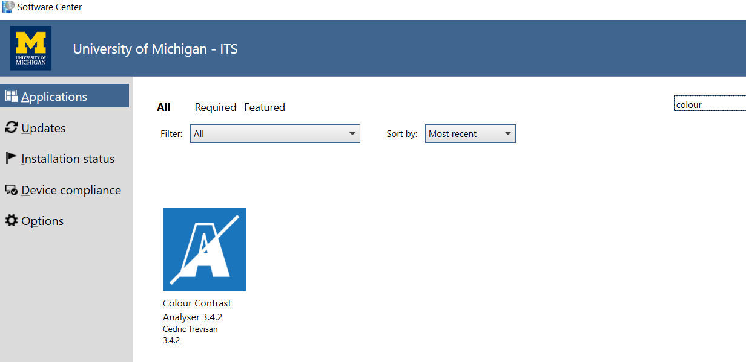
General Considerations – Color Contrast (3 of 3)
To “meet accessibility standards”, aim for a contrast ratio of 4.5:1
Not a perfect science, consider colors you’ll use at the start of a document/in templates

Slide 8
General Considerations – Link text (1 of 2)
Best for digital: Check out U-M’s Color Brand Guide
Best for print: For information on color accessibility, visit U-M’s Color Brand Guide: https://brand.umich.edu/design-resources/colors/
Poor practice: Click here, Learn More
Link text: provide clear information on where a link will take your user, either as the link text directly (best for digital), or next to the link (best for print)
Notes:
Another general consideration is providing clear link text. Again, from a universal design perspective this benefits everyone. This also provides clear guidance for screen reader users on where a link might take them. For digital document, it’s best if you can include the destination of the link in the link, see our first example here. Check out U-M’s Color Brand Guide. This makes it quite clear where this link will go. You should be sensitive to context here. If I were creating link text for a panel presentation at a national conference, I’d probably say “Check out the University of Michigan’s color brand guide”, just to be clear about where this link goes.
For documents that might be printed, either by me or my user (say a syllabus), you may want to still include the full link URL, see our second example.
A bad practice is to have links with no clear destination, random URLs, or links that all have the same text. For example, if you have a page of events on a Word doc you are sharing with your department, if all of the links say “Learn more” or “Click here” under the image of an event, users may not know which link corresponds to which event, or even what “Learn More” means. Does that mean you’ll go to an article published about the topic? The registration form? Remove ambiguity, be clear and specific with your link text.

Slide 9
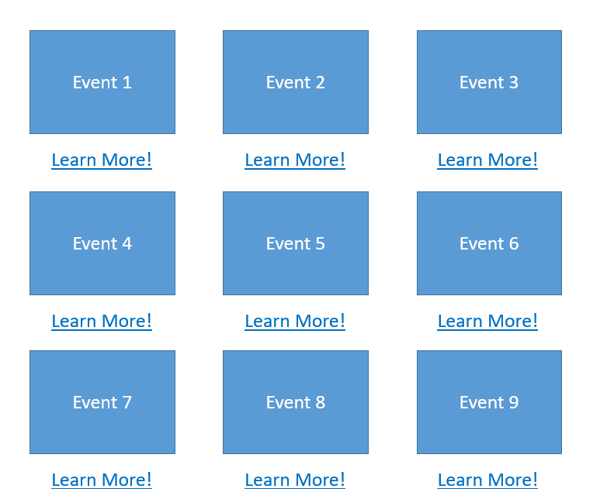
General Considerations – Link text (2 of 2)
Not clear where links will go
Not clear which link applies to which placeholder event
Notes:
Here’s an example of how poor link text can provide some confusion. I have to look twice to compute which Event each Learn More might go to.

Slide 10
General Considerations – Typography (1 of 2)
Typography: use a “sans-serif” font
There are a variety of fonts that purport that they have increased accessibility for certain populations
Various levels of research
In general, there is great research that sans-serif, fonts without “serifs” (stylistic extensions, embellishments, or strokes attached to some characters)
Serif: A brown quick fox jumps over the lazy dog.
Sans-serif: A brown quick fox jumps over the lazy dog.
Notes:
So, some general typography advice. Use a sans-serif font. Sans-serif just means a font without serifs. Serifs are stylistic strokes, extensions, or embellishments attached to certain characters in a font-family. The most common serif font is Times New Roman. The most common sans-serif fonts are Calibri, and Arial. I will give the caveat that due to its prevalence, Times New Roman actually does have studies which indicates it is fairly readable. This is the exception to the rule. If you must use serifs, use them in short headings, and not your paragraph text.
There are various fonts out there which advertise themselves as accessible, especially for dyslexic populations. I have heard real-world experience from some users that they like these fonts. In general though, a lot of these fonts do not provide convincing peer-reviewed research that they are better than more common sans-serifs. There is one typographical feature that does have a lot of empirical data around it, which I’ll talk about in the next slide

Slide 11
General Considerations – Typography (2 of 2)
In slideshows, consider line length
Shorter line length has been demonstrated to have a positive impact on readability in a variety of studies
Avoid stretching to fit the page
Some people prefer reading in these modes:
Mobile
Ebook reader (E-Reader)
Mass market paperback
As compared to:
Resume with no margins
Textbook
Slideshow with lots of text
Notes:
Okay so one feature of typography with a great deal of evidence around it is line length. The shorter the line length, the less work and visual/motor processing involved in continuing to read.
A lot of the educational content we create is hard to have short line length for when we are using precise wording (exhibit A. this presentation), but, if you can break up slides with visuals, this actually enforces shorter line length. There’s some discourse in presentation communities about this being an unintended effect of bringing visuals more into slideshows.

Slide 12
General Considerations – Alt text
Alt text: a text alternative to an image
You can add alt text to images in Word, PowerPoint, etc. by right clicking the image and selecting Edit Alt text
Keep it short, consider how you’d describe the image in context over the phone to someone
Decorative images need no alt
Notes:
Our next general consideration is alt text. Alt text is a text alternative to an image and is important to ensure folks who are blind, low vision, or with certain cognitive disabilities have equal access to the information the image provides within the context it appears. It’s super easy to add in to Word and PowerPoint documents.
So: what do you write for alt text. You should include information that describes the image in the context it appears. What’s that mean? Got a decorative piece of art you’re using for your conference program? Maybe you don’t need to alt text, unless the visual meaning of the image conveys something important in alignment with your message. Have that same piece of art in a gallery? We should probably provide a text description to help people understand the meaning, emotion, argument, etc.
Have a chart that you’re using on a slide just to say “sales are going up?”, and you already have text on the slide that says that in a specific way? You don’t ned alt text.
Have a chart on a slide demonstrating the sales figures for all four quarters that you’re presenting to a manager group? You should add alt text to that chart.
Here’s my quick test, and it’s an art as much of a science. Does this image mean anything visually? Does its presence make an argument? If yes, alt text. If no, may not be necessary.
Here’s a common one in stuff we create at U-M. See the Equity, Civil Rights, and Title IX Office wordmark with the Block M? That’s our White Marketing Block M wordmark. That means something in this presentation—that’s where I’m from. The first slide on this presentation has alt text for this word mark. Since I don’t want to have this as alt text on every slide, the other occurrences I’ve set as background images, so there is no alt text. It being there on the first slide does communicate something, though.

Slide 13
General Considerations – Accessibility Checkers
Many products we use every day have built in accessibility checkers
You can access this via PowerPoint in the “Review” tab in the top ribbon.
Next you can select check accessibility.
Checkers are a great way to learn about accessibility.
Microsoft’s product is a great teaching tool
PowerPoint accessibility page
Word accessibility page

Slide 14
Designing an accessible presentation
PART I:
Notes:
Alright, basics out of the way. This may have been review for some of you. Let’s talk about designing an accessible presentation.

Slide 15
Starting off
Consider your elements (e.g., graphics, media, tables, color palette, branding)
If using branding or a color palette, design colors to meet contrast standards
Put a star or comment next to items you are unsure how to deal with (e.g., how do I caption my media)
We’ll start with covering
Setting up an environment that works for you
Slide titles, reading order, images
Notes:
Okay you want to make a PowerPoint accessible. First step, put the metaphorical pencil down. And I can’t help this because I used to work in a Teaching & Learning unit with Instructional Designers. Start by sketching out your objectives and the tools you’ll use to meet those. A presentation is a mode of delivering information – what are you delivering? What content will you use to make your points? How can you make those accessible? Knowing what you’re bringing in at the start helps you plan for accessibility. Remember to access is to enter a space, or being able to reach something. Planning with disability in mind is a significant step toward accessibility.
If using branding or a color palette, design colors to meet contrast standards. You know about color contrast tools now, so you’re ready for this step. One note, these tools ask you to meet a 4.1:1 color contrast ratio. If you do that, the compliance person in me is thrilled. If you aim only to meet 4.5:1, you still might be creating access issues. Standards are designed around research which in some ways is a normalizing activity that doesn’t account for the lived experiences of people with disabilities. Trying to exceed the standard is helpful.
Flag any questions you may have up front.

Slide 16
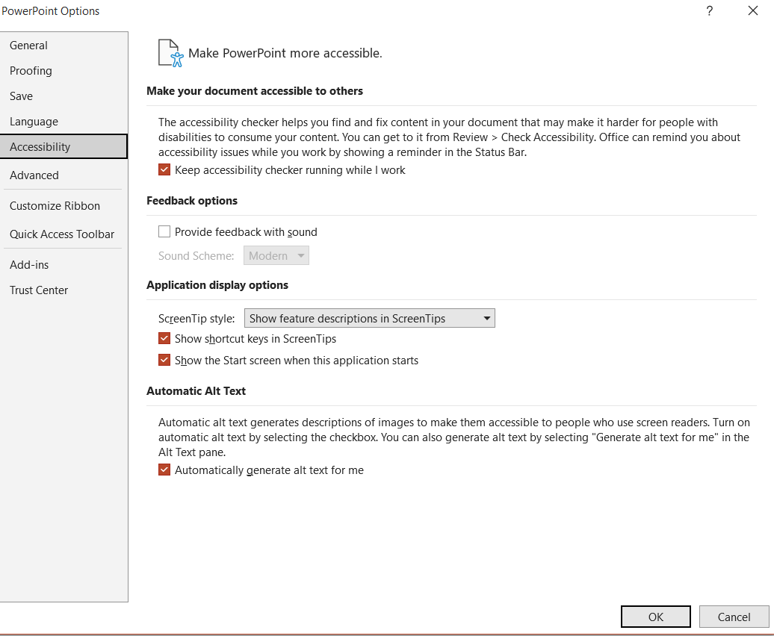
Setting up your presentation environment
File, options
Run checker while you work
Using templates
Right click slide preview in left menu, select layout, pick one

Slide 17
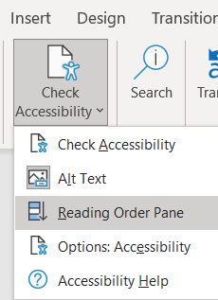
Effective Titles
Check Reading Order
Reading order is the order items will be read off on the page to a screen reader user
Ensure you have a “Title” which is first item
Notes:
So let’s talk about one important concept in PowerPoints. Under the Check accessibility option, you’ll see a way to open something called the “Reading Order Pane.” This option let’s you adjust the order slides can be read off in by screen reader technologies. In general you want the order to reflect how you want the slide to be read. It’s important also that you have a Title as your first item, which is why we always recommend working off of a template and then adding content accordingly, not adding random text boxes. On the next slide I will demonstrate this and explain how these tools work. Before I jump there, I do want to mention that

Slide 18
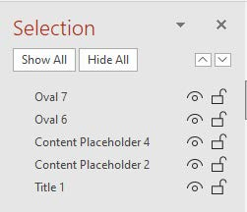
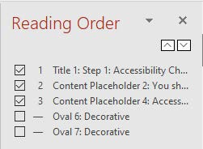
Reading Order
Check Reading Order
Reading order is the order items will be read off on the page to a screen reader user
Edit via “Arrange” then “Selection Pane” (note: if in this view, order is bottom-up)
Also via new feature Reading Order Pane (note: top-down)
Ensure you have a “Title” which is first item
Notes:
So an important step here is checking reading order. Reading order is the order items will be read off on the page. There’s two things to do here. First, you always want your Title to be read off first. Even if you just have an image and want no title, you should hide a title off screen that gets read off. This makes it so when someone is going back through my slides with a screen reader, a title will be read off for each slide they scroll through, so they can find the piece of content they want to revisit. Next, we should always order items in the order we want them to be read off in.
A third thing to consider here. If you have a lot of elements in this area, odds are you may have background images or drawings that you’ve made in PowerPoint. This creates a pretty poor experience for folks. You can actually add background images into the “Slide Master” which is where you can edit your template layouts in PowerPoint. Side note, if you have not discovered Slide Master and you do a lot of presentations, I highly recommend becoming acquainted with this area, as you can produce a variety of templates for re-use.
If you have a drawing you’ve made that is meant to be one visual, consider capturing a screenshot of it, and pasting it in as an image. While this may make the quality a little fuzzier, you’ll be able to add alt text, and assuming the image is appropriately sized for presenting, it should not impact legibility overmuch. You may want to create a copy of the visual in a new PowerPoint so you can edit it later.
I do have some visuals on the screen designed to demonstrate the difference between the selection window and the reading order window. Both of these items will read off information in the same order. The Selection window is bottom up, so Title 1 is first, and Oval 7 is last in the image on the left. The Reading order window is top down, so title 1 is first and oval 7 is last.
Combining knowledge of Reading Order and General practices, as well as learning about the Slide Master feature are the three main things you need to do PowerPoint accessibility very well.

Slide 19
Accessibility workspaces (1 of 3)
Review, Check Accessibility
Reading Order
Alt text
Notes:
So on this more-crowded-than-I-would-recommend slide, I am demonstrating how to use the accessibility checker. You can go to Review in PowerPoint, then check accessibility. This will open an Accessibility menu in the top menu in PowerPoint. Again, if you click on the Accessibility checker that you have constantly running in the footer it will take you here too. There’s a lot of options here. Heck, if you’re doing an in person presentation without a CART captioner you can also use subtitles for that – you can also do that in individual presentations by setting that up when you’re in the slide show view.

Slide 20
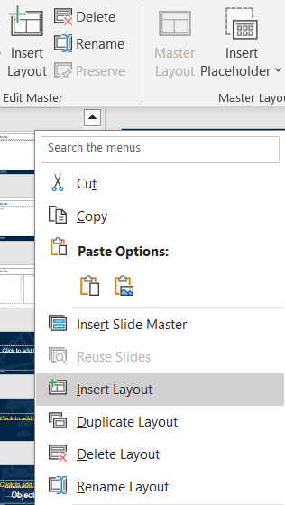
Accessibility workspaces (2 of 3)
Slide master
Background and decorative graphics
Having trouble with reading order? This is where you go.
Notes:
Slide master can be used to move background elements to the background. Adjusting reading order and having elements vanish behind others? Let’s fix that here. You can move true background elements into current template layouts or create new layouts using the slide master. I’ve got three images on the screen now, one of which shows where the slide master is in PowerPoint.
You access Slide Master via the View menu in PowerPoint and then select Slide Master on the left side. This is how your designers do all the amazing things they do, and also how accessibility pros get the job done on reading order sometimes.
My next image here shows a demonstration of me editing a background element, the ECRT wordmark, in my slideshow. Point being, you can move items from your PowerPoint proper to the Slide master templates

Slide 21
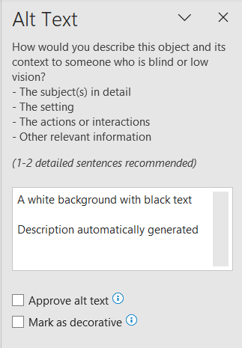
Accessibility workspaces (3 of 3)
Alt text
To automate or not to automate?
Select images, right click view alt text
Select image, open alt text in accessibility menu
Notes:
Let’s talk about the alt text window. PowerPoint gives you the option to automatically generate alt text. The tool for this currently, on February 21, 2024, is not very good. I recommend leaving this unchecked. If you want to use AI to assist with alt text there are better ways to do that, such as using suggested prompts in a GenAI program.
You can view alt text of images by right clicking the image, and selecting view alt text, or by clicking an image and having the accessibility – alt text side menu open in the accessibility menu.

Slide 22
Presenting tips – prior to presenting
Provide your (accessible) slideshow in advance where possible
Provide slides and terms to CART and ASL professionals
Add a slide which includes accessibility info (if/how it is captioned, if ASL is provided, if recording, participation guidelines, etc.)
Notes:
Provide your (accessible) slideshow in advance where possible this allows people to engage with your material in a variety of ways.
Provide to CART and ASL professionals as well, this makes their job a bit easier to have some expectation of what they’re running through. Especially at universities, we have a habit of presenting complex information, or weird PowerPoints on making PowerPoints accessible.

Slide 23
Presenting tips – day of
Test your audio settings in advance
Give multiple ways of audience participation
Request other presenters to follow a practice of self identification (especially if using automated captioning)
Describe visuals within the context they appear
Notes:
Provide your (accessible) slideshow in advance where possible this allows people to engage with your material in a variety of ways.
Provide to CART and ASL professionals as well, this makes their job a bit easier to have some expectation of what they’re running through. Especially at universities, we have a habit of presenting complex information, or weird PowerPoints on making PowerPoints accessible.

Slide 24
Remediating for accessibility
PART II:
Notes:
Wow so we’re a few minutes in and I am getting to this part, I swear.

Slide 25
Remediation tips (1 of 2)
Start by using the accessibility checker
Always involve the author where possible
If checking Google Slides, you can export to PowerPoint to see the Reading Order

Slide 26
Remediation tips (2 of 2)
You can hover over slide previews to see the slide title
Recommended workflow: Reading order, then slide by slide, rather than issue by issue
If slide titles are duplicated, simply add (X of Y; or continued)

Slide 27
Complex Issues
PART III:

Slide 28
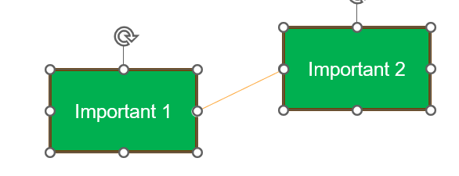
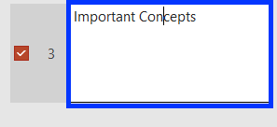
Complex cases – complex diagrams
Grouping objects, lines, shapes using arrange panel
Can provide one description for full diagrams
Limitations:
Shapes will still appear in reading order, even if decorative, even if grouped (you can view this in Arrange panel)
This feature does not work in slide show view

Slide 29
Complex cases – tables
Word and PowerPoint still only support simple tables with simple column or row headers
Some screen readers may not access table header information, it can be helpful to include written information about this
Some screen readers may not access alt text associated with tables

Slide 30
Complex cases – media
When including video or audio clips
you can add captioning in PowerPoint
VTT files
Note: even if you hire a CART provider, you should provide captioning for pre-recorded media you include

Slide 31
Getting involved
Digital Accessibility Community of Practice (DAC) – contact me
Learn more from Microsoft and Adobe’s accessibility guides
Review the University Standard Practice Guide on digital accessibility
Check out the accessibility.umich.edu website

Slide 32
Upcoming Events and Resources
ECRT Events page
ECRT YouTube Channel
Filterable list of resources on the ECRT website

Slide 33
Thank you!

Slide 34
Questions

