Slide 1
Everything You Need to Know About Service Animals
Allison Kushner, J.D.
ADA Coordinator, Director of Disability Equity
ADA Team of ECRT

Slide 2
Zoom Webinar Tips
Use the Q&A feature to submit your questions.
ASL interpretation can be utilized by clicking Interpretation and selecting American Sign Language.
CART transcription can be turned on by selecting Show Captions.

Slide 3
Please Engage
We are modeling creating a comfortable, inclusive, brave and safe space
Questions are encouraged: Q&A at any time during the presentation
Q & A can be submitted anonymously
We don’t know what we don’t know
If you’re thinking about it, chances are someone else is, too!
Respect the experiences of others
Opportunities for growth and learning
We’re all learning together

Slide 4
Agenda
Disability is an integral part of the university’s diversity, equity, and inclusion efforts. It is important to be part of a culture that supports and embraces disability inclusion. This session will cover:
ADA Basics
Differences between service animals, service animals in training, and emotional support animals
Service animal etiquette
FAQs

Slide 5
Role of the ADA Team
Provide institutional consultation, educational outreach, and advice about accessibility, disability, and inclusion.
Promote digital and physical accessibility planning and implementation.
Advocate for the inclusion of disability as a critical part of diversity initiatives and planning across all aspects of our university community.
Facilitate the Interactive Process for workplace accommodations.
Coordinate and/or provide ASL interpreting and CART transcription services.

Slide 6
Legal Framework & Basics
A Brief Introduction

Slide 7
What Is a Disability?
An individual has a disability if they:
Have a physical or mental impairment that substantially limits one or more major life activities; or
Have a record of such an impairment; or
Are regarded as having such an impairment.
An individual has to be a qualified individual with a disability (IWD).
Must meet the general requirements for the employment position or academic program with or without reasonable accommodation.

Slide 8
Physical and Mental Impairments
Physical or Mental Impairments:
Physiological disorder or condition, cosmetic disfigurement, or anatomical loss affecting the neurological; musculoskeletal; special sense organs; respiratory, including speech organs; cardiovascular; reproductive; digestive; genito-urinary; hemic and lymphatic; skin; and endocrine.
Mental or psychological disorder, such as intellectual disabilities, organic brain syndrome, emotional or mental illness, and specific learning disabilities.
Non-exhaustive list.

Slide 9
Substantial Limitation to Major Life Activities
Caring for one’s self
Performing manual tasks
Walking, bending, lifting
Seeing, hearing, speaking, breathing
Learning, reading, concentrating, thinking
Eating
Sleeping
Working
Functions of the immune system
Normal cell growth
Digestive, bowel, bladder
Respiratory, circulatory

Slide 10
What Is the ADA? The Americans with Disabilities Act (1990) and the Amendments Act (2008)
Prohibits discrimination and harassment against a qualified individual with a disability (IWD) in employment, public places, public education, etc.
Employment (Title I) Application procedures, hiring, promotion, discharge, compensation, benefits, training, etc.
Federal, state, and local government (Title II): Requires places, services, and benefits provided to be accessible, including places of education like U-M.
Public places (Title III): Requires places open to the public, including businesses that are open to the public to be accessible and provide accessible information/services digitally as well.
Protects individuals from discrimination based on association with an IWD.
Creates an affirmative duty to provide a reasonable accommodation.
Denial to provide a reasonable accommodation already approved may be discriminatory on its face.

Slide 11
The Rehabilitation Act of 1973
Section 504 of the Rehab Act:
Designed to protect the rights of individuals with disabilities in programs and activities that receive Federal financial assistance from the U.S. Department of Education (ED).
"No otherwise qualified individual with a disability in the United States ... shall, solely by reason of her or his disability, be excluded from the participation in, be denied the benefits of, or be subjected to discrimination under any program or activity receiving Federal financial assistance.

Slide 12
External Enforcement Bodies
Employment: Equal Employment Opportunities Commission (EEOC)
Responsible for enforcing federal laws that make it illegal to discriminate against a job applicant or an employee because of the person's race, color, religion, sex (including pregnancy and related conditions, gender identity, and sexual orientation), national origin, age (40 or older), disability or genetic information.
Education: Office of Civil Rights (OCR)
Responsibility is to eliminate discrimination on the basis of disability against students with disabilities. OCR receives numerous complaints and inquiries at all levels of education including higher education involving Section 504 of the Rehabilitation Act of 1973.

Slide 13
Student Academic Modifications and Adjustments
The University is required to provide students with:
Appropriate academic adjustments and auxiliary aids and services that are necessary to afford an IWD an equal opportunity to participate in a school's program.
The University is not required to make:
Adjustments or provide aids or services that would result in a fundamental alteration of a recipient's program or impose an undue burden.
Reasonable accommodations to individuals who are not qualified.

Slide 14
Workplace Accommodations
Employers such as the university are required to provide modifications or adjustments to a job or the work environment that will enable an applicant or employee with a disability to participate in the application process or to perform essential job functions.
Reasonable accommodation also includes adjustments to assure that an individual with a disability has rights and privileges in employment equal to those of employees without disabilities.

Slide 15
Examples of Accommodations & Modifications
Workplace:
Education:
Flexible schedule
Ergonomic equipment
Written instructions and feedback
Extra training materials
Service animals
Extended time for assignments and tests
Excused absences
Priority seating
Quiet testing
Service animals

Slide 16
Service Animals, Service Animals in Training and Emotional Support Animals
What’s the difference?

Slide 17
Meet Scout!

Slide 18
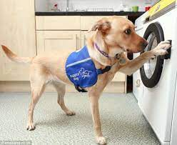
Service Animals
Any dog or miniature horse that is individually trained to do work or perform tasks for the benefit of an individual with a disability, including a physical, sensory, psychiatric, intellectual, or other mental disability.
Only Service Dogs are covered under Title II and III of the ADA.*
The work or tasks performed by a service animal must be directly related to the individual’s disability.
Service animals are working animals, not pets, and are not emotional support animals.

Slide 19
Examples of Service Animals
Guide Dog: serves as a travel tool for persons who have visual impairments or are blind.
Hearing or Signal Dog: alerts an IWD who is deaf or hard of hearing when a sound occurs, such as a knock on the door.
Psychiatric Service Dog: performs tasks that assist IWD in detecting the onset of psychiatric episodes and lessen their effects. Tasks may include reminding the handler to take medicine, providing safety checks or room searches, turning on lights for persons with PTSD, interrupting self-harm, and keeping disoriented individuals from danger.
Sensory Signal Dog or Social Signal Dog (SSigDOG): trained to assist an autistic person or their caregiver. These dogs are trained to do a variety of social or sensory tasks based on the needs of the individual.
Seizure Response Dog: may be trained to stand guard during a seizure or may go for help.

Slide 20
Where Are Service Animals Allowed?
Anywhere their handler is allowed to go in places of public accommodation:
Anywhere that is inviting someone in.
Anywhere that is charging for goods, services, and lodging.
Medical facilities.
In places owned or operated by federal or state government or that accept federal or state funds:
Public schools, town halls, state agencies, etc.

Slide 21
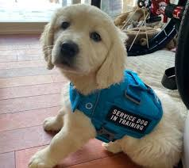
Service Animals in Training
Means a dog or miniature horse accompanied by an animal raiser or trainer with the intent that the animal is being raised, socialized, and trained to become a service animal (Michigan Public Act 75, 2022).
In Michigan, service animals in training are considered the same as service animals for the purpose of bringing the animal into public spaces for the purposes of training.

Slide 22
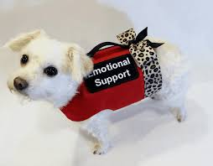
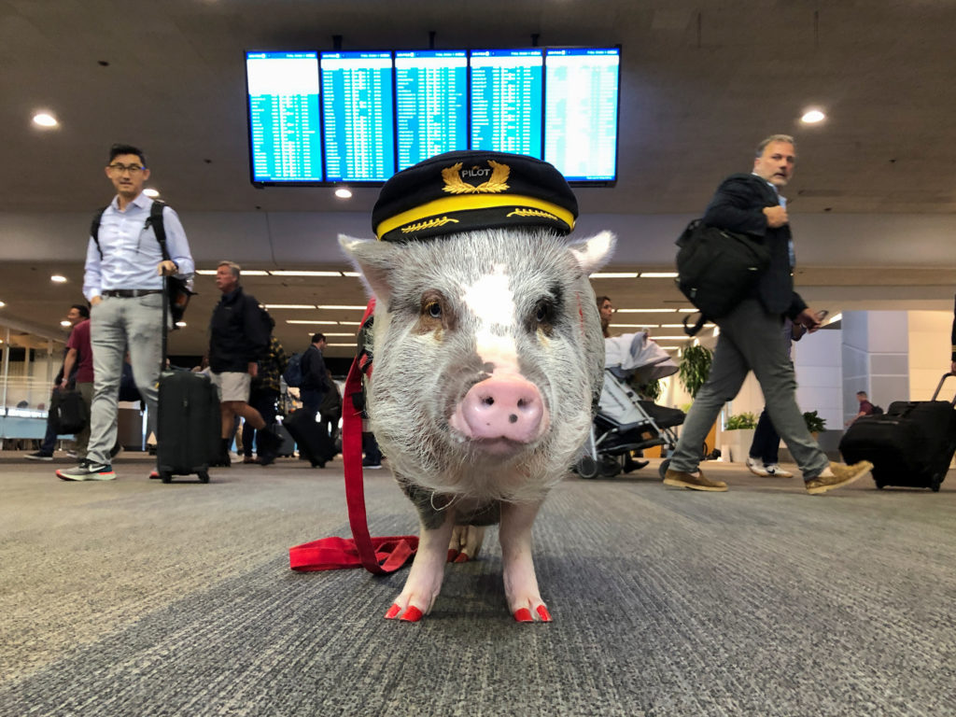
Emotional Support Animals
Also known as comfort animals.
Provide companionship, relieve loneliness, and sometimes help with depression, anxiety, certain phobias, and other types of mental health, but do not have special training to perform tasks that assist people with disabilities.
Can be any animal type.
Not covered by the ADA or Michigan law.
May be allowed in housing under the Fair Housing Act as an accommodation.

Slide 23
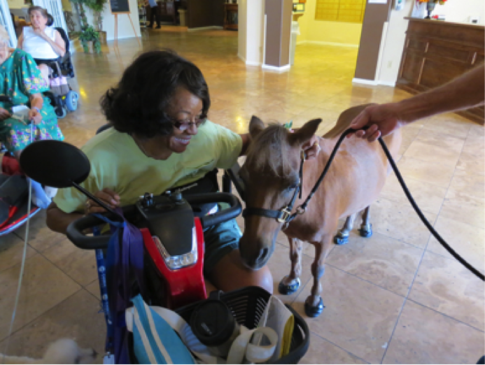
Therapy Animals
Therapy animals provide people with therapeutic contact, usually in a clinical setting, to improve their physical, social, emotional, and/or cognitive functioning.
Are not covered under the ADA.
Are not provided as reasonable accommodations.

Slide 24
Service Animal Handler Rights and Responsibilities

Slide 25
What Can Be Asked of a Handler?
Is this dog (or mini horse) a service animal required because of disability?*
Or service animal in training in Michigan.
What work or task is the service animal trained to perform?
It must be trained to perform something specific - providing comfort or support is not a specific task.
Best practice: If the answer to question #1 is “yes”; unless there is a specific reason to ask #2, you do not need to ask the second question.

Slide 26
Handler Responsibilities
A service animal must be under the ”care and control” of a handler at all times:
Care and control: harnessed, leashed or tethered in public unless these devices interfere with the service animal’s work or the individual cannot utilize these items due to disability.
Can be by voice, signal or other effective means to control.
Control also means the service animal should not bark repeatedly in public places.
Barking a few times, or because it has been provoked, does not mean a dog is out of control.
A service animal must be housebroken.

Slide 27
Under Care & Control Examples
A person who uses a wheelchair using a retractable leash to pick up or retrieve items.
Even if it is far away, it must remain under control of the handler at all times.
A person with PTSD has a service animal that enters spaces, reviews for threats and then goes directly back to its handler to signal it is safe to enter.
The animal may be off leash to perform this task but on the leash when it is not entering the room to check it.
A nurse who utilizes a service animal for anxiety leaves their service animal under the registration desk while they escort a patient to a room.
The animal may be either tethered under the desk or can be signaled using voice commands.

Slide 28
Excluding Service Animals
May generally only be excluded when the presence fundamentally alters the “nature of the goods, services, or program.”
May also be excluded if a particular service animal is out of control, the handler cannot regain control, or if it is not housebroken.

Slide 29
Examples of Reasons to Exclude Service Animals
In a residential hall, specific rooms may be reserved specifically for individuals with allergies to dogs.
In a zoo, service animals may be restricted from specific exhibits where animals on display are the natural prey or predator of dogs- where their presence could be disruptive causing the zoo animals to become aggressive or agitated.
A burn unit- where sterilization is critical to care of patients.
A public pool (only excluded from the water).

Slide 30
Handler Rights
To be allowed in any place generally that the public is invited in or able to go:
Museums, restaurants, stores, theatres, schools, events, etc.
To address the behavior of the service animal if it is not under control.
To enter the public space without the service animal if the animal is denied entry due to out-of-control behavior or direct threat purposes.

Slide 31
Service Animals in the Workplace
Service animals are not “called out” in Title I of the ADA which covers employment.
This means individuals seeking to bring a service animal into their place of employment beyond the spaces typically open to the public are required to request a reasonable accommodation to bring their service animal with them to work.
A reasonable accommodation is any modification or adjustment to a job or the work environment that will enable an applicant or employee with a disability to participate in the application process or to perform essential job functions.

Slide 32
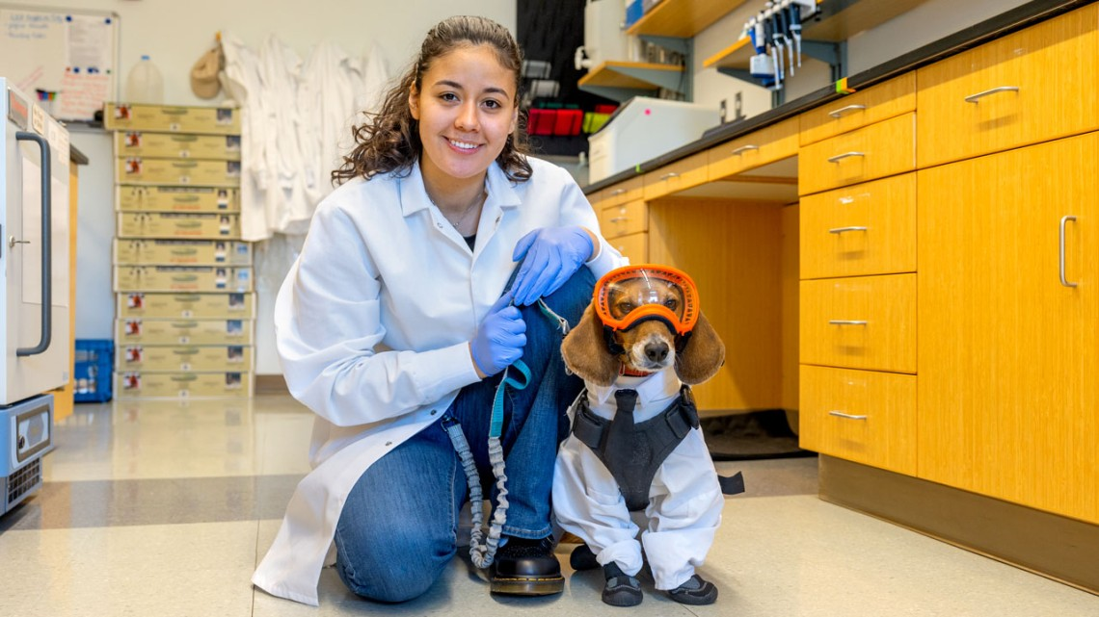
What Does This Mean for the Employer?
As the employer, a service animal needs to be evaluated just as any other reasonable accommodations are evaluated:
Cannot create an undue burden on unit operations.
The presence of the service animal cannot pose a direct threat to the health or safety of others.

Slide 33
Steps to Request a Service Animal Accommodation
An employee requesting to bring their service animal into their workspace should request an accommodation.
Submit a request to the ADA Team portal; or
Directly request accommodation from their unit.
Our team is trained to assist with the nuances surrounding reasonable accommodations related to service animals.
We strongly advise reaching out to the ADA Team to discuss requests or concerns.
If the service animal is not possible as an accommodation, the employee should be provided alternate accommodations that provide equally effective access to their essential job functions.

Slide 34
Possible Additional Accommodations Related to Service Animals at Work
Allow the employee to take leave to participate in individualized service animal training.
Provide the employee with a private/enclosed workspace.
Provide the employee with office space near a door and/or out of high-traffic areas.
Establish an accessible path of travel that is barrier-free.
Allow equal access to employee break rooms, lunchrooms, restrooms, meeting rooms, and services provided/sponsored by the employer.

Slide 35
Caring for a Service Animal at Work
Remember: service animals and service animals in training must be housebroken.
Provide a designated area where the employee can tend to the service animal’s basic daily needs, e.g., eating or bodily functions.
Allow periodic bio breaks for the service animal.
Consider general disability awareness training on the use of service animals in the workplace.
Hint: The ADA Team is always happy to provide training and workshops.

Slide 36
Service Animal Etiquette

Slide 37
Dos and Don’ts: Etiquette
Dos
Don’ts
Address the IWD – not the service animal.
Treat the owner with respect, giving them as much space and time as they need.
Remember that identifying gear is not required.
Be on the lookout for a service animal without a handler – this could indicate an emergency needing attention.
Interact with a service animal without permission from the owner.
Ask any questions about the handler’s disability upon seeing their service animal.
Distract, feed, approach, or speak to the service animal.
Engage with the animal even if it appears to be “off work” or resting.

Slide 38
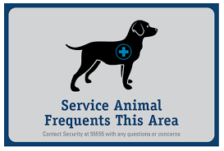
Communication Tips for Supervisors
Always discuss the use of a service animal with the handler first.
Have an open dialogue about the communication plan to those in the building/unit about the presence of a service animal.
Let the employee lead - if they want to educate their coworkers that is OK; just go over information together before presenting to others.
Remember confidentiality first.
Ask whether the employee prefers the term “service animal” or only “animal in the workplace.”

Slide 39
Crafting Communications to a Team
Remember confidentiality - no names.
Email is preferred instead of open discussion at a staff meeting.*
Email contents:
Animal/s are in the building for a specific purpose and they are not to be interacted with for any reason.
Explain what interacting covers: talking, whistling, cooing, barking, petting or asking to pet, praising, tapping or clapping, or giving the animal food or treats.
Encourage employees with questions or concerns to reach out to the supervisor directly.

Slide 40
Handling Responses to Service Animal Presence
Thank the employee/community member for bringing their concern to you.
Fear: explain that general fear/phobia of dogs is not an acceptable reason under the ADA to remove the animal.
Must be objective evidence based on available information that the animal poses a direct threat to health or safety of others.
Allergies: provide information about requesting accommodations related to their allergies - be prepared to identify spaces for both employees.

Slide 41
Service Animal FAQs

Slide 42
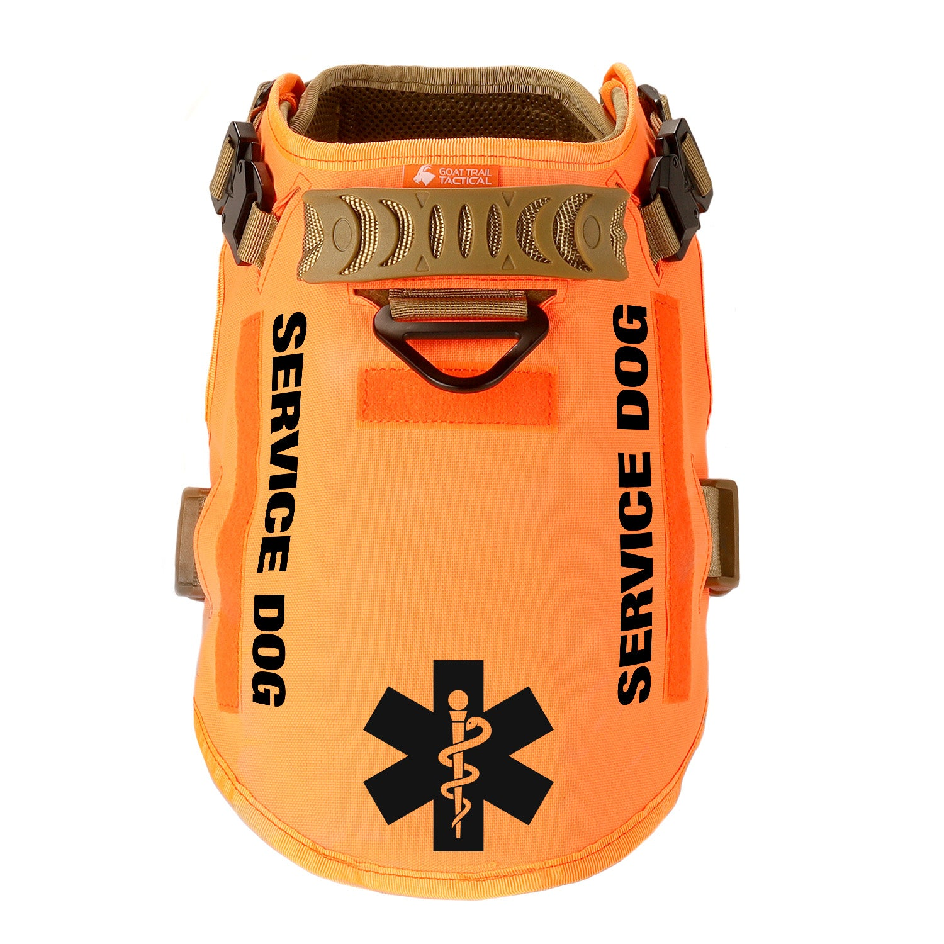
Do service animals need to wear identifying vests or harnesses?
No.
Service animals are not required to be marked in any way to indicate their designation as a service animal.

Slide 43
Do service animals need to be certified, registered or show proof of training?
No!
Service animals must only be individually trained to provide a specific task for the individual with a disability.
Mandatory registration is not allowed under the ADA or Michigan law.

Slide 44
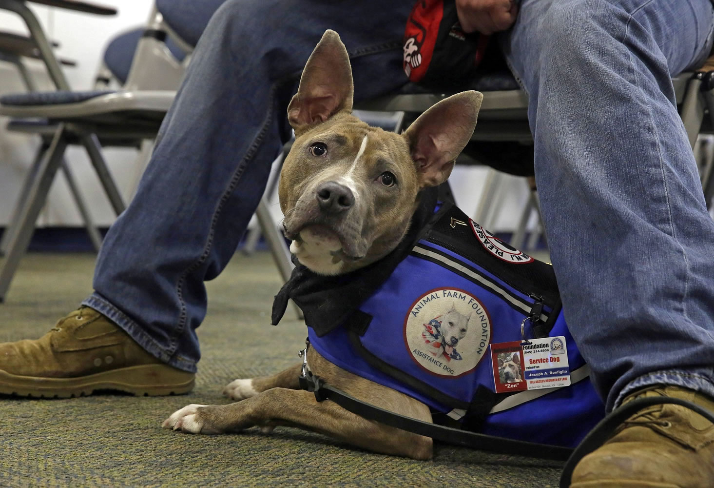
Are there breed restrictions or size restrictions for service animals?
No!
Service animals may be any dog (or mini horse), even if there are breed restrictions in a location, apartment, or housing complex.

Slide 45
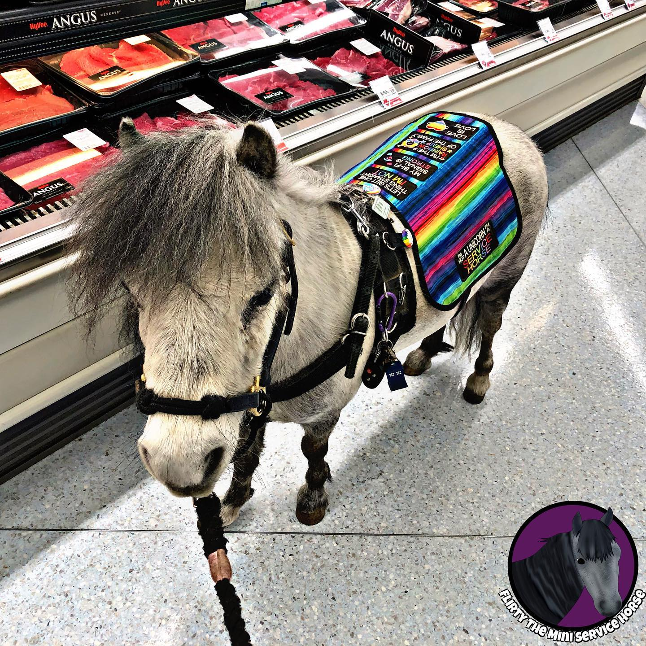
Are there specific requirements for service mini horses?
The requirements are the same as for service dogs with the added requirement that:
That the establishment can safely accommodate the miniature horse’s type, size, and weight; and
Whether the miniature horse’s presence will compromise legitimate safety requirements necessary for the safe operation of a facility.

Slide 46
Can service animals be denied entry because of fear or allergies?
Generally, no!
Fear of animals or allergies is not a reason to deny an IWD the use of a service animal in a public place or workspace.
We will need to find a way to accommodate both the individual using the service animal and the individual with the allergy.
This may mean separated spaces or reassignment to a specific area/cube/office for either the individual with the service animal or allergy.

Slide 47
What documentation may employers request related to service animals?
Employers may only request medical documentation when the need is not obvious.
Documentation to support the employee has a disability and their functional limitations.
May rely on the employee’s explanation of what tasks the service animal does - may not exist in medical documentation.
Can accept training certificates if the employee offers them, but they are not required.

Slide 48
Is proof of vaccination required for service animals?
If local ordinances or state law requires the vaccination or registration of animals, the same rules apply to service animals.
However, unless there is a requirement to provide vaccination information for other animals on campus (housing), it is generally not recommended to ask for vaccination documentation for service animals.

Slide 49
If I have a disability and register my dog, is it now a service animal?
No!
The dog must be individually trained to perform a task related to the individual’s disability.
A person voluntarily registering the untrained dog (ESA or pet) with the state of Michigan to receive a service animal “patch” may be guilty of a misdemeanor.
It is also a misdemeanor for any individual without a disability to represent a pet, ESA or therapy animal as a service animal.

Slide 50
Resources

Slide 51
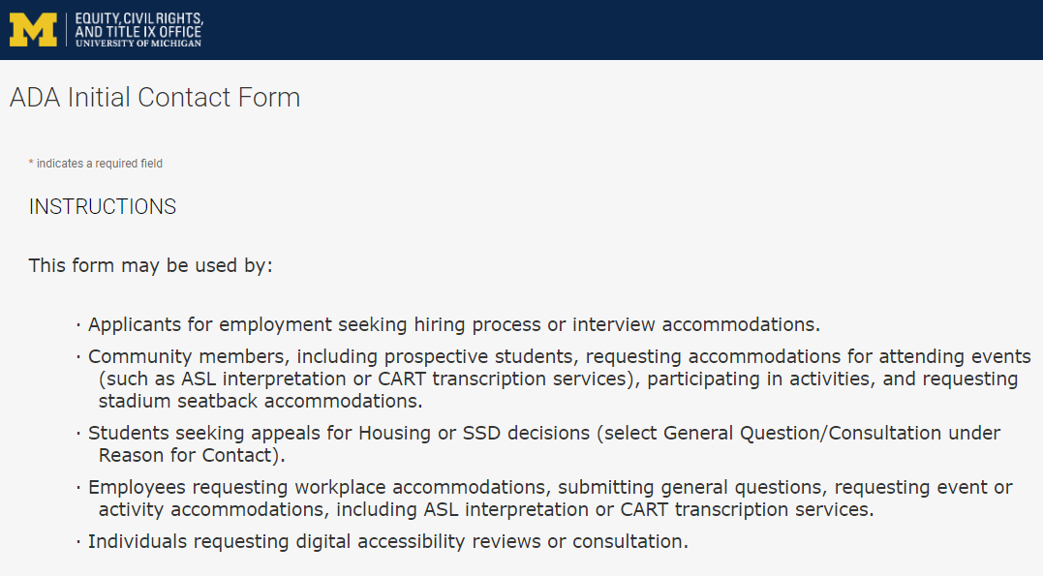
Contact the ADA Team https://ecrt-umich-accommodate.symplicity.com/public_accommodation/
Use the ADA Initial Contact Form to request:
Workplace accommodation
Hiring process accommodation
Consultation with the ADA Team
ASL or CART services
Event accommodation
Digital accessibility review or consultation
General accessibility questions and best practices

Slide 52
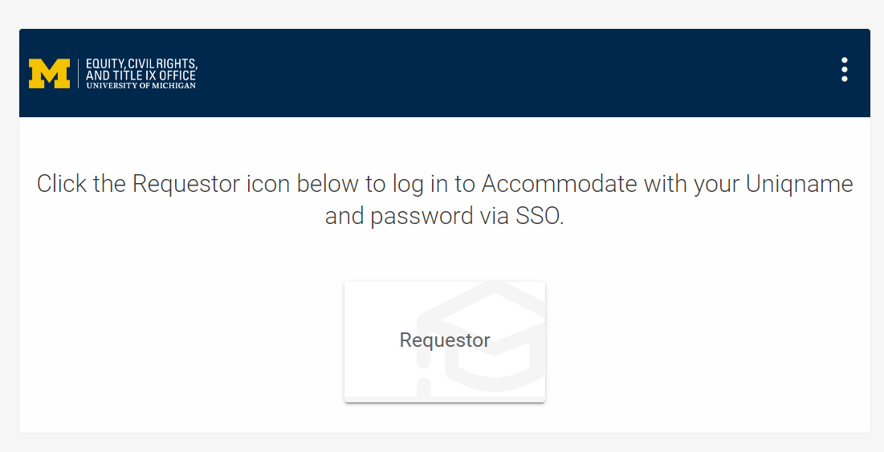
Accommodate Database https://ecrt-umich-accommodate.symplicity.com/
Log into Accommodate to:
View your initial request
View any letters, documents, or notes associated with your request
Submit additional requests
Access the Resource Library
Previously recorded workshops
Frequently Asked Questions
Documents related to accommodations

Slide 53
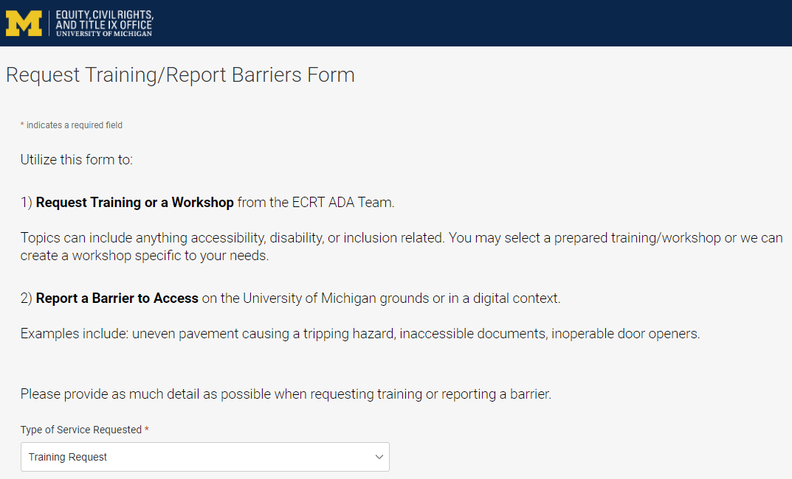
Request Training or Workshops https://ecrt-umich-accommodate.symplicity.com/activity_provider_request/
Use the Request Training/Report Barriers form to request training for your department or group. Topics include:
Ableism Awareness
Creating Accessible Digital Documents
Creating Inclusive Environments
Disability Awareness
Reasonable Accommodations and the Interactive Process
Service and Emotional Support Animals

Slide 54
Report Barriers to Access https://ecrt-umich-accommodate.symplicity.com/activity_provider_request/
Use the Request Training/Report Barriers form to report physical or digital barriers to access
Examples:
Inoperable door openers or elevators
Cracked pavement causing tripping hazards
Inaccessible software or documents

Slide 55
Questions?

Slide 56
Thank You From ECRT!

