Slide 1
A Supervisor and HR Partner’s Guide to Reasonable Workplace Accommodations
ADA Team of ECRT
(Updated March 2024)
Notes:
This workshop is also recommended for Human Resources partners and anyone interested in learning more about the interactive process to determine reasonable workplace accommodations.

Slide 2
Zoom Webinar Tips
Use the Q&A feature to submit your questions.
ASL interpretation can be utilized by clicking Interpretation and selecting American Sign Language.
CART transcription can be turned on by selecting Show Captions.
Notes:
This workshop is also being recorded and will be made available on ECRT’s YouTube channel: https://www.youtube.com/@ECRTumich as soon as possible. The slides will be sent out to all registered participants within the coming days.

Slide 3
Agenda
Disability is integral to the university’s diversity, equity, inclusion, and accessibility (DEIA) efforts.
It is important to be part of a culture that supports and embraces disability inclusion. This session will cover:
General background information on the ADA and its protections
The Interactive Process
The Interactive Process – interactive game
Frequently Asked Questions

Slide 4
Please Engage
We are modeling creating a comfortable and inclusive space.
Questions are encouraged!
We don’t know what we don’t know.
If you’re thinking about it, chances are someone else is, too.
We strive to promote a brave and safe space.
Respect the experiences of others.
Opportunities for growth and learning.
We’re all learning together.

Slide 5
The Americans with Disabilities Act (ADA)
And the ADA Team

Slide 6
Role of the ADA Team
Provide institutional consultation, educational outreach, and advice about accessibility, disability, and inclusion.
Promote digital and physical accessibility planning and implementation.
Advocate for the inclusion of disability as a critical part of diversity initiatives and planning across all aspects of our university community.
Facilitate the Interactive Process for workplace accommodations.
Coordinate and/or provide ASL interpreting and CART transcription services.

Slide 7
What is the ADA? The Americans with Disabilities Act (1990) and the Amendments Act (2008)
Prohibits discrimination and harassment against a qualified individual with a disability (IWD) in employment, public places, public education, etc.
Employment -Title I: Application procedures, hiring, promotion, discharge, compensation, benefits, training, etc.
Federal, state, & local government -Title II: Requires places, services, and benefits provided to be accessible, including places of education like U-M.
Public places -Title III: Requires places open to the public to be accessible and provide accessible information & digital services.
Protects individuals from discrimination based on association with an IWD.
Creates an affirmative duty to provide a reasonable accommodation (to deny a reasonable accommodation is discriminatory).

Slide 8
Legal Framework
The Americans with Disabilities Act 1990
Amendments Act 2008: expanded definitions and spirit of the law
Title I – employment
Title II – state and local government
Title III – public accommodations
Rehabilitation Act of 1973
Fair Housing Act
Air Carrier Access Act
Individuals with Disabilities in Education Act (IDEA)
Michigan Persons with Disabilities Civil Rights Act
Deaf Persons’ Interpreters Public Act
Public Act No. 75 of 2022 (service animals in training)
Notes:
There are many laws and regulations that apply at the University of Michigan, depending on someone’s role

Slide 9
U-M Disability Related Policies: SPG 201.35 and SPG 601.20
Nondiscrimination Policy (201.35):
“The University of Michigan is committed to a policy of equal opportunity for all persons and does not discriminate on the basis of race, color, national origin, age, marital status, sex, sexual orientation, gender identity, gender expression, disability, religion, height, weight, or veteran status in employment, educational programs and activities, and admissions.”
Electronic Information and Technology Accessibility Policy (601.20):
All EIT used, created, and procured for use by U-M "should provide equal access and be as effective, available, and usable for individuals with disabilities as for those who do not have disabilities.”

Slide 10
The Interactive Process
4 Steps to Accommodation

Slide 11
Disability Definition
A physical or mental impairment that substantially limits one or more major life activity.
Substantial limitation is determined by comparison to an average person in the general population.
Major life activities include: bending, breathing, caring for self, concentrating, hearing, interacting with others, learning, lifting, sitting, speaking, standing, thinking, walking, working, etc.
This includes people who have a record of such an impairment, even if they do not currently have a disability.
It also includes individuals who do not have a disability, but are regarded as such.

Slide 12
Background
The ADA Team is a neutral party facilitating the request for accommodation between the employee and their unit.
The Interactive Process does not address complaints against a coworker, colleague, supervisor, etc.
Complaints of retaliation, discrimination, and harassment are addressed via ECRT.
General complaints, concerns, or issues should be addressed by HR.
Employees requesting accommodations may not know exactly what they need and may be wary of disclosing their disability.
Employers need to consider the needs of the unit, but also the health and safety of the employee.
Notes:
The ADA Team need not be a party to all requests, as units can facilitate this process on their own. For today’s training purposes, we’ll be operating on the assumption the ADA Team is facilitating the Interactive Process.

Slide 13
Definitions (1 of 2)
Disability: a physical or mental impairment that substantially limits one or more major life activity.
Accommodation: any modification or adjustment to policy, practice, or environment that provides IWDs equitable access to programs, services, or benefits.
Accessibility Specialist: the ADA Team representative responsible for facilitating the Interactive Process between the employee and their department.

Slide 14
Definitions (2 of 2)
Interactive Process: conversations between the employee and the employer to identify a reasonable accommodation based on disability-related needs.
Qualified employee: an individual who meets the requirements for the position and can, with or without reasonable accommodation, perform the essential functions of the job.
Essential job functions: the fundamental job duties of the employment position the individual with a disability holds or desires.

Slide 15
Top Factors Considered Before Disclosing Disabilities
Uncertain about process: Not sure what to say or to who or what could help.
Concern about medical documentation not being sufficient.
Fear: Concerns about losing their job, being treated differently, discrimination and retaliation.
Overwhelmed by options: Where to go for access and support?
Exhaustion: Redirected too many times or without resolution.
Negative experiences of others.
Notes:
For many employees, the decision to engage with the ADA Office or to request accommodations from their supervisor or unit begins with a decision about whether or not to disclose a disability. This decision is directly corelated to past experiences and their level of comfort and inclusion in their current or past workplace

Slide 16
Goals of the Interactive Process
To identify an effective and reasonable accommodation for an employee with a disability to perform the essential functions of their job.
To provide reasonable workplace accommodations that benefit the employee and the employer.
To find a way to enable an employee with a disability to work effectively, productively, and safely in their job.

Slide 17
Individual Responsibilities
Employee Responsibilities
Employer Responsibilities
Explain the limitations of the disability and how they relate to the accommodation request.
Identify a preferred accommodation but be prepared to discuss alternatives.
How would one accommodation be more or less effective than another?
Make fact-based decisions and avoid the “what if” mindset.
Engage in a good-faith effort.
Consult with the employee about limitations.
Consider the employee’s preferred accommodation option.
Employers have the option to implement the accommodation that is most appropriate for BOTH the employer and the applicant.
Make fact-based decisions and avoid the ”what if” mindset.
Engage in a good-faith effort.
Notes:
Applicants should help the employer understand how the diagnosis affects the ability to participate in the hiring process. Keep in mind, the applicant does NOT need to reveal their diagnosis.

Slide 18
Requesting Accommodations
Accommodation: any modification or adjustment to policy, practice, or environment that provides IWDs equitable access to programs, services, or benefits.
Requests do not require magic words and do not need to be submitted in writing.
“ I need an accommodation for…
“I’m having a hard time with…”
“I need help with…”
“It would be helpful if I could use/have/try…”
“I could engage more fully if…”
Notes:
Accommodation requests should put the employer on notice of the need for assistance with essential job functions.
More language examples:
- “The construction noise outside is making it so harder for me to focus than usual.”
- “Wow does my back hurt after standing all day!”

Slide 19
Step 1: Employee Requests an Accommodation
Submit a request using the ADA Initial Contact Form.
Supply medical documentation.
This allows the ADA Team to make a disability determination and ensures the employee is eligible for workplace accommodations.
Become familiar with policies and procedures.
Notes:
The ADA team reviews medical documentation to ensure the condition rises to the level of a disability, using the ADA definition of disability. We’ll talk about documentation needs on the next slide.

Slide 20
Medical Documentation
Medical documentation is needed unless the disability and need for accommodation is obvious.
Accommodation Medical Request Form (AMRF) or doctor’s note:
Diagnosis
Limitations/restrictions/barriers
Recommendations
Length of need
Confidentiality
We do not share information about an employee’s disability or medical condition, symptoms, or personal information outside of the ADA Team without an explicit need to know.

Slide 21
Step 2: Employee Meets with an Accessibility Specialist
Employees will meet to discuss their request in detail. This is an opportunity to provide additional information and share lived experiences.
This meeting can take place during the workday without using PTO/vacation time, so long as the employee has their supervisor’s approval.
The employee does not need to disclose to the supervisor specifics regarding the meeting. They should, however, give adequate notice of the need to meet with ECRT and provide the date/time of the scheduled meeting.
Notes:
When the employee shares the need to meet with ECRT, they can simply state they need time away to speak with someone in ECRT regarding a workplace benefit. They do not need to state the meeting will be taking place with the ADA Team specifically. However, if the employee does not wish to disclose meeting with ECRT, they may use PTO/vacation time.
Regardless of if the employee shares they are meeting with ECRT or if they are requesting time off, the employee should follow standard unit communication guidance to inform the unit they are requesting time away.
At the conclusion of Step 2, we also will send an email to the employee giving additional information about the next steps of the interactive process and that nothing has been determined at this point.
Sometimes employees choose to not move forward from step 2, so we do not notify the supervisor of the request for accommodations. Other times, the employee simply needs more time to decide to move forward, more time to obtain documentation, or more time to consider what accommodations may be helpful.

Slide 22
What Information Is Needed
Accessibility Specialists will:
Confirm essential job functions – tasks that are critical to the role where removing them would fundamentally alter the job.
Determine barriers – what is it about the job or environment that is creating difficulty?
Consult with resources for guidance and assistance.
Example: Job Accommodation Network (JAN).
Consider reasonable alternatives.

Slide 23
Essential Job Functions
Essential job functions are job duties an employee must perform.
These are not incidental, extra, or secondary job duties.
Examples of essential job functions:
A truck driver must have the ability to operate/drive a truck.
A nurse in the ED must have the ability to perform CPR.
Examples of non-essential job functions:
A truck driver scheduling meetings.
A nurse in the ED filling the copy machine with paper.

Slide 24
Step 3a: Accessibility Specialist Meets with the Unit HR
New as of March 2024
Accessibility Specialists may meet with the employee’s unit Human Resources representative(s) prior to meeting with the supervisor.
The unit HR representative can share information regarding:
Overall staffing trends.
Policy-related information.
The employee’s use of PTO/vacation time.

Slide 25
Step 3b: Accessibility Specialist Meets with the Supervisor and Unit HR
The Accessibility Specialist will have made a disability determination and initially reviewed the employee’s preferred request for reasonableness.
The unit must be able to discuss the employee’s essential job functions.
This meeting provides the unit the ability to discuss their needs and get answers to their questions.
If a unit cannot support an employee’s preferred accommodation, they should explain how the request may pose a burden to the unit.
Notes:
We’ll discuss how Accessibility Specialists determine reasonableness on the next slide.
It is important to document why an accommodation cannot be supported in order to fully engage in the interactive process and minimize risk to the university. If a unit cannot support a preferred accommodation, we will then discuss alternatives that may still provide support to the employee. Though uncommon, there may be instances where an effective accommodation cannot be identified. Though some units may feel like there is “fault” when this occurs, it is up to the ADA Team to determine reasonableness – the burden does not fall to the unit or any one particular individual.

Slide 26
Determining Reasonableness
All accommodations are assessed on a case-by-case basis.
Medical necessity is NOT the threshold for determination.
If multiple accommodations are effective, the unit can choose which effective and reasonable accommodation to implement.
Exceptions:
Direct threat to health and/or safety.
Modification of essential job functions.
Undue hardship:
Nature and cost (not likely to apply to U-M as it is based on the financial resources of the university as a whole).
Resources, size, number of employees, location.
Impact of the accommodation on the operation and resources.
Notes:
Two people with similar conditions may not need the same accommodations.
Direct threat: think back to the nurse in the ED not being able to perform CPR.
Modification of job duties: the truck driver no longer driving a truck.

Slide 27
Step 4: Finalize the Accommodation
Draft documents will be issued to the unit and the employee to review.
This provides an additional opportunity to ensure the employee’s needs are being met in an effective way without posing a burden to the unit’s operations.
Accommodation documents will be finalized with a copy sent to all parties involved with a copy stored with the ADA Team.

Slide 28
Accommodation Examples
Modify or provide equipment:
Sit-to-stand desk, ergonomic chair, noise-canceling headphones.
Modify a work schedule:
Flexible start or end times, alter a break schedule, provide additional breaks.
Provide accessible software:
Speech to text, large format, organizational programs, time management software.
Alter a uniform/attire:
Allow headwear, allow facial hair, fabric modifications.

Slide 29
Implementing an Accommodation
Save the accommodation document somewhere secure, but accessible when needed. It should be stored separately from the employee’s personnel file.
Create a plan for communication:
Determine how the accommodation should be implemented, and then implement it promptly.
Create clear and concise expectations.
Know who to contact when questions arise.
Check in regularly to make sure the accommodation is working as expected.
Notes:
Implementing accommodations promptly will help to eliminate risk. We have a duty not just to identify a reasonable accommodation, but to implement it right away. This may mean purchasing equipment, installing software, modifying a schedule, or relocating furniture. If delays are unavoidable, document what steps you’ve taken to help move things along.
The ADA Team’s 4 step process is now complete, but this is where the Unit and Employee begin to set up their next steps

Slide 30
Monitoring Accommodations
Check on effectiveness.
Is the accommodation working as expected?
Maintain the accommodation.
It should continue to be utilized unless the employee states otherwise.
Encourage ongoing communication.
Restrict medical inquiries.
Don’t ask for updated documentation if there is no need
Document findings.
Effective, needs amendment, change in need, etc.

Slide 31
Keys to Effective Accommodations
Open-mindedness
Communication
Documentation
Notes:
Being open-minded about alternative ways to support the employee
Communicating effectively and frequently
Documenting each of the steps you have taken (what you said and did, how you did it)

Slide 32
Cost of Accommodations
More than half of all accommodations have NO COST associated.
When there is a cost:
43%: a one-time fee to the unit of around $300.
7%: an ongoing cost to the unit of around $3,750/year.
On average, the cost of an accommodation is offset within 6-10 months:
Fewer missed workdays.
Fewer workers’ compensation claims.
More productive employees.
Notes:
One-time fee examples: furniture, hardware, software programs
Ongoing cost examples: software subscriptions, interpreters/CART, travel accommodations

Slide 33
Reasons Why We WANT to Accommodate
Accommodations enable IWDs to have equal access to opportunities.
Greater employee retention.
Increase in employee productivity, efficiency, success, and performance.
Improved safety.
Increase in morale and improved coworker interactions.
Notes:
We could spend a lot of time talking about the reasons you are required to accommodate, but instead, we’ll spend more time talking about why you should WANT to accommodate!

Slide 34
Supervisor’s Checklist
Recognize a request for accommodation
Communicate options
Contact the ADA Team for consultation or facilitation
Involve the employee in the process
Maintain confidentiality and privacy
Maintain equity in the work environment
Document, document, document
Most importantly – come from a place of “how can I help?”
Notes:
This is a great slide to keep handy for instances where the ADA Team may not be involved in the Interactive Process, but know that the ADA Team is always available to consult.
Involve the employee in the process: Ask what you can do to support the employee and help to eliminate barriers.

Slide 35
Documenting
What the employee said when they requested an accommodation.
I asked, “How can I help?”
The employee said “…”
I said “…” (yes; no - and the reason why; let’s loop in the ADA Team, etc.)
If medical documentation was provided, I sent it to an appropriate party.
Or, I didn’t ask for any medical information or documentation and referred the employee to the appropriate resource(s).
On [date], I followed up by …
Notes:
Example:
1. Employee said they are having a hard time lifting heavy boxes.
2. I asked what would be helpful to lift the heavy boxes.
3. The employee requested a pushcart.
4. I said we can purchase a pushcart, but let’s consult with MHealthy Ergonomics to make sure we’re getting something that will work well for you.
5. I thanked the employee for having documentation available, but to supply it to MHealthy instead.
6. I spoke with the employee 3 weeks later to make sure the identified pushcart was working for them.

Slide 36
The Interactive Process Game

Slide 37
Instructions
Determine if an employee triggered engagement in the Interactive Process in the following scenarios.
Remember: Requests for accommodation do not require magic words and do not need to be submitted in writing.
Requests for accommodation need to put the employer on notice of the need for assistance with essential job functions due to disability.
Also remember: triggering the Interactive Process does not automatically render a disability determination nor implement an accommodation.

Slide 38
Question 1:
“I get migraines in the morning. I can’t be in 9am meetings.”
Notes:
Has the employee shared information related to a medical condition or disability and stated they are having difficulty performing an essential job function?

Slide 39
Answer 1:
“I get migraines in the morning. I can’t be in 9am meetings.”
YES!
Job function: meetings
Condition: migraines

Slide 40
Question 2:
“It’s hard for me to sit all day because of my back pain.”

Slide 41
Answer 2:
“It’s hard for me to sit all day because of my back pain.”
YES!
Job function: sitting (at a desk, driving a bus, etc.)
Condition: back pain

Slide 42
Question 3:
“I don’t like my coworkers. I shouldn’t have to work with them on projects.”

Slide 43
Answer 3:
“I don’t like my coworkers. I shouldn’t have to work with them on projects.”
No
Job function: interacting with others?
Condition: ?
Notes:
If the employee said the coworkers trigger anxiety, this answer would be yes!

Slide 44
Question 4:
“I need a different job. I just can’t do this.”

Slide 45
Answer 4:
“I need a different job. I just can’t do this.”
Maybe
Job function: not specified
Condition: Not specified, but we can ask more questions like “How can I help?”

Slide 46
Question 5:
“I need FMLA because of my condition.”

Slide 47
Answer 5:
“I need FMLA because of my condition.”
Maybe
Job function: unknown
Condition: Not specified, but we can ask more questions like “How can I help?”
Notes:
Many times, a request for FMLA can turn into a concurrent request for accommodation, or perhaps a request for accommodation upon return to work after FMLA.

Slide 48
Frequently Asked Questions

Slide 49
What are the most common concerns with workplace accommodations?
Supervisors and employees having difficulty or not knowing how to communicate about accommodations or access.
Maintaining confidentiality and understanding who has a need to know.
Not knowing the underlying condition is causing a lack of understanding as to how the limitations relate to the job duties.
The ADA Team determines reasonableness on behalf of the employer to maintain the employee’s privacy.
Putting too much stock in morale and precedent.
We can help to create an inclusive workspace that addresses these concerns, but they are not a reason to deny a reasonable accommodation.
Notes:
The “what if” mindset can also cause issues. We recommend taking a fact-based approach and resolving questions or issues as they arise.

Slide 50
When should an employee request accommodations?
Before experiencing performance issues.
When there is difficulty performing essential job functions due to disability.
As soon as an employee feels they need help.
There is no specific time requirement, but accommodations are not retroactive.
Notes:
We’ve heard from supervisors that their employees are performing well and exceeding expectations, so why are they requesting an accommodation?
Employees need to receive support BEFORE there are problems, otherwise, it can lead to burnout, sick days, need for FMLA or extended sick leave, etc. Often an employee is performing well while working, but at what expense? They could be masking their symptoms and hiding limitations to continue to perform well, but this is generally not sustainable.

Slide 51
Can accommodations change?
Yes!
All accommodations are amendable.
Either the employee OR the unit can contact the ADA Team to request a review.
The ADA Team will facilitate the Interactive Process to determine a more effective accommodation that works for the employee and the unit.
Notes:
Examples: reduction in limitations, additional requested accommodations, extension of a temporary accommodation

Slide 52
Can a supervisor choose to change an accommodation?
Yes, but…
They should include the employee to ensure they are still receiving the support they need.
A supervisor can support the employee by engaging in the Interactive Process to determine effective changes.
Accommodations can be amended for many reasons:
Unit needs have changed (staffing turnover, change in schedule, change in workload).
Employee needs have changed (medically or functionally).

Slide 53
What accommodation information can be shared?
The accommodation document should be shared on a need-to-know basis only.
Other supervisors the employee reports to.
Someone who handles scheduling.
Someone who handles purchasing of items or equipment.
Supervisors and managers can share work-related restrictions.
Lifting/carrying restrictions, sitting or standing time restrictions, etc.
Sharing that an employee has an accommodation is also sharing that employee’s private disability information.

Slide 54
How can I respond to coworkers asking about accommodations?
Respect the privacy of your coworkers, just as you would want your privacy respected.
We’re acting for legitimate business purposes.
We are complying with legal obligations.
We have a policy of assisting any employee who encounters difficulties in the workplace.
We can discuss your specific needs privately.
Notes:
Coworkers do not have a need-to-know about someone else’s accommodation. Information should not be shared, but you can use any of the statements here.

Slide 55
Can I expect IWDs to perform equally as those without disabilities?
Yes.
An employee with a disability must meet the same production and performance standards as their non-disabled coworkers in the same job.
Keep in mind accommodations may be necessary to assist an employee in meeting production or performance standards.
Supervisors should give clear and concise expectations regarding quality of work.

Slide 56
Must I rescind discipline after disclosure?
No - accommodations are not retroactive.
However, if this is the first time the employee has cited a disability as the cause of the need for discipline, the supervisor should provide:
Information about reasonable accommodations.
Clear and concise expectations for performance and productivity standards.
A supervisor cannot refuse to engage in the Interactive Process or provide accommodations as a result of the discipline.

Slide 57
Must I remove essential job functions as an accommodation?
No, but…
Units are not required to remove essential job functions, and generally removing them would not be reasonable. However, a temporary change can be a reasonable accommodation.
If essential functions are removed, a supervisor should document:
We all understand and agree functions x, y, z are essential.
We are temporarily removing functions x, y, z for this long.
(In a performance review) The employee has not been performing x, y, z, but based on the jobs they are performing, here is how they are doing.

Slide 58
If an employee requests FMLA, do I need to mention accommodations?
Maybe.
A request for FMLA for an employee’s own condition could also prompt engagement in the Interactive Process.
Ask the employee if they may need support beyond what FMLA can provide.
If yes, provide information or refer the employee to the ADA Team.
If no, do not pursue accommodations, but document the interaction.

Slide 59
Can I ask employees with known disabilities if they need an accommodation?
Yes.
Alternatively, a supervisor may prefer to ask if there are any steps that can be taken to enable the employee to improve performance or conduct without mentioning accommodation or the employee’s disability.
“How can I help?”
“How can I support you?”
“How can we make the environment more inclusive?”
Be prepared to offer resources or a referral to the ADA Team.

Slide 60
Why would an employee choose to work with the ADA Team rather than their unit?
The employee is new to their diagnosis and is seeking guidance on the process.
The employee may not know how to discuss their request with their unit.
An employee may not want to inadvertently disclose their condition to their supervisor.
There may be tension between the employee and their unit.

Slide 61
Wrap Up
Notes:
Lauren

Slide 62
Key Takeaways
Dos
Don’ts
Keep an open mind.
Be prepared to accommodate employees.
Consult with the ADA Team/ADA Coordinator when questions come up.
Communicate with the employee to ensure support.
Live in the “what if” mindset.
Ask about an employee’s medical condition or documentation.
Share information without a need to know.
Be afraid to ask for assistance.

Slide 63
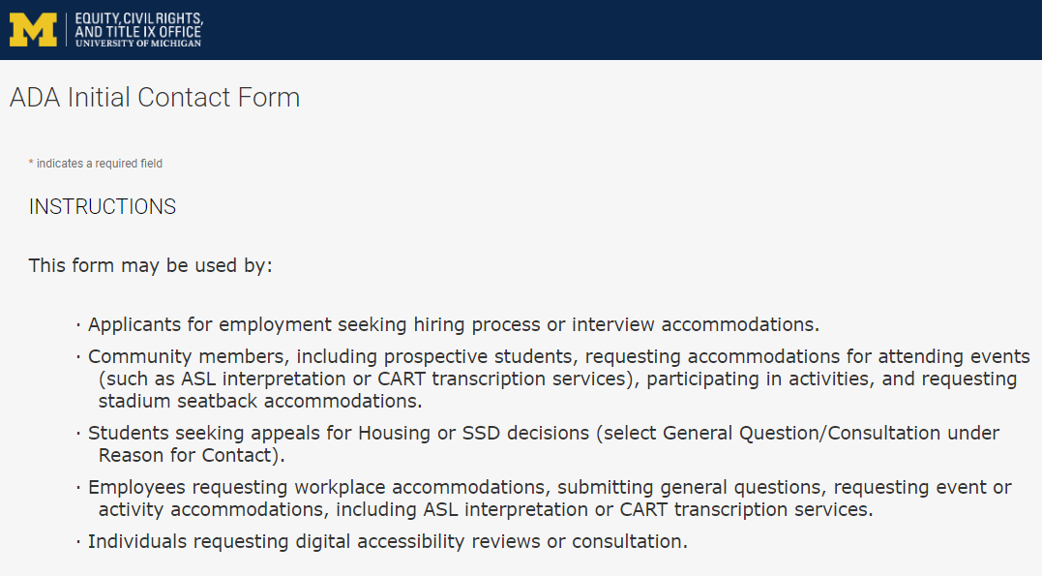
Contact the ADA Team https://ecrt-umich-accommodate.symplicity.com/public_accommodation/
Use the ADA Initial Contact Form to request:
Workplace accommodation
Hiring process accommodation
Consultation with the ADA Team
ASL or CART services
Event accommodation
Digital accessibility review or consultation
Stadium seatback accommodations
Notes:
Individuals who have previously contacted the ADA Team (after January 2, 2024) should log into their case file to submit new requests at https://ecrt-umich-accommodate.symplicity.com/

Slide 64
Questions?

Slide 65
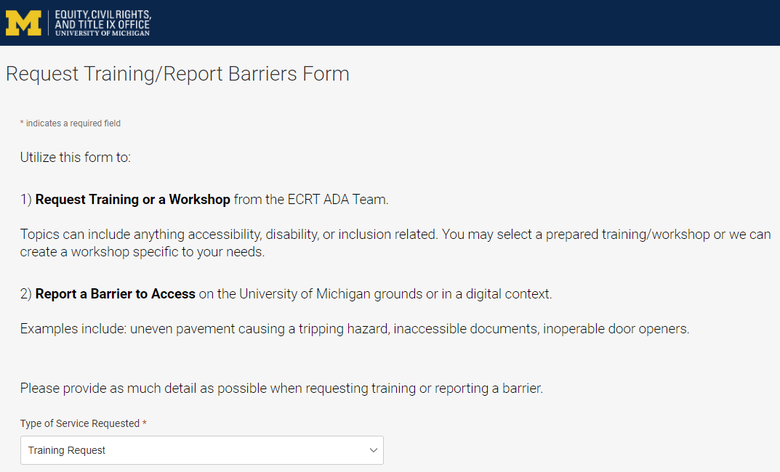
Request Training or Workshops https://ecrt-umich-accommodate.symplicity.com/activity_provider_request/
Use the Request Training/Report Barriers form to request training for your department or group. Topics include:
Ableism Awareness
Creating Accessible Digital Documents
Creating Inclusive Environments
Disability Awareness
Reasonable Accommodations and the Interactive Process
Service and Emotional Support Animals
Supervisor’s Guide to Accommodations

Slide 66
Report Barriers to Access https://ecrt-umich-accommodate.symplicity.com/activity_provider_request/
Use the Request Training/Report Barriers form to report physical or digital barriers to access
Examples:
Inoperable door openers or elevators
Cracked pavement causing tripping hazards
Inaccessible software or documents

Slide 67
Thank You From ECRT

