Slide 1
Creating a Disability-Centric Workplace: Adding Accessibility to DEI(A) 2.0
ADA Team of ECRT
Notes:
Today we’re going to be talking about ways we can add the A to DEI and how we can work together to create accessible environments for everyone.

Slide 2
Agenda
Disability is an integral part of the university’s diversity, equity, inclusion, and accessibility (DEIA) efforts. It is important to be part of a culture that supports and embraces disability inclusion. This session will cover:
Who we are and what we do
Ableism and language etiquette
Communication strategies
Creating and maintaining inclusive environments
Time for questions

Slide 3
Please Engage
We are modeling a comfortable, inclusive, brave, and safe space.
Questions are encouraged – we’re all learning together.
If you’re thinking about it, chances are someone else is, too!
We don’t know what we don’t know.
Respect the experiences of others.
Opportunity for growth and learning.

Slide 4
Who We Are
ADA Coordinator
Deputy ADA Coordinator
Digital Information Accessibility Coordinator
Digital Communications Specialist
Case Manager (2*)
Accessibility Specialists (3)
ASL Interpreters (3)
In less than 1 year we have grown from a team of 3 to a team of 12!
Notes:
Our team is almost entirely comprised of individuals who have been here for 1 year or less. We are learning the university processes and working to enact change.

Slide 5
What We Do (1 of 3)
Provide consultation, subject matter expertise, and advice on disability & accessibility matters including:
Building accessibility review (pre- and post-construction).
Advise on a wide range of physical accessibility committees, DEI(A) committees, and working groups.
Advise on best practices for hiring and interviewing.

Slide 6
What We Do (2 of 3)
Respond to reported digital and physical accessibility barriers.
Approve and facilitate requests for the use of the ADA Fund.
Digital product and website review for 508 compliance.
Provide ASL interpretation and CART (Communication Access Realtime Translation) transcription coordination for employees and events across campus.
Provide ongoing training and workshops to increase disability awareness and promote best practices for accessibility.

Slide 7
What We Do (3 of 3)
Facilitate the interactive process for employees and units.
Provide recommendations to employees seeking accommodations as subject matter experts for a wide range of accessibility options, and accommodations.
Provide support and reasonableness determinations for the LSA Disability Navigator Program.
Student accommodation and housing accommodation appeals.

Slide 8
What We Don't Do (1 of 2)
While we wish we had a magic wand, we don’t.
We cannot make any changes retroactively.
We have no centralized funding to purchase items for employees or units…we wish we did.
We cannot change the compliance regulations or requirements.
We cannot assist individuals directly who do not engage with us.

Slide 9
What We Don’t Do (2 of 2)
“Accio accessibilio!”
We cannot make other people do anything they are not willing to do – but really, who can?
We cannot mandate campus-wide training, but we do hope to engage as many people on an annual basis as we can.
We cannot change an individual’s negative past experiences, but we hope to learn from them.
We do not process or advise on vacation, PTO, extended sick leave, FMLA, or personal conflicts with coworkers or supervisors.
Fix parking overnight, but we’re getting there.

Slide 10
Disclosure and Requesting Accommodations

Slide 11
Top Factors Considered Before Disclosing Disabilities
Uncertain about process: Not sure what to say or to who or what could help.
Concern about medical documentation not being sufficient.
Fear: Concerns about losing their job, being treated differently, discrimination and retaliation.
Overwhelmed by options: Where to go for access and support?
Exhaustion: Redirected too many times or without resolution.
Negative experiences of others.
Notes:
For many employees, the decision to engage with the ADA Office or to request accommodations from their supervisor or unit begins with a decision about whether or not to disclose a disability. This decision is directly corelated to past experiences and their level of comfort and inclusion in their current or past workplace

Slide 12
How to Disclose
A common misconception is that employees are required to share their diagnosis with their supervisor.
Supervisors will need to know about an accommodation and the limitations or barriers the employee is experiencing, but they DO NOT need to know the specific condition or diagnosis of the employee.
Medical information is only shared privately and confidentially with the ADA Team when an employee requests an accommodation.
We don’t need someone’s entire medical history, a diagnosis, a few recommendations for accommodations, and how long they should be in place is generally enough.

Slide 13
Steps to Take When an Accommodation Request Is Received
Implement the requested accommodation, if you can.
Consult with the ADA Team - we’re here to help!
Staff have specialized training and access to resources.
Centralized storage for medical documentation and accommodation documents.
Follow up with the requestor to ensure needs are met.
Maintain privacy.

Slide 14
Ableism & Language Etiquette
Notes:
Considering those with neurodiverse disabilities but also those within the broader disability community, our words and actions have a very important role in creating the neuro-inclusive and disability-inclusive environments we are trying to create in the workplace and classroom. Language and actions are two of the most impactful areas where you can make a difference in creating and maintaining an inclusive environment.

Slide 15
Ableism
Ableism: the intended or unintended discrimination of and social prejudice against people with (or perceived to have) disabilities based on the belief that typical abilities are superior.
Assumption that individuals require “fixing” and defines people by their disability.
Like other -isms, ableism classifies entire groups of people as “less than.”
Includes harmful stereotypes, misconceptions, and generalizations of IWDs.
Devalues and limits potential.

Slide 16
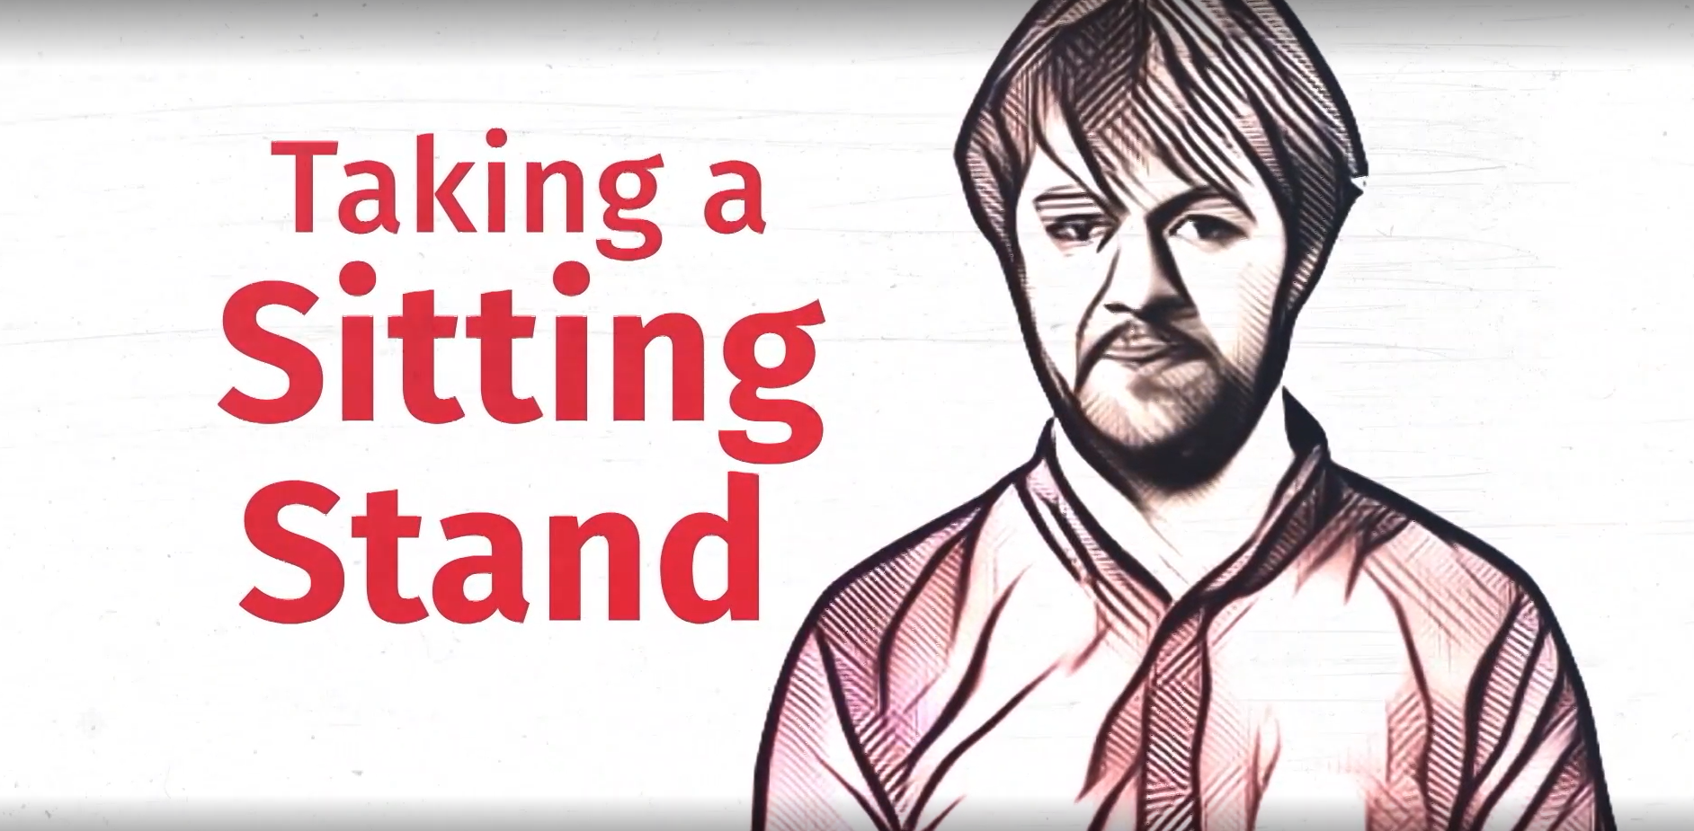
Spoon Theory
Notes:
Link to video: https://www.cbc.ca/news/canada/saskatchewan/spoon-theory-taking-a-sitting-stand-1.6221706
Credit: CBC/Radio-Canada / CBSSaskatchewan

Slide 17
Ableist Microaggressions
Questioning whether someone really needs an assistive device, software program, ergonomic equipment, or any other type of accommodation.
“They seem fine to me!” or “They don’t look disabled.”
Interrupting someone or finishing sentences because someone is taking too long.
Using condescending or louder voices to explain something to an IWD.
Requiring everyone to participate in the same way.
“Everyone needs to turn their cameras on in this meeting.”
Doing the bare minimum of an accommodation.

Slide 18
Replacing Microaggressions with Microaffirmations!
Be considerate about how information is processed and received.
Reading, hearing, seeing, experiencing, or multiple concurrent modalities.
When considering an accommodation request, consider whether you can provide accommodations to everyone.
Can you create an environment where someone doesn’t need to ask for accessibility?
Provide agendas, clear directions, and a variety of seating options for events.
State ahead of time what is provided so someone doesn’t need to ask for an accommodation to be included.

Slide 19
Consider Your Language
Person-First Language
Identity-First Language
The individual is emphasized ahead of their disability, as disability is just one part of their identity.
Aims to recognize humanity first.
Person with a disability.
Individual with… epilepsy, an intellectual disability, a mental illness.
Person who is… deaf, blind, hard of hearing.
Individual who uses … a wheelchair, a walker, an assistive device.
Person who has… depression, anxiety, ADHD.
Challenges negative connotations by claiming disability directly.
Acknowledges disability as an integral part of identity.
Disabled person.
Deaf/deaf person (“D” refers to culture, “d” refers to the medical condition).
Autistic person.
AHEAD (Association on Higher Education and Disability) has adopted the use of Identity-First language.
Notes:
How do we know which is the right type of language to use? Both can be right, depending on the circumstances

Slide 20
Keep in Mind
Disability and disabled are not bad words.
Challenge yourself to remove words and characterizations that may be offensive to others or outdated.
There are very few instances where you would use “challenged” or “special needs.”
Ask what is preferred, if you feel comfortable doing so.
Pay attention to how someone refers to themselves.
Acknowledge that language evolves over time.
Notes:
Remember we’re interacting with individuals and there is likely to never be a 100% buy in for all words and characterizations.

Slide 21
Language to Avoid
Language with negative overtones:
Stroke victim
Afflicted with cerebral palsy
Suffering from anxiety
Wheelchair bound
Language regarded as slurs:
Crazy
The R word
Spaz
Language that assumes knowledge about an individual’s experience because:
you “know someone with”
a “family member has”
“I used to have”
Remember: everyone experiences disability differently!

Slide 22
Common Misconceptions
People with disabilities:
Are less productive, less effective, or less efficient.
Are difficult to manage.
Are required to disclose their disabilities to their employer.
Are difficult or expensive to accommodate.
Neurodivergent people:
Only have Autism.
Cannot work well in a team.
Do not want to socialize or are anti-social.
Create a burden and problem that needs to be fixed.
Are high- or low-functioning.

Slide 23
Communication Strategies

Slide 24
Communication: A Basic Human Right
Remember that individuals with disabilities (IWDs) experience the world in unique ways. What may be a communication strategy that works for one person, may not be the best strategy for another.
IWDs have the right to:
Express their feelings, needs, and wants.
Understand communications from others and access effective communication methods.
An effective and reliable means of independence, individuality, and dignity.

Slide 25
Communication Is Key (1 of 3)
Ask individuals about their communication preferences.
In writing, verbal discussion, both depending on circumstances?
Say and write what you mean - be direct and avoid idioms, sarcasm, and jargon.
Pause when you ask questions to allow time to process and prepare.
Pay more attention to what people say rather than their facial expressions or tone.
Lack of eye contact or fidgeting doesn’t mean lack of attention.

Slide 26
Communication Is Key (2 of 3)
Model active listening:
Repeat back what you think you heard; “I think what I heard you say”
Don’t pretend to understand, instead, let the person know you are having difficulty understanding.
Consider providing context and notice for potentially sensitive conversations (mistakes, opportunities for growth).
Be prepared to step away and come back to a conversation.
Allow others to have the ability to regroup and continue conversation when appropriate.

Slide 27
Communication Is Key (3 of 3)
Use a normal tone of voice. Don’t speak louder unless asked to do so.
Be patient and don’t rush the conversation.
Do not equate directness or a lack of small talk with being anti-social.
Acknowledge and validate concerns, statements, and feelings.
Avoid defensiveness or dismissal.
Relax – everyone makes mistakes. Apologize when necessary and work towards improving next time.

Slide 28
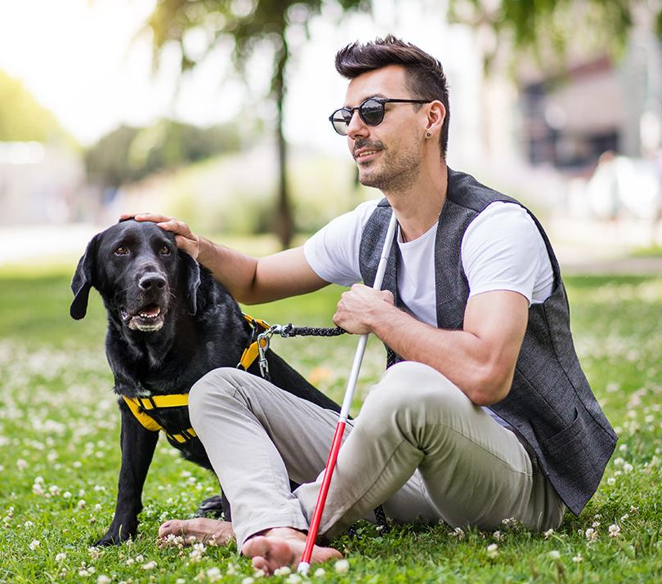
Interacting with People with Visual Disabilities
Interact with the individual, not their assistant, guide, or service dog.
Provide large print or alternative format materials and electronic copies for those who utilize software programs such as screen readers and speech-to-text.
Be sure your documents are created accessibly!
Answer verbally rather than nodding or shaking your head.
State your name when beginning a conversation.

Slide 29
Interacting with People with Auditory Disabilities
Interact with the individual, not their assistant, interpreter, or service dog.
Provide printed or online materials, rather than only spoken language.
Utilize captioning, CART transcription services, microphones, and amplification devices.
Understand that English does not equal ASL so writing or texting may not be effective.
Spotlight ASL interpreters on Zoom.
Notes:
CART = Communication Access Realtime Translation

Slide 30
Interacting with People Using Assistive Devices
Do not push, lean on, or hold someone’s assistive device (wheelchair, walker, cane, etc) unless asked.
Consider the device an extension of the user’s body.
Don’t be afraid of your language.
Saying “walk this way” to someone in a wheelchair is probably not offensive.
Speak with a wheelchair user at eye level, whenever possible.
Sit with them, if practical.

Slide 31
Interacting with People with Any Disability Type
Be clear and concise - use plain English.
Avoid jargon, idioms, and sarcasm.
Don’t speak of individuals with disabilities as inspirations or tragedies.
Avoid stereotypes.
Consider your space and how to make it more accessible.

Slide 32
Creating & Maintaining Inclusive Environments
How do we create spaces where people are comfortable disclosing their disability needs? Or better yet, how do we create spaces where disclosure isn’t necessary?

Slide 33
What Are Inclusive Environments?
Places where everyone:
Is respected and valued.
Is allowed to participate and contribute equally.
Is supported.
Has access to resources and opportunities.
Can freely express themselves.
Can feel a sense of belonging.
Notes:
In the next 3 slides, we’ll provide some examples of environments we DO NOT want to create or maintain.

Slide 34
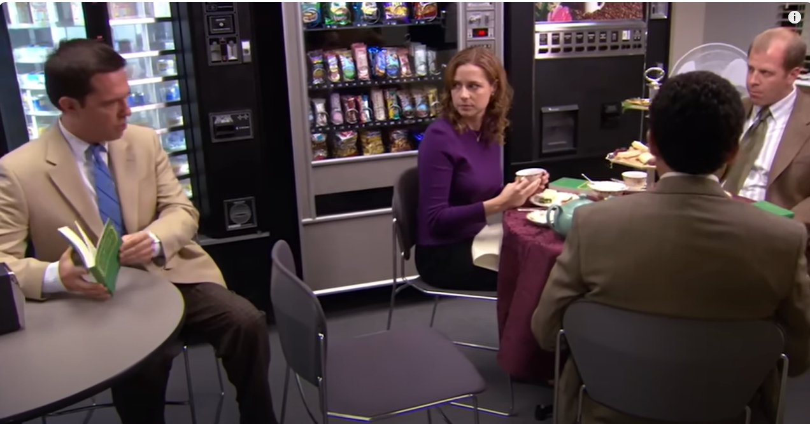
Exclusion
“I’m sorry Andy, but this is a closed club.”
Notes:
Andy wants to join the Finer Things Club with Pam, Toby, and Oscar, but he’s not invited.
Credit: The Office

Slide 35
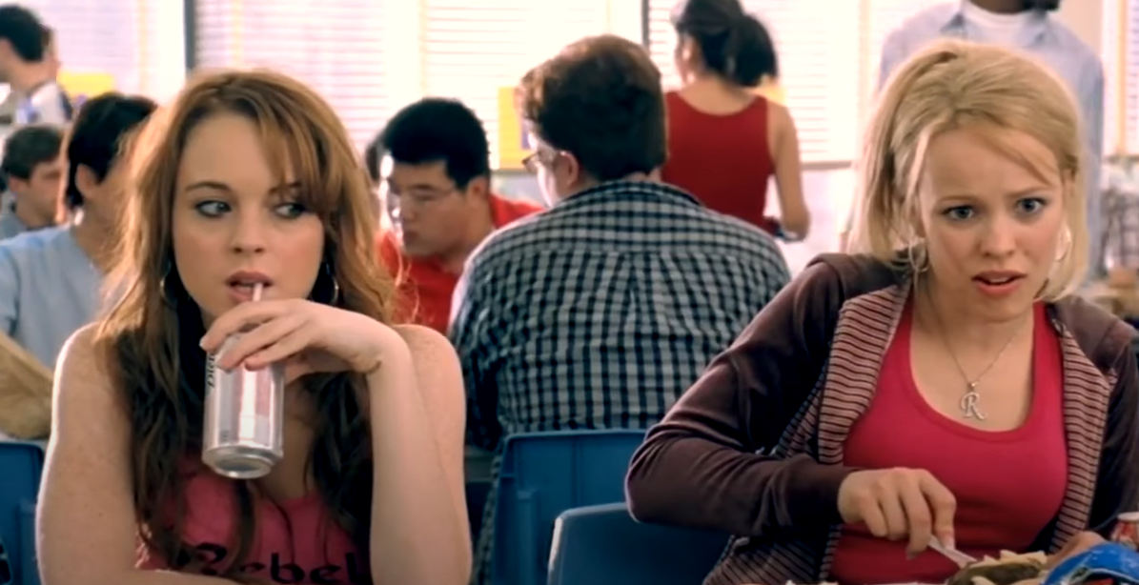
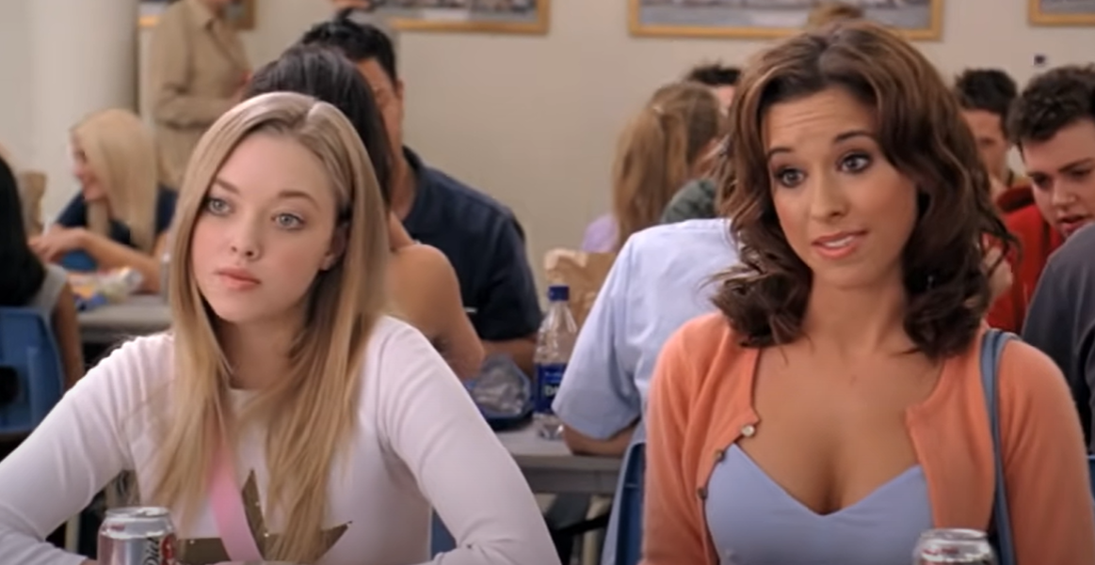
Segregation
“You can’t sit with us!”
Notes:
Gretchen and Karen tell Regina that she’s not allowed to sit with them because she doesn’t adhere to The Plastics’ standards.
Credit: Mean Girls

Slide 36
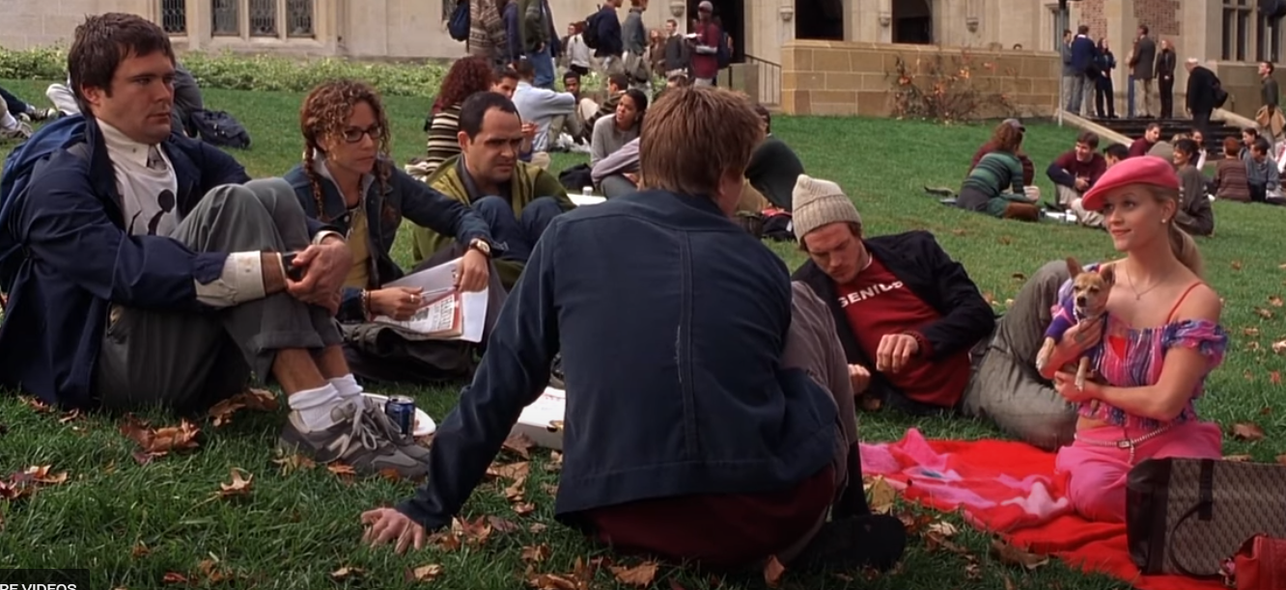
Integration
You can sit with us, but we don’t think you belong here.
Notes:
Elle Woods introduces herself to other new Harvard students, who all speak about their prestigious educational background while Elle describes herself as a Gemini vegetarian.
Credit: Legally Blonde

Slide 37
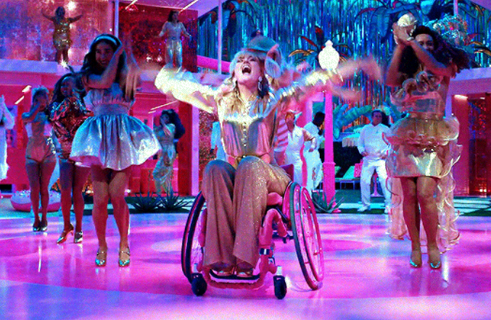
Inclusion
Dance the night away!
Notes:
Wheelchair user Babie, Bionic Barbie, and Deaf Barbie are all dancing together with the other Barbies in Barbieland.
Credit: Barbie

Slide 38
Inclusion Changes the Environment
Reduces the need for modifications and accommodations.
Make something initially accessible to as many people as possible.
Reduces or removes structural access barriers.
May not need changes for diverse abilities.
Tends to benefit everyone.
Proactive.
Anticipates diverse needs – saving time and expense.
Accessibility is an aspect of inclusivity.

Slide 39
How to Create Inclusive Spaces
Build a welcoming and diverse department.
Employ universal design principles.
Allow employees with disabilities to be leaders.
Provide and attend training centered on disability, inclusion, and accessibility.
Ensure team events and meetings are inclusive.
Refer employees to ECRT or other U-M resources.
Be prepared to accommodate.

Slide 40
Workplace Design (1 of 2)
Consider the impact on the senses (sight, smell, touch, sound).
Offer different types of spaces with intention:
Low stimulation/quiet areas for concentration.
Areas for collaboration and movement.
Recharge areas for privacy and reflection.
Provide white noise machines and noise-cancelling devices or headphones.
Avoid strong/harsh/unnatural fragrances when possible.
Notes:
Creating an intentionally welcoming environment for all employees means having options and embracing differences in how people work

Slide 41
Workplace Design (2 of 2)
Provide alternate lighting options and dimmable lights.
Provide various ergonomic seating options.
Offer fidget tools, toys, or other objects in shared spaces.
Build in breaks during long meetings or in between several meetings.
Encourage comfortable attire and furniture when possible.
Consider apps and planner options.

Slide 42
Meeting and Event Accessibility Tips
Create accessible handouts or materials and provide alternative format printed materials, whenever possible.
Use audio amplification devices or microphones.
Provide a virtual attendance option, not just a recording.
Consider mobility limitations and provide a variety of seating options.
Create clear paths through doorways, hallways, and restroom entrances.
Consider accommodations, interpreters, and CART.
Provide information in advance and avoid last-minute changes.
Review the Accessible and Inclusive Resource Guide for Events.

Slide 43
Remember:
Accessibility is the floor, not the ceiling!

Slide 44
Your Questions Answered

Slide 45
What are some best practices for sending accessible emails?
Use sans-serif fonts like Arial, Calibri, Helvetica, & Tahoma.
This is an example of an inaccessible serif called Garamond.
Minimum of 11 or 12 pt font.
Don’t use emojis in place of words.
Use alt-text for images.
Use the Colour Contrast Analyser app.
Add the Web Disability Simulator Chrome Extension.
Break up text into short paragraphs.
Use text in your signature, not just an image.
Notes:
Serif fonts use extra embellishments which may be harder to read for many users, especially when words or lines of words are too close together.
The Colour Contrast Analyser app (using British spelling) is available in the UM Software Center

Slide 46
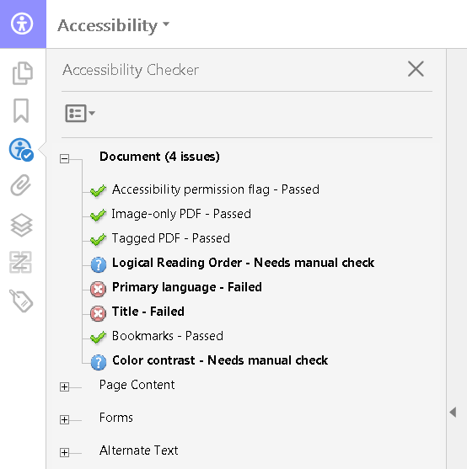
What are some best practices for creating accessible PDFs?
Use Adobe’s accessibility checker.
Check for tagged content.
Use appropriate structure of headings and paragraphs.
Add alt-text for images.
Starting with an accessible Word Document can often make this process easier!
Notes:
PDFs can be very tricky to remediate for accessibility! We discourage saving documents as PDFs due to accessibility hurdles.
And really, we just discourage use of PDFs in general…

Slide 47
What requirements or best practices exist for outdoor events?
Review the Accessible and Inclusive Resource Guide for Events.
Consider the location and proximity of services.
Restrooms, lactation spaces, emergency services, etc.
Consider the terrain, parking, and access to event components such as tables, stages, and ramps.
Plan for the weather (sun, rain, snow, wind) and have a plan in place for shade, cooling, heating, etc.
Avoid spaces with ongoing construction projects.

Slide 48
What are the best ways to accommodate dietary restrictions?
Ask for input from attendees regarding specific needs.
Provide a variety of food choices like vegan, vegetarian, gluten-free, lactose-free, and Kosher/Halal options.
Ensure ingredients are clearly labeled.
Offer individually packaged meals to avoid cross-contamination.
Avoid common food allergens like peanuts and shellfish.
Provide multiple drink container options.
The food label above includes the name of the dish, the ingredients, and the allergens.
Notes:
Bonus that this food label is in two languages!

Slide 49
How can we make hybrid events and meetings better for team members who are joining virtually?
Set up video to view either a presenter in a meeting, or the attendees (or both!)
Minimize background noise.
Request speakers state their name when they begin speaking.
Read questions or comments from the chat aloud.
Repeat questions asked in the live room.
Use breakout rooms for group activities and discussion.
Use polls to increase engagement.

Slide 50
Wrap Up

Slide 51
Key Takeaways
Dos
Don’ts
Consider accessibility barriers when planning events and meetings.
Embrace individuality.
Utilize multiple communication strategies.
Realize that you don’t know what you don’t know, but be open to learning from those who do.
Assume knowledge of someone’s experiences.
Be complacent in your learning and growth.
Beat yourself up if you don’t get it right the first time (as long as you try to get it right the next time).
Be afraid to ask questions.

Slide 52
Questions?

Slide 53
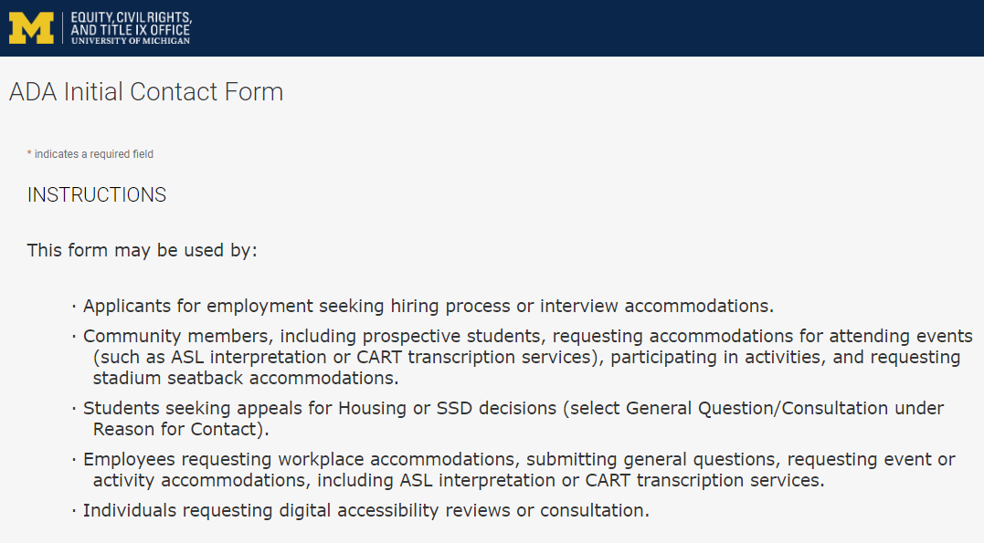
Contact the ADA Team https://ecrt-umich-accommodate.symplicity.com/public_accommodation/
Use the ADA Initial Contact Form to request:
Workplace accommodation
Hiring process accommodation
Consultation with the ADA Team
ASL or CART services
Event accommodation
Digital accessibility review or consultation
Stadium seatback accommodations

Slide 54
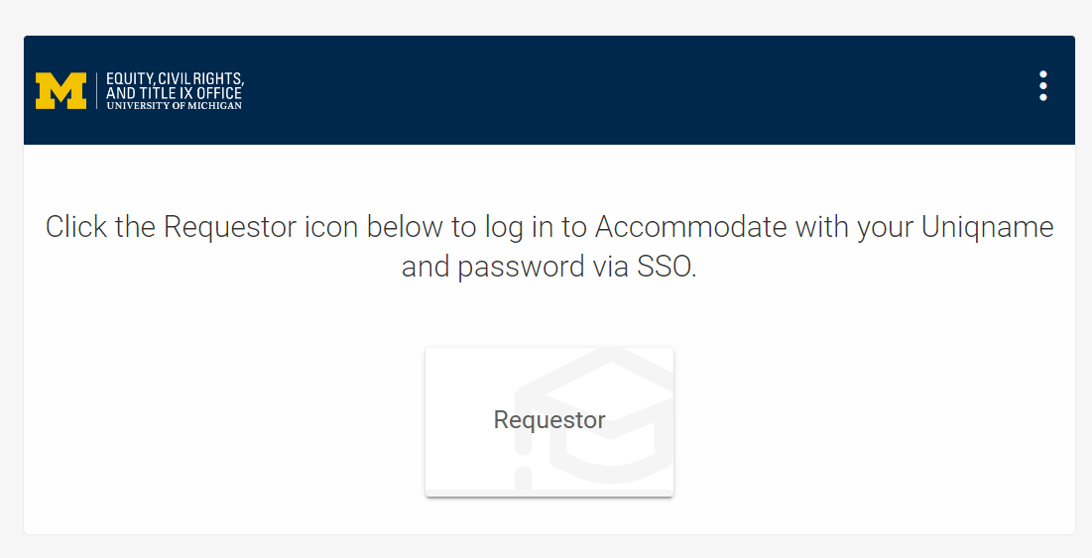
Accommodate Database https://ecrt-umich-accommodate.symplicity.com/
Log into Accommodate to:
View your initial request
View any letters, documents, or notes associated with your request
Submit additional requests
Access the Resource Library
Previously recorded workshops
Documents related to accommodations

Slide 55
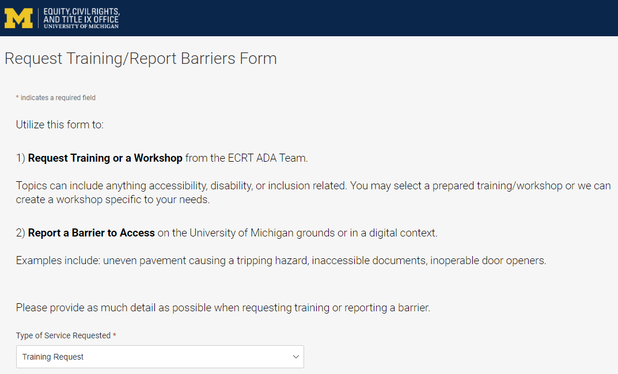
Request Training or Workshops https://ecrt-umich-accommodate.symplicity.com/activity_provider_request/
Use the Request Training/Report Barriers form to request training for your department or group. Topics include:
Ableism Awareness
Creating Accessible Digital Documents
Creating Inclusive Environments
Disability Awareness
Reasonable Accommodations and the Interactive Process
Service and Emotional Support Animals

Slide 56
Report Barriers to Access https://ecrt-umich-accommodate.symplicity.com/activity_provider_request/
Use the Request Training/Report Barriers form to report physical or digital barriers to access
Examples:
Inoperable door openers or elevators
Cracked pavement causing tripping hazards
Inaccessible software or documents

Slide 57
More Learning Opportunities From ECRT
Filterable list of resources on the ECRT website
ECRT's YouTube Channel
ECRT's Upcoming Events Page
Resource Library of Accommodate
FAQs on the ADA, for supervisors, and for employees
Documents used in the Interactive Process
Recordings and slides from prior workshops

Slide 58
Thank You From ECRT!

