Slide 1
Ableism Awareness
Erin Metz
Senior Accessibility Specialist
May 5, 2025
Notes:
Hello, I’m Erin Metz, a Senior Accessibility Specialist with the Disability Equity Office. I’m joined by Katrina Johnson who is providing ASL Interpretation. Today, we'll explore the important topic of ableism. We appreciate you taking the time to engage with this critical subject.

Slide 2
Agenda
The University of Michigan is committed to fostering an inclusive environment where accessibility and the needs of individuals with disabilities are prioritized, ensuring equitable opportunities for all members of our diverse community. This workshop will cover:
Background information on the ADA and its protections
Disability statistics
Ableism & language etiquette
Thinking inclusively
Notes:
The University of Michigan is committed to fostering inclusive environments where the needs of disabled individuals are prioritized, ensuring equitable opportunities for all members of our community. This workshop will cover a brief background on the ADA and its protections, disability statistics, ableism and language etiquette, and we’ll end by going over some steps you can take to think more inclusively.

Slide 3
The Americans with Disabilities Act (ADA)
Notes:
Let’s start with the ADA

Slide 4
What Is the ADA? The Americans with Disabilities Act (1990) and the Amendments Act (2008)
Prohibits discrimination and harassment against an individual with a disability (IWD) in employment, public places, public education, etc.
Protects individuals from discrimination based on association with an IWD.
Creates an affirmative duty to provide a reasonable accommodation (to deny a reasonable accommodation is discriminatory).
Notes:
The Americans with Disabilities Act of 1990, updated in 2008, is a key piece of legislation. It prohibits discrimination against individuals with disabilities across various domains like employment and public spaces.

Slide 5
U-M Disability Related Policies: SPG 201.35 and SPG 601.20
Nondiscrimination Policy (201.35):
“The University of Michigan is committed to a policy of equal opportunity for all persons and does not discriminate on the basis of race, color, national origin, age, marital status, sex, sexual orientation, gender identity, gender expression, disability, religion, height, weight, or veteran status in employment, educational programs and activities, and admissions.”
Electronic Information and Technology Accessibility Policy (601.20):
All EIT used, created, and procured for use by U-M "should provide equal access and be as effective, available, and usable for individuals with disabilities as for those who do not have disabilities.”
Notes:
At our university, there are two policies that reinforce our commitment to disability inclusion. The first is the non-discrimination policy stating that we do not discriminate based on any class, including disability.
The second is the Electronic Information and technology accessibility policy. This requires us to provide effective and usable access to all whether disabled or not. We are ALL responsible for upholding these policies regardless of our role at U-M.

Slide 6
Think About It #1
How many people with disabilities do you know?
none
1 to 5
10 or more
Notes:
Before I talk about what a disability is, let’s check in. Take a moment and think about the people you know. How many of them have disabilities? Do you know any? Maybe just a few, or maybe you interact with lots of people with disabilities

Slide 7
Disability Definition
A physical or mental impairment that substantially limits one or more major life activity
Substantial limitation is determined by comparison to an average person in the general population
Major life activities include: bending, breathing, caring for self, concentrating, hearing, interacting with others, learning, lifting, sitting, speaking, standing, thinking, walking, working, etc.
This includes people who have a record of such an impairment, even if they do not currently have a disability
It also includes individuals who do not have a disability, but are regarded as such
Notes:
As defined by the ADA, a disability is a physical or mental impairment that substantially limits one or more major life activity. It's crucial to recognize that this includes individuals who previously had disabilities, and those who are perceived to have disabilities.

Slide 8
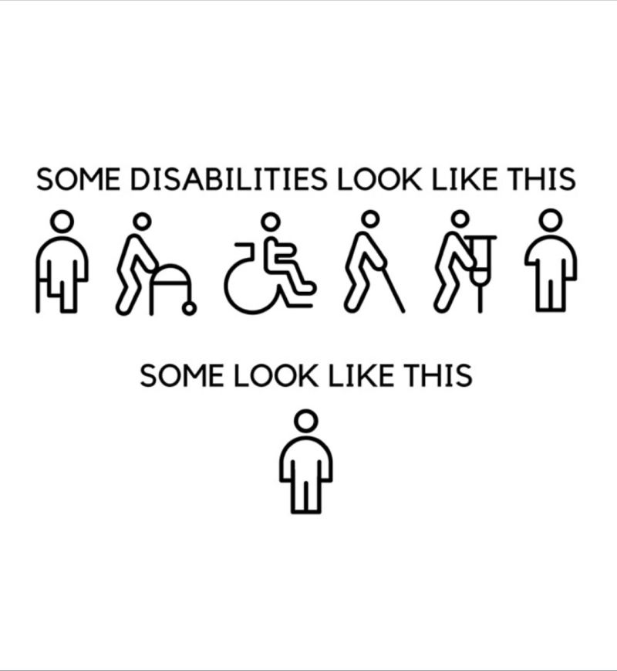
Why Accessibility Is Important
Because people with disabilities are everywhere.
Notes:
Some people may have an image that comes to mind when the word disabled is used. That image may resemble the top row of this graphic: people who are using canes, walkers, and wheelchairs. But, realistically, most disabled people resemble the bottom image: a person who shows no outward sign of difference, meaning we can’t tell if they have a disability or not.
This is why accessibility is so important: because people with disabilities are everywhere.

Slide 9
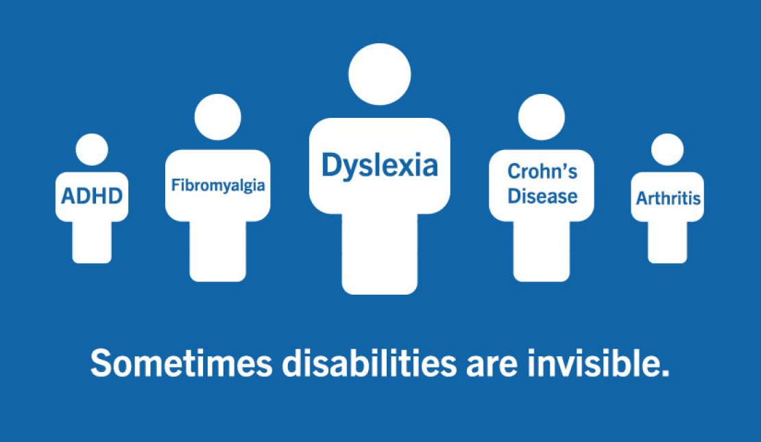
Non-Apparent Disability Examples
Allergies
Arthritis
Asthma
Cancer
Chronic pain or fatigue
Crohn’s disease
Diabetes
Fibromyalgia
Heart disease
Inflammatory bowel disease
Lyme disease
Lupus
Migraine
Thyroid disorders
Notes:
The most common disabilities are non-apparent, or what some call invisible disabilities. Non-apparent disabilities can be apparent at times with a visible component we are able to identify, some are non-apparent such as many chronic conditions and then there are those that may manifest in both apparent and non-apparent ways. It is important to remember that disability itself is a spectrum of experiences and can change over time, become progressive, wax and wane and even be temporary.

Slide 10
Think About It #2
How many people with disabilities do you know?
none
1 to 5
10 or more
Notes:
Now that we have learned more about disabilities and how they can present, let’s revisit the question: considering non-apparent disabilities, how many people with disabilities do you now think you know? You likely know far more than 10.

Slide 11
Disability Models
Older Models
Newer Models
Legal Model
Defined by the ADA
Guided by compliance
Medical Model
Considers disability via diagnosis
Focus on “fixing” the person
Social Model
Created by the barriers in society
Biopsychosocial Model
Combination of biological & environmental factors and how a person thinks about their own abilities
Notes:
Let's explore some models of disability. The older models include the legal model which is the definition we just went over, and also the medical model which focuses on "fixing" the individual. Newer models like the social model emphasize societal impact. But the biopsychosocial model considers disability as a combination of factors such as how environments are structured, and how a person thinks or feels about their abilities and limitations.

Slide 12
Disability Statistics & Disclosure
Notes:
I want to take just a minute to talk about some disability statistics because many people can struggle to conceptualize the sheer number of people who have experienced or currently experience disability.

Slide 13
Think About It #3
What approximate percentage of adults in the U.S. have a disability?
5%
15%
25%
55%
Notes:
Let’s begin with another thought provoking question: what percent of adults in the US have a disability? Do you think it’s 5, 15, 25, or 55%?

Slide 14
U.S. Adult Statistics
Notes:
Per the CDC’s report last updated July 16, 2024, 1 in 4 adults (28.7%) have some type of disability.
-13.9% have a cognition disability with serious difficulty concentrating, remembering, or making decisions
-12.2% have a mobility disability that could involve serious difficulty walking or climbing stairs
-7.7% have difficulty performing errands alone
-6.2% are deaf or hard of hearing
-5.5% are blind or have other vision disabilities
-3.6% have difficulty with self care
Source: CDC.gov https://www.cdc.gov/disability-and-health/articles-documents/disability-impacts-all-of-us-infographic.html#:~:text=More%20than%201%20in%204,have%20some%20type%20of%20disability.

Slide 15
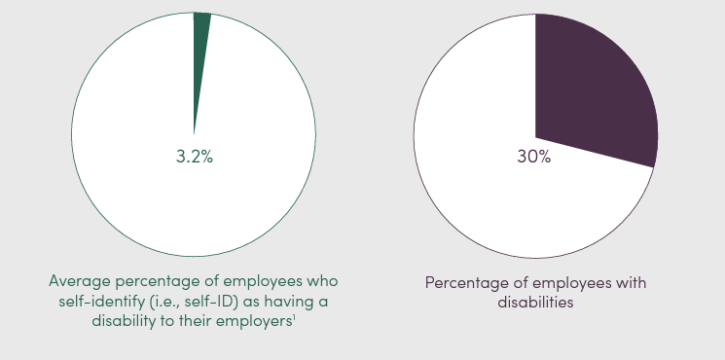
Identifying as an IWD to an Employer
Notes:
Employees tend to not self-identify as disabled to their employer. On average, only 3.2% of employees disclose, even though 30% of employees have disabilities. This tells us a substantial number of people have disabilities but are not disclosing. This could be for positive reasons like not experiencing barriers in the workplace, or for negative reasons, which we’ll hear about on the next slide.

Slide 16
Experiences of Employees Who Disclose Disability Status
Notes:
42% of employees who have disclosed their disability status to their employers report they then experienced misjudgment, 31% experienced insults, 20% felt like they themselves or conversations about their disability were avoided, and 14% experienced general discomfort after disclosure.

Slide 17
Why These Statistics Are Important
IWDs have an unemployment rate that is 4x higher than for individuals without disabilities.
The largest minority group in the U.S. and one of the only groups you can join at any time in your life.
IWDs are everywhere.
Notes:
These statistics are important because in the U.S., the unemployment rate for individuals with disabilities is four times higher than that of non-disabled individuals, highlighting a significant employment gap. Disability is the largest minority group in the U.S., one that anyone can join at any time, reaffirming the universal relevance of disability awareness.

Slide 18
Ableism
Notes:
So let’s get into the heart of why we’re here, to become more ableism aware

Slide 19
Think About It #4
I know what ableism is
I have seen or experienced ableism in the workplace
Notes:
Before we talk about ableism, let’s check in. Do you know what ableism is? Have you seen or experienced ableism in the workplace?

Slide 20
What Is Ableism?
Ableism: the discrimination of and social prejudice against people with (or perceived to have) disabilities based on the belief that typical abilities are superior
Assumption that individuals need to be fixed
Ableism can be intentional or unintentional
Notes:
Ableism is the discrimination of and social prejudice against people with (or who we may think have) disabilities based on the belief that typical abilities are superior. Ableism follows the medical model in assuming that people with disabilities need to be fixed. Ableism can be intentional, but it’s also important to realize that ableism can be unintended or unintentional

Slide 21
Ableist Microaggressions
Questioning whether someone really needs an assistive device or any other type of accommodation.
“Do you even need that cane, you seem fine.”
Interrupting or finishing sentences because someone is taking too long.
Using condescending or louder voices to explain something.
Requiring everyone to participate in the same way.
“Everyone needs to turn their cameras on in this meeting.”
Notes:
Microaggressions question the legitimacy of disabilities or accommodations, like doubting if someone needs their cane. They can also be interrupting someone who is taking extra time to speak or form thoughts, speaking louder to explain something to a person with a disability, but also requiring everyone to participate in the same way, such as requiring everyone to turn on a camera during a Zoom meeting.
Remember – often these actions can be unconscious, but it is our responsibility to learn and modify our behaviors.

Slide 22
Microaggressions in Daily Life (1 of 2)
Denial of personal identity:
“I can’t believe you have a family.”
Denial of disability experience:
“We are all disabled in some way.”
Denial of privacy:
“What’s wrong with you?”
Notes:
From Washington State University in Vancouver: Examples of Disability Microaggressions in Everyday Life
As we go through this list of microaggressions disabled people experience in daily life, think of some of the microaggressions you have heard or experienced.
Denial of personal identity: I can’t believe you have a family because there is no part of your life that is normal like mine.
Denial of disability experience: We are all disabled in some way, so your thoughts and feelings are invalid and not important to me.
Denial of privacy: You’re not allowed to maintain your private disability information so you need to tell me what happened to you

Slide 23
Microaggressions in Daily Life (2 of 2)
Helplessness:
Someone grabbing your arm and leading you to the door.
Secondary gain:
“We raised enough money to get that wheelchair for you!”
Infantilization:
I’ll do that for you.
Patronization:
“You are so inspiring.”
Notes:
Helplessness: Someone grabbing you and pulling you through a doorway - You can’t do this by yourself because you have a disability.
Secondary gain: We raised enough money to get you a wheelchair - I enjoy the recognition for being nice to you.
Infantilization: I’ll just do it for you - You’re not capable, and I can do it better and faster than you.
Patronization: You are so inspiring - It must be so hard to be you, but you’re special for living with a disability.

Slide 24
Most Common Microaggressions I Hear
Why do I need to make this accessible? It’s extra work for me to do this task.
Reframe: The work is not complete until it is accessible.
There’s an accessible path on the other side of the building, why do we need a closer entrance?
Reframe: Everyone should be allowed equal access.
Notes:
Two of the most common microaggressions I hear are “why do I need to make something accessible, it’s extra work for me to do it” – but if we need to reframe this to the work is not complete until it’s accessible. Remember the SPG I mentioned at the beginning of this presentation? We are required to create accessibly.
The second microaggression I commonly hear is that if there is an accessible path somewhere else, why do we need another or a closer one? It’s because everyone should be allowed equal access.
What are some microaggressions you have heard or experienced?

Slide 25
Replacing Microaggressions with Microaffirmations
Be considerate about how information is processed and received.
Reading, hearing, seeing, experiencing, or multiple concurrent modalities.
Create an environment where someone doesn’t need to ask for accessibility.
Avoid assuming no one on your team is disabled or needs an accommodation.
You still need to create accessible documents, emails, and environments.
Notes:
What we all should work toward is replacing ableist microaggressions with disability-inclusive microaffirmations like considering how people process information and providing information in multiple formats. We can work toward creating environments where someone doesn’t need to ask for accessibility because we’ve done what we can to be inclusive.
And lastly, we may not know who has a disability and may need access. Instead of making assumptions about accessibility needs, let’s create environments where accessibility is a given, not an afterthought. This helps everyone feel included.

Slide 26
Avoid Ableist Actions
Choosing an inaccessible location for an event.
Standing in front of a push bar/door opener.
Using the accessible bathroom stall when you may not need it.
Or making assumptions that someone using an accessible stall “doesn’t look disabled.”
Parking/standing in an accessible parking space.
Blocking a curb cut or blocking a sidewalk.
Notes:
We should also work to avoid ableist actions like hosting events in inaccessible locations, blocking door openers, using the accessible bathroom stall if you don’t need it, but conversely, assuming someone doesn’t need to use an accessible stall because they don’t look disabled. Also, parking in an accessible parking space without a permit, and blocking a curb cut or sidewalk.
Many of these actions are overtly ableist, though perhaps not something we’ve considered in our own lives as ableist.

Slide 27
Haben Girma
“The only difference between accommodations for non-disabled people and disabled people is ableism.”
“Most places provide seats for individuals who aren’t wheelchair users – that should be considered an accommodation for them – and also provide lights inside so sighted people can see. That is an accommodation for sighted people that blind people do not need.”
Notes:
Here I have two quotes from Haben Girma, a human rights lawyer advancing disability justice and the first Deafblind person to graduate from Harvard Law School. She states ““The only difference between accommodations for non-disabled people and disabled people is ableism.” She goes on to share ““Most places provide seats for individuals who aren’t wheelchair users – that should be considered an accommodation for them – and also provide lights inside so sighted people can see. That is an accommodation for sighted people that blind people do not need.”
Haben’s words can help us to understand that we unconsciously accommodate the needs of non-disabled people everyday. We should strive to also unconsciously provide accommodations to everyone, regardless of their disability status.

Slide 28
Language Etiquette
Notes:
Our language can shape our perception of disabilities, so it is important we utilize language appropriately

Slide 29
Language to Avoid
Assumes knowledge about an individual’s experience because:
you “know someone with”
a “family member has”
“I also have/had”
because everyone experiences disability differently
Language with negative overtones:
Stroke victim
Afflicted with or suffering from
Wheelchair, home, bed bound
Language regarded as slurs:
Crazy
The R word
Spaz

Slide 30
Keep in Mind
Disability and disabled are not bad words.
Challenge yourself to remove words and characterizations that may be offensive to others.
There is no reason to use “differently-abled” or “specially-abled.”
Pay attention to how someone refers to themselves.
Acknowledge that language evolves over time.

Slide 31
Language Swap
Avoid: Handicap restroom
Why: Implies incapacity
Replace with: Accessible
Avoid: Special needs
Why: Euphemistic
Replace with: Disabled
Avoid: Wheelchair-bound
Why: Implies confinement
Replace with: Wheelchair user
Avoid: Crazy
Why: Stigmatized & misused
Replace with: wild, intense
Notes:
It's okay to use the terms ‘disability’ and ‘disabled.’ They’re direct and not pejorative. Avoid euphemisms and pay attention to how individuals self-identify

Slide 32
Thinking Inclusively

Slide 33
Check Your Bias
Our reliance on sight, hearing, and mobility can be unconscious
“We don’t know what we don’t know,” but it is our job to ask questions and consider others' experiences
Think about various disability categories and ask:
What can I do to create an inclusive environment for someone in one or more disability categories during meetings, events, or at work?
Notes:
Understanding comes from asking questions and being open to diverse experiences and it is vital to check our biases regularly. Our reliance on our own abilities can be unconscious, but we must learn to consider what we can do to create inclusive environments.
Think about various disability categories and ask yourself what you can do to create an inclusive environment for someone who has one or more disabilities during your workday.

Slide 34
Disability: An Aspect of Diversity
IWDs experience the world in unique ways, just as we all do.
May be chronic, long-term, or temporary.
May be a recent diagnosis or a cyclical one.
May be apparent sometimes but not others.
May be progressive.
Consider in terms of barriers due to context or surroundings.
Notes:
Disabilities are a natural part of diversity and disabled people experience the world uniquely, just like everyone else. Disabilities might be long-term or temporary and are influenced by context. Understanding this can enhance inclusivity

Slide 35
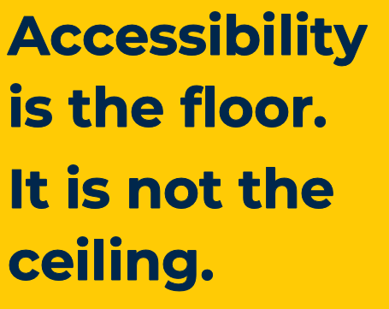
Accessibility Is Not…
Making one-off changes to technology or processes
This is an accommodation, but it is not the goal
A feature or enhancement
Giving an unfair advantage to someone
Simply conformance with legal standards or guidelines
Arbitrary
It’s not what you think is accessible
Notes:
Accessibility is not just about making ad-hoc adjustments or merely meeting legal requirements. It’s not an enhancement or an unfair advantage. It isn’t a burden or an afterthought and it is certainly not only about what you think may be accessible.

Slide 36
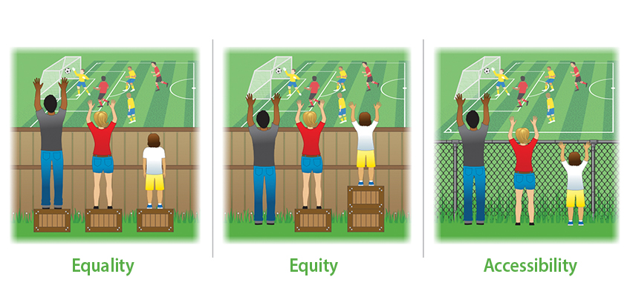
Accessibility Is…
An ongoing and intentional process
Creating an equivalent, real-world user experience for all
Innovative
Considering multiple ways to access information benefits everyone
Notes:
Accessibility is an ongoing process where we create equivalent experiences for everyone.
In this image which you’ve likely seen before, equality means giving everyone the same thing – the same box to stand on to see over a fence to watch a game.
Equity is giving everyone what they need to overcome the barrier of the fence.
But Accessibility is removing the barriers so that everyone is included.
Thank you all so much for joining us for this important topic and please feel free to reach out with any questions you may have.

