Slide 1
Accessible Event Planning (Part 2) Preparing and Hosting an Event
Lauren O’Connor
Accessibility Specialist + Occupational Therapist
Disability Equity Office of ECRT

Slide 2
Zoom Webinar Tips
Use the Q&A feature to submit your questions.
ASL interpretation can be utilized by clicking Interpretation and selecting American Sign Language.
CART transcription can be turned on by selecting Show Captions.
Notes:
This workshop is also being recorded and will be made available on ECRT’s YouTube channel: https://www.youtube.com/@ECRTumich as soon as possible. The slides will be emailed to all registered participants within the coming days along with an anonymous survey. We do really hope you’ll complete the short survey, as this helps us determine how we can best assist you with your learning goals.

Slide 3
Agenda
The University of Michigan is committed to fostering an inclusive environment where accessibility and the needs of individuals with disabilities are prioritized, ensuring equitable opportunities for all members of our diverse community. This workshop will cover:
General Guidelines
Event Accommodations
In-Person Event Accessibility
Physical, Social, and Sensory-Informed Spaces
Virtual and/or Hybrid Event Accessibility
Disability Equity Office Resources and Services

Slide 4
Please Engage
We are modeling a comfortable, inclusive, brave, and safe space.
Questions are encouraged – we’re all learning together.
We don’t know what we don’t know.
Respect the experiences of others.
Opportunity for growth and learning.

Slide 5
Accessible Event Planning, Part 1
The previous workshop in this series emphasized accessible digital marketing and alt text.
If you are interested in watching a recorded copy of this presentation, it has been made available on the Disability Equity Office's YouTube channel.
Topics discussed in Part 1:
Digital Accessibility
Effective Alt Texts for Digital Images
Alt Texts in Social Media and Marketing Materials
Alt Text Interactive Activity
Planning Accessible Events

Slide 6
General Guidelines

Slide 7
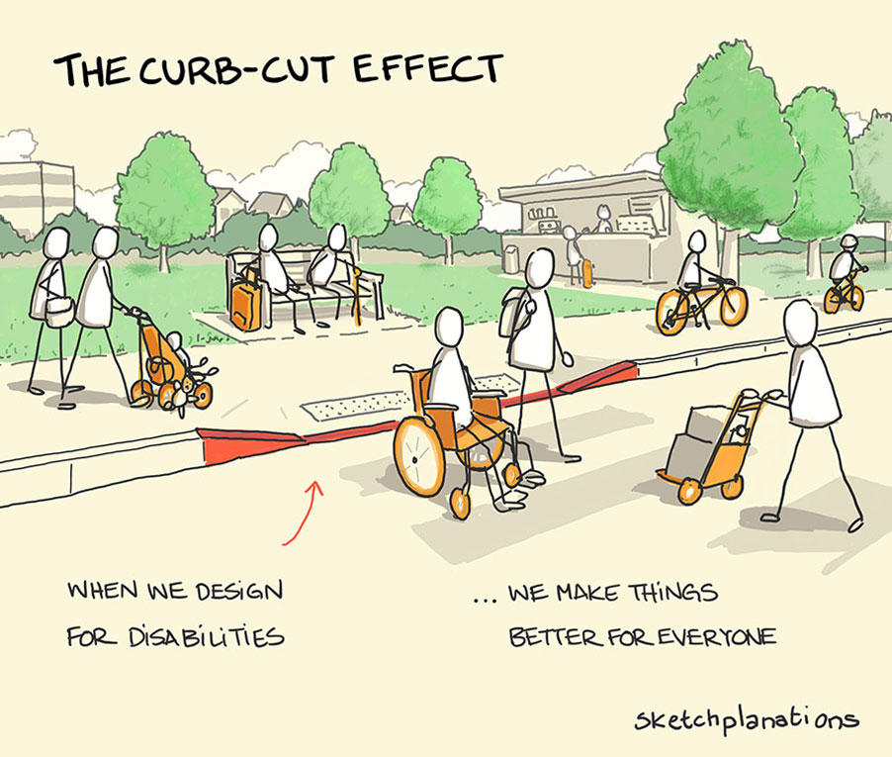
Access Changes the Environment
Access reduces the need for modifications and accommodations.
Access reduces or removes structural access barriers.
Access tends to benefit everyone.
Access is proactive.
Accessibility is an aspect of inclusivity.

Slide 8
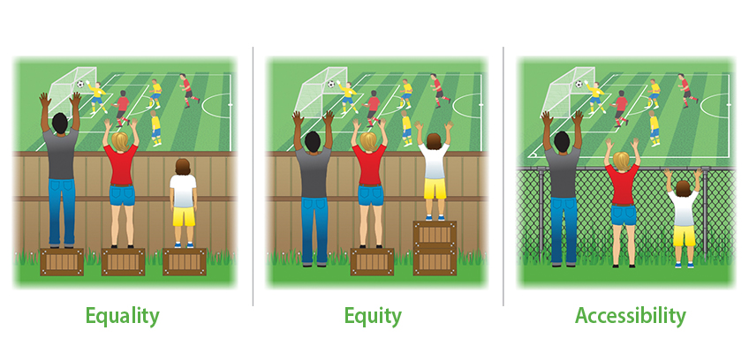
Accessibility Is…
An ongoing and intentional process
Creating an equivalent, real-world user experience for all
Innovative
Considering multiple ways to access information benefits everyone
Notes:
Equality – The assumption is that everyone benefits from the same supports. This is equal treatment.
Equity – Everyone gets the supports they need; thus, producing equity.
Accessibility – All 3 can see the game without supports or accommodations because the cause of inequity was addressed. The barrier was removed.

Slide 9
Key Considerations for Events
Accessible location considerations
Hybrid or by accommodation request only
Audiovisual(AV)/technology
Staffing needs to ensure success
Equitable attendee experiences
Marketing and communications

Slide 10
Event Scheduling Considerations
Date
Cultural and religious holidays
Time
Time of day (morning, afternoon, evening)
Duration of event
Location
In-person
Hybrid
Virtual

Slide 11
Handouts, Presentations, and Infographics
Ensure advertising and marketing materials are accessible.
Strive for simplicity and good readability.
Write in plain language.
Include large text with high color contrast.
Make materials available before, during, and after the event.

Slide 12
Event Accommodations

Slide 13
Meeting and Event Accommodations
Include language regarding what accommodations are already provided in the RSVP.
Detail the event’s activities (i.e. agenda, phone and video access options).
Factor the costs of captioning, sign language interpretation, and other requested accommodations into your budget. These costs are dependent on:
Duration of the event
Vendor
Notice given to service provider
Range of accommodations needed

Slide 14
Language for the Event
"If you need disability-related accommodations to participate in this program/event, please contact (name, host department/unit) at (phone number, e-mail). Early requests are strongly encouraged to allow sufficient time to meet your access needs.”
“Note: Due to availability and scheduling needs, please allow at least two weeks' notice for requests for Communication Access Real-time Translation (CART) services or an American Sign Language interpreter.”

Slide 15
Accommodations Statement
To create an accommodation statement:
Communicates your commitment to creating an accessible meeting
Provides basic details about the event format and accessibility features
Tells people who to request accommodations
Example: "Please let us know how we can ensure that this event is inclusive to you. The Zoom webinar will include auto-captions. What accommodations or access needs can we help facilitate?"

Slide 16
American Sign Language (ASL)
American Sign Language (ASL) is a visual language that uses handshapes, locations, movements, palm orientations, and non-manual language signs (such as facial expressions and body posture) to convey meaning.
It is the primary language of many Deaf and hard-of-hearing individuals.

Slide 17
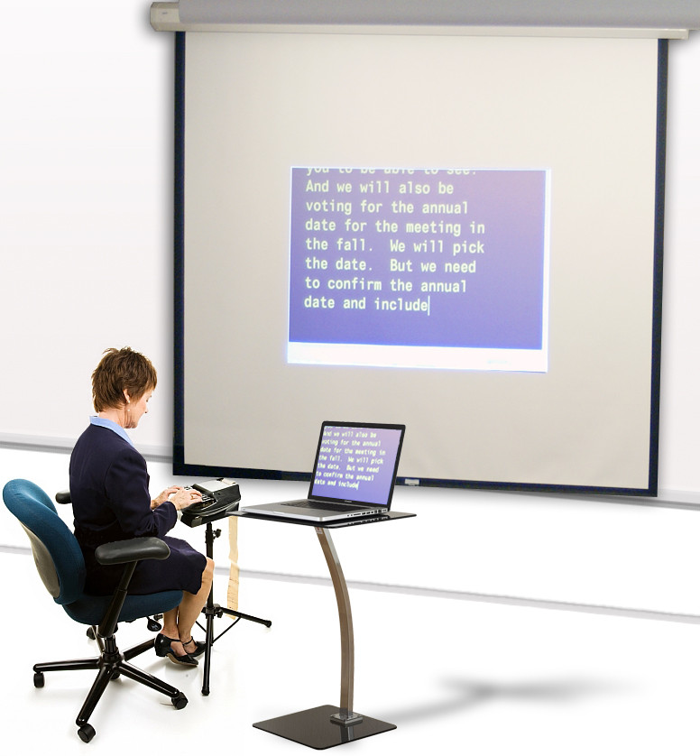
Communication Access Real-Time Translation (CART) 1 of 2
CART (Communication Access Real-time Translation) captioning is a real-time captioning service where a captioner listens to an event (like a meeting, lecture, or broadcast) and immediately displays the spoken words as text.
CART provides a full text/transcription of the event in real-time for viewers.
For more details on what CART is, please visit What is real-time captioning?
Notes:
For more information, see the National Association of the Deaf discussion of CART.

Slide 18
Communication Access Real-Time Translation (CART) 2 of 2
A CART operator does not necessarily need to be on site to provide these services. If a room is already set up with the technology, you can utilize remote captioning/CART if:
The captioner can access audio from the event and
There is a CART screen at the event
View a comparison of live captioning service capabilities with the Live Captioning Matrix.

Slide 19
Considerations for ASL and/or CART
These services include:
Preparation time – review event agendas, presentations, potential content/phrases/names/acronyms, watch previous recordings of the speaker(s) to anticipate cadence, speech patterns, etc.
Setup time
Actual time of the event
There are additional fees to have a transcript of captioning, which is edited by reviewing the audio of the event.
Provide as much advanced information about the event as soon as possible.
Notes:
Please note that providing just one of the following three resources: American Sign Language (ASL), Community Access Realtime Translation (CART), and Event Captioning – may not meet the needs of all attendees, and the meeting/event organizers should be prepared to field requests accordingly. Please contact ASL providers with your event information to request a price quote for their services.

Slide 20
Closed Captions
Closed Captions
Closed captions are a textual representation of the audio within a media file.
Closed captions assume the viewer cannot hear.
They are often dictated with a CC icon on video players and remotes.
Closed captions include non-speech elements of audio (like sounds or speaker identifications).
Subtitles
These are for hearing viewers who don’t understand the language of the audio.
Their purpose is to translate the spoken audio into the viewer’s language.
Subtitles do not include the non-speech elements of the audio.

Slide 21
In-Person Event Accessibility

Slide 22
Event Registration and Check-In
Consider providing resources, expectations, and reminders to so that attendees can plan according to their own needs.
Examples: Location of designated rooms (restroom, lactation, low-sensory, etc.), accessible routes, event timelines and agendas.
It may be helpful to provide this information at registration in a physical folder, a digital packet, and/or by a QR code.

Slide 23
Helpful Signage and Notifications
Nametags
Use accessible font styles, sizes, and colors.
Include pronouns and phonetics.
Utilize color communication badges.
Signage
Provide visible signage for instructions and wayfinding.
Be certain to include this at multiple entrances.
Reminders
Before meetings and events, send multiple reminders with the description of the layout of the room, parking instructions, and available bathrooms.
Notes:
Color communication badges – this allows participants to indicate their communication preferences through different colors.

Slide 24
Food and Drink
Ensure that ingredients are clearly labeled in large print and either individually packaged or offered in a way that avoids cross-contamination.
Provide water and make straws available.
Have options to hold beverages other than glass or ceramic.
Avoid common food allergens (especially peanuts) in spaces and list any possible factory exposure to them on packages.
When possible, provide a range of food that include:
Vegan/vegetarian
Gluten-free, healthy
Lactose-free
Kosher/Halal options
Notes:
Kosher/Halal Resources
Check with the attendee as sometimes a vegetarian meal is acceptable:
Hillel Cafe provide Kosher sandwiches, wraps, salads, and bagel boxes to U-Go’s at the Michigan Union and League and Bert’s Cafe at the Undergrad Library. For kosher catering, please contact Hillel at 734-769-0500.
University of Michigan Museum of Arts (UMMA) uses two Kosher caterers: Chef Cari Kosher Catering, 248-770-6521 and Jewel Kosher Catering, 248-968-1200
Chabad of Ann Arbor also provides Kosher/Halal resources.
Grocery stores that carry Kosher meats and other products: Busch’s, 2240 S Main St, Ann Arbor, 734-998-2666; Kroger, 3615 Washtenaw, Ann Arbor, 734-677-2370; Trader Joe’s, 2398 East Stadium Blvd, Ann Arbor, 734-975-2455.
(Kosher/Halal Source: Barbara Smith, Senior Executive Assistant for Dean Thomas A. Finholt, U-M School of Information. Contact: bjosmith@umich.edu)

Slide 25
Personal Assistance and Safety
If requested, designate staff who can offer individual assistance with navigation, accommodations, food, etc.
Identify them with plain, text printed name tags and encourage them to verbally offer help.
Ensure that there are emergency plans that include locations of exits, a protocol for people with limited mobility and other disabilities, and the nearest area of rescue assistance.
For planning emergency protocols, please contact the Division of Public Safety and Security (DPSS) at 734-763-1131.

Slide 26
Physical, Social, and Sensory-Informed Spaces

Slide 27
Sensory-Informed Spaces
Consider the impact on the senses (sight, smell, feel, sound).
Avoid strong/harsh/unnatural fragrances when possible.
Provide alternate lighting options and dimmable lights.
Offer different types of spaces with intention, such as relaxation rooms.

Slide 28
Physical Accessibility
Ramps, wide doorways, elevators, accessible restrooms, and clear pathways are crucial for ensuring ease of movement.
Providing variability as a standard, increases access for differing needs.
Ask for and offer individual preferences, when possible.
Provide various ergonomic seating or comfortable seating options.

Slide 29
Language for Food Allergens
For in-person training where food may be served, the following language is also recommended:
"If you have dietary restrictions or allergies, please contact (name, host department) at (phone number, email).”

Slide 30
Social Accessibility
Providing variability as a standard, increases access for differing needs.
Consider differences in communication styles.
Build in breaks during long meetings or in between several meetings.
Ask for and offer individual preferences, when possible.
Notes:
Communication recommendations:
Avoid idioms
Pause when you ask questions (silently and slowly count to 10)
Pay attention to what people say vs. their face expressions or tone
Do not equate lack of eye contact or fidgeting with inattention
Ask individuals about their communication preferences: Email, verbal discussion, both?

Slide 31
Virtual and/or Hybrid Event Accessibility

Slide 32
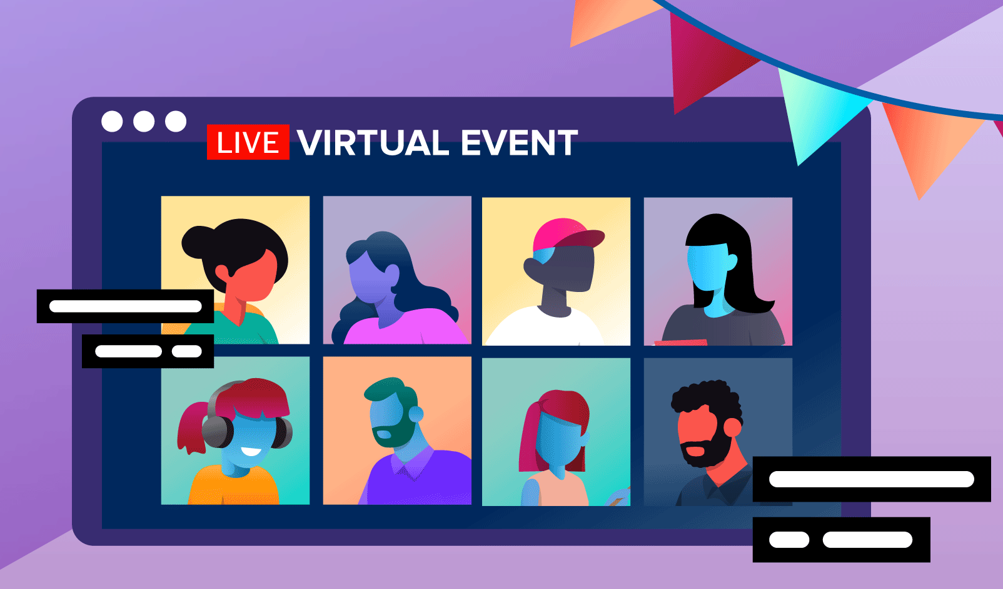
Event Format (Virtual, Hybrid)
University of Michigan ITS: Hosting Accessible Remote Events
ITS offers various self-paced trainings that will help viewers learn about many of these accessibility topics.
University of Michigan ITS: Training
Event and Meeting Accessibility
Form and Survey Accessibility
University of Michigan ITS: Google Forms Accessibility Best Practices

Slide 33
Virtual Calendar Invitations
Meeting links and login codes.
Alternative options for signing in, such as calling rather than videoconferencing.
Agendas and expected outcomes.
Format of the event.
Anticipated duration of the event (include information re: breaks).
Presentation materials.
Accessibility information.
If the event will be interactive, allow attendees to send questions and comments in advance.

Slide 34
Considerations Prior to the Event
Consider how off-site participants can be seen, heard, and/or otherwise participate during the event.
Arrange the space, such that speakers are near a central point that picks up audio and video appropriately.
Consult with information technology services (ITS), audiovisual services (A/V), and facilities teams to check if the space has resources for off-site or remote participation.
Consider voice amplification devices, such as microphones and lapel mics.
Avoid using whiteboards or large poster paper to write notes. Consider using a Google Doc to take notes and share with off-site participants.

Slide 35
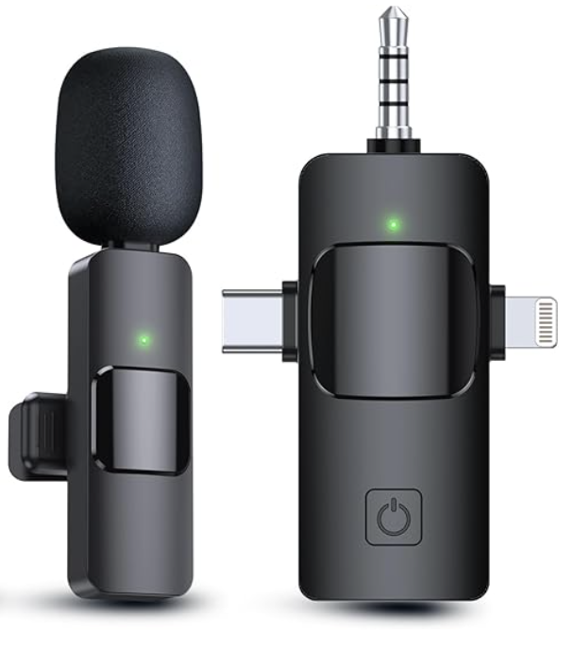
Microphones
Encourage all speakers to use a microphone, even if they think do not need it.
Avoid asking participants if they can hear you without using the microphone.
Ensure there are plenty of microphones and/or lapel mics for speakers as well as for the Q&A.
Please take care to use the microphone correctly by holding it close to your mouth and speaking clearly and slowly.
Consider what types of microphones would be best for your participants (e.g., handheld, standing, wireless, lapel, podium).
Notes:
Suggested microphone: Snowball microphone for small to medium size meetings. This plugs into the laptop by USB and picks up sound well.

Slide 36
Access to Remote Participation
Video Access
A good quality webcam is at eye-level. It should not be mounted or located in a high mount or random corner. Do not rely on webcam microphones for larger meetings/events.
Zoom and Google Hangout are common options. Each option has some accessibility features, Zoom is more preferred.
Phone Access
Test the phone before the meeting/event and consider getting a microphone to make sure everyone can be heard clearly by remote participants.
Consider the location and acoustics of the phone, including the microphone. Make sure laptops are not blocking the speaker/conference phone.

Slide 37
Day Of: Before the Event
Do a practice run and test technology features.
Hosts and presenters should log in early, open any applicable documents that will be used, and close all other unrelated tabs, windows, and programs.
If you are using real-time captioning or interpretation, allow them early access to pin their screens, assign them accordingly, and ensure their technology is properly working.
Start (and end) the meeting on time.

Slide 38
During the Event: Tips for Presenters
Turn on Automated Captioning in Zoom by default, as it helps with comprehension for a wide range of people and situations.
Ask participants to raise their hands and say their names before they start speaking. This helps individuals follow along, regardless of their abilities, limitations, or location.
Address remote participants by name to keep them connected with individuals attending in-person, if it is a hybrid format.
Provide a 10-second pause after questions, to allow time for participant responses.
Notes:
If a question or comment is made during an interactive event, the host/speaker should repeat this content before answering the question or responding to the comment. It may be useful to use the chat feature to submit questions, when engaging in a virtual event.

Slide 39
During the Event: Room Set-Up
Set up the room camera so those joining the meeting remotely can see all of the in-person participants.
Display the remote participants on a shared screen, such as a projector, so they are more easily seen by those attending in-person.
Rearrange the gallery view of participants on the projector screen to prioritize the videos of remote participants.

Slide 40
Questions?

Slide 41
Additional U-M Links to Accessibility Resources
Videoconferencing Tool Comparison
Videoconferencing Accessibility
Meetings & Events Best Practices
Hybrid Meeting Best Practices
Getting Started With Automated Captions in Zoom
U-M Live Event Stream
Vice President for Communications Webpage on Accessibility: Brand and Visual Identity
Notes:
For more information and other resources on accessible materials, please see the links on this page for information on crafting accessible documents, flyers, and U-M branded PowerPoint templates.

Slide 42
Disability Equity Office
Contact Information and Resources

Slide 43
Happening @ Michigan (Again)
Check out the Disability Equity Office’s upcoming presentations and interactive workshops by scanning this QR code or by visiting the upcoming events page!

Slide 44
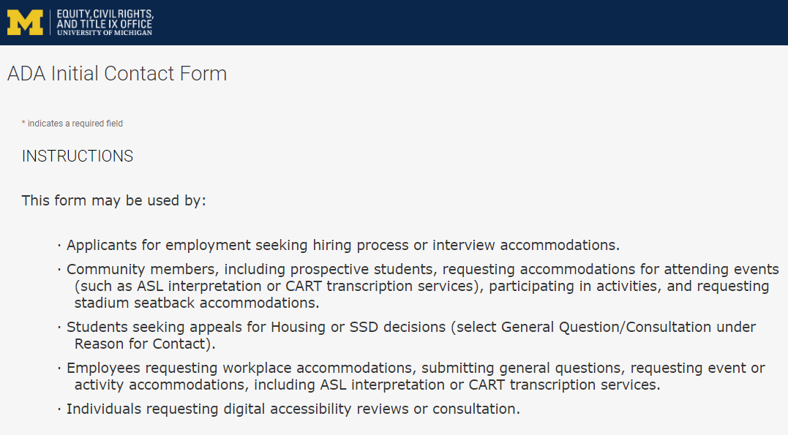
Contact the Disability Equity Office https://ecrt-umich-accommodate.symplicity.com/public_accommodation/
Use the ADA Initial Contact Form to request:
Workplace accommodation
Hiring process accommodation
Consultation with the Disability Equity Office staff
ASL or CART services
Digital accessibility review or consultation
Stadium seatback accommodations
Notes:
Employee login: https://ecrt-umich-accommodate.symplicity.com
ADA Initial Contact Form: https://ecrt-umich-accommodate.symplicity.com/public_accommodation/

Slide 45
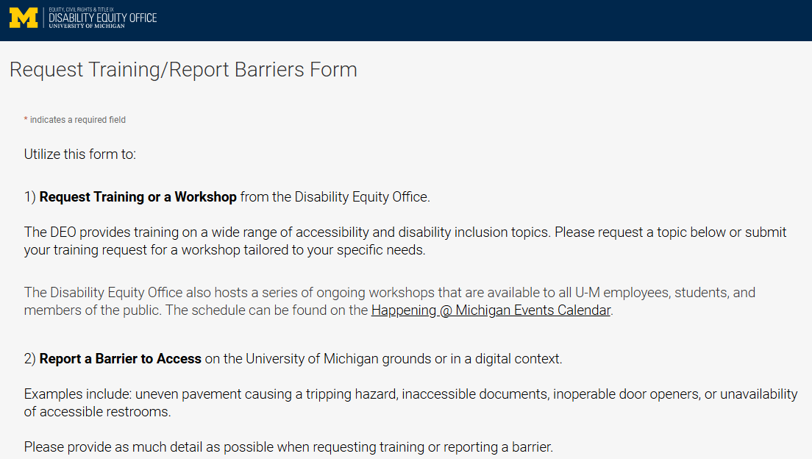
Request Training or Workshops https://ecrt-umich-accommodate.symplicity.com/activity_provider_request/
Use the Request Training/Report Barriers form to request training for your department or group. Topics include:
Ableism Awareness
Creating Accessible Digital Documents
Creating Inclusive Environments
Disability Awareness
Reasonable Accommodations and the Interactive Process
Service Animals
Notes:
Request Training/Report Barriers Form: https://ecrt-umich-accommodate.symplicity.com/activity_provider_request/
Happening @ Michigan Events Calendar for DEO : https://events.umich.edu/group/5177

Slide 46
Report Barriers to Access https://ecrt-umich-accommodate.symplicity.com/activity_provider_request/
Use the Request Training/Report Barriers form to report physical or digital barriers to access
Examples:
Inoperable door openers or elevators
Cracked pavement causing tripping hazards
Inaccessible software or documents
Notes:
Request Training/Report Barriers Form: https://ecrt-umich-accommodate.symplicity.com/activity_provider_request/

Slide 47
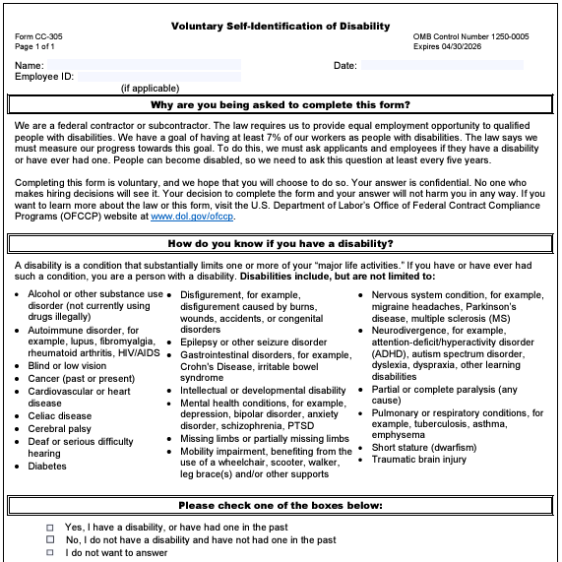
Voluntary Self-Identification of Disability
Update your information through Wolverine Access
Click on Employee Self Service
Go to Campus Personal Information
Select Disability Status
Notes:
Updating your voluntary self-id information plays a pivotal role in creating inclusive workplaces. It helps provide a better understanding of the diversity of our organization and helps to identify opportunities for improvement.
This information is used to measure the university’s commitment to accessibility and is never shared with your supervisor.

Slide 48
More Learning Opportunities From DEO
Filterable list of resources on the ECRT website
ECRT's YouTube Channel
DEO's Happening @ Michigan event list
Recorded Presentations & Trainings
Sign up for the DEO Newsletter
Notes:
Filterable list of resources on the ECRT website: https://ecrt.umich.edu/get-help-support/resources/
ECRT’s YouTube Channel: https://www.youtube.com/@ECRTumich
DEO’s Upcoming Events are listed on the Happening @ Michigan website: https://events.umich.edu/group/5177
Recorded Presentations & Trainings website: https://ecrt.umich.edu/disability-accessibility/presentations-trainings/
DEO Newsletter sign up form: https://umich.us18.list-manage.com/subscribe?u=155e051009a7f5441a41bef64&id=6c9fbf9d2c

Slide 49
Thank You From DEO!

