Slide 1
Accessible Word & Google Docs
Phil Deaton (he/him)
Disability Equity Office
Notes:
Thank you for attending our NDEAM event. Introduction.

Slide 2
Zoom Webinar Tips
Use the Q&A feature to submit your questions.
ASL interpretation can be utilized by clicking Interpretation and selecting American Sign Language.
CART transcription can be turned on by selecting Show Captions.
Notes:
This workshop is also being recorded and will be made available on ECRT’s YouTube channel: https://www.youtube.com/@ECRTumich as soon as possible. The slides will be emailed to all registered participants within the coming days along with an anonymous survey. We do really hope you’ll complete the short survey, as this helps us determine how we can best assist you with your learning goals.

Slide 3
Agenda
Disability is an integral part of the university’s diversity, equity, inclusion, and accessibility (DEIA) efforts. It is important to be part of a culture that supports and embraces disability inclusion. This session will cover:
Accessibility considerations in documents (15 minutes)
How to implement accessibility in Docs (15 minutes)
How to implement accessibility in Word (demo; 15 minutes)
Where to learn more/Q&A
Notes:
So today we are going to run through the basics of accessibility in documents. We’ll look at Google Docs and Word. I will do a short demo of making some changes in Microsoft Word after we run through the tips and demonstrate where accessibility features are in both tools.

Slide 4
Please Engage
We are modeling a comfortable, inclusive, brave, and safe space.
Questions are encouraged – we’re all learning together.
We don’t know what we don’t know.
Respect the experiences of others.
Opportunity for growth and learning.

Slide 5
Accessibility considerations in Documents
Notes:
Let’s begin with our first section.

Slide 6
What is a digitally accessible document?
A document that can be used by people with a variety of disabilities
Utilize principles of universal design, or design such that a document can be accessed by the broadest range of people
Uses established digital accessibility standards to maximize access
Notes:
So what is a digitally accessible document? It’s a document that can be used by people with disabilities. We do this by using universal design principles, or the idea of designing documents to be used by the broadest range of people, including people who use screen readers, learning disabilities, and more.
When considering the benefits of universal design, it is essential not to forget that we are benefiting from the needs and labor of disabled people who have articulated ways that spaces, products, and services can be better for all. When you consider how accessibility work you do in documents and presentations in the future impacts others, I urge you to consider how standards developed by and for people with disabilities have impacted a standard for designing for everyone.
Oftentimes when people without disabilities do not want to do digital accessibility work, they do not necessarily recognize that the work we do is to design a better experience for everyone.

Slide 7
Accessibility questions to ask
How can I create structure in my document?
Which colors will I use in my document?
Will I use images? If so, how will I describe those?
Notes:
One way we assist folks is in thinking through accessibility questions on their documents. These are some types of questions we hope you feel more comfortable with after today.
How can I create structure in my document? You can use headings. Also you can use lists, or numbered lists.
Which colors will I use? You can use a contrast checker to help you. In general dark colors on a light background and vice versa are helpful.
Are you using images? Think about how to describe those.

Slide 8
Structure & headings
Headings help to organize information
Headings create an outline for a page
Use headings hierarchically
Using list items?
Use lists and numbered lists appropriately
Notes:
Headings can be used to add structure to documents. You should use headings hierarchically, so for example, the title of the book might be your heading 1, chapter 1, 2, 3 might be heading 2s, and subchapter 3.1, 3.2 might be heading 3s.
Other structural features might be list items and numbered lists.

Slide 9
Color contrast (1 of 2)
Color Contrast: have strong contrast between your text and background
In general: Use dark colors on a light background, or vice versa
Check out U-M’s Color Brand Guide, check out the Accessibility site's color contrast guide
Download from the Software Center on MiWorkspace computers: “Colour Contrast Analyser”
Notes:
General contrast tips. Color contrast checking.

Slide 10
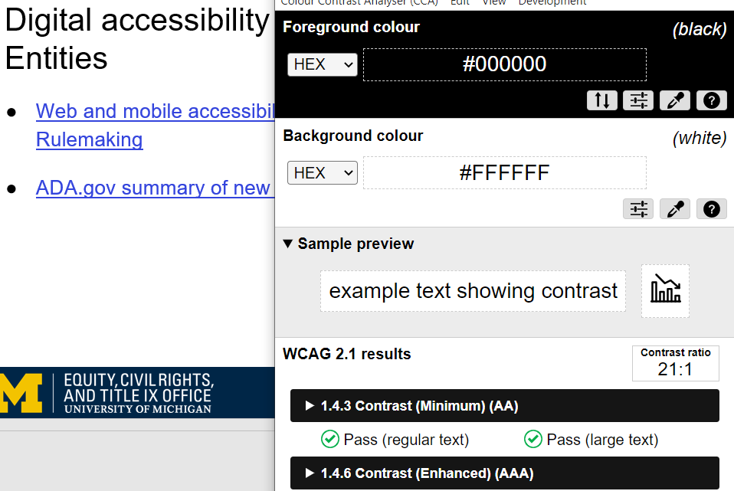
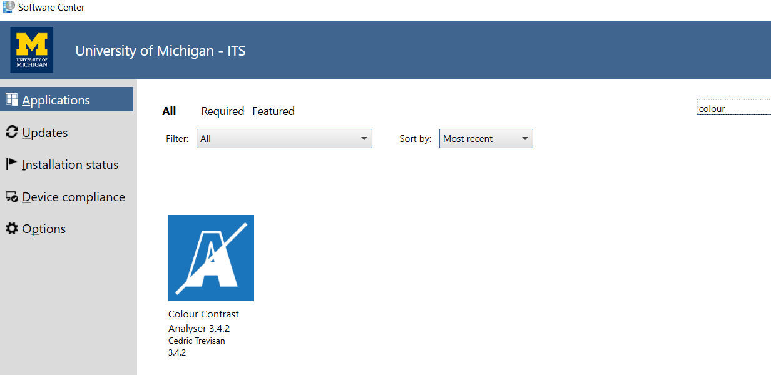
General Considerations – Color Contrast (2 of 2)
To “meet accessibility standards”, aim for a contrast ratio of 4.5:1
Not a perfect science, consider colors you’ll use at the start of a document/in templates
Notes:
The colour contrast analyser tool is available on U-M managed computers.

Slide 11
General Considerations – Link text
Link text: provide clear information on where a link will take your user, either as the link text directly (best for digital), or next to the link (best for print)
Best for digital: Check out U-M’s Color Brand Guide
Best for print: For information on color accessibility, visit U-M’s Color Brand Guide: https://brand.umich.edu/design-resources/colors/
Poor practice: Click here, Learn More
Notes:
Another general consideration is providing clear link text. Again, from a universal design perspective this benefits everyone. This also provides clear guidance for screen reader users on where a link might take them. For digital document, it’s best if you can include the destination of the link in the link, see our first example here. Check out U-M’s Color Brand Guide. This makes it quite clear where this link will go. You should be sensitive to context here. If I were creating link text for a panel presentation at a national conference, I’d probably say “Check out the University of Michigan’s color brand guide”, just to be clear about where this link goes.
For documents that might be printed, either by me or my user (say a syllabus), you may want to still include the full link URL, see our second example.
A bad practice is to have links with no clear destination, random URLs, or links that all have the same text. For example, if you have a page of events on a Word doc you are sharing with your department, if all of the links say “Learn more” or “Click here” under the image of an event, users may not know which link corresponds to which event, or even what “Learn More” means. Does that mean you’ll go to an article published about the topic? The registration form? Remove ambiguity, be clear and specific with your link text.

Slide 12
Typography
Not a perfect science to typography
Consider size of text
Consider having distinct heading styles
Use sans serifs, avoid overly stylistic text
Notes:
We get a lot of questions about typography and there are so many different thought processes here. Preferred typeface varies person to person. Here’s a few good tips. Consider the size of your text. Avoid having too small of text, especially for print outs. 11 or 12 point plus in most fonts is good.
Have distinct heading styles. We talked about heading levels, making each level heading look unique is helpful for legibility.
In general avoid overly stylistic fontfaces. We recommend sans serifs, but this is not a perfect science. Widely used fonts are more recognizable and generally have higher legibility, but again, this is not a perfect science.

Slide 13
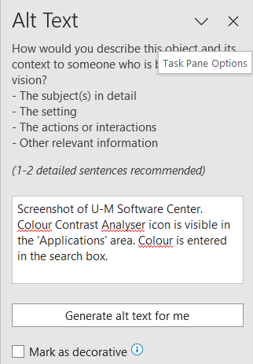
Alt text
Text alternative for an image (decorative images do not need)
Consider how you might describe a visual over the phone
Right click image, edit alt text
Notes:
Images that are not purely decorative should include alt text. Decorative images are images that do not add information or context. Alt text is a text alternative for an image. Struggling with how to start? Consider how you might describe a visual over the phone.

Slide 14
Accessibility in Docs

Slide 15
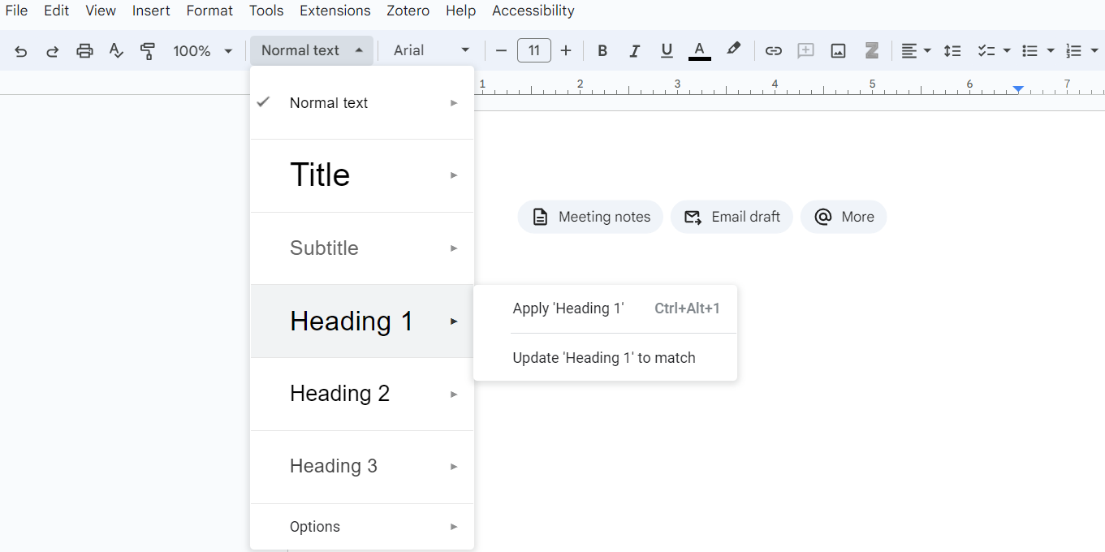
Structure & headings in Docs
Headings can be added and updated in Google Docs
Can Apply the pre-existing layout, or update headings at this level to match
Notes:
Quick explanation of applying vs updating heading.

Slide 16
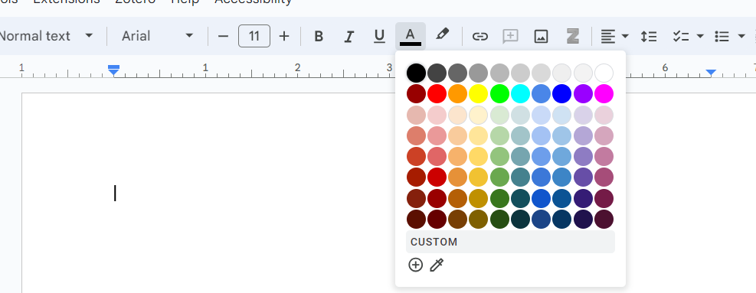
Color in Docs
Adjust text color
In general, dark on light or vice versa
Use a contrast checker
Notes:
You can change text color in Google Docs in the top ribbon as well. It is located near the bold and italics features. Some folks miss this option, but you can select the custom color option. Remember to use your contrast checkers.

Slide 17
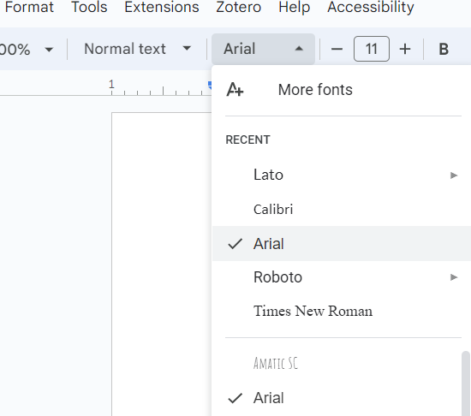
Fonts in Docs
Google Docs has a variety of fonts available
Try to utilize sans serifs
Notes:
How to update fonts in Google Docs, near to where we selected headings and font size, we can change the font. You can see some of how the font is presented in this section to inform your decision. Try sticking with a sans serif font.

Slide 18
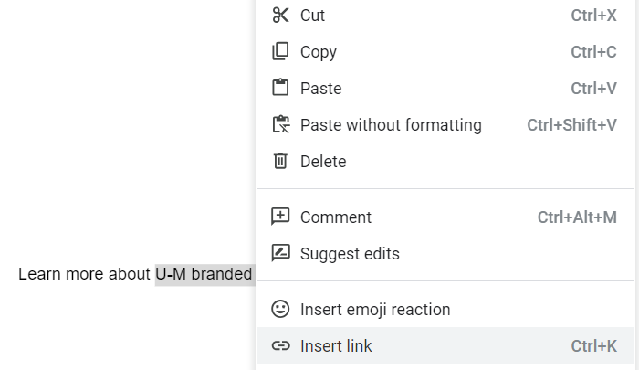
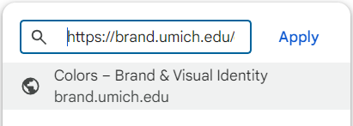
Links in Docs
Highlight link text you would like to use
Right click, insert link
Copy/paste to insert the URL
Link text will go to link
Notes:
Want to update your text to add a link, rather than just using the url in the page? Highlight the link text you would like to use, right click, select insert link. Copy/paste your url into the menu and select apply. Link text will go there.

Slide 19
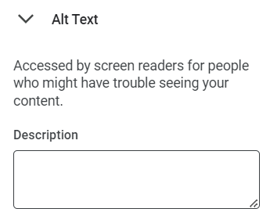
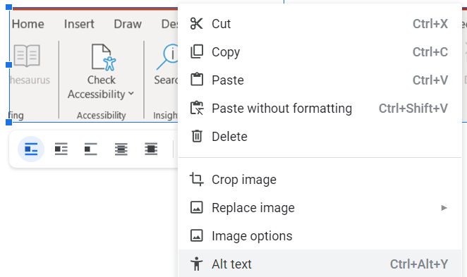
Alt text in Docs
Right click, add alt text
Notes:
Quick explanation of applying vs updating heading.

Slide 20
Accessibility in Word

Slide 21
Demo
Sample document
Will go through these steps
Feel free to pull up Microsoft Word and follow along
End on using the accessibility checker
Notes:
Headings
List items
Spacing
Contrast
Link text
Alt text
Checker

Slide 22
Wrap Up

Slide 23
Reminder: Accessibility questions to ask
How can I create structure in my document?
Which colors will I use in my document?
Will I use images? If so, how will I describe those?
Notes:
One way we assist folks is in thinking through accessibility questions on their documents. These are some types of questions we hope you feel more comfortable with after today.
How can I create structure in my document? You can use headings. Also you can use lists, or numbered lists.
Which colors will I use? You can use a contrast checker to help you. In general dark colors on a light background and vice versa are helpful.
Are you using images? Think about how to describe those.

Slide 24
Finalizing a document
If using Microsoft Word, use the Accessibility Checker under “Review”
Avoid printing to PDF, most documents will be less accessible and authors will need to do work in Adobe Acrobat DC
Notes:
So, if you are in Microsoft Word and you are feeling pretty confident that you’ve answered accessibility questions you have, then DEO recommends using the accessibility checker, found under Review area in Microsoft Word. The accessibility checker is not perfect, but can help you figure if there is something you’ve missed.
Please avoid printing to PDF. Word and Google Doc accessibility work you have done may not transfer over to PDF, and in general PDF has less accessibility than either. You will have to use a different program to finalize accessibility for PDFs (Adobe Acrobat DC).

Slide 25
Learn more
Google Docs: make your Document accessible
Microsoft Word accessibility
Notes:
So we demonstrated where to find these features and did a short demo in Word. Here’s the main two links we recommend for learning more about Google Docs and Word documents.

Slide 26
Key Takeaways
General tips
Core components of accessible docs
Consider accessibility questions as you build your documents
Word and Docs have many accessibility features
Use accessibility checkers
Structure (headings, lists)
Color use
Links
Text choices
Alt text

Slide 27
Questions?
Notes:
We may have received questions throughout. Any we should go back to?

Slide 28
Disability Equity Office
Contact Information and Resources

Slide 29
National Disability Employment Awareness Month Events
October 30, 2024, 12:00pm
Ask an Accessibility Specialist
Join to ask your questions
More webinars are available throughout the year, register at Happening @ Michigan

Slide 30
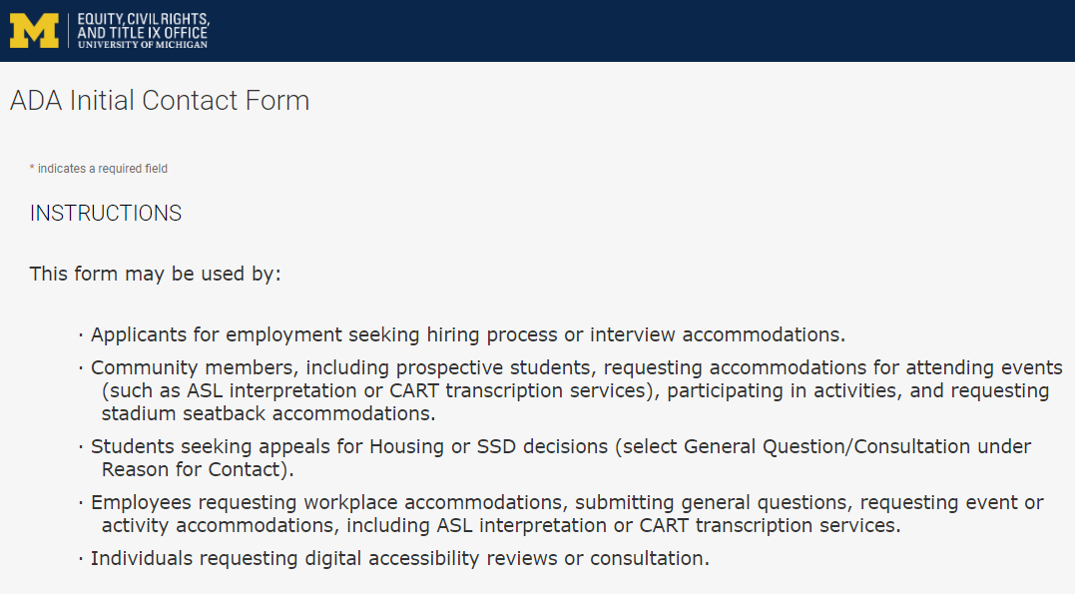
Contact the Disability Equity Office https://ecrt-umich-accommodate.symplicity.com/public_accommodation/
Use the ADA Initial Contact Form to request:
Workplace accommodation
Hiring process accommodation
Consultation with the Disability Equity Office staff
ASL or CART services
Digital accessibility review or consultation
Stadium seatback accommodations
Notes:
ADA Initial Contact Form: https://ecrt-umich-accommodate.symplicity.com/public_accommodation/

Slide 31
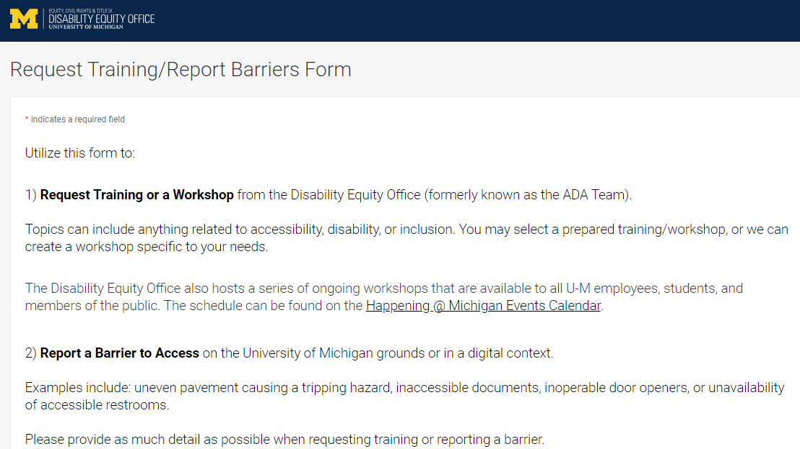
Request Training or Workshops https://ecrt-umich-accommodate.symplicity.com/activity_provider_request/
Use the Request Training/Report Barriers form to request training for your department or group. Topics include:
Ableism Awareness
Creating Accessible Digital Documents
Creating Inclusive Environments
Disability Awareness
Reasonable Accommodations and the Interactive Process
Service Animals
Notes:
Request Training/Report Barriers Form: https://ecrt-umich-accommodate.symplicity.com/activity_provider_request/
Happening @ Michigan Events Calendar for Equity, Civil Rights, and Title IX: https://events.umich.edu/group/4765

Slide 32
Report Barriers to Access https://ecrt-umich-accommodate.symplicity.com/activity_provider_request/
Use the Request Training/Report Barriers form to report physical or digital barriers to access
Examples:
Inoperable door openers or elevators
Cracked pavement causing tripping hazards
Inaccessible software or documents
Notes:
Request Training/Report Barriers Form: https://ecrt-umich-accommodate.symplicity.com/activity_provider_request/

Slide 33
More Learning Opportunities From ECRT
Filterable list of resources on the ECRT website
ECRT's YouTube Channel
ECRT's Upcoming Events Page
Recorded Presentations & Trainings
Notes:
Filterable list of resources on the ECRT website: https://ecrt.umich.edu/get-help-support/resources/
ECRT’s YouTube Channel: https://www.youtube.com/@ECRTumich
ECRT’s Upcoming Events are listed on the Happening @ Michigan website: https://events.umich.edu/group/4765
Recorded Presentations & Trainings website: https://ecrt.umich.edu/disability-accessibility/presentations-trainings/

Slide 34
Thank You From DEO!

