Slide 1
Happening @ Michigan
Check out the Disability Equity Office’s upcoming presentations and interactive workshops by scanning this QR code or by visiting the upcoming events page!
Inclusive Event Planning, Part 2: Preparing and Hosting an Accessible Event
Zoom (Virtual Event)
April 22, 2025 (Tuesday) 12:00pm
Notes:
March 13 - Ask an Accessibility Specialist Office Hours
March 14 - Digital Accessibility Office Hours
March 19 Accessible Word and Google Docs Documents

Slide 2
Inclusive Event Planning (Part 1) Accessible Digital Marketing and Alt Text
Lauren O’Connor
Accessibility Specialist + Occupational Therapist
Disability Equity Office of ECRT

Slide 3
Zoom Webinar Tips
Use the Q&A feature to submit your questions.
ASL interpretation can be utilized by clicking Interpretation and selecting American Sign Language.
CART transcription can be turned on by selecting Show Captions.
Notes:
This workshop is also being recorded and will be made available on ECRT’s YouTube channel: https://www.youtube.com/@ECRTumich as soon as possible. The slides will be emailed to all registered participants within the coming days along with an anonymous survey. We do really hope you’ll complete the short survey, as this helps us determine how we can best assist you with your learning goals.

Slide 4
Agenda
The University of Michigan is committed to fostering an inclusive environment where accessibility and the needs of individuals with disabilities are prioritized, ensuring equitable opportunities for all members of our diverse community. This workshop will cover:
Digital Accessibility
Effective and Inclusive Alt Texts for Digital Images
Alt Text in Social Media and Marketing Materials
Alt Text Interactive Activity
Considerations Before the Event
Disability Equity Office Resources and Services

Slide 5
Please Engage
We are modeling a comfortable, inclusive, brave, and safe space.
Questions are encouraged – we’re all learning together.
We don’t know what we don’t know.
Respect the experiences of others.
Opportunity for growth and learning.

Slide 6
Digital Accessibility

Slide 7
Serif and Sans Serif Fonts
Sans serif:
A b c d e
Serif:
Use sans serif fonts (this font is Verdana).
Other examples: Tahoma, Arial, and Lucida Sans.
Serif fonts, like Garamond, have extra embellishments which can make them harder to read.

Slide 8
Links
Links should be visually distinguishable from other text.
Don’t underline text that is not a link for emphasis: Use bold text, italics or both to show emphasis.
The text for the link should describe what happens when it is clicked.
Helpful: “learn more about accessibility” or “digital accessibility help with ECRT”
Not helpful: “click here” or “follow this link”
All links should have unique names, so it is obvious they lead to different destinations.
Notes:
An easy way to make sure your link text is helpful is to ignore the surrounding content/language. Does reading only the link text provide enough information to know what the link is going to do or where it will lead?

Slide 9
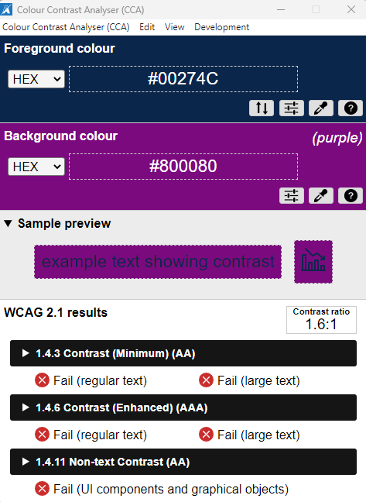
Color Contrast
Ensure minimum color contrast of 4.5:1
Low contrast – hard to read
High contrast – easier to read
Download the Colour Contrast Analyser from the Software Center to check all of your print and electronic materials.
Consider light text on dark backgrounds or dark text on light backgrounds.
University of Michigan's Brand Color Guide
Notes:
When choosing colors for your marketing materials, try to avoid white/black as this could be too much contrast leading to screen glare.

Slide 10
Conveying Information with Color
Color should not be used as the only means of conveying information.
Include text descriptors for those who may have visual disabilities.
Yes
No
Yes
No
Maybe
Maybe
Notes:
A better option would be to use colors and text descriptors, like in the bottom two images, where if someone is unable to decipher the orange, from the blue or green, they are able to depict the “Yes,” “No” and “Maybe” options, instead.

Slide 11
Effective and Inclusive Alt Text for Digital Images

Slide 12
What Is Alt Text?
Alt text (alternative text) helps visually impaired people understand the meaning of an image.
Also displayed when an image fails to load.
Keep alt text short and descriptive.
Why are you sharing this image?
What is the purpose of including the image?
How would you describe the image if you were talking on the phone?
Don’t use “image of” or “photo of” in your description.
Notes:
Visit Accessibility at University of Michigan webpage for more details: https://accessibility.umich.edu/training/alt-text

Slide 13
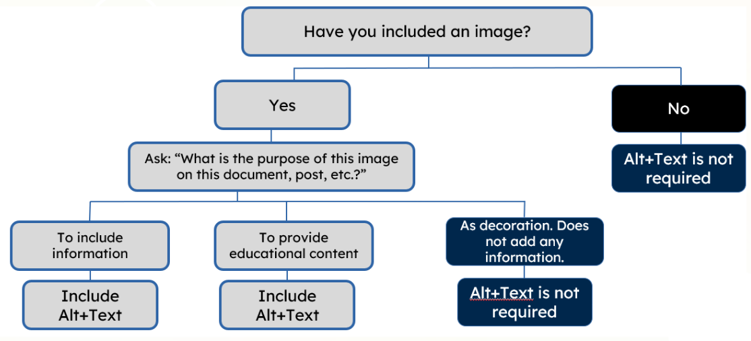
Alt Text Decision Tree
Notes:
Web Content Accessibility Guidelines (WCAG) Decision Tree: https://www.w3.org/WAI/tutorials/images/decision-tree/

Slide 14
Considerations When Creating Alt Text
How would you describe this image to someone who cannot see it?
The subject(s) in detail
The setting
The actions or interactions
Other relevant information
Is there any information included in the image that relies upon sight for understanding?
Location of an activity
Time and/or date of an activity

Slide 15
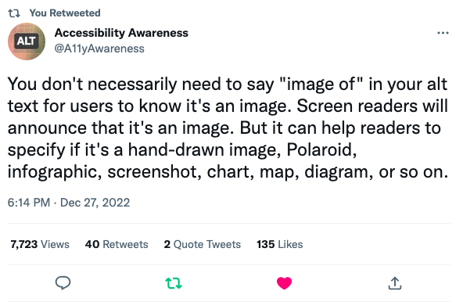
Tips for Writing Alt Text (1 of 2)
Notes:
Alt text is not the same as a photo caption. Captions are typically written to support a photo and usually depend on users being able to see the photo. But alt text is meant to be the stand-in for the photo. The alt text is what a screen reader user gets in place of the photo.

Slide 16
Tips for Writing Alt Text (2 of 2)
Notes:
When writing alt text, you want to keep the content short and to the point.
Use short but logical sentences.
Present important information first in each section, subsection, and paragraph.
Include details that help readers complete the task.
Omit details that don’t help or may distract readers, even if interesting.

Slide 17
Suggested Complex Image “Formula”
Data visualization designer, Mary Cesal, suggests the following formula for alt text for complex images such as charts, graphs, etc.
[Chart type] of [type of data] where [reason for including chart].

Slide 18
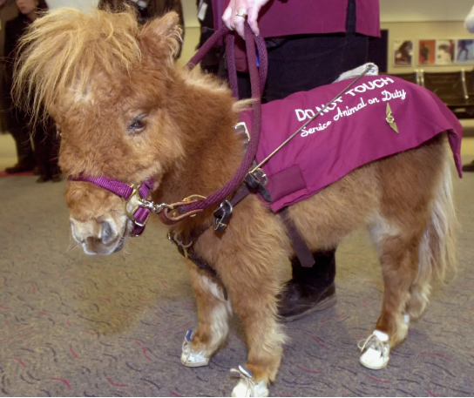
Alt Text Example
Context: Your presentation is about service animals.
Helpful alt text:
A brown miniature horse wearing a purple vest with white wording that says, “DO NOT TOUCH Service Animal on Duty.” The horse is also wearing a purple harness and white shoes.
Ineffective alt text:
An animal
Picture of a miniature horse

Slide 19
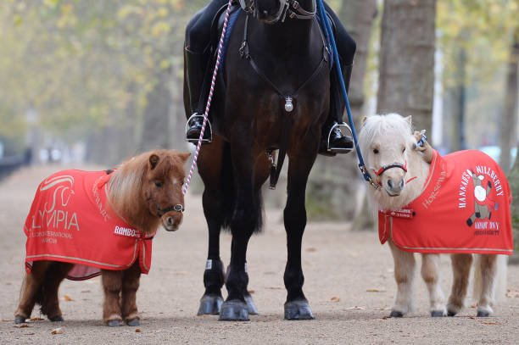
AI Generated Alt Text
AI-generated alt text: “a pony being carried by a person”
This is neither a pony nor a person carrying a pony.
AI-generated alt text: “a horse and pony with red blankets”
This is better, but may still need to be modified, depending on what you are trying to convey with the image.
Notes:
AI-generated alt text is getting better, but it is not always useful. Additionally, an accessibility check will not likely pick up on “bad” alt text, because it is simply looking for any alt-text. This means you should always verify what has been AI-generated!
Second Photo: Better alt text would be, “A dark horse in the middle, accompanied by two miniature horses on each side, which are wearing red covers. The miniature horse on the left is brown, the one on the right is white.”

Slide 20
Alt Text in Social Media and Marketing Materials

Slide 21
Where Is Alt Text Located?

Slide 22
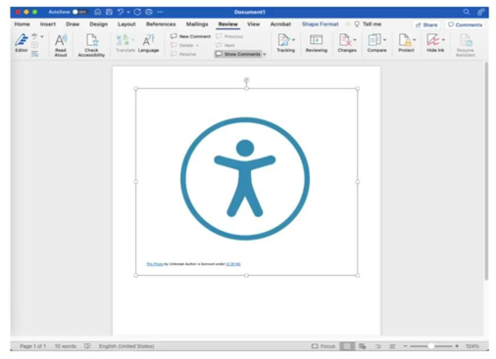
Microsoft Word and PowerPoint
Insert the image you want to use.
Right click on the image.
Choose View Alt Text or Edit Alt Text.
Type a description of the image in the text box on the alt text pane.
If the object is purely decorative, select the Decorative check box.
To check for alt text on images:
Choose Review on the Word ribbon.
Choose Check Accessibility in the ribbon pane.
View the Inspection Results.

Slide 23
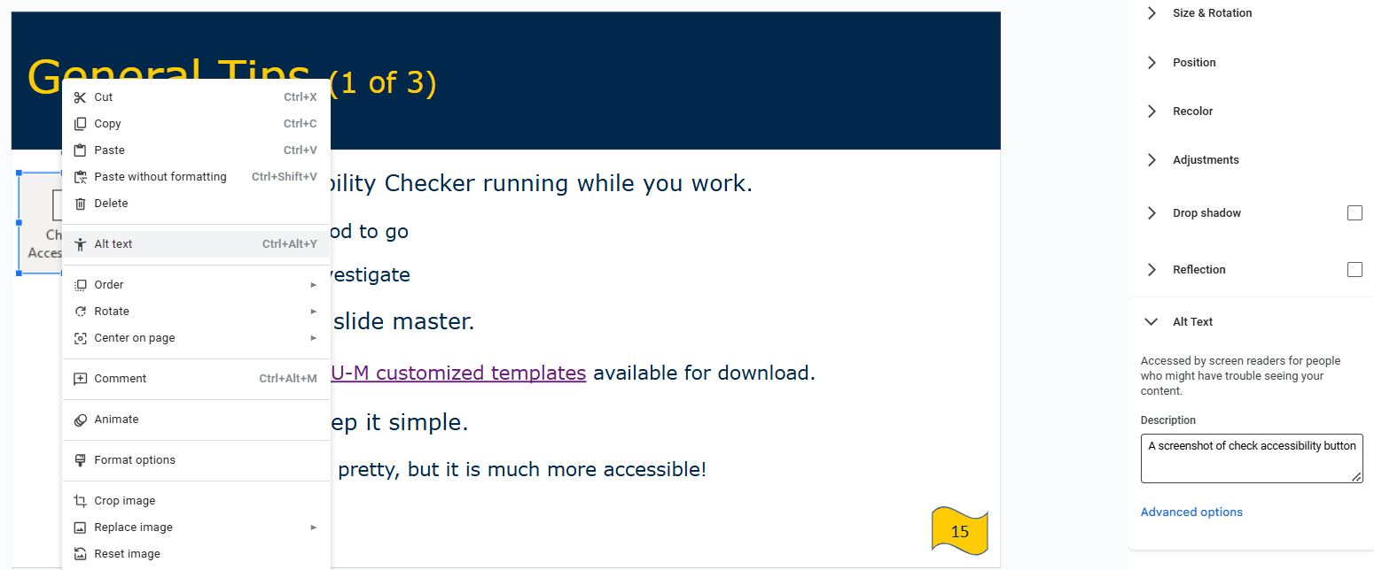
Google Docs and Slides
Insert the image that you want to use.
Right click on the image.
Select the Alt Text option.
Add the alt text in the Description box.
Click OK.

Slide 24
Facebook
Go to the Facebook post and tap on the photo.
Tap the three dots in the top right or tap and hold.
Tap Edit alt text.
You'll see the automatically generated alt text in bold starting with Image may contain:.
Type your alt text in the box, then tap Save.
Facebook Help Center

Slide 25
X/Twitter
After uploading an image to a Tweet, select the +ALT button on the image. (“ALT” is the abbreviation for alternative text, which is the technical name for image description.)
Enter a description of the image in the text box.
Select Done.
Select Tweet.
Twitter Help Center
Notes:
Your alt text length will depend on the length of the content. Twitter/X, for example, allows 1,000 characters but that doesn’t mean you should go that long. Some suggest 120-150 characters, but these recommendations are variable depending who you are seeking this information from. Write what you need, but don’t add more, if it is not necessary.

Slide 26
Instagram
To see and edit alt text for a photo before you post to Instagram:
Upload an existing photo to Instagram.
Choose a filter and edit the image.
Click Next.
Click Accessibility.
Write the alt text in the box.
Click Share to post.
Instagram Help Center

Slide 27
Alt Text Interactive Activity

Slide 28
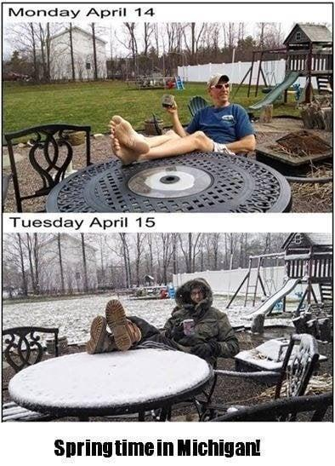
Alt Text Example 1
Choose the better alt text description:
Meme with text: “Monday April 14, Tuesday April 15, Springtime in Michigan!”
Meme labeled, “Springtime in Michigan!” with two photographs arranged top and bottom.
Top Photo: Monday, April 14 with an individual sitting on their patio in shorts and a t-shirt with green grass in the yard.
Bottom Photo: Tuesday, April 15 with the same person pictured in the same spot, however, wearing a winter coat, boots, and gloves, with snow in the yard.

Slide 29
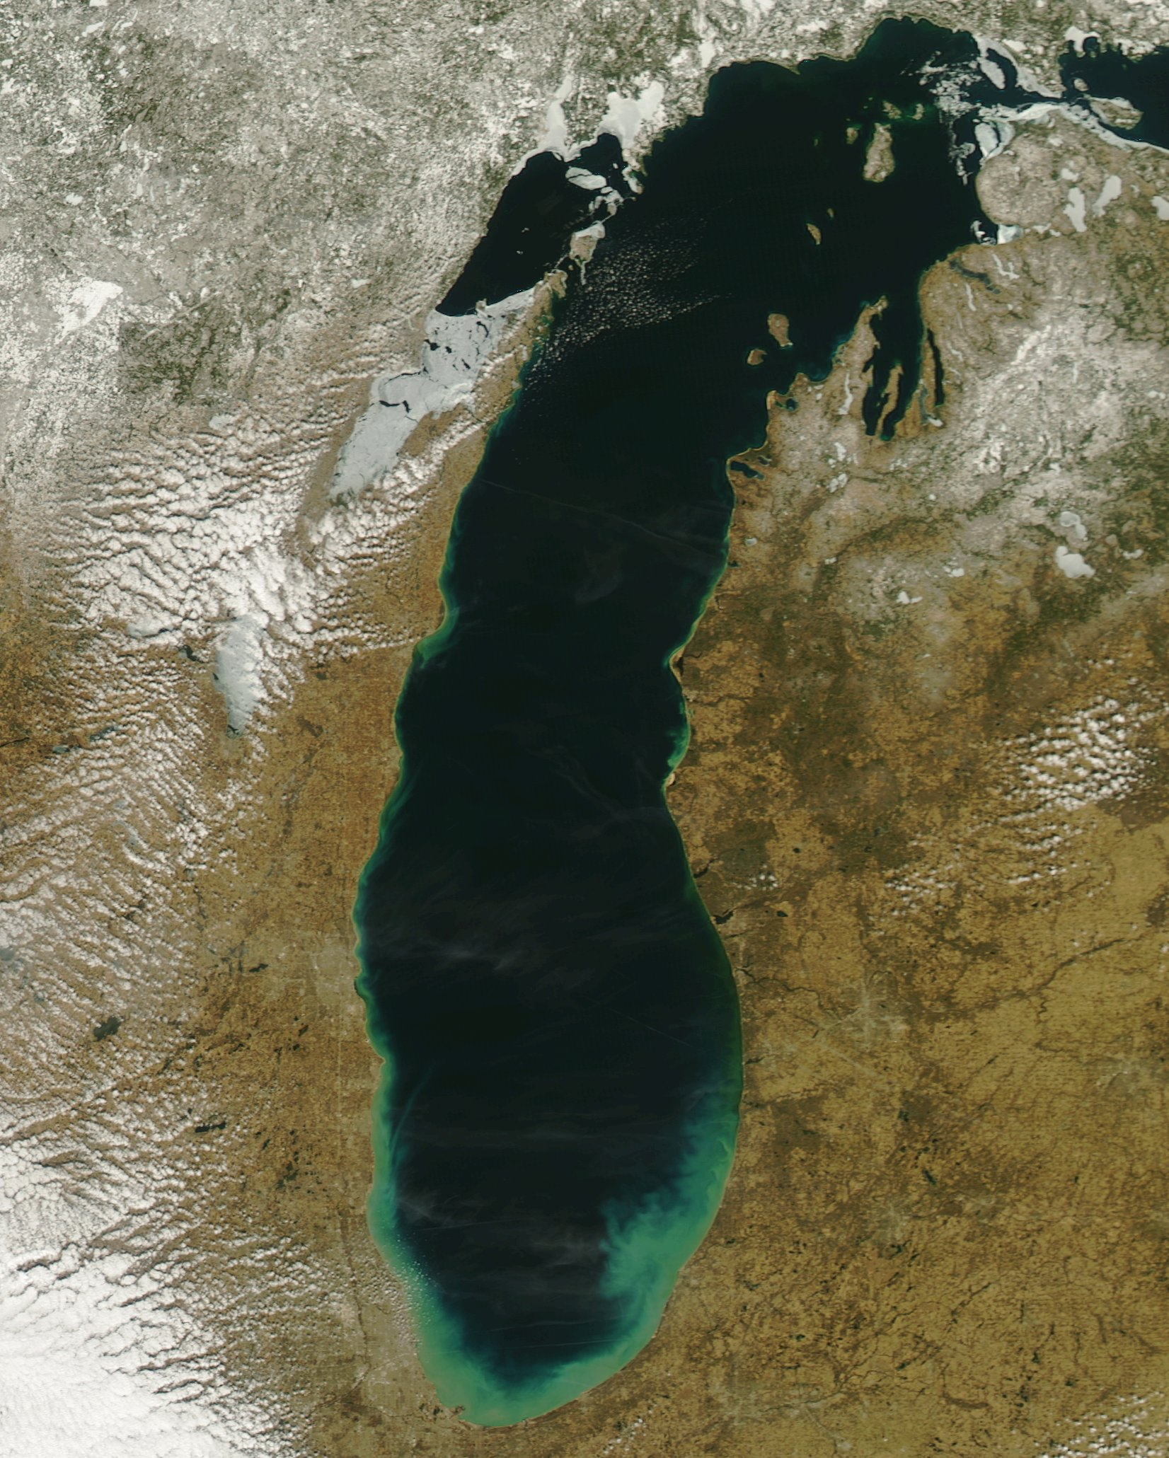
Alt Text Example 2
Choose the better alt text description:
Lake Michigan.
Satellite image of Lake Michigan.

Slide 30
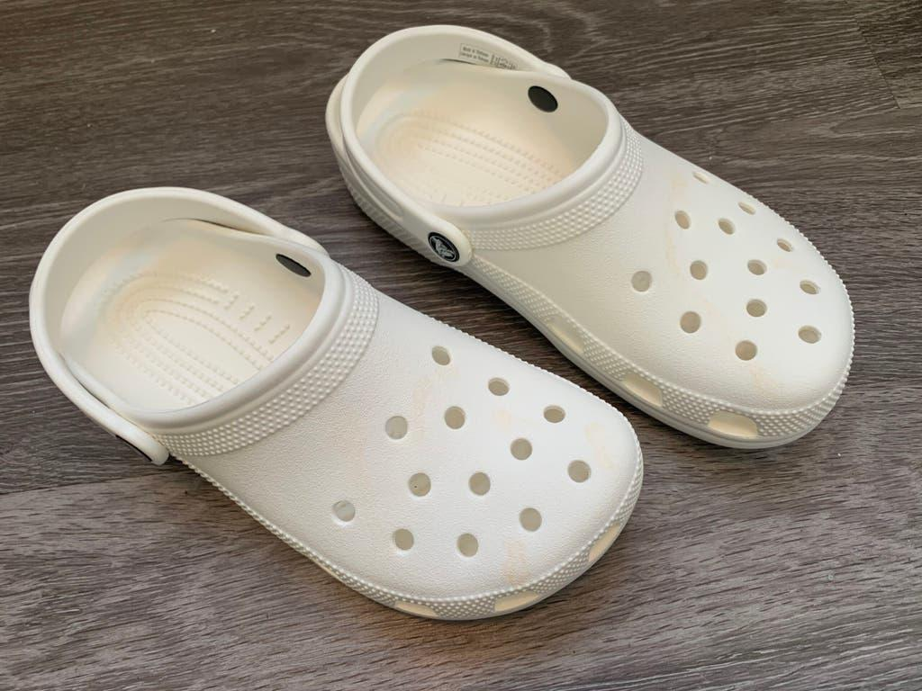
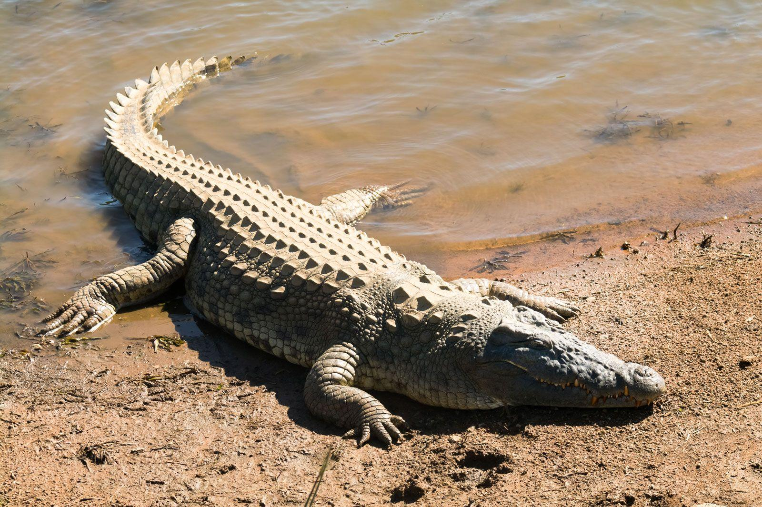
Alt Text Practice 1
Generate an alt text description for these images.
Write alt text for the top image.
Write alt text for the bottom image.
Write “bad” alt text that could represent both images.

Slide 31
Alt Text Practice 2
Generate an alt text description for these images.
Write an example of effective alt text for the combined images above.
Write “bad” alt text that could create confusion within the image.

Slide 32
Considerations Before the Event

Slide 33
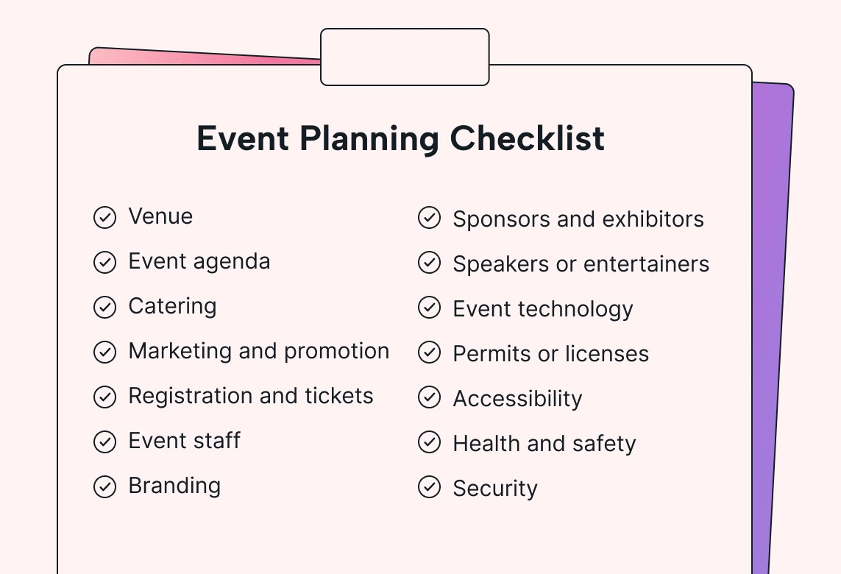
Before the Event
Ensure registration materials and digital documents are accessible.
Include resources for attendees to utilize in their planning, such as maps, wayfinding, and information about parking.
Relay expectations in planning communications.
Date, timeframe
Location, parking
Retreat/lactation spaces
Agenda: Scheduled breaks, event activities, etc.

Slide 34
Marketing Materials
Include information about proactive measures in all event advertising and invite participants to identify accommodation needs.
This includes food allergies and chemical sensitivities, before the event.
Promote and advertise using a variety of media: email (including text format), social media, website, posters, flyers, etc.
Notes:
- When creating marketing and materials, pay attention to readability and visibility so participants can follow along with the content and find the information easily.
- This can increase participation and make the event more inclusive.

Slide 35
Handouts, Presentations, and Infographics
Strive for simplicity and good readability.
Write in plain language.
Make materials available before, during, and after the event.
For more information and other resources on accessible materials, please see the Improving Accessibility of Word and Powerpoint Files presentation and visit U-M's Digital Accessiblity Guide for Content Creators & Presenters.
Notes:
Write in plain language - (i.e. if you are using acronyms- make sure to write out the meaning of each letter, explain jargon or complex terms that people might not be familiar with, have summaries of texts, and be concise).
When making these items, consider the content from the “Digital Accessibility” segment earlier in this presentation.

Slide 36
Language for the Event (1 of 2)
"If you need disability-related accommodations to participate in this program/event, please contact (name, host department/unit) at (phone number, e-mail). Early requests are strongly encouraged to allow sufficient time to meet your access needs.”
“Note: Due to availability and scheduling needs, please allow at least two weeks' notice for requests for Communication Access Real-time Translation (CART) services or an American Sign Language interpreter.”
Notes:
As you send out the invitation or registration for your presentations, meetings, workshops, conferences, etc., we encourage you to utilize the following language to ensure that individuals know to contact the training organizer if they anticipate that accommodations will be needed.

Slide 37
Language for the Event (2 of 2)
For in-person training where food may be served, the following language is also recommended:
"If you have dietary restrictions or allergies, please contact (name, host department) at (phone number, email).”

Slide 38
Access Statement
An access statement informs participants of accessible resources available for the event. This includes:
Address, parking information
Points of entry, elevator and ramp locations
Restroom types and locations
If the event is scent-free and other similar topics
Availability of CART/ASL services
Access and accommodation statements should be included in RSVP forms, emails, calendar invites and other marketing materials.

Slide 39
Example Access Statement
“Accessible entrance through adjacent buildings, or the [directional] corner ground-floor entrance of [building]. From the [directional] entrance, the elevators are down the hall on the [left, right, or both] side. The event is on the [number] floor in room [#]. [Type of] restroom is located on the [number] floor near the [stairs, elevator, or room number]. The following services are provided for this event: [American Sign Language (ASL), Communication Access Realtime Translation (CART), etc.].”
Notes:
Content modified from Source: Accessible and Inclusive Resource Guide for Events
*This is simply an example and can be modified in any way to include additional details, such as location for lactation rooms, areas for breaks, etc.
Source: Happening @ U-M for The University of Michigan Initiative on Disability Studies (UMInDS) Welcomes: Lauren Obermark/ Interdependent Pedagogies: Rethinking Access and Disability in Graduate Education on October 28, 2019 organized by Melanie Yergeau, Associate Professor, LSA English Language and Literature.

Slide 40
Accommodations Statement
To create an accommodation statement:
State commitment to accessibility and willingness to make accommodations
Describe the event so individuals can assess their needs
Invite people to contact organizer if they anticipate that accommodations will be needed
Example: “Please let us know how we can ensure that this event is inclusive to you. What accommodations or access needs can we help facilitate?”
It is important to follow up with requestors so that they know if and how their requests will be honored.
Notes:
An accommodation statement provides a space for participants to let the event planner know what resources they need to fully participate.
Source: Stephanie Rosen, Accessibility Specialist, Universities Library & Dilip Das, Assistant Vice Provost for Academic Affairs, Office of the Provost.
Source: RSVP Google Form for the Disability Culture Panel on July 22, 2019, organized by Ashley Wiseman, Associate Director, Global Scholars Program and Ashley Bates, Program Manager, Zell Visiting Writers Series.

Slide 41
General Considerations
When selecting an event venue, it is recommended to consult with building facility, IT, and A/V team to see if space and your event needs are possible before booking the event.
If possible, tour the space prior to the event/meeting.
Consider the following when deciding on a space:
Physical accessibility
Digital accessibility
Ergonomics/layout
Sensory-needs
Notes:
I will go more into these considerations in Part 2, but wanted to begin talking about them, as many of the behind-the-scenes event planning occur at the same time as the advertising and marketing of the event.
- Physical accessibility: Location, elevator/stairs access, ramp access, stage access, Wheelchair accessible space, automatic door openers
- Ergonomics/layout: Variety of chair options with space around them, chairs with or without arms to provide more flexible seating arrangements. And various different table options.
- Sensory needs (auditory, visual, thermoregulatory, ):
Avoid spaces with ongoing construction, new carpeting, newly painted walls, and recently used chemicals for smell-sensitivity
Consider lighting variability
Thin walls can be distracting in terms of sound clarity in the room

Slide 42
Questions?

Slide 43
Happening @ Michigan (Again)
Check out the Disability Equity Office’s upcoming presentations and interactive workshops by scanning this QR code or by visiting the upcoming events page!
Inclusive Event Planning, Part 2: Preparing and Hosting an Accessible Event
Zoom (Virtual Event)
April 22, 2025 (Tuesday) 12:00pm

Slide 44
Disability Equity Office
Contact Information and Resources

Slide 45
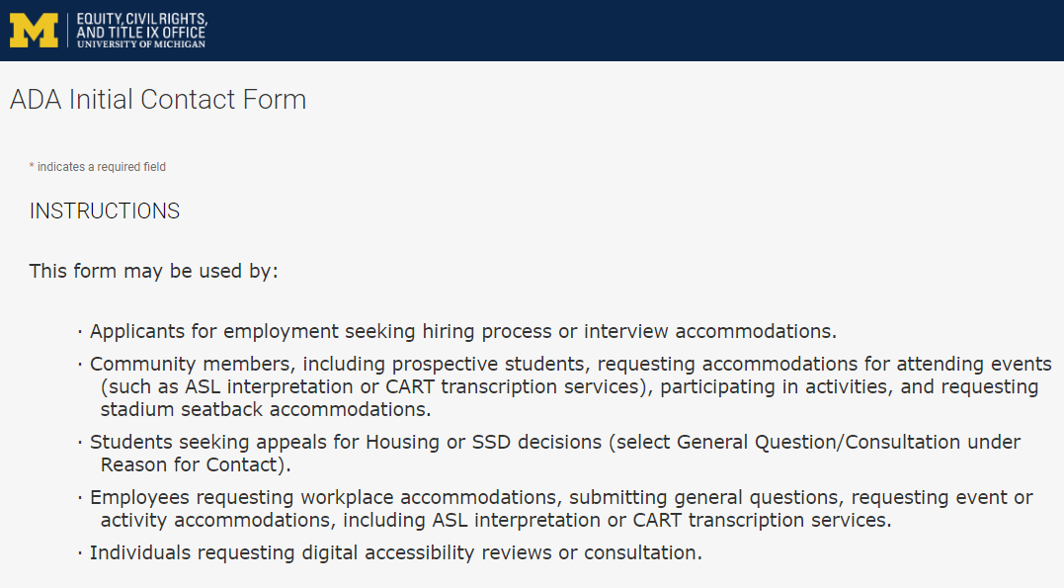
Contact the Disability Equity Office https://ecrt-umich-accommodate.symplicity.com/public_accommodation/
Use the ADA Initial Contact Form to request:
Workplace accommodation
Hiring process accommodation
Consultation with the Disability Equity Office staff
ASL or CART services
Digital accessibility review or consultation
Stadium seatback accommodations
Notes:
Employee login: https://ecrt-umich-accommodate.symplicity.com
ADA Initial Contact Form: https://ecrt-umich-accommodate.symplicity.com/public_accommodation/

Slide 46
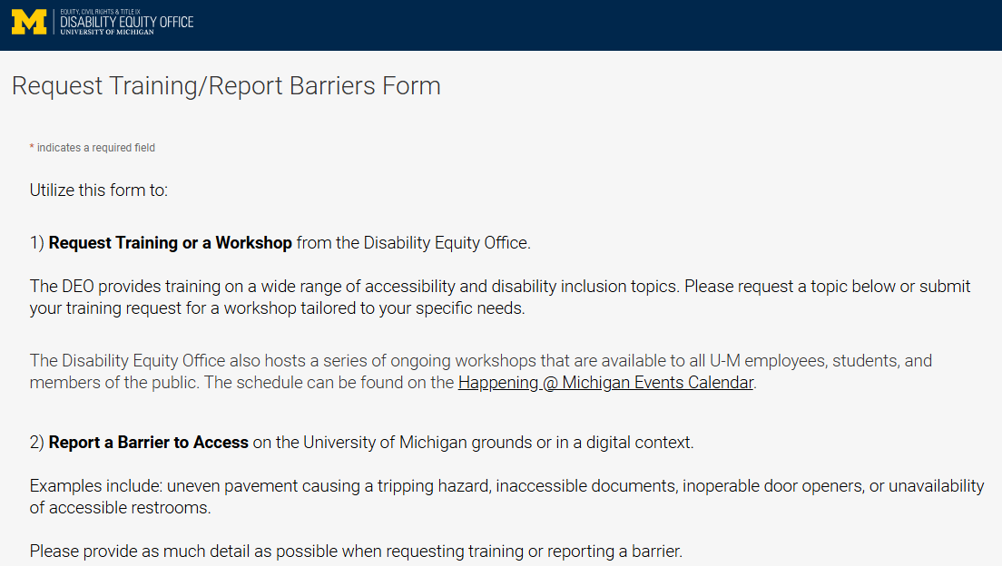
Request Training or Workshops https://ecrt-umich-accommodate.symplicity.com/activity_provider_request/
Use the Request Training/Report Barriers form to request training for your department or group. Topics include:
Ableism Awareness
Creating Accessible Digital Documents
Creating Inclusive Environments
Disability Awareness
Reasonable Accommodations and the Interactive Process
Service Animals
Notes:
Request Training/Report Barriers Form: https://ecrt-umich-accommodate.symplicity.com/activity_provider_request/
Happening @ Michigan Events Calendar for DEO : https://events.umich.edu/group/5177

Slide 47
Report Barriers to Access https://ecrt-umich-accommodate.symplicity.com/activity_provider_request/
Use the Request Training/Report Barriers form to report physical or digital barriers to access
Examples:
Inoperable door openers or elevators
Cracked pavement causing tripping hazards
Inaccessible software or documents
Notes:
Request Training/Report Barriers Form: https://ecrt-umich-accommodate.symplicity.com/activity_provider_request/

Slide 48
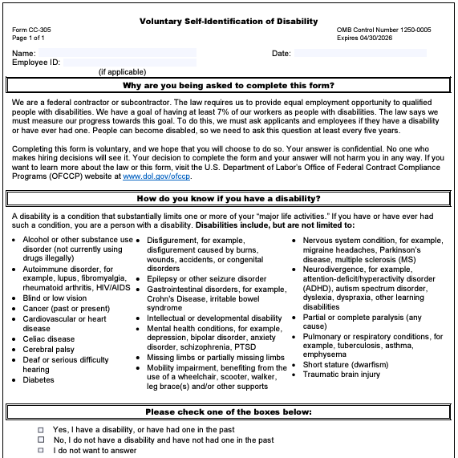
Voluntary Self-Identification of Disability
Update your information through Wolverine Access
Click on Employee Self Service
Go to Campus Personal Information
Select Disability Status
Notes:
Updating your voluntary self-id information plays a pivotal role in creating inclusive workplaces. It helps provide a better understanding of the diversity of our organization and helps to identify opportunities for improvement.
This information is used to measure the university’s commitment to accessibility and is never shared with your supervisor.

Slide 49
More Learning Opportunities from the DEO
Filterable list of resources on the ECRT website
ECRT's YouTube Channel
DEO's Happening @ Michigan event list
Recorded Presentations & Trainings
Sign up for the DEO Newsletter
Notes:
Filterable list of resources on the ECRT website: https://ecrt.umich.edu/get-help-support/resources/
ECRT’s YouTube Channel: https://www.youtube.com/@ECRTumich
DEO’s Upcoming Events are listed on the Happening @ Michigan website: https://events.umich.edu/group/5177
Recorded Presentations & Trainings website: https://ecrt.umich.edu/disability-accessibility/presentations-trainings/
DEO Newsletter sign up form: https://umich.us18.list-manage.com/subscribe?u=155e051009a7f5441a41bef64&id=6c9fbf9d2c

Slide 50
Thank You from DEO!

