Slide 1
The Interactive Process Determining Reasonable Workplace Accommodations
ADA Team of ECRT

Slide 2
Zoom Webinar Tips
Use the Q&A feature to submit your questions.
ASL interpretation can be utilized by clicking Interpretation and selecting American Sign Language.
CART transcription can be turned on by selecting Show Captions.
Notes:
This workshop is also being recorded and will be made available on ECRT’s YouTube channel: https://www.youtube.com/@ECRTumich as soon as possible. The slides will be sent out to all registered participants within the coming days.

Slide 3
The Interactive Process
4 Steps to Accommodation
Notes:
In today’s presentation, we will be emphasizing the 4 steps of the Interactive Process that are facilitated by the ADA Team on the University’s campus, in order to identify and implement workplace accommodations.
As we will be moving through this section quickly, you can find a more thorough explanation of the process in our Supervisor and HR Partners Guide to Reasonable Workplace Accommodations workshop: https://ecrt.umich.edu/get-help-support/disability-accessibility/presentations-trainings/

Slide 4
Role of the ADA Team
When the ADA Team facilitates the interactive process, we:
Centrally and confidentially store medical documentation.
Brainstorm accommodation options based on specialized education and expertise.
Provide guidance, knowledge, and consultation to employees and units about accommodations, compliance with the ADA, and best practices for creating inclusive environments for individuals with disabilities.
Assist with determining reasonableness under the ADA.
Supply written documents outlining determined accommodations.
Notes:
We will speak more to these items later in the presentation and include examples during a role play scenario.

Slide 5
Step 1: Employee Requests an Accommodation
Employees can submit a request using the ADA Initial Contact Form.
They will be asked to supply medical documentation confirming a diagnosis, duration, limitations, and accommodation recommendations from their provider, if available.
Notes:
When speaking in terms of “duration,” this is to identify if the condition is temporary, such as a broken leg, where accommodations are implemented for a period of time and have a corresponding expiration date - versus, those who are chronic or long-term and include accommodations that are implemented as an ongoing status.

Slide 6
Step 2: Employee Meets with an Accessibility Specialist
Employees can:
Provide their understanding of the day-to-day job duties of their position.
Share experienced barriers – what is it about the job or environment that is creating difficulty?
Consult with resources like Job Accommodation Network (JAN).
Consider reasonable alternatives.
Notes:
Sometimes, employees choose to not move forward from step 2, so we do not notify the supervisor of the request for accommodations.
Other times, the employee simply needs more time to decide to move forward, more time to obtain documentation, or more time to consider what accommodations may be helpful.

Slide 7
Step 3a: Accessibility Specialist Meets with the Unit HR
Accessibility Specialists may meet with the employee’s unit Human Resources representative(s) prior to meeting with the supervisor to share information about:
Overall staffing trends, unit needs, or upcoming changes.
Policy-related information.
Any additional relevant information to understand the job functions and possible performance concerns.
Notes:
Example of upcoming changes may be a new supervisor, building or renovation information, work location structure (hybrid etc.)

Slide 8
Step 3b: Accessibility Specialist Meets with the Supervisor and Unit HR
Discussion of:
Limitations/barriers and how they relate to the requested accommodation (or alternative).
Essential job functions.
Unit needs and questions.
When possible, a requested accommodation should be supported if reasonable. If it cannot be supported, the Accessibility Specialist will request information explaining why and will then discuss equally effective accommodations.
Notes:
The Interactive Process is not always linear and there may be instances where steps 2 or 3 are repeated. In these circumstances, Accessibility Specialists will contact the necessary parties and request follow-up meetings. However, this varies by situation and can be dependent upon conversations and if there is any clarification that may be needed in order to move forward to the next steps.

Slide 9
Step 4: Finalize the Accommodation
Draft documents will be issued to the unit and employee for review.
This provides an additional opportunity to ensure the employee’s needs are being met effectively without posing a burden to the unit’s operations.
Accommodation documents will be finalized with a copy sent to all parties involved. A copy is also stored with the ADA Team.
Only individuals who have a need-to-know about the accommodation should informed of its implementation.

Slide 10
Who is Considered in the “Need-to-Know?” (1 of 2)
The ADA requires employers to keep all disability-related information confidential.
Medical information should only be shared with those who have a need-to-know.
Knowing fewer details about an employee’s medical condition can be beneficial:
can reduce the risk of improper sharing of information.
allows the supervisor to concentrate on performance and not make assumptions about medical conditions or their impact when it is not appropriate.
Notes:
Unit representatives often do not need to know the specifics of an employee’s medical condition to implement accommodations, therefore, requests are presented from the perspective of the work-related limitation that is impacting the employee’s ability to safely or efficiently complete their essential job functions.
Example: If an employee’s limitation is concentration, it could be related to many disability categories including neurodivergent diagnoses, anxiety, depression, ADHD, autism, migraine, headache, fibromyalgia, and so many more.

Slide 11
Who is Considered in the “Need-to-Know?” (2 of 2)
When requesting the unit meeting, Accessibility Specialists remind HR representatives and supervisors that the interactive process is confidential.
How should an HR representative and/or supervisor proceed, if they do not think they are the proper person to be involved in this process?
What should these individuals do, if they consider an additional person in their department to be part of the decision-making process?
Notes:
The only details about the accommodation that may be relayed to individuals uninvolved in the process are circumstances that involve the need to make a schedule change, provide equipment, or modify a policy, etc. For example, an individual who works in procurement or is involved with a unit’s budget does not need to know the employee’s need for an accommodation or specific limitations, however, they may be involved through supervisor instruction to purchase a piece of equipment to support the ability to implement the accommodation. This individual does not need to know who the equipment is for; rather only details involving equipment features, approval for purchase, and the desired delivery date.
If the involved parties feel that they are not the proper person, or recommend that an additional department individual be included in this process, it is recommended that they contact the Accessibility Specialist on the specific case. The Accessibility Specialist will request that the additional person(s) name, relationship to the employee, the reason they should be included, and their contact information. This will help the ADA Team to determine if this individual is considered someone with a “Need-to-Know” privilege.

Slide 12
Interactive Process Role Play

Slide 13
Example Step 1: Request Submitted
Employee’s Answer: I am having trouble sitting all day in front of my computer. My doctor recommends I use a standing desk and some ergonomic equipment to help with my pain.
I’m also having a hard time concentrating because I work in a busy office with a lot of distractions. I’m not sure what could help, but I’m really having a hard time getting my work done.
Question: Please describe your requested accommodation and how it will help you perform the essential functions of your job:
Notes:
Lauren Employee, a Case Manager in ECRT, submitted an accommodation request and relevant medical documentation via the ADA Initial Contact Form.
Lauren then schedules a meeting to talk with Erin, an Accessibility Specialist, about her request.

Slide 14
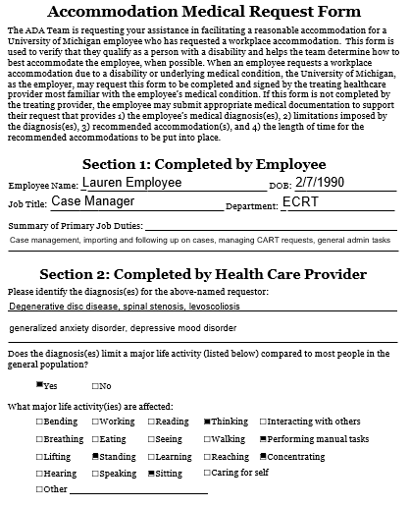
Example Medical Documentation (pg 1)
Notes:
Note: this document will not be shared with anyone outside of the ADA Team. We are sharing it with you today for demonstrative purposes only.
Disability Definition: A physical or mental impairment that substantially limits one or more major life activity.
Relevant AMRF information shows Lauren has degenerative disc disease, spinal stenosis, levoscoliosis, generalized anxiety disorder, and depressive mood disorder.
Affected major life activities include thinking, standing, sitting, concentrating, and performing manual tasks.

Slide 15
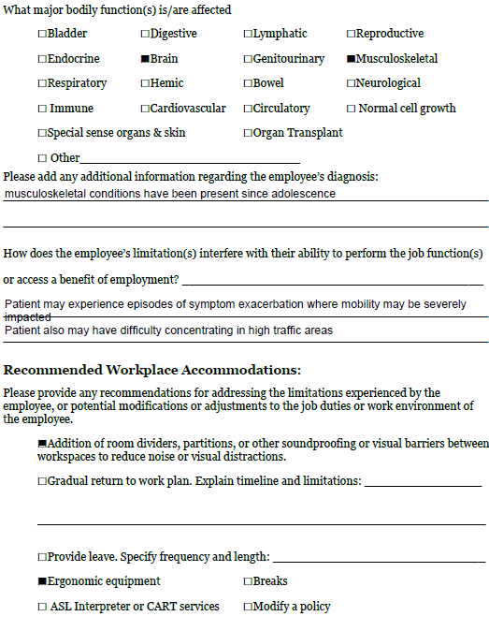
Example Medical Documentation (pg 2)
Notes:
Affected major body functions are brain and musculoskeletal which have been present since adolescence.
Patient may experience episodes of symptom exacerbation where mobility may be severely impacted. Patient may also have difficulty concentrating in high traffic areas.

Slide 16
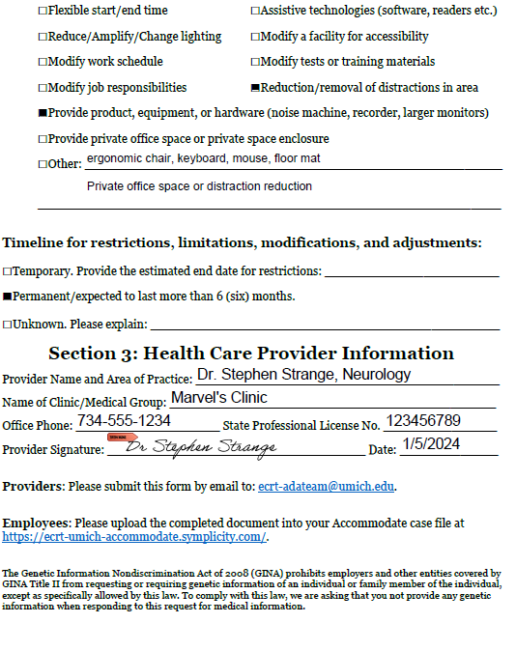
Example Medical Documentation (pg 3)
Notes:
Recommended accommodations include room dividers, reduction or removal of distractions, providing equipment such as an ergonomic chair, keyboard, mouse, floor mat. Also a private office space or distraction reduction.
These limitations are expected to be permanent.
The document is signed by Dr. Stephen Strange and includes a license number.

Slide 17
Example Step 2: Meeting With the Employee
Erin sends Lauren an email with instructions to help her prepare:
Log into your case file to upload your most recent job description or prepare a summary of your job duties.
Be prepared to discuss how your requested accommodations will help you to fulfill your essential job duties.
Review accommodation options and suggestions available via JAN - the Job Accommodation Network.

Slide 18
Employee Meeting Questions
Tell me about your job.
What are the limitations you’re experiencing?
What have you tried in the past?
Tell me about your work environment.
How do you think these requests will assist with the limitations you’re experiencing?
Have you considered other accommodation ideas?

Slide 19
Example Step 3a: Meeting With Unit HR
Erin contacts Allison, the HR representative for the unit, to determine if a conversation prior to the full unit meeting may be helpful.
Erin and Allison schedule a time to talk about Lauren’s request and other relevant information.
Allison provides a copy of Lauren’s job description for Erin to review prior to the meeting.
Notes:
In this meeting, there is a more prevalent need-to-know regarding medical information.
This option may be appropriate if a Unit HR rep anticipates any concerns best suited to discussion privately prior to meeting with the supervisor. This could include: if the Unit HR has been made aware of any performance related concerns, concurrent use of FMLA or other leave, or if they have information related to overall staffing or accommodation trends in the unit that may be helpful for the accessibility specialist to be aware of.

Slide 20
Unit HR Meeting Questions
Has the job description changed since it was last reviewed?
Are you aware of any performance-related issues that may be related to disability?
Has the employee utilized FMLA leave or utilized any other PTO or time away from work related to their underlying condition?
Do you foresee any challenges with the requested accommodations?
Are there any unit policies/procedures we should be aware of?

Slide 21
Example Step 3b: Meeting With the Supervisor and Unit HR
Erin schedules a meeting with the HR Rep Allison and the supervisor Megan to discuss Lauren’s request and provides extra information:
Agenda
Requested Accommodations: 1. ergonomic equipment: sit-to-stand desk, chair, keyboard, mouse, anti-fatigue mat 2. environmental modifications: private office space, noise-reducing headphones, white noise machine
Notes:
The email also includes the following language: During our meeting we will discuss the barriers and/or limitations related to the accommodation requests. Please keep in mind that no determinations have been made at this point in the interactive process and nothing listed in the agenda requires any action at this time. We will use our meeting to discuss any requested accommodations, questions, or concerns you may have.

Slide 22
Supervisor and Unit HR Meeting Questions
Describe the essential job functions.
Do you foresee challenges with supporting the requested accommodations?
Tell me about the work environment.
What concerns or questions do you have?

Slide 23
Example Step 4: Determining and Finalizing the Accommodation
Work Environment Modification The employing unit will relocate the employee’s workspace to a cubicle further from high-traffic areas. The employing unit will implement 8’ cube wall panels, purchase a white noise machine, and purchase noise-reducing headphones for the employee’s use.
Equipment The employing unit will purchase an electric sit-to-stand desk converter, an ergonomic chair, ergonomic keyboard, ergonomic mouse, and an anti-fatigue floor mat for the employee’s use.
The employee shall provide a list of preferred items for purchase to the employing unit. If the unit is unable to purchase a preferred item, the unit will confer with the employee to ensure a suitable alternative item is purchased.
Notes:
An accommodation document is created describing the accommodations in detail. This document will also reflect the length of time the accommodation should be in place.

Slide 24
Wrap Up
Notes:
Lauren

Slide 25
Questions?

Slide 26
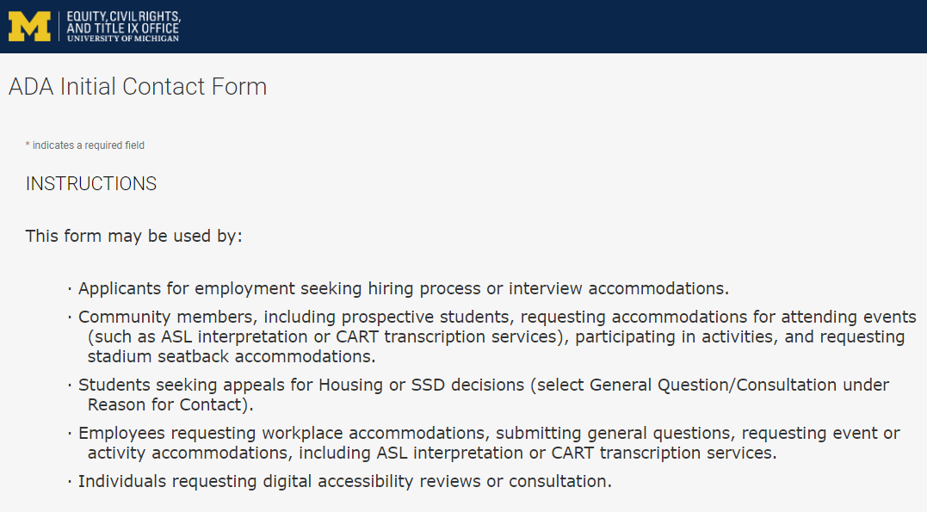
Contact the ADA Team https://ecrt-umich-accommodate.symplicity.com/public_accommodation/
Use the ADA Initial Contact Form to request:
Workplace accommodation
Hiring process accommodation
Consultation with the ADA Team
ASL or CART services
Event accommodation
Digital accessibility review or consultation
Stadium seatback accommodations
Notes:
Individuals who have previously contacted the ADA Team (after January 2, 2024) should log into their case file to submit new requests at https://ecrt-umich-accommodate.symplicity.com/

Slide 27
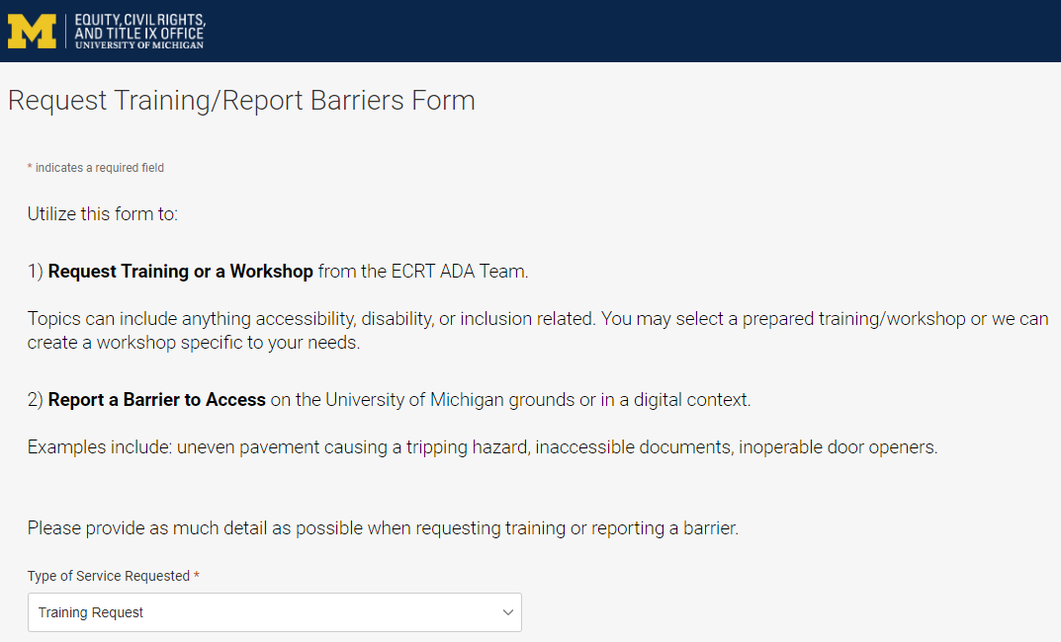
Request Training or Workshops https://ecrt-umich-accommodate.symplicity.com/activity_provider_request/
Use the Request Training/Report Barriers form to request training for your department or group. Topics include:
Ableism Awareness
Creating Accessible Digital Documents
Creating Inclusive Environments
Disability Awareness
Reasonable Accommodations and the Interactive Process
Service and Emotional Support Animals
Supervisor’s Guide to Accommodations

Slide 28
Report Barriers to Access https://ecrt-umich-accommodate.symplicity.com/activity_provider_request/
Use the Request Training/Report Barriers form to report physical or digital barriers to access
Examples:
Inoperable door openers or elevators
Cracked pavement causing tripping hazards
Inaccessible software or documents

Slide 29
Thank You From ECRT

