Slide 1
Interview and Hiring Process Accommodations
Allison Kushner, Director Disability Equity Office & ADA Coordinator

Slide 2
Zoom Webinar Tips
Use the Q&A feature to submit your questions.
ASL interpretation can be utilized by clicking Interpretation and selecting American Sign Language.
CART transcription can be turned on by selecting Show Captions.
Notes:
This workshop is also being recorded and will be made available on ECRT’s YouTube channel: https://www.youtube.com/@ECRTumich as soon as possible. The slides will be emailed to all registered participants within the coming days along with an anonymous survey. We do really hope you’ll complete the short survey, as this helps us determine how we can best assist you with your learning goals.

Slide 3
Agenda
The University of Michigan is committed to fostering an inclusive environment where accessibility and the needs of individuals with disabilities are prioritized, ensuring equitable opportunities for all members of our diverse community. This workshop will cover:
Brief Background Information on the ADA
Reasonable Accommodations During the Hiring Process
Accessible Hiring Practices
Onboarding and Retention Tips
Frequently Asked Questions
Interactive Activity: Interviewing and Hiring Case Scenarios
Resources

Slide 4
Please Engage
We are modeling a comfortable, inclusive, brave, and safe space.
Questions are encouraged – we’re all learning together.
We don’t know what we don’t know.
Respect the experiences of others.
Opportunity for growth and learning.

Slide 5
The Americans with Disabilities Act (ADA)

Slide 6
What is the ADA? The Americans with Disabilities Act (1990) and the Amendments Act (2008)
Prohibits discrimination and harassment against an individual with a disability (IWD) in employment, public places, public education, etc.
Employment (Title I): Application procedures, hiring, promotion, discharge, compensation, benefits, training, etc.
Federal, state, and local government (Title II): Requires places, services, and benefits provided to be accessible, including places of education like U-M.
Public places (Title III): Requires places open to the public, including businesses that are open to the public to be accessible and provide accessible information/services digitally as well.
Protects individuals from discrimination based on association with an IWD.
Creates an affirmative duty to provide a reasonable accommodation (to deny a reasonable accommodation is discriminatory).

Slide 7
Disability Definition
A physical or mental impairment that substantially limits one or more major life activity.
Substantial limitation is determined by comparison to an average person in the general population.
Major life activities include (but are not limited to): bending, breathing, caring for self, concentrating, hearing, interacting with others, learning, lifting, sitting, speaking, standing, thinking, walking, working, etc.
This includes people who have a record of such an impairment, even if they do not currently have a disability.
It also includes individuals who do not have a disability but are regarded as such.

Slide 8
Functional Disability Categories
Age-related: Decreased sensory acuity, dexterity, stamina
Auditory: Deaf, hard-of-hearing
Cognitive: Learning disability, dyslexia, traumatic brain injury
Motor: Paralysis, cerebral palsy, missing/damaged limbs
Neurodiverse
Psychological: Anxiety disorder, bipolar disorder, PTSD
Seizure/epilepsy
Substance use disorders
Visual: Blind, low-vision
*This list is non-exhaustive

Slide 9
Non-apparent Disabilities
Fibromyalgia
Heart disease
Inflammatory bowel disease
Lyme disease
Lupus
Migraine
Thyroid disorders
*This list is non-exhaustive
Allergies
Arthritis
Asthma
Cancer
Chronic pain
Chronic fatigue
Crohn’s disease
Diabetes

Slide 10
Reasonable Accommodations
Engaging in the Interactive Process

Slide 11
Requesting Accommodations
Accommodation: any modification or adjustment to policy, practice, or environment that provides IWDs equitable access to programs, services, or benefits.
Requests do not require magic words and do not need to be submitted in writing.
“I need an accommodation for…”
“It would be helpful if I could use/have…”
“I need help with…”
“I could engage more fully if…”

Slide 12
Goals of the Interactive Process
To identify effective and reasonable accommodations for an applicant with a disability to engage in the hiring process.
To provide reasonable accommodations that allow the IWD to participate in the hiring process fully.

Slide 13
Individual Responsibilities
Applicant Responsibilities
Employer Responsibilities
Explain the limitations of the disability and how they relate to the accommodation request.
Identify preferred accommodations and be open to alternatives (How would one accommodation be more or less effective than another?)
Make fact-based decisions and avoid the “what if” mindset.
Engage in a good-faith effort.
Consult with the employee about limitations.
Consider the employee’s preferred accommodation option.
Employers have the option to implement the accommodation that is most appropriate for BOTH the employer and the employee.
Make fact-based decisions and avoid the ”what if” mindset.
Engage in a good-faith effort.
Notes:
Applicants should help the employer understand how the diagnosis affects the ability to participate in the hiring process. Keep in mind, the applicant does NOT need to reveal their diagnosis.

Slide 14
Examples of Interview Accommodations
Providing a list of questions in advance.
Supplying a list of individuals in the interview, along with their titles and photos.
Touring the building or interview space before the interview.
Offering frequent breaks.
Allowing a support person or service animal.
Utilizing an ASL interpreter, CART transcription, or Zoom captioning.
Ensuring that recruitment, interviews, tests, and other components of the application process are held in accessible locations.
Conducting a virtual interview.
Providing equipment or devices.
Notes:
Example: John is blind and applies for a job as a customer service representative. John could perform this job with assistive technology, such as a program that reads information on the screen. If the company wishes to have John demonstrate his ability to use the computer, it must provide appropriate assistive technology as a reasonable accommodation.
Example: An employer requires job applicants to line up outside its facility to apply for a job, a process that could take several hours. Tara has multiple sclerosis and that makes her unable to tolerate prolonged exposure to temperatures in the 90's. Tara therefore requests that she be allowed to wait indoors where it is air conditioned until the human resources department is ready to take her application. The employer would need to modify its hiring procedure to accommodate Tara.

Slide 15
The Interactive Process
When an applicant requests an accommodation directly with the hiring manager, the hiring manager can determine if the request is reasonable and if so, implement it.
If there are questions on how to best support an applicant or questions about reasonableness, contact the Disability Equity Office for assistance.
Applicants may also request an accommodation with the Disability Equity Office who will determine reasonableness and contact the hiring manager to discuss implementing the appropriate accommodation.
Notes:
This process is a modified version of the Interactive Process employees will go through when requesting accommodations.
Hiring manager responses:
1) Thank you for providing this information/disclosing
2) This request is something the unit can already do, and then implement it for the individual
3) I don’t have an answer right now, but I will follow up with you after discussing the request with the Disability Equity Office/appropriate partner. (Give a deadline for when the answer should be given.)

Slide 16
Accessible Hiring Practices

Slide 17
Recruitment Tips
People with disabilities continue to be the most unemployed and underemployed group – this is untapped diverse talent!
Post job openings with disability organizations and partner with disability resources to recruit.
Highlight the accessibility of the workplace and flexibility if available
Notes:
This could be its own entire presentation but it is important to focus on the environment after the employee has accepted the job as much as promising inclusive and accessible environments during the hiring process. We want to ensure that we are discussing accessibility as everyone’s responsibility and not simply that of those who do the work.

Slide 18
Job Description Language
Write a clear job description that is concise and non-technical (when appropriate).
Focus on the task – not how the task should/could be performed.
Walk > maneuver, traverse
Talk and hear > communicate
Lift or carry > move, transport
Clearly articulate essential job functions and percentages.
Indicate environmental and physical requirements when necessary.
Indicate the availability of flexible work when appropriate.
Job description language can often be discouraging – ensure you use inclusive language.
Include information about requesting accommodations.
Notes:
Hiring begins with a job description- so it is important to keep in mind that how you frame accessibility in your language matters when trying to attract and recruit employees with disabilities

Slide 19
Tips for In-person Interviews
Clear pathways and remove obstacles
Provide seating options, such as tall/short chairs, chairs with/without armrests, and stationary/wheeled chairs
Introductions, and reintroduce if there is a large group
Printed interview questions (or available on employer’s device) for reference
Lighting options (dimmers, reduced lighting, natural lighting)
Auditory input options (low sensory rooms, avoiding spaces near construction, low traffic areas)
Olfactory needs (avoid spaces that recently used chemicals, provide a fragrance-free/reduced environment)
Notes:
Consider the impacts of our senses and how they can impact an individual’s focus. If someone is distracted, you will not be assessing their performance at their best.
Ensure clear pathways through doors, hallways, and restroom entrances to increase access for individuals with mobility limitations and paths for wheelchairs
Consider the impact of multisensory environments.

Slide 20
Tips for Virtual or Hybrid Interviews
Provide a virtual attendance option.
University of Michigan ITS: Hosting Accessible Remote Events.
Provide information in advance and avoid last-minute changes.
Include resources for attendees to utilize in their planning, such as:
Logistics, Transportation, and Parking, Paratransit, and Parking Maps.
Zoom captioning by default or provide CART or ASL interpreters when requested.
Notes:
Provide information in advance (such as: date, timeframe, location, parking, lactation spaces, scheduled breaks, agenda, etc.)

Slide 21
Virtual/Hybrid Considerations for Interviews and Meetings
Each speaker should identify themselves when speaking.
Spotlight an ASL interpreter feed, use Zoom captioning or CART transcription.
Read questions or comments from the chat aloud.
Enable your camera when speaking and reduce background noise and visual distractions.
Consider non-moving virtual backgrounds.
Place interview questions in the chat.
Notes:
This assists participants, captioners, and interpreters and allows for a bit of overlapping talk between participants
Virtual backgrounds: (sorry, no palm trees waving and ocean waves)

Slide 22
Inclusive Practices for All
Zoom captioning is turned on by default.
Offer multiple interview times and include morning and afternoon options.
Ability to list preferences for times.
Provide questions or scenarios ahead of time.
Keep the size of the interviewing group manageable.
Ensure hiring managers are aware of accommodation resources, expectations for performance standards and are aware of disability etiquette and how to avoid ableist thinking.
Notes:
What changes can you make to provide additional inclusive practices in your own hiring process even when an accommodation is not requested? Keep in mind that many individuals prefer not to disclose their need for accommodation at the interview stage because of concerns related to stigma, discrimination, prior experiences, etc. To create more inclusive environments for successful interviews, you can make small changes to the interview process that can assist everyone
EARN has a great worksheet: https://production-askearn-org.s3.us-east-1.amazonaws.com/EARN_2020_Checklist_Accessible_Authentic_Interviews_2668b527ed.pdf

Slide 23
Onboarding & Retention Tips

Slide 24
Access = Choices
Ensure you are focusing on accessibility across all aspects of your environment, even after the hiring process concludes.
Offer ergonomic options by default when onboarding.
Keyboard, mouse, chairs, larger monitors, risers, headphones, noise machines, alternate lighting options or overhead light filters.
Check-in after hire and then 1-2 times per year about access needs or changes
Notes:
Providing employees with the tools they need to be successful allows you to create a more welcoming space while improving productivity and reducing workplace injury via ergonomic options.
It is important to remember that disability and accessibility needs change over time, regardless of disability status so it is important to check in with your employees to encourage them to reach out or request any ergonomic or other workplace needs and provide an annual reminder of resources like requesting accommodations as well

Slide 25
Accessible Onboarding Before Day 1
Provide information on how to request accommodations.
Provide information about accessible parking and transportation options.
Provide a tentative schedule of the first few days or week.
Be sure all systems, programs, and documents are accessible.

Slide 26
Accessible Onboarding Day 1
Provide a tour of the overall physical space and individual office space.
Include information on emergency plans and accessible entrances/exits/bathrooms.
Introduce employee to staff.
Schedule time for staff to meet and greet the employee either individually or in small group settings.
Reflect organizational culture in benefits and supports.
Flexible schedules and work/life balance.
Resource groups and shared experiences.
Notes:
“It is important to us that all employees have a good work-life balance. To ensure that we give our employees the tools they need to do that, we offer flexible schedules that allow you to take certain afternoons off.”
“You may want to consider joining one or more of our employee resource groups to connect with your colleagues across the organization on shared interests or experiences. We get a lot of important input from these groups, so they are a great way to help shape our company culture.”

Slide 27
Accessible Onboarding: Training
Share accessible training resources and guides.
Task-oriented training and shadowing opportunities.
Schedule check-ins with manager or supervisor within the first week and weekly for new employees to ask questions or provide feedback.
Provide clear expectations.
Discuss needs and preferences, including format preferences, tasks, feedback, and support.
Performance feedback.
The good and the areas of improvement.
Notes:
It is important that training provides real-time experiences and expectations are set at the beginning

Slide 28
Disability Inclusive Retention
Encourage all employees to participate in professional development.
Provide leadership opportunities; ability to sit on committees.
Foster open and communicative supervisory relationships.
Allow flexible working opportunities when possible and check-in over time.
Provide process and procedure manuals that are routinely updated and link to workflows and resources.
Think creatively!

Slide 29
Frequently Asked Questions

Slide 30
When should an employer ask an applicant if they need an accommodation?
The employer should provide information about how to request accommodations during all stages of the hiring process.
How to request an accommodation in the job posting:
Suggested language: Individuals with disabilities and those using assistive technologies can receive personal assistance by contacting [insert contact name and information].
How to request an accommodation in the offer of an interview or other hiring process activity:
Suggested language: Individuals with disabilities are encouraged to request reasonable accommodations to participate in [an interview, timed written test, job demonstration, etc.], please contact [insert contact name and information].
An employer, however, cannot ask questions about an applicant's disability either because it is apparent or because the applicant has voluntarily disclosed a non-apparent disability.

Slide 31
Does the ADA require an employer to provide an IWD an interview accommodation?
Yes.
Employers are required to provide reasonable accommodation(s) and an employer cannot refuse to consider an applicant because they require a reasonable accommodation to compete for or perform a job.
Notes:
Reasonable accommodation may also be required to enable an employee to perform a job, gain access to the workplace, and enjoy the benefits and privileges of employment available to employees without disabilities.
https://www.eeoc.gov/laws/guidance/job-applicants-and-ada

Slide 32
Does an applicant need to tell the employer during the application process that they may need an accommodation if hired?
No.
Applicants are not required to inform an employer about the need for a reasonable accommodation at any specific time.
Disclosure is a personal decision.
Applicants may not realize an accommodation is needed until they have more information about the job or perform the tasks in the work environment.
Notes:
Some applicants choose to inform an employer during the application process after they better understand the job and its requirements. Others choose to wait until they have a job offer.
Determining the best moment to tell a prospective employer about the need for reasonable accommodation on the job is a personal decision.
A question to ask: Are you able to perform the essential functions of the job with or without a reasonable accommodation?

Slide 33
What are examples of questions that an employer cannot ask on an application or during an interview?
The ADA prohibits potential employers from asking oral or written questions that are likely to elicit a disability disclosure before making a job offer (i.e., the pre-offer period).
Examples of prohibited questions during the pre-offer period include:
Do you have a heart condition? Do you have asthma or any other difficulties breathing?
Do you have a disability that would interfere with your ability to perform the job?
How many days were you sick last year?
Have you ever filed for workers' compensation? Have you ever been injured on the job?
Have you ever been treated for mental health disorders?
Notes:
Some questions that may reveal a disability (and medical examinations) may be permitted after extending a job offer but before the individual begins work (i.e., the post-offer period).
https://www.eeoc.gov/laws/guidance/job-applicants-and-ada
A question to ask: “Are you able to perform the essential functions of the job with or without a reasonable accommodation?” If the answer is yes, there is no reason to ask further questions. Employees with disabilities can engage in the interactive process once hired to determine what accommodations may assist them with performing essential job functions.

Slide 34
Must the employer keep medical information disclosed during the hiring process confidential?
Yes.
The confidentiality requirements of the ADA protect both information voluntarily revealed, and information revealed in response to an employer's written or oral questions or during a medical examination.
Notes:
There are different schools of thought about disclosing disability status during an interview or in application materials. However, if a diagnosis or disability status is disclosed, the hiring committee will need to set that information aside in its decision making and ensure the materials are kept confidential. While diagnosis should not be shared, limitations or restrictions may be shared on a need-to-know basis only.

Slide 35
What if an applicant’s disability prevents them from performing some job duties?
An applicant or employee is only qualified if they can perform the essential functions of a job, with or without a reasonable accommodation.
However, an employer cannot reject an applicant because a disability interferes or prevents them from performing minor (non-essential) job functions.

Slide 36
Example: Essential Job Functions
Example: The essential functions for a file clerk position are to file and retrieve written materials.
While the job description states that the clerk must also answer the phone, in practice the clerk rarely does this because other employees have responsibility for this duty.
The employer cannot reject this applicant solely because they are unable to answer the phone, as it is not an essential part of performing this job.
Notes:
Determining essential functions example: is the function “typing” or is it inputting data - can we use speech recognition software to input data rather than a keyboard?

Slide 37
If an accommodation is provided to one applicant, does it need to be provided to everyone to maintain equity?
No.
The purpose of an interview/hiring process accommodation is to provide equal access for the IWD, thereby making it equitable.
Example: providing an IWD interview questions in advance.
*BUT…many best studies have shown that providing questions in advance to ALL applicants creates a much more equitable and accessible process with better outcomes at time of hiring.
Notes:
Providing questions in advance can build opportunities for candidates to be confident in showcasing their skills

Slide 38
Interactive Activity: Interviewing and Hiring Case Scenarios

Slide 39
Case Scenario #1: The Facts
Situation: An employer holds interviews via zoom with their entire team on the call. Martin has Autism and anxiety and has difficulty processing information in crowded and high stress settings, such as an interview.
Accommodation(s) Requested: Martin requests to have interview questions in advance and to have his camera off during the interview.

Slide 40
Case Scenario #1: Resolution
Resolution: The employer modified the interview procedure to accommodate Martin’s disability-related needs. Bill can receive the interview questions in advance and turn off his camera, as needed.
Additional Accommodation Alternative(s):
Notes:
Alternatives:
-additional time after asking the question to process the information and formulate his answers
-turn the camera off during this processing time, but keep it on while answering the question

Slide 41
Case Scenario #2: The Facts
Situation: An employer requires job applicants to apply for a job in-person. This includes lining up outside and awaiting one’s turn, a process that could take several hours. Bill has a spinal cord injury that makes it difficult for him to tolerate prolonged exposure to varying temperatures, due to challenges with thermoregulation.
Accommodation(s) Requested: Bill requests that he be allowed to wait indoors, where it is temperature-controlled, until the human resources department is ready to take his application.

Slide 42
Case Scenario #2: Resolution
Resolution: The employer modified its hiring procedures to accommodate Bill’s disability-related needs. Bill is able to wait indoors in a temperature-controlled environment until it is his turn.
Additional Accommodation Alternative(s):
Notes:
Alternatives:
-modifying the format of the interview to occur via Zoom
-providing the applicant with a specific time frame to show up for the interview that does not require the additional wait time.

Slide 43
Case Scenario #3: The Facts
Situation: Yasmin is a job applicant and receives a phone interview time slot of 1 hour. Yasmin has anxiety and a mild speech disorder that makes her verbal responses take longer and can cause her voice to fatigue.
Accommodation(s) Requested: Yasmin requests that she be allowed to meet in person, receive questions in advance, and to respond to interview questions in writing instead of responding verbally.

Slide 44
Case Scenario #3: Resolution
Resolution: The employer modified the interview format to accommodate Yasmin’s disability-related needs.
Additional Accommodation Alternative(s):
Notes:
Alternatives:
-additional interview time
-breaks
-verbally respond to questions

Slide 45
Case Scenario #4: The Facts
Situation: Sadie is blind and has been invited to participate in pre-employment testing. The testing center is in a building Sadie has never been to, and even the employees describe the building as easy to get lost in.
What accommodations might assist Sadie?
Notes:
Suggestions:
-offering a tour of the building prior to the testing date
-meeting Saida at the entrance of the building to assist with navigation
-allowing a companion to assist Saida with navigation
-allowing a service animal to accompany Saida

Slide 46
Case Scenario #4: Resolution
Resolution: The employer offered to provide a tour prior to the pre-employment testing date and had an employee meet the applicant at the entrance on the testing date.
Additional Accommodation Alternative(s):
Notes:
Suggestions:
-allowing a companion to assist Saida with navigation
-allowing a service animal to accompany Saida

Slide 47
Resources
For You and for Applicants
Notes:
LO

Slide 48
Accessible Transportation & Parking
Accessible Parking at Michigan Medicine
U-M Health provides a variety of parking options for patients, including on-site parking structures as well as valet services. Accessible parking spaces are available at all parking structures.
Accessible Parking on Campus
Learn how to request parking services to accommodate disabilities.
Paratransit Transportation Services
U-M Transportation Services offers curb-to-curb paratransit services for students, faculty, and staff (clients) who are unable to use the fixed route campus system.

Slide 49
Campus Maps
Campus Construction Maps
Architecture, Engineering and Construction (AEC) provides maps showing construction zones on campus.
Campus Map
The Interactive Campus Map allows searching for specific buildings, identifying directions from place to place, exploring bus routes, and seeing parking options. The map is also available on the Michigan mobile app, which provides a map and real-time bus information on the go.
Gender Inclusive Restrooms
Map with all-gender restrooms in Central, North, and Athletic campuses, housed within the Trans guide to U-M from the Spectrum Center.
Lactation Room Locations
Locations and directions to Lactation and Personal Care Rooms on the U-M Ann Arbor campus and at Michigan Medicine facilities in Ann Arbor.

Slide 50
Questions?

Slide 51
Disability Equity Office
Contact Information and Resources

Slide 52
Happening @ Michigan
Check out the Disability Equity Office’s upcoming presentations and interactive workshops by scanning this QR code or by visiting the upcoming events page!

Slide 53
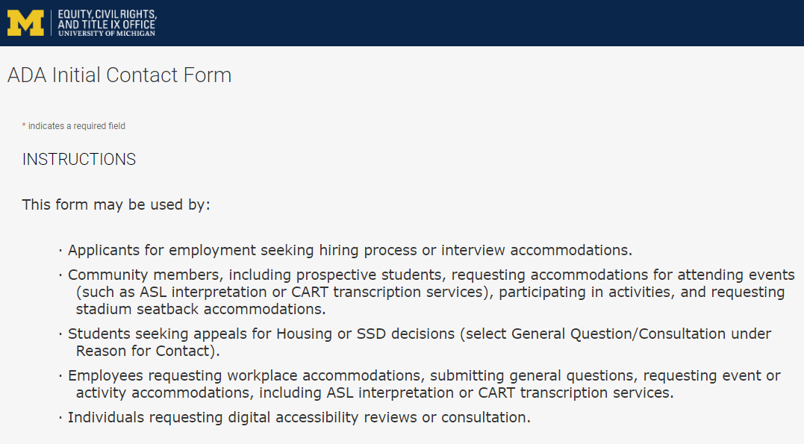
Contact the Disability Equity Office https://ecrt-umich-accommodate.symplicity.com/public_accommodation/
Use the ADA Initial Contact Form to request:
Workplace accommodation
Hiring process accommodation
Consultation with the Disability Equity Office staff
ASL or CART services
Digital accessibility review or consultation
Stadium seatback accommodations
Notes:
Employee login: https://ecrt-umich-accommodate.symplicity.com
ADA Initial Contact Form: https://ecrt-umich-accommodate.symplicity.com/public_accommodation/

Slide 54
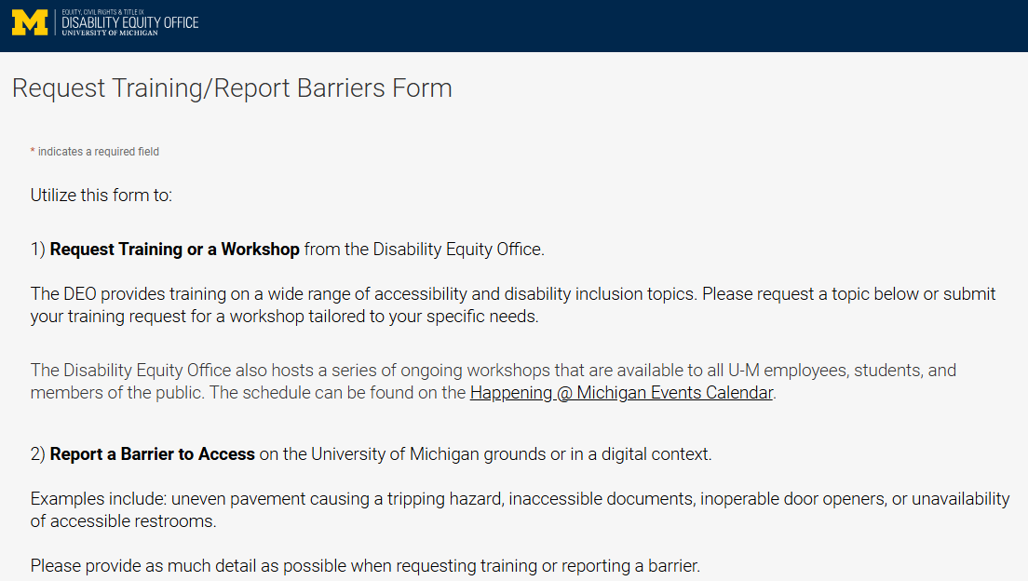
Request Training or Workshops https://ecrt-umich-accommodate.symplicity.com/activity_provider_request/
Use the Request Training/Report Barriers form to request training for your department or group. Topics include:
Ableism Awareness
Creating Accessible Digital Documents
Creating Inclusive Environments
Disability Awareness
Reasonable Accommodations and the Interactive Process
Service Animals
Notes:
Request Training/Report Barriers Form: https://ecrt-umich-accommodate.symplicity.com/activity_provider_request/
Happening @ Michigan Events Calendar for DEO : https://events.umich.edu/group/5177

Slide 55
Report Barriers to Access https://ecrt-umich-accommodate.symplicity.com/activity_provider_request/
Use the Request Training/Report Barriers form to report physical or digital barriers to access
Examples:
Inoperable door openers or elevators
Cracked pavement causing tripping hazards
Inaccessible software or documents
Notes:
Request Training/Report Barriers Form: https://ecrt-umich-accommodate.symplicity.com/activity_provider_request/

Slide 56
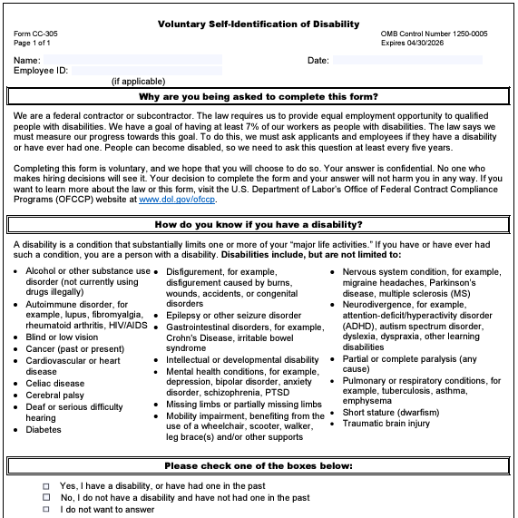
Voluntary Self-Identification of Disability
Update your information through Wolverine Access
Click on Employee Self Service
Go to Campus Personal Information
Select Disability Status
Notes:
Updating your voluntary self-id information plays a pivotal role in creating inclusive workplaces. It helps provide a better understanding of the diversity of our organization and helps to identify opportunities for improvement.
This information is used to measure the university’s commitment to accessibility and is never shared with your supervisor.

Slide 57
More Learning Opportunities From DEO
Filterable list of resources on the ECRT website
ECRT's YouTube Channel
DEO's Happening @ Michigan event list
Recorded Presentations & Trainings
Sign up for the DEO Newsletter
Notes:
Filterable list of resources on the ECRT website: https://ecrt.umich.edu/get-help-support/resources/
ECRT’s YouTube Channel: https://www.youtube.com/@ECRTumich
DEO’s Upcoming Events are listed on the Happening @ Michigan website: https://events.umich.edu/group/5177
Recorded Presentations & Trainings website: https://ecrt.umich.edu/disability-accessibility/presentations-trainings/
DEO Newsletter sign up form: https://umich.us18.list-manage.com/subscribe?u=155e051009a7f5441a41bef64&id=6c9fbf9d2c

Slide 58
Thank You From DEO!

