Slide 1
Effective Communication
Erin Metz
Senior Accessibility Specialist
Notes:
Effective communication is a basic human right. This workshop will discuss your duty under the Americans with Disabilities Act (ADA) to provide access to effective communication with diverse groups, including those who are deaf/hard of hearing, have auditory processing disorders, are neurodivergent, etc. We will also cover communication strategies for employees and supervisors navigating the interactive process for workplace accommodations.

Slide 2
Zoom Webinar Tips
Use the Q&A feature to submit your questions.
ASL interpretation can be utilized by clicking Interpretation and selecting American Sign Language.
CART transcription can be turned on by selecting Show Captions.
Notes:
This workshop is also being recorded and will be made available on ECRT’s YouTube channel: https://www.youtube.com/@ECRTumich as soon as possible. The slides will be emailed to all registered participants within the coming days along with an anonymous survey. We do really hope you’ll complete the short survey, as this helps us determine how we can best assist you with your learning goals.

Slide 3
Agenda
It is important to be part of a culture that supports and embraces disability inclusion. This session will cover:
ADA requirements for effective communication
Interaction tips for various disability groups
7 Cs of Effective Communication
Accommodation examples
Communication Strategies

Slide 4
Please Engage
We are modeling a comfortable, inclusive, brave, and safe space.
Questions are encouraged – we’re all learning together.
We don’t know what we don’t know.
Respect the experiences of others.
Opportunity for growth and learning.

Slide 5
Poll #1: I Am Here Today Because…
I want to learn more about the requirements of the ADA
I am an employee who wants to learn to communicate more effectively with my supervisor
I am an employee who wants to learn to communicate more effectively with my coworkers
I am a supervisor who wants to learn to communicate more effectively with my employees
I just want to learn more from the Disability Equity Office
Notes:
Select all that apply

Slide 6
ADA Requirements for Effective Communication
Notes:
Wanting to focus more on how to help facilitate effective communication, we can briefly talk about the ADAs requirements

Slide 7
Definition & Purpose
Effective communication: a communication between two or more people wherein the intended message is successfully delivered, received, and understood.
The main purpose of the effective communication requirement of the ADA is to ensure that communication with people with vision, hearing, or speech disabilities is equally effective as communication with people without disabilities.
Notes:
To be clear and avoid confusion: the ADA does not require that supervisors effectively communicate with employees and vice versa. The ADA requires entities to provide auxiliary aids to assist with meaningful understanding and participation by individuals with disabilities. We will be discussing strategies for more meaningful communication a bit later in the presentation.

Slide 8
Prohibited Practices Under the ADA
Failure to provide auxiliary aids or services/failure to accommodate
Imposing eligibility criteria to screen out individuals with disabilities
Imposing charges on individuals with disabilities to cover the cost of providing accommodations
Discrimination based on disability
Notes:
Ignorance or indifference to the law is not an excuse as to why someone did not provide an accommodation or engaged in any other prohibited practice.

Slide 9
Communication is Key

Slide 10
U.S. Statistics
12 million people over age 40 have visual disabilities
1 million are blind
3 million have a visual disability after correction
18 million people have disabilities related to voice
30 million people have hearing loss in both ears
11 million have an auditory processing disorder
66 million people have dyslexia
15-20% of people are neurodivergent (estimated 51-68 million)
Notes:
In its 2019 report, the National Deaf Center on Postsecondary Outcomes found that in 2017, only 53.3% of deaf people were employed, compared to 75.8% of hearing people; this is an employment gap of 22.5 percentage points.[7] These barriers to employment opportunities should be recognized as a crisis.
https://www.nad.org/dhhcan-and-its-efforts/#:~:text=F.R.%20%C2%A735.160).-,Recommendations%3A,Employment,-In%20its%202019

Slide 11
Communication Myths
Communication disabilities are a sign of low intelligence
People who cannot hear, speak, or see cannot understand language
If a Deaf person can understand some gestures, they can communicate solely through gestures and lipreading

Slide 12
Communication Assumptions
Eye contact
Can’t be too much or too little
Can’t have eyes closed
Posture
Can’t fidget or make frequent movements
Doodling
Notes:
Just because someone may be doing these things while in a meeting or a conversation, does not mean they are not engaging

Slide 13
Different Ways to Communicate
People who are blind may give and receive information audibly rather than in writing
Deaf people may give and receive information in writing or in sign language rather than verbally
People with cognitive disabilities may prefer written communication and lists
Individuals with language and communication disabilities may prefer to communicate via fluency devices and speech generating systems

Slide 14
Communication is Key (1 of 2)
Ask individuals about their communication preferences.
Email, discussion, both depending on circumstances?
Avoid idioms (i.e., “You can say that again”), sarcasm, and jargon.
Pause when you ask questions (silently and slowly count to 10).
Pay more attention to what people say vs. their facial expressions or tone.
Notes:
Communication is key to so many aspects of our life: our work, our education, our home and family life. To participate in more effective communication, here are some tips:

Slide 15
Communication is Key (2 of 2)
Model active listening.
Do not equate directness or a lack of small talk with being anti-social.
Consider providing context and notice for conversations.
Be prepared to step away and regroup, then come back to a conversation.

Slide 16
The 7 Cs of Effective Communication
Notes:
https://pumble.com/learn/communication/effective-communication/

Slide 17
Poll #2: I Communicate Effectively With Others…
Never
Sometimes
Most of the time
Always

Slide 18
Poll #3: Others Communicate Effectively With Me…
Never
Sometimes
Most of the time
Always

Slide 19
1st C: Clarity
Be clear and only communicate specific messages
The receiver of the message should immediately be aware of what is being asked of them
Limit the risk of misunderstanding
Limit the risk of misinterpreting
Notes:
Clarity makes understanding easier and faster

Slide 20
2nd C: Coherence
Connect all of the points to ensure consistency and logic
Gives credibility to ideas
Avoids confusion and exhaustion for the receiver
Notes:
It should not feel like navigating a maze in order to understand the idea someone is sharing with us

Slide 21
3rd C: Confidence
Helps convey what you need in an efficient way
Appear more assertive
Gives credibility to the information and communicator
Appear more professional

Slide 22
4th C: Correctness
To communicate correctly, think ahead about what you are trying to communicate
Correctness:
Improves the impact of the message
Increases professionalism
Improves comprehension
Avoids confusion and misunderstanding

Slide 23
5th C: Conciseness
Be brief and stick to the point
“I need the quarterly reports completed by tomorrow at noon.”
“Hi Elenor! How are you doing today? I know our office has been swamped lately and that you have been really busy with training Janet and working on the new database. But I have a meeting next week with Michael and I need to make sure we are able to show our monthly quotas have been met. Do you think you might be able to have some data available for me soon so I can review it.”
Notes:
Which of these two statements is easier to understand?

Slide 24
6th C: Concreteness
Provide a clear picture by being specific
Maintain interest
Avoid misinterpretation
Set a course of action

Slide 25
7th C: Courtesy
Deliver information with respect by being friendly and honest
Builds rapport between teams
Allows individuals to feel heard and appreciated
Builds a more efficient and loyal team
Notes:
Consider the viewpoints of others, show respect, be polite and sensible

Slide 26
All 7 Cs
Clarity
Coherence
Confidence
Correctness
Conciseness
Concreteness
Courtesy
Notes:
When we practice the 7 Cs, it can lead to innovative ideas because we can all communicate effectively our needs, our wants, and our thoughts.

Slide 27
Accommodations

Slide 28
Reasonable Modifications
Public entities are required to make changes to policies, practices, or procedures when necessary
Modifications may not be necessary if they fundamentally alter the nature of the service, program, or activity

Slide 29
Accommodations for Print Disabilities
Qualified readers
Audio recordings
Braille materials
Screen reader software
Magnification software/magnifiers
Large print materials
Notes:
Any other effective methods of making visually delivered materials available to IWDs

Slide 30
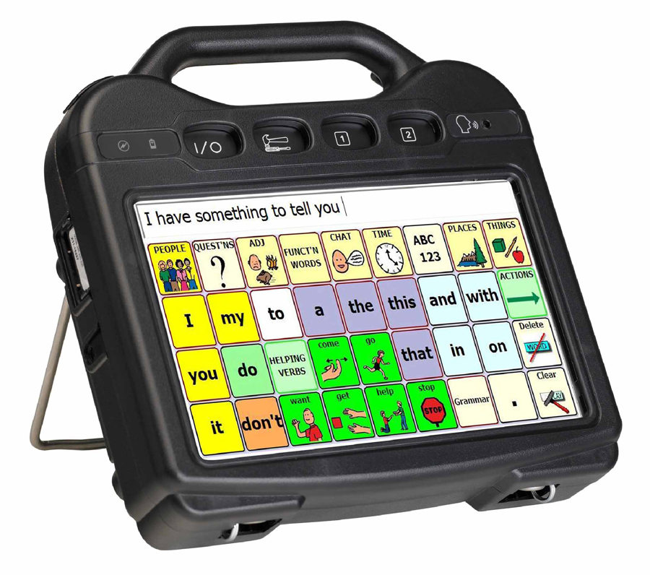
Accommodations for Speech Disabilities
Assistive technology
Text to speech software
Interpreters
Voice-amplification devices
Augmentative & Alternative Communication (AAC)

Slide 31
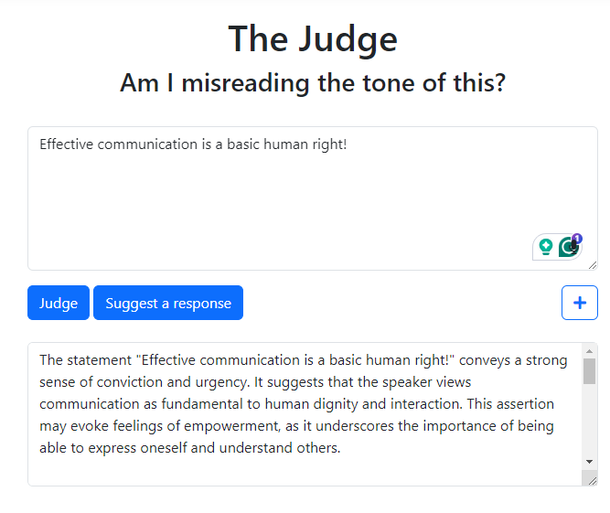
Accommodations for Deciphering Messages
Goblin Tools
“The Judge” can help to decipher messages and determine the emotional context
Grammarly
Used as a tool to be clearer and more concise
UM Chat GPT
Can help to match a desired tone
Notes:
Some individuals have challenges with properly interpreting communication or appropriately conveying messages. For example, some neurodivergent individuals have indicated limitations with "reading into" emails and making assumptions about what they thought the person sending it was trying to deliver.

Slide 32
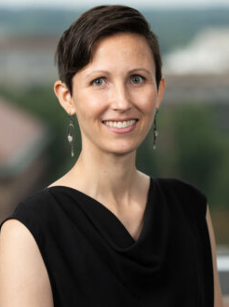
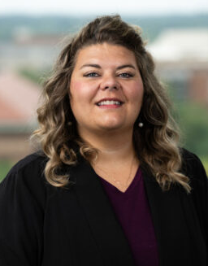
Accommodations for Auditory Disabilities
Sign language interpreting
CART (Computer Assisted Real-Time Transcription)
Captioned phones
Assistive listening devices
Hearing aid compatible phones
Videophones

Slide 33
Poll #4
What percent of information is communicated effectively through lip reading?
10%
25%
50%
70-80%
Notes:
Answer on next slide

Slide 34
Lip Reading is Not Reliable or Effective
20% effective
If - - - - - conversation - - Deaf - - - - not - - - - - communication - - - - - - - lip -, - - - not - - of - - information - - - - - - - - two -.
50% effective
If - were to - in conversation - a Deaf - and - - not provide - - of - communication - - solely - the - to lip -, - would - not obtain - of - - information - was - - be - between - two -.
Notes:
J Acoust Soc Am. 2011 Jul
A 2011 study found that the mean word recognition accuracy for lip reading was about 10%

Slide 35
Lip Reading Example – 100%
If we were to engage in conversation with a Deaf individual and we did not provide any type of effective communication but relied solely upon the individual to lip read, they would likely not obtain any of the important information that was meant to be shared between the two parties.

Slide 36
Communication Strategies
Suggestions for addressing some of the most frequently asked questions

Slide 37
Poll #5
Why is effective communication important to you?
Notes:
Allows access to all
People who are comfortable talking about their concerns at work are more likely to find resolution and less likely to leave employment

Slide 38
Asking For Help (Accommodations)
Be direct when stating you need help at work
“I am having a hard time concentrating because of the noise level in the room.”
Don’t be afraid to ask for what you think would help
“Can I move my workstation to a quieter area?”
Notes:
Maybe you can’t move your workstation to a quieter area, but maybe you can use noise reducing headphones instead.
If you don’t know what you need to help, that’s ok! Use the resources available like JAN or the Disability Equity Office.

Slide 39
Discussing Accommodations With Employees
It is important to remind supervisors and managers that the ADA prohibits employers from disclosing an employee's "medical" information.
Disclosing that someone is being provided a reasonable accommodation is risky because it could be considered a disclosure of that person’s disability.
It is much simpler for an employer to simply disclose that it has made a "modification" to comply with "federal law."
Another alternative would be to say that this is private information and cannot be disclosed.
Notes:
"The human Resource Guide To Answering ADA Workplace Questions: Checklists and Practical Hints for Human Resources Personnel, Eleventh Edition" by David K. Fram, Esq. Director, ADA Services; National Employment Law Institute:
https://askjan.org/blogs/jan/2013/12/the-manager-s-dilemma-an-employee-is-asking-about-a-co-worker-s-accommodation-as-a-manager-what-do-i-say.cfm
“I’m happy to have a private conversation with you if you would like to discuss your own needs”

Slide 40
Discussing Accommodations With Coworkers
Employees are not required to talk to their coworkers about their accommodations
If you choose to talk to coworkers, it is up to you on what information you feel comfortable sharing
Some people use this as teachable moments
Some want to maintain privacy

Slide 41
Use the Right Communication Medium or Platform
Determine the most effective method of communicating with those you are engaging with:
Email
Zoom/Google Meet
Face-to-face
Gchat
Notes:
Using the right medium or platform to communicate matters. Effective communication requires you to consider whether you need to meet in person or if Zoom would suffice. Is your message casual enough to use Gchat, or would a formal email be more efficient and thorough? Whatever you choose should be intuitive and appropriate for the current situation.

Slide 42
Communication Preferences
Ask what type of communication is preferred
Gchat, email, conversation, phone calls, meetings
Small talk/no small talk
Straight to the point/niceties (how are you, hello, good morning, etc.)
I need this/I could use some help if anyone is free

Slide 43
Consider Your Audience
Be aware of your audience—those you intend to communicate with may differ from those who actually receive your messages.
Knowing your audience can be key to delivering the right messages effectively.
Their age, race, ethnicity, gender, marital status, income, education level, subject knowledge, and professional experience can all affect how they’ll receive your message.

Slide 44
Practice Active Listening
Active listening: the practice of giving your full attention in a communication exchange.
Pay attention to body language
Give encouraging verbal or visual cues
Ask questions
Repeat back what you heard or think you heard
Practice non-judgment
Notes:
Active listening means you are not preparing your responses, not thinking about what task you need to perform next, not thinking about the errands you need to run after work. Active listening is committing 100% of your attention to the communication.

Slide 45
Poll #6: Fill in the Blank:
I will now communicate more effectively by

Slide 46
Questions?

Slide 47
Disability Equity Office
Contact Information and Resources

Slide 48
National Disability Employment Awareness Month Events
NDEAM Trivia Live!
Oct 16 @ noon
Limitations & Accommodations
Oct 22 @ 10:00am
Is Sign Language Universal?
Oct 23 @ noon
Disability Dialogues with the ADA Coordinators
Oct 24 @ 11:00am
A Spoon Theory Experience
Oct 25 @ 9:00am
Accessible Word and Google Docs Documents
Oct 28 @ 11:00am
Ask an Accessibility Specialist
Oct 30 @ noon
Register today @ Sessions

Slide 49
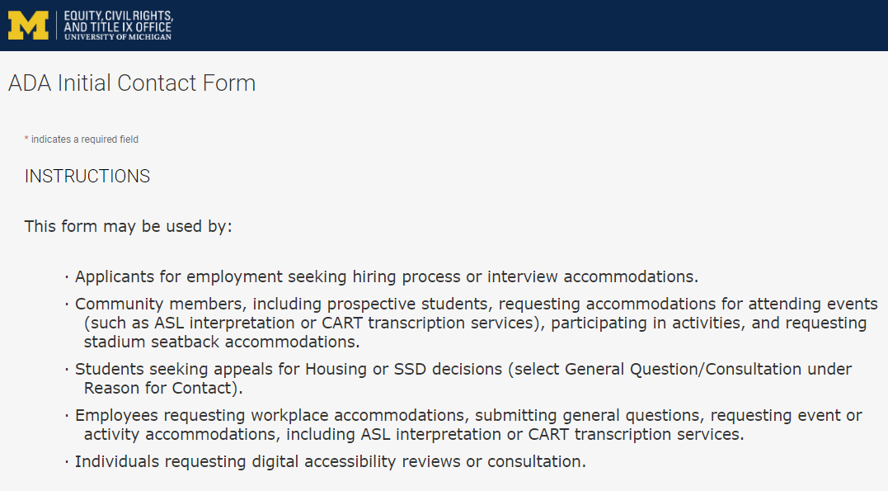
Contact the Disability Equity Office https://ecrt-umich-accommodate.symplicity.com/public_accommodation/
Use the ADA Initial Contact Form to request:
Workplace accommodation
Hiring process accommodation
Consultation with the Disability Equity Office staff
ASL or CART services
Event accommodation
Digital accessibility review or consultation
Stadium seatback accommodations
Notes:
ADA Initial Contact Form: https://ecrt-umich-accommodate.symplicity.com/public_accommodation/

Slide 50
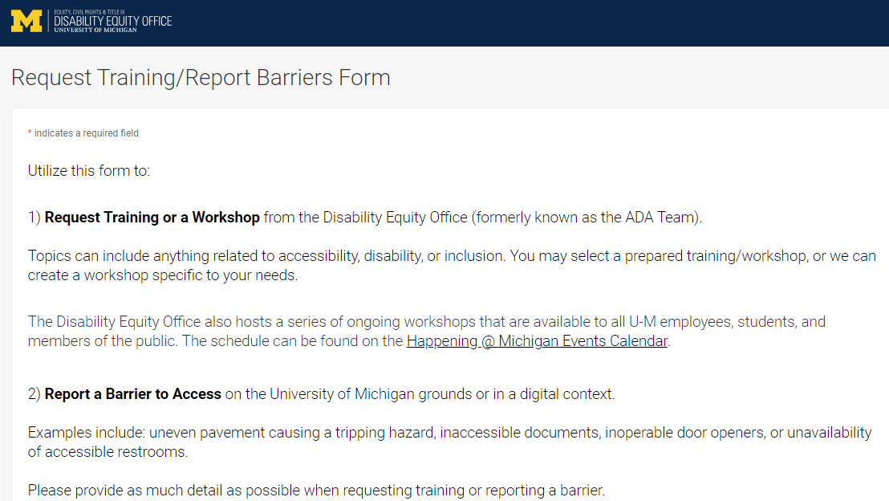
Request Training or Workshops https://ecrt-umich-accommodate.symplicity.com/activity_provider_request/
Use the Request Training/Report Barriers form to request training for your department or group. Topics include:
Ableism Awareness
Creating Accessible Digital Documents
Creating Inclusive Environments
Disability Awareness
Reasonable Accommodations and the Interactive Process
Service Animals
Notes:
Request Training/Report Barriers Form: https://ecrt-umich-accommodate.symplicity.com/activity_provider_request/
Happening @ Michigan Events Calendar for Equity, Civil Rights, and Title IX: https://events.umich.edu/group/4765

Slide 51
Report Barriers to Access https://ecrt-umich-accommodate.symplicity.com/activity_provider_request/
Use the Request Training/Report Barriers form to report physical or digital barriers to access
Examples:
Inoperable door openers or elevators
Cracked pavement causing tripping hazards
Inaccessible software or documents
Notes:
Request Training/Report Barriers Form: https://ecrt-umich-accommodate.symplicity.com/activity_provider_request/

Slide 52
More Learning Opportunities From ECRT
Filterable list of resources on the ECRT website
ECRT's YouTube Channel
DEO's Upcoming Events Page
Recorded Presentations & Trainings
Notes:
Filterable list of resources on the ECRT website: https://ecrt.umich.edu/get-help-support/resources/
ECRT’s YouTube Channel: https://www.youtube.com/@ECRTumich
ECRT’s Upcoming Events are listed on the Happening @ Michigan website: https://events.umich.edu/group/5177
Recorded Presentations & Trainings website: https://ecrt.umich.edu/disability-accessibility/presentations-trainings/

Slide 53
Thank You From DEO!

