Slide 1
Is Sign Language Universal? A Brief History of ASL
Kacey Lundgren
ASL Interpreter

Slide 2
Zoom Webinar Tips
Use the Q&A feature to submit your questions.
ASL interpretation can be utilized by clicking Interpretation and selecting American Sign Language.
CART transcription can be turned on by selecting Show Captions.
Notes:
This workshop is also being recorded and will be made available on ECRT’s YouTube channel: https://www.youtube.com/@ECRTumich as soon as possible. The slides will be emailed to all registered participants within the coming days along with an anonymous survey. We do really hope you’ll complete the short survey, as this helps us determine how we can best assist you with your learning goals.

Slide 3
Please Engage
We are modeling a comfortable, inclusive, brave, and safe space.
Questions are encouraged – we’re all learning together.
If you’re thinking about it, chances are someone else is, too!
We don’t know what we don’t know.
Respect the experiences of others.
Opportunity for growth and learning.

Slide 4
Is Sign Language Universal?

Slide 5
There is No Universal Sign Language
Languages, both spoken and signed, develop naturally around the world wherever there is need
There are estimated to be over 300 different signed languages (there are over 7,000 spoken languages)
Most sign languages are named for the location where they are used: ASL - American Sign Language, used most prominently in America

Slide 6
Agenda
History of sign language in North America
History of American Sign Language (ASL)
History of Deaf Education in America
Key takeaways
Questions

Slide 7
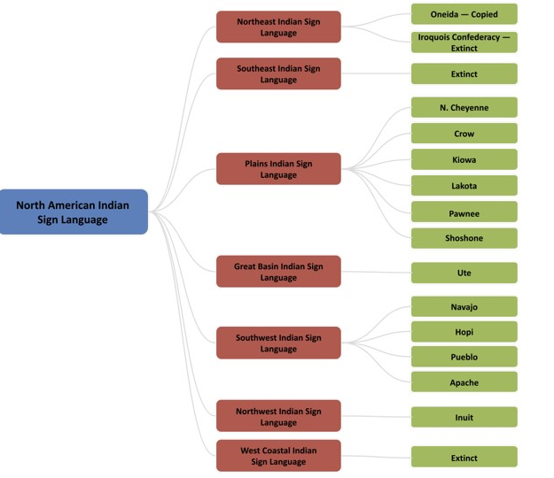
North American Indian Sign Language (NAISL)
Also called Hand Talk, sometimes noted as the first “universal American language”
Within NAISL (blue, first column) were many regional variations (red, second column), and then within each region was additional variation depending on the tribe (green, third column)
Dr. Melanie McKay-Cody from the University of Arizona is leading the research, preservation efforts, and revival of these languages
Notes:
Citations:
Heumann, Judy. (2023, February 22). Indigenous Sign Languages with Dr. Melanie McKay-Cody. The Heumann Experience. https://judithheumann.com/melaniemckaycody/
Mittan, Kyle. (2023, February 6). Researcher will Showcase Native American Sign Language in Super Bowl Performance. The University of Arizona. https://news.arizona.edu/news/researcher-will-showcase-native-american-sign-language-super-bowl-performance
Plains Indian Sign Language. (2024, July 1). Wikipedia. Retrieved July 15, 2024, from https://en.wikipedia.org/wiki/Plains_Indian_Sign_Lang uage
Tomkins, William. (1969). Indian Sign Language. Dover Publications, Inc.
Sid Richardson Museum. (2023, October 4). Lecture: The Inclusive Work of C. M. Russell and Hand Talk Signs. YouTube. https://www.youtube.com/watch?app=desktop&v=tkOuYBAXvag&t=3s
Sid Richardson Museum. (2023, December 20). Plains Indian Sign Language and Charles Russell. https://sidrichardsonmuseum.org/plains-indian-sign-language-and-charles-russell/
Vox. (2022, May 16). The Hidden History of Hand Talk. YouTube. https://www.youtube.com/watch?v=s1-StAlw3aE

Slide 8
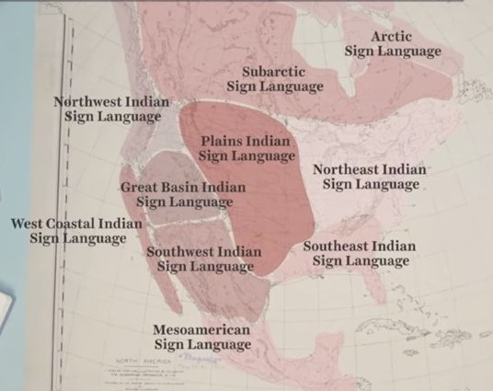
How Old is NAISL?
Images of sign language have been found in ancient Native American rock carvings and paintings dating back 6,000 years
Spanish conquistadors in the early 1500s noted that the Native Americans they came across all used sign language
Almost everyone signed, not only deaf individuals
Used for ceremonies, rituals, storytelling, hunting, warfare, and as the lingua franca (common language) for trading between tribes
Notes:
Citations:
Heumann, Judy. (2023, February 22). Indigenous Sign Languages with Dr. Melanie McKay-Cody. The Heumann Experience. https://judithheumann.com/melaniemckaycody/
Mittan, Kyle. (2023, February 6). Researcher will Showcase Native American Sign Language in Super Bowl Performance. The University of Arizona. https://news.arizona.edu/news/researcher-will-showcase-native-american-sign-language-super-bowl-performance
Plains Indian Sign Language. (2024, July 1). Wikipedia. Retrieved July 15, 2024, from https://en.wikipedia.org/wiki/Plains_Indian_Sign_Lang uage
Tomkins, William. (1969). Indian Sign Language. Dover Publications, Inc.
Sid Richardson Museum. (2023, October 4). Lecture: The Inclusive Work of C. M. Russell and Hand Talk Signs. YouTube. https://www.youtube.com/watch?app=desktop&v=tkOuYBAXvag&t=3s
Sid Richardson Museum. (2023, December 20). Plains Indian Sign Language and Charles Russell. https://sidrichardsonmuseum.org/plains-indian-sign-language-and-charles-russell/
Vox. (2022, May 16). The Hidden History of Hand Talk. YouTube. https://www.youtube.com/watch?v=s1-StAlw3aE

Slide 9
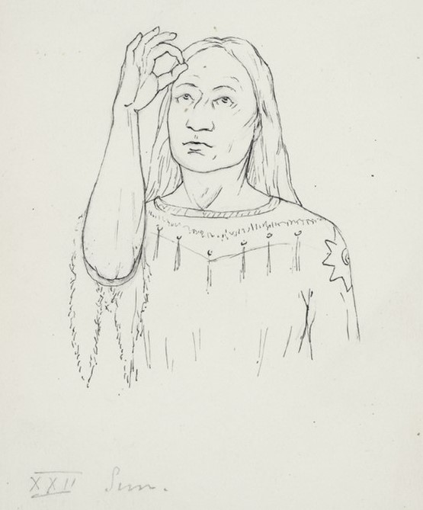
Plains Indian Sign Language (PISL)
Most Native Sign Languages have been lost
Some individuals worked (and are still working) to preserve them
Plains Indian Sign Language is one of the most well documented native sign languages: several books published, captured in paintings, videos, and even the Boy Scouts added it to their curriculum
Notes:
Citations:
Heumann, Judy. (2023, February 22). Indigenous Sign Languages with Dr. Melanie McKay-Cody. The Heumann Experience. https://judithheumann.com/melaniemckaycody/
Mittan, Kyle. (2023, February 6). Researcher will Showcase Native American Sign Language in Super Bowl Performance. The University of Arizona. https://news.arizona.edu/news/researcher-will-showcase-native-american-sign-language-super-bowl-performance
Plains Indian Sign Language. (2024, July 1). Wikipedia. Retrieved July 15, 2024, from https://en.wikipedia.org/wiki/Plains_Indian_Sign_Lang uage
Tomkins, William. (1969). Indian Sign Language. Dover Publications, Inc.
Sid Richardson Museum. (2023, October 4). Lecture: The Inclusive Work of C. M. Russell and Hand Talk Signs. YouTube. https://www.youtube.com/watch?app=desktop&v=tkOuYBAXvag&t=3s
Sid Richardson Museum. (2023, December 20). Plains Indian Sign Language and Charles Russell. https://sidrichardsonmuseum.org/plains-indian-sign-language-and-charles-russell/
Vox. (2022, May 16). The Hidden History of Hand Talk. YouTube. https://www.youtube.com/watch?v=s1-StAlw3aE

Slide 10
1930 Plains Indian Sign Language Council
Notes:
Citations:
Hand Talk. (2022, March 5). 1930 PISL Council. YouTube. https://www.youtube.com/watch?v=6JAq8lrRo5c

Slide 11
Colin Denny uses Plains Indian Sign Language at Superbowl LVII in 2022
Notes:
Citations:
SWIC ASL. (2023, February 12). Super Bowl 2023: America the Beautiful - ASL Performer, Colin Denny. YouTube. https://www.youtube.com/watch?v=v_7zTalX1As

Slide 12
The First Piece of the Puzzle
North American Indian Sign Language
?
ASL
?
?

Slide 13
Martha’s Vineyard
Martha’s Vineyard is a small, very isolated island that was located in the Massachusetts Bay Colony
Puritan families emigrated there from the Kentish Weald (Southeast England)
Possible existence of an Old Kentish Sign Language (OKSL) in the area that was also brought over
Jonathan Lambert was the first known Deaf person to immigrate (1694). He had two Deaf children who were the first deaf individuals born on the island
Residents on the island typically married each other
Notes:
Citations:
Martha’s Vineyard Sign Language. (December 29, 2023). Wikipedia. Retrieved July 29, 2024, from https://en.wikipedia.org/wiki/Martha%27s_Vineyard_Sign_Language
Rhode Island PBS. (2023, October 15). The Hidden History of Martha’s Vineyard Sign Language: Rhode Island PBS Weekly. YouTube. https://www.youtube.com/watch?v=NG1WRa4w-fA
Romm, Cari. (2015, September 25). The Life and Deaf of Martha’s Vineyard Sign Language. The Atlantic. https://www.theatlantic.com/health/archive/2015/09/marthas-vineyard-sign-language-asl/407191/

Slide 14
Martha’s Vineyard Sign Language (MVSL)
Deafness ratio is typically 1:6,000 however in Martha’s Vineyard it was 1:25 and in the Chilmark area of Martha’s Vineyard it was even 1:4
Due to the isolation and high rate of deafness, a (possibly) new sign language developed
Martha’s Vineyard Sign Language either developed naturally there or was based on the old Kent Sign Language that was possibly brought over from England
Martha’s Vineyard was often called “the place where everybody spoke sign”
Notes:
Citations:
Martha’s Vineyard Sign Language. (December 29, 2023). Wikipedia. Retrieved July 29, 2024, from https://en.wikipedia.org/wiki/Martha%27s_Vineyard_Sign_Language
Rhode Island PBS. (2023, October 15). The Hidden History of Martha’s Vineyard Sign Language: Rhode Island PBS Weekly. YouTube. https://www.youtube.com/watch?v=NG1WRa4w-fA
Romm, Cari. (2015, September 25). The Life and Deaf of Martha’s Vineyard Sign Language. The Atlantic. https://www.theatlantic.com/health/archive/2015/09/marthas-vineyard-sign-language-asl/407191/

Slide 15
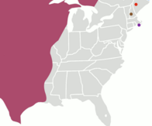
Triangle of Village Sign Languages
Some Martha’s Vineyard residents moved inland and founded additional villages; these sign languages may or may not be related to Martha’s Vineyard Sign Language
Martha’s Vineyard Sign Language, Massachusetts (1- purple dot)
Henniker Village Sign Language, New Hampshire (2 - brown dot)
Sandy River Valley Sign Language, Maine (3 - red dot)
Plains Indian Sign Language (pink area)
3
2
1
Notes:
Citations:
Martha’s Vineyard Sign Language. (December 29, 2023). Wikipedia. Retrieved July 29, 2024, from https://en.wikipedia.org/wiki/Martha%27s_Vineyard_Sign_Language
Plains Indian Sign Language. (2024, July 1). Wikipedia. Retrieved July 15, 2024, from https://en.wikipedia.org/wiki/Plains_Indian_Sign_Lang uage
Sandy River Valley Sign Language. (2022, December 16). Wikipedia. Retrieved August 8, 2024 from https://en.wikipedia.org/wiki/Sandy_River_Valley_Sign_Language

Slide 16
More Puzzle Pieces
North American Indian Sign Language
2. Martha’s Vineyard Sign Language(s?)
ASL
?
3. Other

Slide 17
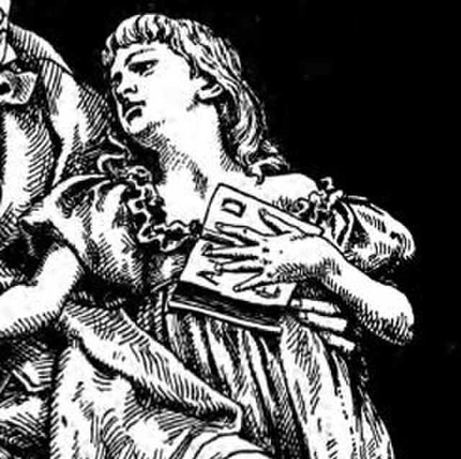
Alice Cogswell
Born in 1805 in Hartford, Connecticut
She became deaf at age two due to Spotted Fever (cerebral spinal meningitis)
Public opinion in America at that time was that deaf people could not be educated, Alice’s father disagreed
With no sign language or specialized education available, she had limited access to language and educational opportunities
Notes:
Citations:
Alice Cogswell. (2024, March 18). Wikipedia. Retrieved July 25, 2024, from https://en.wikipedia.org/wiki/Alice_Cogswell
DiMarco, N. & Siebert, R. (2022). Deaf Utopia: A Memoir – and a Love Letter to a Way of Life. William Morrow. April 19, 2022.
National Deaf Life Museum. (2024). Thomas Hopkins Gallaudet Meets Alice Cogswell. Gallaudet University. https://gallaudet.edu/museum/history/thomas-hopkins-gallaudet-meets-alice-cogswell/

Slide 18
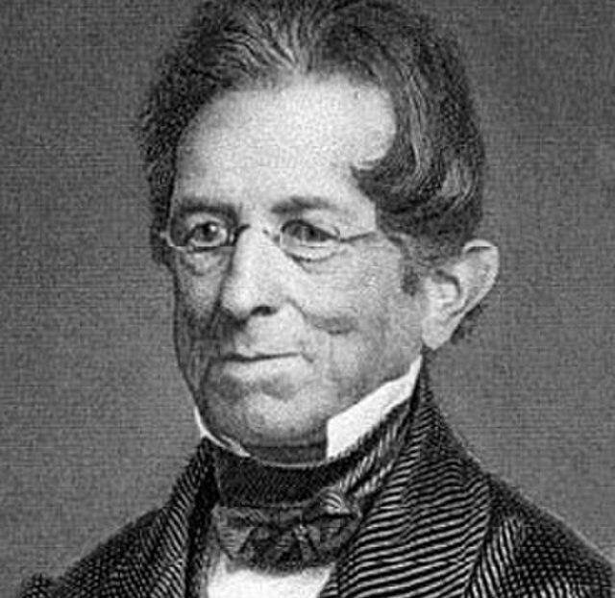
Alice Cogswell meets Thomas Hopkins Gallaudet
Recently graduated, Gallaudet decided to go home and visit his family, who were neighbors of the Cogswells
Gallaudet meets and successfully communicates the word “hat” with Alice (age 9) and is inspired
Alice’s father, a wealthy surgeon, enlists Thomas Hopkins Gallaudet to go to Europe and learn how they educate deaf children so he can replicate it here in America (goal: give Alice an education)
Notes:
Citations:
Alice Cogswell. (2024, March 18). Wikipedia. Retrieved July 25, 2024, from https://en.wikipedia.org/wiki/Alice_Cogswell
DiMarco, N. & Siebert, R. (2022). Deaf Utopia: A Memoir – and a Love Letter to a Way of Life. William Morrow. April 19, 2022.
National Deaf Life Museum. (2024). Thomas Hopkins Gallaudet Meets Alice Cogswell. Gallaudet University. https://gallaudet.edu/museum/history/thomas-hopkins-gallaudet-meets-alice-cogswell/

Slide 19
Trivia Time!
Gallaudet travels to Europe and goes to:
Germany
France
England
Italy
Notes:
Answer: England

Slide 20
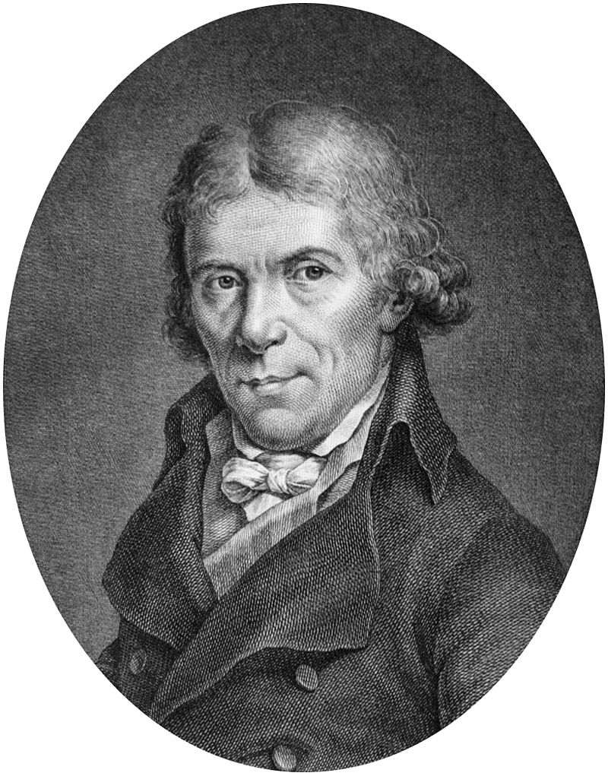
England! Wait, What?
Gallaudet first travels to England, but is rebuffed by the Braidwoods, whose schools focused on oral methods (learning to speak and lipread)
Meets Abbe Sicard (pictured), Laurent Clerc, and Jean Massieu, who came from a school in France that focused on manual methods (using sign language)
Gallaudet travels with them to Paris, France where he begins to study their methods to bring back to America
Laurent Clerc agrees to come to America to help
Notes:
Citations:
Biography of Laurent Clerc. (2024). Gallaudet University. https://gallaudet.edu/student-success/tutorial-center/english-center/reading-esl/esl-practice-reading-exercises/biography-of-laurent-clerc/
National Deaf Life Museum. (2024). Thomas Hopkins Gallaudet Meets Alice Cogswell. Gallaudet University. https://gallaudet.edu/museum/history/thomas-hopkins-gallaudet-meets-alice-cogswell/

Slide 21
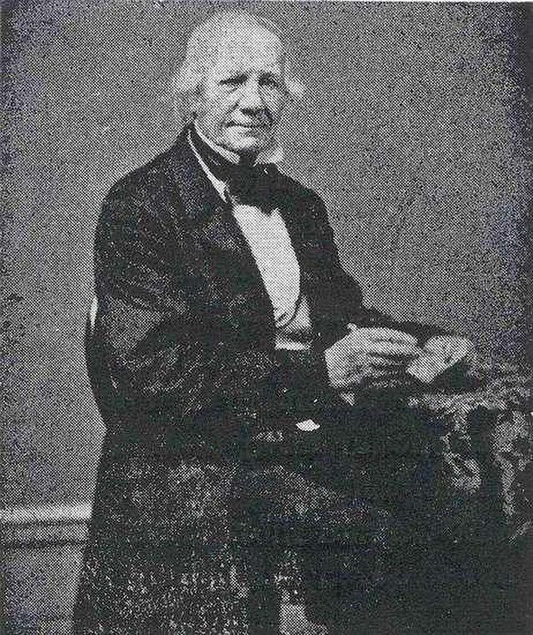
Laurent Clerc, First Teacher of the Deaf in America
With Thomas Hopkins Gallaudet, founded the first school for the Deaf in America: The Connecticut Asylum for the Instruction of Deaf and Dumb persons in 1817 (still going strong today! Name eventually changed to: The American School for the Deaf)
Alice Cogswell, age 12, is part of the first class to enroll
Clerc never returned to France. He married, had six children, and taught for 42 years before retiring
Helped found an additional 30 schools in America and advocated for the use of sign language
Notes:
Citations:
Biography of Laurent Clerc. (2024). Gallaudet University. https://gallaudet.edu/student-success/tutorial-center/english-center/reading-esl/esl-practice-reading-exercises/biography-of-laurent-clerc/
From Asylum to School: Families Pool Their Resources. (2024). Gallaudet University. https://gallaudet.edu/museum/exhibits/history-through-deaf-eyes/formation-of-a-community/from-asylum-to-school-families-pool-their-resources/#:~:text=In%20the%20early%201800s%2C%20some,taught%20students%20at%20the%20school.
National Deaf Life Museum. (2024). Thomas Hopkins Gallaudet Meets Alice Cogswell. Gallaudet University. https://gallaudet.edu/museum/history/thomas-hopkins-gallaudet-meets-alice-cogswell/

Slide 22
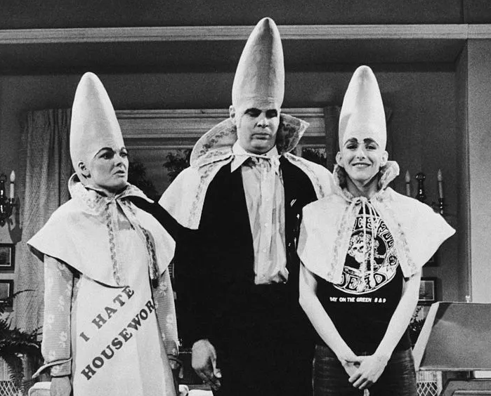
We are from France
ASL is considered a part of the French Sign Language family, however it has evolved enough that a French Sign Language user and an ASL user cannot understand each other
About 58% of ASL signs are similar to their old French signs
Languages must be 80% similar or more to be considered a dialect of one another
Notes:
Citations:
Carrol, Tobias. (2022, January 18). Revisiting the Early Days of “SNL”’s Coneheads. InsideHook. https://www.insidehook.com/television/revisiting-snl-coneheads-sketches

Slide 23
The Completed Puzzle
North American Indian Sign Language
2. Martha’s Vineyard Sign Language(s?)
ASL
4. French Sign Language
3. Other

Slide 24
American Sign Language
Clerc used French Sign Language while children who enrolled at the school brought their own fully developed sign languages, home signs, and gestures
These languages mixed to become ASL
ASL is not based on English
ASL is grammatically closer to Navajo

Slide 25
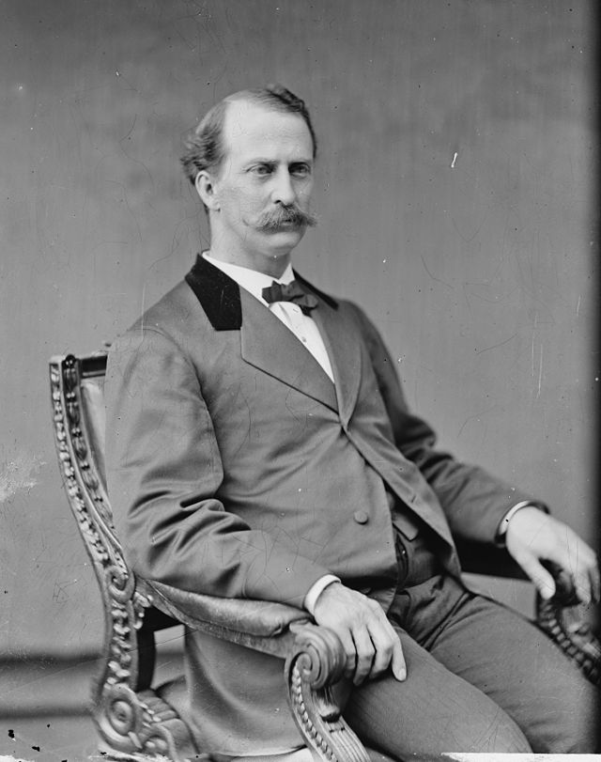
Edward Minor Gallaudet
Born February 5th, 1837, the youngest of Thomas Hopkins Gallaudet’s eight children
Amos Kendell donated land for a school in D.C.
In 1857, age 20, became superintendent of the new Columbia Institution for the Instruction of the Deaf, Dumb, and Blind in Washington D.C.
E.M. Gallaudet successfully lobbied Congress and in 1864, Congress passed an act allowing the Columbia Institution to become a university and confer degrees
Notes:
Additional notes: In 1856 a man named Amos Kendell donated two acres of his northeast Washington D.C. estate to establish a school and dormitories for 12 deaf and 6 blind students. Amos Kendell was postmaster general for two different presidents and a wealthy businessman but we don’t really know why he was moved to make such a generous donation for these children. A year later when the school was completed, Amos Kendell convinced congress to incorporate the school.
Citations:
Kratz, Jessie. (2022, April 1). Facial Hair Friday: Edward Minor Gallaudet. The National Archives: Pieces of History. https://prologue.blogs.archives.gov/2022/04/01/facial-hair-friday-edward-miner-gallaudet/
National Deaf Life Museum. (2024). History. Gallaudet University. https://gallaudet.edu/museum/history/
National Deaf Life Museum. (2024). The Legacy Begins. Gallaudet University. https://gallaudet.edu/museum/history/the-legacy-begins/

Slide 26
More Trivia Time!
The year is 1864. Which US President signed that bill into law?
President Monroe
President Lincoln
President Van Buren
President Garfield
Notes:
Answer: President Lincoln

Slide 27
Answer: President Lincoln!
Notes:
Answer: President Lincoln

Slide 28
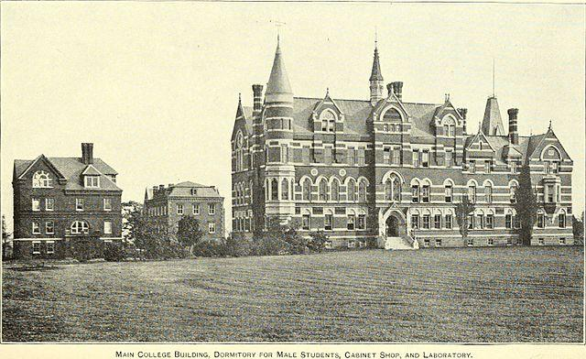
Gallaudet University
Charter signed by President Lincoln
First and only University for Deaf and Hard of Hearing students in the world
E.M. Gallaudet served as President until 1910 (53 years)
1894 the name was changed to Gallaudet College and in 1986, it obtained university status
Notes:
Additional notes: Edward Minor has two nice buildings named after him on campus including a 35-room Victorian Gothic mansion, which was built in 1869 for him and his family to live in while he was president. That mansion is still in use today, every university President since Edward Minor has lived there. But the school was named in honor of his father. There is a famous statue of Gallaudet meeting young Alice at the front of the school to honor that history. One of the dormitories is named after Clerc and Clerc also has a nice bust in a courtyard on campus.
Citations:
National Deaf Life Museum. (2024). History. Gallaudet University. https://gallaudet.edu/museum/history/
National Deaf Life Museum. (2024). House One, The Edward Minor Gallaudet Residence. Gallaudet University. https://gallaudet.edu/museum/history/house-one-the-edward-miner-gallaudet-residence/
National Deaf Life Museum. (2024). The Legacy Begins. Gallaudet University. https://gallaudet.edu/museum/history/the-legacy-begins/

Slide 29
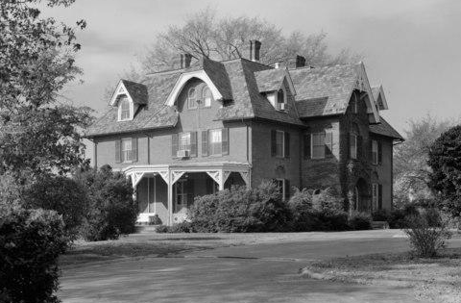
Edward Minor Gallaudet Residence
Edward Minor Gallaudet has a 35-room Victorian Gothic mansion named for him. It was built in 1869 for him and his family to live in. Every President of the University since has lived there
Edward Minor also has a statue on campus
Near the entrance of campus is a statue of Thomas Hopkins Gallaudet meeting Alice
Clerc has a dorm named after him, as well as a bust in a courtyard
Notes:
Citations:
National Deaf Life Museum. (2024). History. Gallaudet University. https://gallaudet.edu/museum/history/
National Deaf Life Museum. (2024). House One, The Edward Minor Gallaudet Residence. Gallaudet University. https://gallaudet.edu/museum/history/house-one-the-edward-miner-gallaudet-residence/
National Deaf Life Museum. (2024). The Legacy Begins. Gallaudet University. https://gallaudet.edu/museum/history/the-legacy-begins/

Slide 30
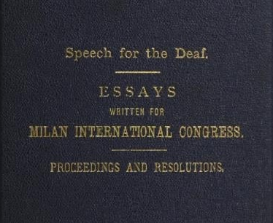
A Clash of Methods
1880 International Congress on Deaf Education convened in Milan, Italy (called the Milan Conference)
164 attendees, only one was Deaf (James Denison, USA, who attended with Edward Minor Gallaudet)
Decided to ban sign language use in Europe and America, which had devastating effects on the Deaf community
In 2010, the International Congress on Deaf Education issued a formal apology acknowledging that this discriminatory ruling was a violation of both human and constitutional rights
Notes:
Citations:
DiMarco, N. & Siebert, R. (2022). Deaf Utopia: A Memoir – and a Love Letter to a Way of Life. William Morrow. April 19, 2022.
Pyfers, Liesbeth. (2020, October). Deaf History: Europe. Retrieved August 13, 2024, from https://deafhistory.eu/index.php/component/zoo/item/1880

Slide 31
A New Dialect
Two language communities developed during segregation: white schools for the Deaf were prioritized with the “best” resources and methods (oralism) while many Black Schools for the Deaf continued to use ASL
Where oralism was enforced, Deaf teachers were often fired and replaced with hearing teachers who could teach speech and lipreading. Deaf students were even physically punished for using ASL
Black communities helped preserve and pass on ASL during this time
In isolation, a new dialect of ASL emerged - Black ASL (BASL)
Notes:
Citations:
DiMarco, N. & Siebert, R. (2022). Deaf Utopia: A Memoir – and a Love Letter to a Way of Life. William Morrow. April 19, 2022.
McCaskill, C., Lucas, C., Bayley, R., Hill, J. C., Dummett, R., Baldwin, P., Hogue, R., & Anderson, G. B. (2020). The hidden treasure of black ASL: Its history and structure. Gallaudet University Press.
Miller Memorial. (2024). Gallaudet University. https://gallaudet.edu/louise-b-miller-memorial/

Slide 32
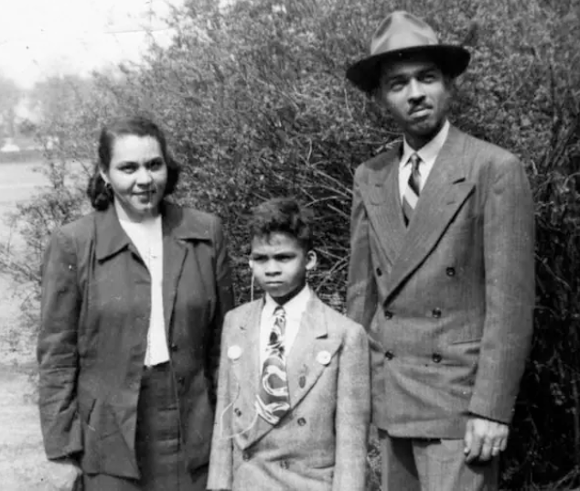
Miller v. Board of Education of District of Columbia
In 1877, as schools were segregated, so too were schools for the Deaf segregated, including Gallaudet University, which was only for white Deaf students
Louise B. Miller, a resident of DC, had to send her three children out of state to get an education. She sued in 1954 to get her children access to Gallaudet, and won
Gallaudet University was forced to construct a separate, segregated elementary school on campus
This decision is seen as a precursor to Brown v. Board of Education
Notes:
Citations:
DiMarco, N. & Siebert, R. (2022). Deaf Utopia: A Memoir – and a Love Letter to a Way of Life. William Morrow. April 19, 2022.
McCaskill, C., Lucas, C., Bayley, R., Hill, J. C., Dummett, R., Baldwin, P., Hogue, R., & Anderson, G. B. (2020). The hidden treasure of black ASL: Its history and structure. Gallaudet University Press.
Miller Memorial. (2024). Gallaudet University. https://gallaudet.edu/louise-b-miller-memorial/

Slide 33
Black ASL (BASL)
Desegregation began in 1954 but was a slow process and the last school for the Deaf to desegregate was Louisiana in 1978
When students integrated, they had a hard time understanding each other - the language had changed
Research was published in 2011 proving that ASL and BASL are dialects (80% similar or more)
Some scholars believe BASL aligns more closely with the ASL used prior to the Milan Conference due to less language interruption
BASL is still used today, mainly in the South (USA)
Notes:
Citations:
DiMarco, N. & Siebert, R. (2022). Deaf Utopia: A Memoir – and a Love Letter to a Way of Life. William Morrow. April 19, 2022.
McCaskill, C., Lucas, C., Bayley, R., Hill, J. C., Dummett, R., Baldwin, P., Hogue, R., & Anderson, G. B. (2020). The hidden treasure of black ASL: Its history and structure. Gallaudet University Press.
Miller Memorial. (2024). Gallaudet University. https://gallaudet.edu/louise-b-miller-memorial/

Slide 34
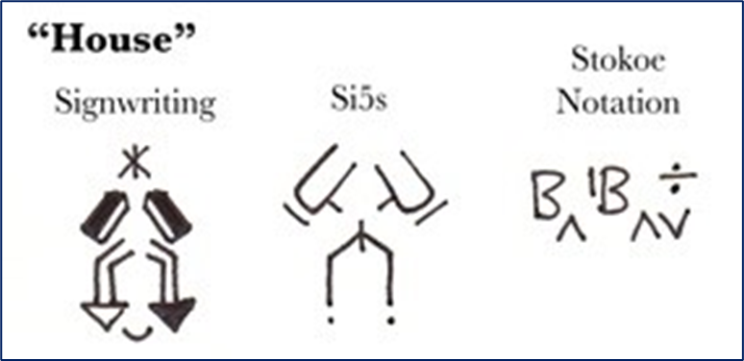
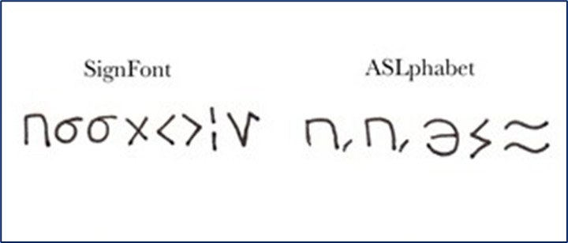
Major Victories Since Milan
Gallaudet University is still going strong, the campus has expanded to include an elementary, middle and high school to go along with the university
In 1960, Dr. William Stokoe proved that ASL is a language, not just gestures or pantomime
Learning ASL does not prevent a child from learning English; research shows it actually helps
Currently there is still no official written form of ASL, although many have tried to create one (see left)
Some linguists argue that video recordings are its written form
ASL is now being offered at high schools and colleges all around the country
Notes:
Additional Notes: In 1960, in a huge victory for sign language, linguist Dr. William C Stokoe published proof that ASL is an official language. It is not pantomime. It’s not just gestures. It is its own language, equal to spoken language. Research into bilingualism and language acquisition have proven that learning ASL does not prevent a Deaf child from learning English, in fact it only helps. During his research Dr. Stoke devised one of the first attempts at a written form of ASL. It’s called Stokoe notation and is the one pictured here in the top right corner. It’s mostly fallen out of use but there are still some academic circles that use it. There is still no standardized written form of ASL, pictured here are some of the other attempts at creating one. These are all various ways of writing the sign for HOUSE. Some linguists argue that video recordings are the written form of ASL.
In 1988 there was another huge victory for the Deaf Community. In its 124 year history, Gallaudet had never had a Deaf President. There were four presidential candidates that year, three of them were Deaf. However, the Board picked the only hearing candidate and this ignited a week of intense protesting that is now called the Deaf President Now movement. Under pressure and media scrutiny, the Board eventually reversed its decision and elected Dr. I. King Jordan, the first Deaf President in Gallaudet’s history. He was President for 18 years, and a tireless advocate for not only the Deaf community but the disability community at large. He retired in 2006.
In 1990 the ADA was passed which has had a huge positive impact on the Deaf Community. Deaf individuals were a key part of the protests that led up to the passage of the ADA. Judy Heumann noted that in 1977 when they took over the Government Heath, Education, and Welfare building in San Francisco and the police cut the phone lines, Deaf protesters were able to sign out the windows to supporters on the street to pass along information, keeping lines of communication open and the protest going.
Citations:
Chamot, Josh. (2003, June 25). American Sign Language Spoken Here. U.S. National Science Foundation. https://new.nsf.gov/news/american-sign-language-spoken-here
Heumann, J. E., & Joiner, K. (2020). Being Heumann: an unrepentant memoir of a disability rights activist. Beacon Press.
National Deaf Life Museum. (2024). History. Gallaudet University. https://gallaudet.edu/museum/history/
National Deaf Life Museum. (2024). I. King Jordan Biography. Gallaudet University. https://gallaudet.edu/museum/history/i-king-jordan-bio/

Slide 35
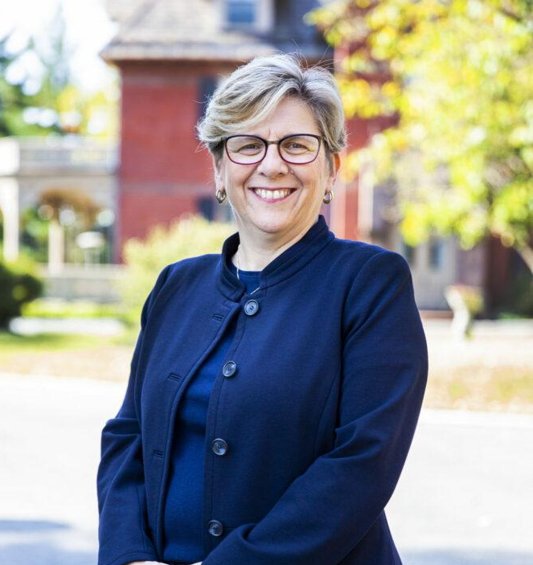
Deaf President Now
In 124 years, Gallaudet University had never had a Deaf president
In 1988, the board selected the one hearing candidate (who didn’t know sign language) over the three Deaf candidates
One week of protests
Zinser resigned after three days as President and the Board elects Dr. I. King Jordan, the first Deaf President of Gallaudet
Gallaudet has had a Deaf President ever since. On the left, is an image of Roberta J. “Bobbi” Cordano, the current President of Gallaudet University
Notes:
Citations:
Chamot, Josh. (2003, June 25). American Sign Language Spoken Here. U.S. National Science Foundation. https://new.nsf.gov/news/american-sign-language-spoken-here
Deaf President Now (DPN) Protest. (2024). Gallaudet University. https://gallaudet.edu/museum/history/the-deaf-president-now-dpn-protest/
Heumann, J. E., & Joiner, K. (2020). Being Heumann: an unrepentant memoir of a disability rights activist. Beacon Press.
National Deaf Life Museum. (2024). History. Gallaudet University. https://gallaudet.edu/museum/history/
National Deaf Life Museum. (2024). I. King Jordan Biography. Gallaudet University. https://gallaudet.edu/museum/history/i-king-jordan-bio/
Weinstock, Robert. (2024, October 14). Washington Business Journal Names President Cordano 2024 DEI Champion. Gallaudet University: University Communications. https://gallaudet.edu/university-communications/washington-business-journal-names-president-cordano-2024-dei-champion/

Slide 36
International Sign (IS)
Not an official language. Current status: Pidgin (think Spanglish)
First attempt at creating an International Sign system was in 1951. Originally a massive failure, International Sign has continued to develop and is now quite popular
Designed to be easily understood by anyone with knowledge of any sign language
Used at most events where international deaf people need to communicate
Still evolving, heavily influenced by Western sign languages
Notes:
Citations:
1. DiMarco, N. & Siebert, R. (2022). Deaf Utopia: A Memoir – and a Love Letter to a Way of Life. William Morrow. April 19, 2022.
2. International Sign. (2024, May 6). Wikipedia. Retrieved August 13, 2024, from https://en.wikipedia.org/wiki/International_Sign

Slide 37
Key Takeaways
There is no universal sign language. However, there is a system called International Sign. It was intentionally created and is used at international gatherings
There are more than 300 different sign languages around the world
Sign Languages develop naturally wherever there is a need, the same way spoken languages develop
Sign language has been used in North America for over 6,000 years
American Sign Language is an official language. It is a mix of several different sign languages and is grammatically very different from English
ASL has accents and dialects

Slide 38
Questions?

Slide 39
Disability Equity Office
Contact Information and Resources

Slide 40
National Disability Employment Awareness Month Events
A Spoon Theory Experience
Oct 25 @ 9:00am (Michigan Union)
Accessible Word and Google Docs Documents
Oct 28 @ 11:00am (virtual)
Ask an Accessibility Specialist
Oct 30 @ noon (virtual)
Register today @ Sessions

Slide 41
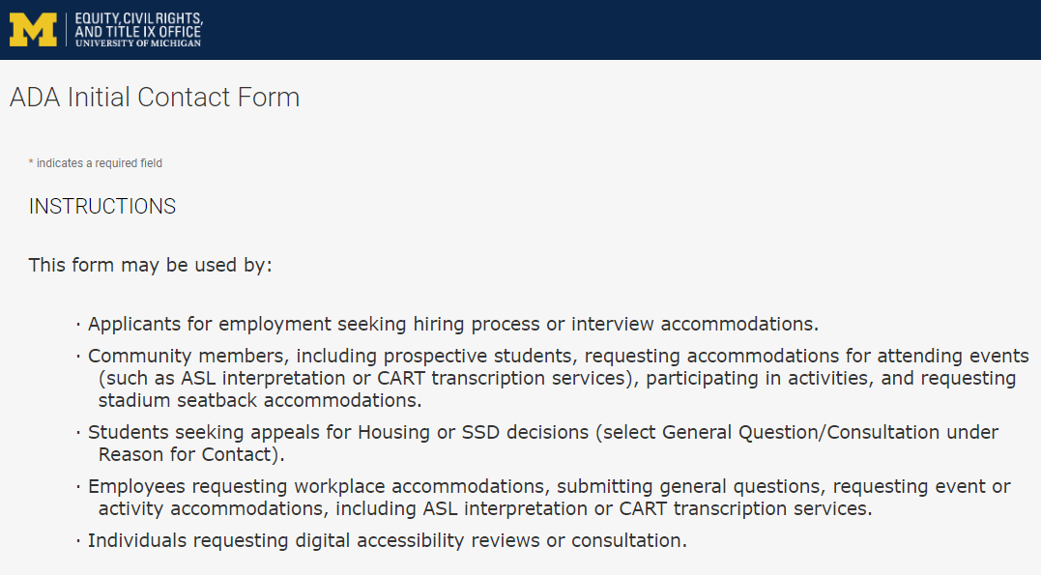
Contact the Disability Equity Office https://ecrt-umich-accommodate.symplicity.com/public_accommodation/
Use the ADA Initial Contact Form to request:
Workplace accommodation
Hiring process accommodation
Consultation with the Disability Equity Office staff
ASL or CART services
Digital accessibility review or consultation
Stadium seatback accommodations
Notes:
ADA Initial Contact Form: https://ecrt-umich-accommodate.symplicity.com/public_accommodation/

Slide 42
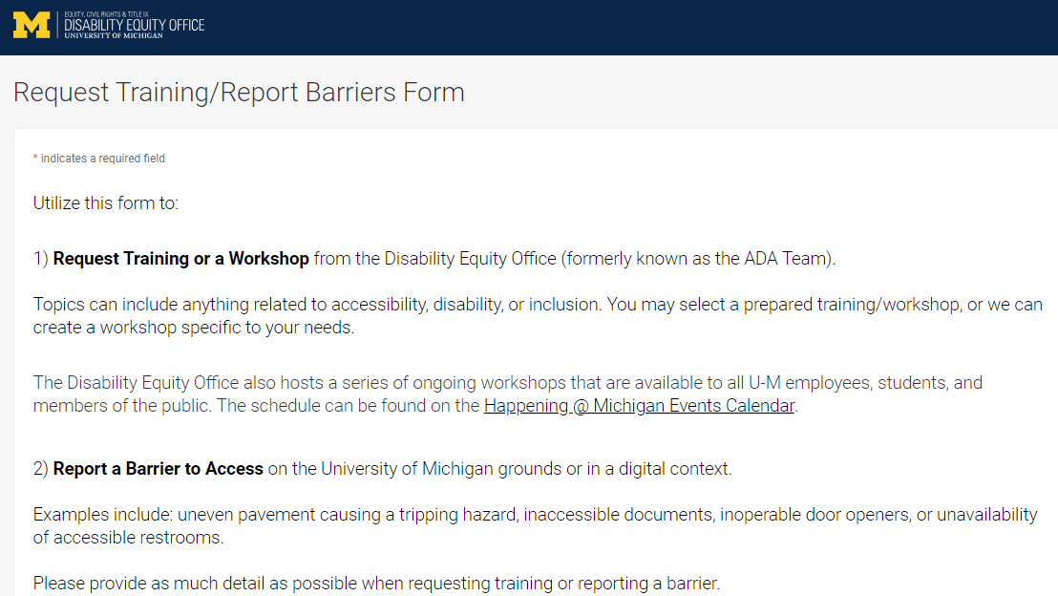
Request Training or Workshops https://ecrt-umich-accommodate.symplicity.com/activity_provider_request/
Use the Request Training/Report Barriers form to request training for your department or group. Topics include:
Ableism Awareness
Creating Accessible Digital Documents
Creating Inclusive Environments
Disability Awareness
Reasonable Accommodations and the Interactive Process
Service Animals
Notes:
Request Training/Report Barriers Form: https://ecrt-umich-accommodate.symplicity.com/activity_provider_request/
Happening @ Michigan Events Calendar for Equity, Civil Rights, and Title IX: https://events.umich.edu/group/4765

Slide 43
Report Barriers to Access https://ecrt-umich-accommodate.symplicity.com/activity_provider_request/
Use the Request Training/Report Barriers form to report physical or digital barriers to access
Examples:
Inoperable door openers or elevators
Cracked pavement causing tripping hazards
Inaccessible software or documents
Notes:
Request Training/Report Barriers Form: https://ecrt-umich-accommodate.symplicity.com/activity_provider_request/

Slide 44
More Learning Opportunities From ECRT
Filterable list of resources on the ECRT website
ECRT's YouTube Channel
ECRT's Upcoming Events Page
Recorded Presentations & Trainings
Notes:
Filterable list of resources on the ECRT website: https://ecrt.umich.edu/get-help-support/resources/
ECRT’s YouTube Channel: https://www.youtube.com/@ECRTumich
ECRT’s Upcoming Events are listed on the Happening @ Michigan website: https://events.umich.edu/group/4765
Recorded Presentations & Trainings website: https://ecrt.umich.edu/disability-accessibility/presentations-trainings/

Slide 45
Thank You From DEO!

