Slide 1
Neuro-Inclusion and Disability-Centered Workspaces
Erin Metz
Accessibility Specialist
Notes:
JF

Slide 2
Zoom Webinar Tips
Use the Q&A feature to submit your questions.
ASL interpretation can be utilized by clicking Interpretation and selecting American Sign Language.
CART transcription can be turned on by selecting Show Captions.
Notes:
This workshop is also being recorded and will be made available on ECRT’s YouTube channel: https://www.youtube.com/@ECRTumich as soon as possible. The slides will be emailed to all registered participants within the coming days along with an anonymous survey. We do really hope you’ll complete the short survey, as this helps us determine how we can best assist you with your learning goals.

Slide 3
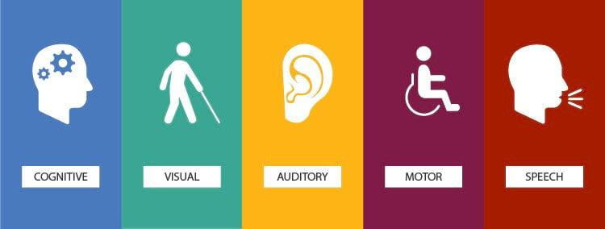
Agenda
Disability is an integral part of the university’s diversity, equity, inclusion, and accessibility (DEIA) efforts. This session will cover:
The ADA and Disability Basics
Introduction to Neurodiversity
Executive Functioning
Ableism & Language Etiquette
Inclusive Environments
Notes:
EM:

Slide 4
The Americans with Disabilities Act (ADA)
And a Few Disability Basics
Notes:
JF

Slide 5
What is the ADA? The Americans with Disabilities Act (1990) and the Amendments Act (2008)
Prohibits discrimination and harassment against a qualified individual with a disability (IWD) in employment, public places, public education, etc.
Protects individuals from discrimination based on association with an IWD.
Creates an affirmative duty to provide a reasonable accommodation (this means that to deny a reasonable accommodation is discriminatory).
Notes:
IWD = Individual With a Disability

Slide 6
Disability Definition
A physical or mental impairment that substantially limits one or more major life activity.
This includes people who have a record of such an impairment, even if they do not currently have a disability.
It also includes individuals who do not have a disability, but are regarded as such.
Notes:
Substantial limitation is determined by comparison to an average person in the general population.
Major life activities include: bending, breathing, caring for self, concentrating, hearing, interacting with others, learning, lifting, sitting, speaking, standing, thinking, walking, working, etc.

Slide 7
Disability Models
Older Models
Newer Models
Legal model
Defined by the ADA.
Medical model
Considers disability a medical diagnosis of the body or mind.
Often leads to a focus on how to “fix” the disabled person.
Social model
Disability is created by the barriers in society, rather than by individual differences.
“We are more disabled by the society we live in than by our bodies and our diagnoses.” Stella Young
Biopsychosocial model
Disability is a combination of biological factors, how environments are structured, and how a person thinks or feels about their abilities and limitations.
Notes:
Link: Stella Young’s Ted Talk “I’m not your inspiration, thank you very much.” (https://www.ted.com/talks/stella_young_i_m_not_your_inspiration_thank_you_very_much?language=en)

Slide 8
Individuals with Disabilities
1 in 4 adults in the United States and over a billion worldwide.
Unemployment rate is 4x higher than for individuals without disabilities.
96% of people with chronic conditions live with non-apparent disabilities.
Largest minority group in the U.S. and one of the only groups you can join at any time in your life.
Two people can have the same disability, but with different impacts.

Slide 9
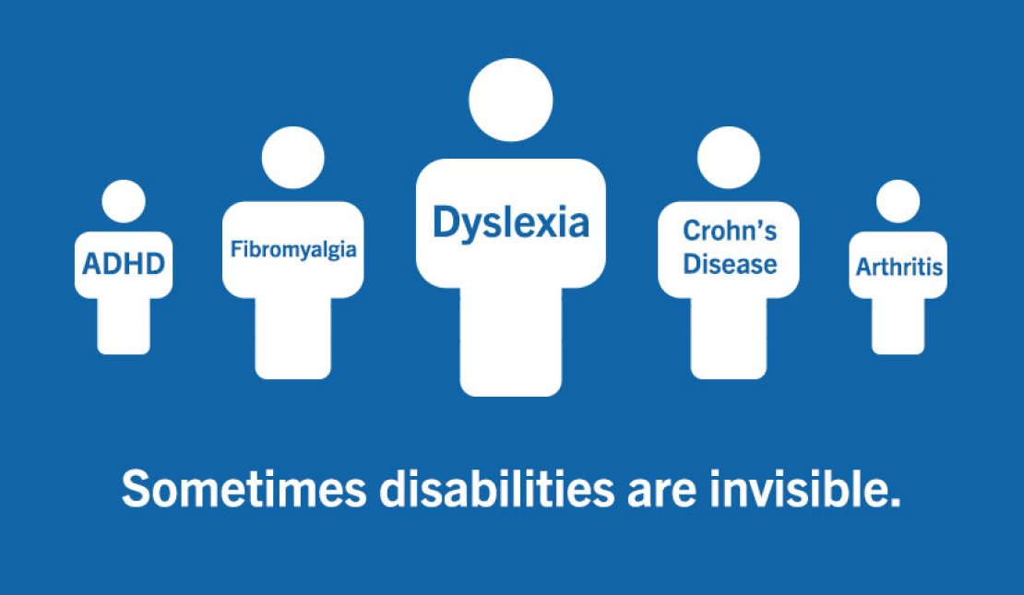
Non-Apparent Disabilities *a non-exhaustive list*
Diabetes
Fibromyalgia
Heart disease
Inflammatory bowel disease
Lyme disease
Lupus
Migraine
Thyroid disorders
ADHD
Allergies
Arthritis
Asthma
Cancer
Chronic pain
Chronic fatigue
Crohn’s disease
Notes:
We want to take a minute to discuss the concept of non-apparent or what some individuals have called invisible disabilities.
Non-apparent disabilities can be apparent, with a visible component we can identify, some are non-apparent such as many chronic conditions, and some may manifest in apparent and non-apparent ways.
It is important to remember that disability itself is a spectrum of experiences and can change over time, become progressive, wax and wane, and even be temporary.

Slide 10
Introduction to Neuro-diversity and Neuro-inclusion
Notes:
LO: I’ll begin by providing some definitions, to help familiarize us with this topic. Many of these words sound similar, but have different meanings.

Slide 11
Definitions (1 of 3)
Neurodivergent: describes the variation of cognitive-functioning that people experience, that is outside the “normative” way of processing.
Neurodiversity: a framework for understanding and supporting the natural and different ways people think, learn, and perceive the world.
Notes:
We are ALL neurodiverse in some way, as no two brains are exactly alike, nor work in the exact same way. This is referred to as neurodivergence.
These definitions refer to differences, whereas opposing terminology consists of neurotypical or neuromajority, which I will define on our next slide.

Slide 12
Definitions (2 of 3)
Neurotypical: a term, synonymous with ‘Neuromajority’ that is used to describe the societal standard of “normal” brain functioning.
Neuronormative: describes the policies and practices that are intended to “normalize” human behaviors.
Notes:
I’m using quotes when stating the term “Normal,” because there is not an overall standard for what is considered normal, rather expectations from society.
These practices refer to a set of assumptions, norms, and practices that consider neurotypicality as the superior mode of cognition and these perspectives stigmatize attitudes, behaviors, or actions that reflect neurodivergent ways of processing as deviant or inferior.
Examples of these practices consist of societal expectations for what is considered a “normal” level of eye contact, appropriate facial expressions, or flow of conversational responsiveness. This is a standard projected onto others. Not all neurodivergent individuals experience these challenges in interactions, however, some do. These interactions may be more difficult for some neurodivergent individuals to understand, sense, or apply due to variations in their neurocognitive processing. Again, we all neurodiverse and experience differences in varying ways.

Slide 13
Definitions (3 of 3)
Masking: describes a social strategy used to alter behaviors and mannerisms, to conform to societal expectations, often at the cost of one’s own true identity.
Camouflage: adaptive behaviors used to blend into societal standards or social environments to avoid exclusion.
Social Mimicry: actions that imitate social interactions, conversations, and expressions to fit in.
Notes:
Due to frequent practices of neuronormativity in society, these strategies are often employed for neurodivergent individuals to feel more welcome and included in community-based settings.
When thinking of a tangible example of this, how many people have laughed at a joke they didn’t understand? This helps make us feel included.
When neurodivergent individuals work to conform to these standards, they dissociate from their own individual and unique identities. As disability allies, we want to embrace our differences. One way to do so is by identifying and creating supports and resources that include variations in our worlds and workplaces.

Slide 14
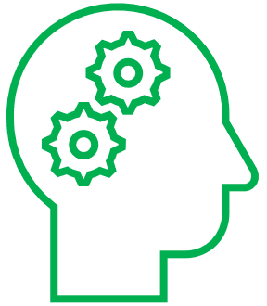
What is Neuro-Inclusion?
Neuro-Inclusion: equitable and inclusive systems and practices accounting for variations in brain functioning.
Notes:
More specifically, neuro-inclusion in the workplace refers to creating an inclusive environment that values and supports individuals with diverse neurocognitive abilities. This supports the understanding of neurodiversity and encourages that we unlearn practices of neuronormativity.

Slide 15
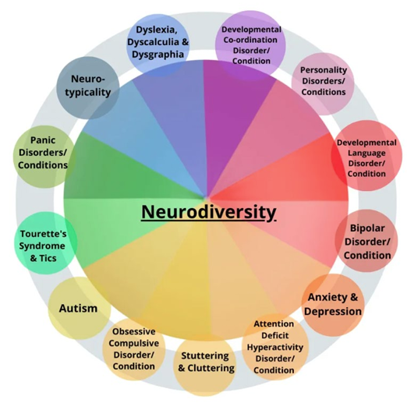
Neurodivergent Categories *a non-exhaustive list*
ADD/ADHD
Alzheimer’s Disease
Anxiety
Autism Spectrum Disorder
Bipolar Conditions
Down Syndrome
Dyscalculia
Dyspraxia
Dyslexia
Epilepsy
Multiple Sclerosis
Obsessive Compulsive Disorder
Parkinson’s Disease
PTSD
Synesthesia
Tourette’s Syndrome
Notes:
Societally, it is common for individuals to think of the diagnosis of Autism Spectrum Disorder, when hearing the term “Neurodivergent,” however, there are many other conditions that fall within this umbrella term. This is a non-exhaustive list that includes additional diagnoses which are categorized as such.
Some of these conditions you may not have realized are even considered to be neurodivergent.
At the bottom left of this slide, there are two less familiar terms, which are: Dyscalculia and Dyspraxia
*Dyscalculia - a math learning disability that impairs an individual's ability to learn number-related concepts and perform accurate math calculations. It is sometimes called “number or math dyslexia.”
*Dyspraxia - a disorder that affects movement and coordination. It is also known as Developmental Coordination Disorder.

Slide 16
Myths and Misconceptions
People with disabilities:
Neurodivergent people:
Are less productive, less effective, or less efficient.
Are difficult to manage.
Are required to disclose their disabilities to their employer.
Are difficult or expensive to accommodate.
Only have Autism.
Cannot work well in a team.
Do not want to socialize or are anti-social.
Create a burden and problem that needs to be fixed.
Are high- or low-functioning.

Slide 17
Executive Functioning
Notes:
LO:

Slide 18
Executive Functions
Executive functions: a set of cognitive abilities that include the ability to plan, organize, strategize, pay attention, recall information, start and stop actions, form concepts, and think abstractly.
Executive functioning skills are commonly affected by individuals with neurodiverse conditions.
Creating a more neuro-inclusive work environment allows individuals with executive functioning differences to address many environmental factors that can impact their ability to manage limitations successfully.
Notes:
https://askjan.org/articles/Executive-Functioning-Deficits.cfm

Slide 19
Executive Functioning Barriers and Supports (1 of 3)
Time Management: Barriers
Time Management: Supports
Difficulty with time initiation.
Inability to accurately mark time as it passes.
Reduced time anticipation, including the ability to determine the amount of time tasks may take.
Timers and alarms, schedule transition periods into a calendar.
Checklists of assignments, divide large assignments into tasks with specific completion deadlines.
Wall calendar for visualization of due dates, color-coding tasks.
Notes:
As accessibility specialists, our role is to facilitate the Interactive Process to identify and implement reasonable accommodations into the workplace.
In this process, employees will provide us with their lived experiences, barriers and/or limitations in the workplace. We will use our backgrounds, expertise, and resources, to collaborate with the employee on potential supports, or accommodations, that could be implemented into the workplace to assist them with fulfilling the essential functions of their job.
I’m going to provide you with three examples of limitations that an individual with a neurodivergent diagnosis may experience challenges with and discuss potential resources or supports that are accommodation options in the workplace. These could also be used in the academic environment, or other community-based settings.
We will start with time management -

Slide 20
Executive Functioning Barriers and Supports (2 of 3)
Concentration: Barriers
Concentration: Supports
Decreased concentration caused by visual and/or auditory distractions in the work environment.
Internal distractions, caused by ruminating thoughts.
Noise canceling headsets, sound absorption panels, and white noise machines.
Install cubicle walls and frosted window panels.
Reduce clutter and provide organizational bins/desk organizers.
Relocate an office away from high traffic and distraction areas.
Modify lighting and other sensory input.

Slide 21
Executive Functioning Barriers and Supports (3 of 3)
Memory: Barriers
Memory: Supports
One’s ability to remember tasks and items of daily recall.
Challenges with prospective memory, including preparing for or remembering activities that are occurring later in time.
Provide written instructions and verbal feedback.
Provide meeting agendas and minutes.
Use a recorder for meetings.
Allow for additional training time.
Flow charts and visual cues for job tasks.

Slide 22
General Tips to Support Neurodivergent Individuals
Embrace individuality:
Understand unique needs and strengths.
Identify, acknowledge, and understand differences.
Tailor roles to individual abilities and avoid a one-size-fits-all mentality.
Reduce sensory overload.
Have meaningful interactions:
Make direct conversations about personal needs a priority.
Build trust through understanding.
Engage resources when needed.

Slide 23
Ableism & Language Etiquette
Notes:
JF: Considering those with neurodiverse disabilities but also those within the broader disability community, our words and actions have a very important role in creating the neuro- and disability-inclusive environments we are trying to maintain.
Language and actions are two of the most impactful areas where you can make a difference in creating and maintaining inclusive environments.

Slide 24
Ableism
Ableism: the intended or unintended discrimination and social prejudice against people with disabilities based on the belief that typical abilities are superior.
Assumption that IWDs require “fixing” and defines people by a disability.
Like racism and sexism, ableism classifies entire groups of people as “less than.”
Includes harmful stereotypes, misconceptions, and generalizations of IWDs.
Devalues and limits potential.

Slide 25
Ableist Microaggressions
Questioning whether someone really needs an assistive device, software program, ergonomic equipment, or any other type of accommodation.
“They seem fine to me!” or “They don’t look disabled.”
Interrupting or finishing sentences because someone is taking too long.
Using condescending or louder voices to explain something to an IWD.
Requiring everyone to participate in the same way.
“Everyone needs to turn their cameras on in this meeting.”
Doing the bare minimum of an accommodation.

Slide 26
Replacing Microaggressions with Microaffirmations!
Be considerate about how information is processed and received.
Reading, hearing, seeing, experiencing, or multiple concurrent modalities.
When considering an accommodation request, consider whether you can provide accommodations to everyone.
Can everyone have access to a Zoom link, use noise-canceling headphones, use a sit-to-stand desk?
Provide agendas, clear directions, and a variety of seating options for events.
State ahead of time what accommodations are provided, so an IWD doesn’t need to ask for something in order to be included.

Slide 27
Consider Your Language
Person-First Language
Identity-First Language
The individual is emphasized ahead of their disability, as disability is just one part of their identity.
Aims to recognize humanity first.
Person with a disability.
Individual with… epilepsy, an intellectual disability, a mental illness.
Person who is… deaf, blind, hard of hearing.
Individual who uses … a wheelchair, a walker, an assistive device.
Person who has… depression, anxiety, ADHD.
Challenges negative connotations by claiming disability directly.
Acknowledges disability as an integral part of identity.
Disabled person.
Deaf/deaf person (“D” refers to culture, “d” refers to the medical condition).
Autistic person.
AHEAD (Association on Higher Education and Disability) has adopted the use of Identity-First language.
Notes:
How do we know which is the right type of language to use? Both can be right, depending on the circumstances

Slide 28
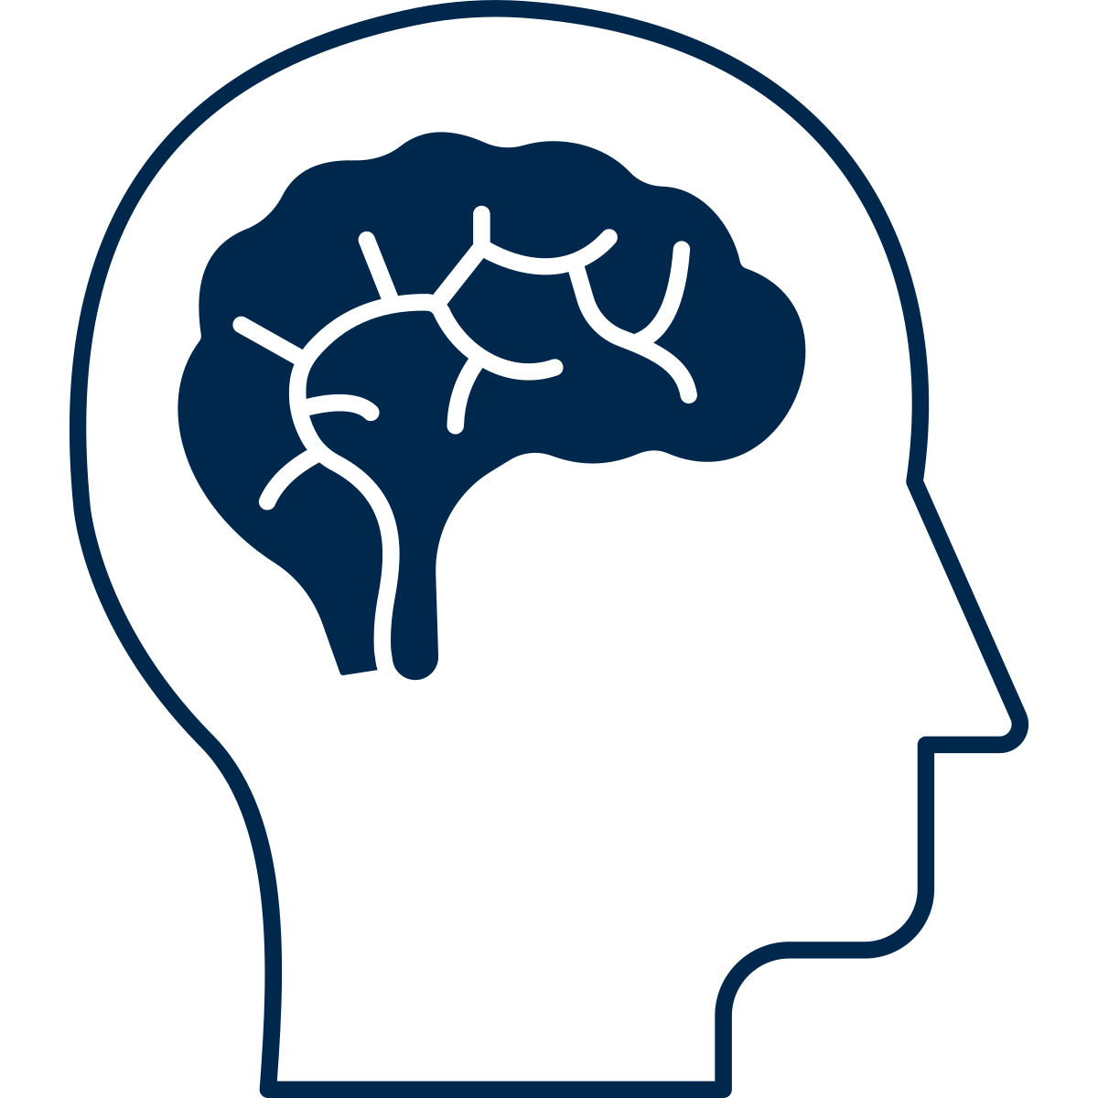
Keep in Mind
Disability and disabled are not bad words.
Challenge yourself to remove words and characterizations that may be offensive to others.
There is no reason to use “differently-abled” or “specially-abled.”
Ask what is preferred, if you are in a position to do so.
Pay attention to how someone refers to themselves.
Acknowledge that language evolves over time.

Slide 29
Language to Avoid
Language with negative overtones:
Stroke victim
Afflicted with cerebral palsy
Suffering from anxiety
Wheelchair bound
Language regarded as slurs:
Crazy
The R word
Spaz
Language that assumes knowledge about an individual’s experience because:
you “know someone with”
a “family member has”
“I used to have”
Remember: everyone experiences disability differently!
Notes:
Also want to avoid outdated language/language that has evolved over time: For example: replace “handicap” with “accessible” parking

Slide 30
Creating & Maintaining Inclusive Environments
Notes:
LO:

Slide 31
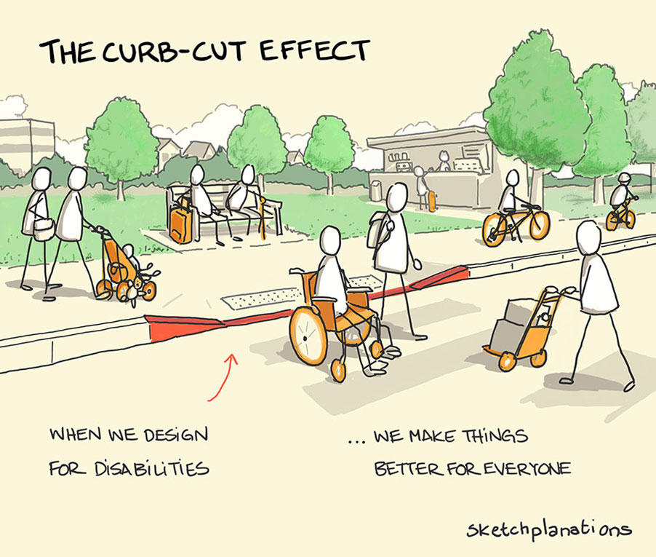
Inclusion Changes the Environment
Inclusion reduces the need for modifications and accommodations.
Inclusion reduces or removes structural access barriers.
Inclusion tends to benefit everyone.
Inclusion is proactive.
Accessibility is an aspect of inclusivity.
Notes:
Making something initially accessible to as many people as possible: May not need changes for diverse abilities. Anticipating diverse needs saves time and expense.

Slide 32
Workplace Design
Consider the impact on the senses (sight, smell, feel, sound).
Avoid strong/harsh/unnatural fragrances when possible.
Provide alternate lighting options and dimmable lights.
Offer different types of spaces with intention.
Provide various ergonomic seating or comfortable seating options.
Build in breaks during long meetings or in between several meetings.
Consider apps and planner options.
Notes:
Creating an intentionally-welcoming environment for all employees means having options and embracing differences in how people work
Offer different types of spaces with intention: Low stimulation/quiet areas for concentration, Areas for collaboration and movement, and recharge areas for privacy and reflection.
The goal would be to normalize accommodations, not people. Prioritize comfort and safety over efficiency and economy through use of education and training, modifications, and integration of sensory-informed spaces.

Slide 33
Communication is Key (1 of 2)
Ask individuals about their communication preferences.
Email, discussion, both depending on circumstances?
Avoid idioms (i.e., “You can say that again”), sarcasm, and jargon.
Pause when you ask questions (silently and slowly count to 10).
Pay more attention to what people say vs. their facial expressions or tone.
Lack of eye contact or fidgeting doesn’t mean lack of attention.

Slide 34
Communication is Key (2 of 2)
Model active listening:
Repeat back what you think you heard; “I think what I heard you say was…” not “You said…”
Do not equate directness or a lack of small talk with being anti-social.
Consider providing context and notice for potentially sensitive conversations (mistakes vs. opportunities for growth).
Be prepared to step away and come back to a conversation.
Allow others to have the ability to regroup and continue conversation when appropriate.

Slide 35
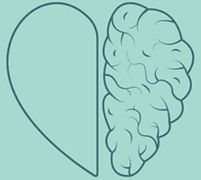
Neurodiversity Affirming Practices
Challenges systemic barriers and societal assumptions.
Unlearns ableism.
Stay sensory-informed.
Recognizes and encourages authenticity and differences.
Views modifications as growth, as opposed to change.
Conveys respect.
Notes:
These practices help to shift focus from deficits and limitations to presuming competence, which empowers strength and potential.

Slide 36
Wrap Up
Notes:
JF:

Slide 37
Key Takeaways
Dos
Don’ts
Consider accessibility barriers when planning events and meetings.
Embrace individuality.
Utilize multiple communication strategies.
Assume knowledge of someone’s experiences.
Be complacent in your learning and growth.
Be afraid to ask questions.

Slide 38
Disability Equity Office
Contact Information and Resources

Slide 39
Happening @ Michigan
Check out the Disability Equity Office’s upcoming presentations and interactive workshops by scanning this QR code or by visiting the upcoming events page!

Slide 40
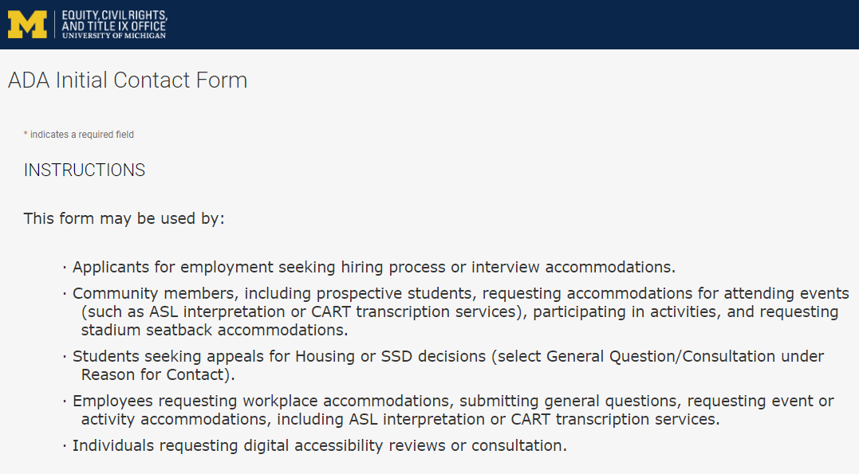
Contact the Disability Equity Office https://ecrt-umich-accommodate.symplicity.com/public_accommodation/
Use the ADA Initial Contact Form to request:
Workplace accommodation
Hiring process accommodation
Consultation with the Disability Equity Office staff
ASL or CART services
Digital accessibility review or consultation
Stadium seatback accommodations
Notes:
Employee login: https://ecrt-umich-accommodate.symplicity.com
ADA Initial Contact Form: https://ecrt-umich-accommodate.symplicity.com/public_accommodation/

Slide 41
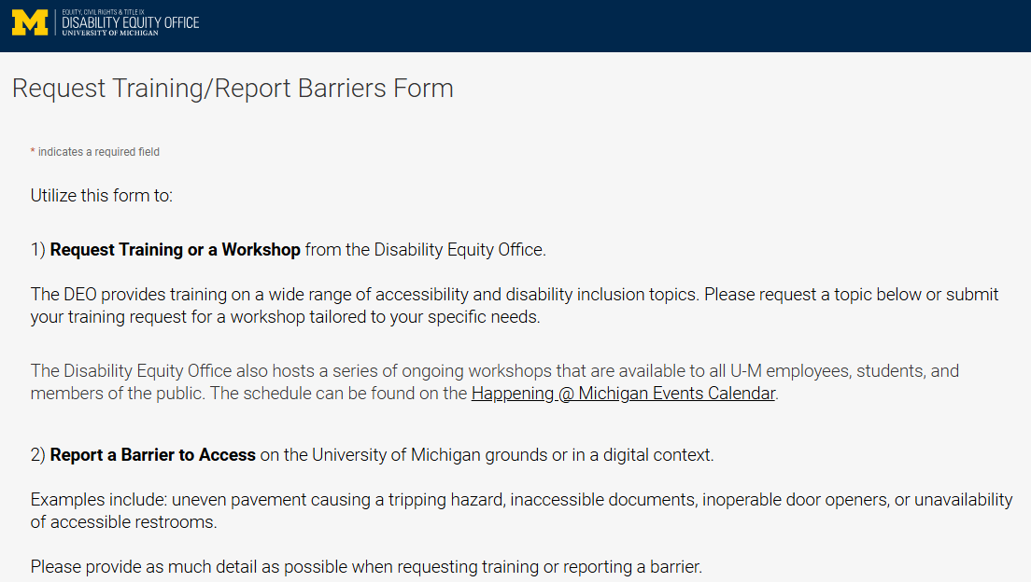
Request Training or Workshops https://ecrt-umich-accommodate.symplicity.com/activity_provider_request/
Use the Request Training/Report Barriers form to request training for your department or group. Topics include:
Ableism Awareness
Creating Accessible Digital Documents
Creating Inclusive Environments
Disability Awareness
Reasonable Accommodations and the Interactive Process
Service Animals
Notes:
Request Training/Report Barriers Form: https://ecrt-umich-accommodate.symplicity.com/activity_provider_request/
Happening @ Michigan Events Calendar for DEO : https://events.umich.edu/group/5177

Slide 42
Report Barriers to Access https://ecrt-umich-accommodate.symplicity.com/activity_provider_request/
Use the Request Training/Report Barriers form to report physical or digital barriers to access
Examples:
Inoperable door openers or elevators
Cracked pavement causing tripping hazards
Inaccessible software or documents
Notes:
Request Training/Report Barriers Form: https://ecrt-umich-accommodate.symplicity.com/activity_provider_request/

Slide 43
More Learning Opportunities From DEO
Filterable list of resources on the ECRT website
ECRT's YouTube Channel
DEO's Happening @ Michigan event list
Recorded Presentations & Trainings
Notes:
Filterable list of resources on the ECRT website: https://ecrt.umich.edu/get-help-support/resources/
ECRT’s YouTube Channel: https://www.youtube.com/@ECRTumich
DEO’s Upcoming Events are listed on the Happening @ Michigan website: https://events.umich.edu/group/5177
Recorded Presentations & Trainings website: https://ecrt.umich.edu/disability-accessibility/presentations-trainings/

Slide 44
Thank You From DEO!

