Slide 1
Non-Apparent Conditions and Self-Advocacy for Employees with Disabilities
Lauren O’Connor
Accessibility Specialist
Occupational Therapist (OTR/L)
Certified Brain Injury Specialist (CBIS)
Disability Equity Office

Slide 2
Agenda
The University of Michigan is committed to fostering an inclusive environment where accessibility and the needs of individuals with disabilities are prioritized, ensuring equitable opportunities for all members of our diverse community. This session will cover:
Defining non-apparent conditions
Examples of non-apparent disabilities
Environmental impact on an individual’s disability
Accommodation options
Disclosure and requesting accommodations
Strategies for self-advocacy

Slide 3
Defining Non-Apparent Conditions

Slide 4
Disability Definition
A physical or mental impairment that substantially limits one or more major life activity.
Substantial limitation is determined by comparison to an average person in the general population.
Major life activities include: bending, breathing, caring for self, concentrating, hearing, interacting with others, learning, lifting, sitting, speaking, standing, thinking, walking, working, etc.
This includes people who have a record of such an impairment, even if they do not currently have a disability.
It also includes individuals who do not have a disability but are regarded as such.
Notes:
What may be substantially limiting for one person may not be the same for someone else.
Record of impairment example: history of cancer, but currently in remission/not receiving treatment
Regarded as example: assuming someone has a physical or mental impairment when they do not.

Slide 5
Non-Apparent Disability
Non-apparent disabilities cannot be easily seen or detected by others.
Otherwise known as:
Hidden Disability
Invisible Disability
Notes:
“Non-apparent disability”: This is the recommended terminology, as it implies the disability is just that – non-apparent and does not imply any negative connotation. We believe disability is a strength and it does not matter what type of disability someone has.
“Hidden disability”: This implies that the person with the disability is purposefully withholding this information. There is a difference between choosing to not self-disclose a disability versus actively hiding it.
“Invisible disability”: For some people with disabilities, this term is offensive. It suggests the person is not visible or that you cannot discern that a person has a disability, which is not always true. The same is true for “non-visible disability”. Non-apparent disabilities may become apparent, depending on the type of disability.

Slide 6
Non-Apparent Disability Definition
A physical, mental, or neurological condition that is not visible from the outside, yet can limit or challenge a person’s movements, senses, and/or activities.

Slide 7
Examples of Non-Apparent Conditions

Slide 8
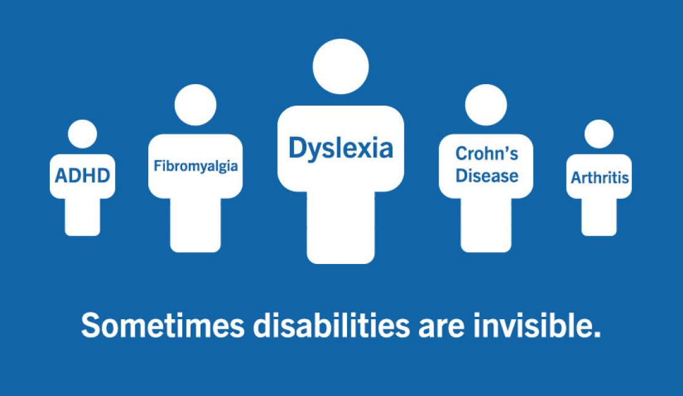
Examples of Non-Apparent Disabilities
ADHD
Allergies
Anxiety
Arthritis
Asthma
Bipolar disorder
Brain injuries
Cancer
Chronic fatigue / pain
Celiac or Crohn’s disease
Depression
Diabetes
Fibromyalgia
Heart disease
Inflammatory bowel disease
Lyme disease
Lupus
Migraine
Multiple Sclerosis
Thyroid disorders
*This list is non-exhaustive

Slide 9
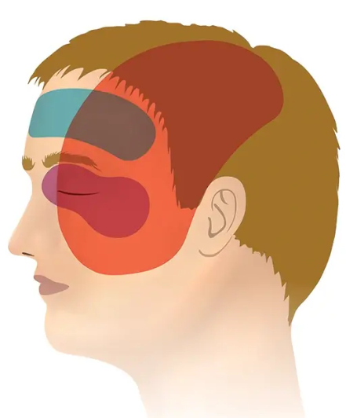
Migraine
Limitation(s): Thinking, Interacting with others, Seeing, Concentrating
Workplace Barrier(s): Bright overhead lighting, increased auditory input (i.e. HVAC, colleague collaboration, nearby construction), heat, extended screentime for computer-based work

Slide 10
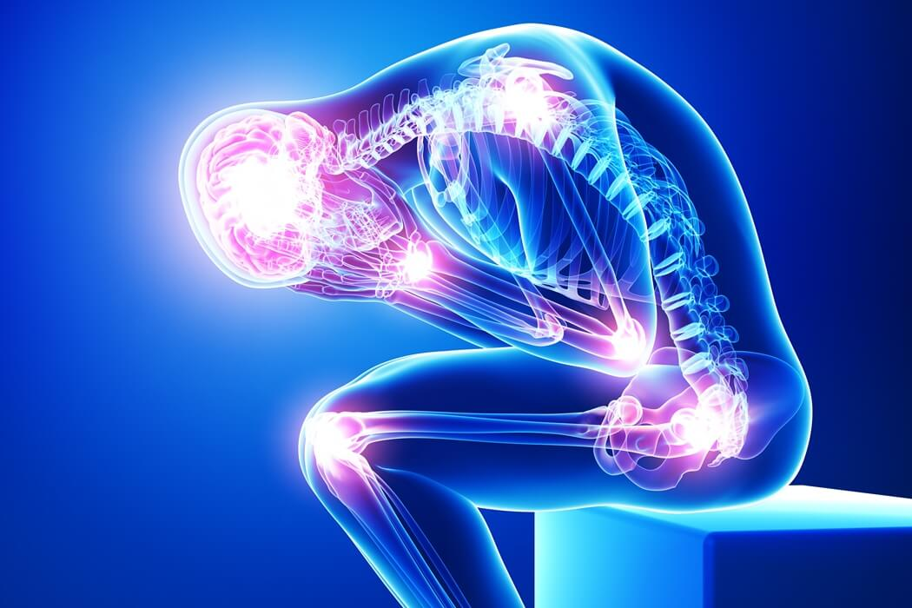
Chronic Pain
Limitation(s): Bending, Working, Walking, Performing manual tasks, Lifting, Standing, Sitting
Workplace Barrier(s): Frequency and duration of meetings, standard workstation setup, storage location of office supplies, repetitive movements, requirement to transport heavy materials to different locations

Slide 11
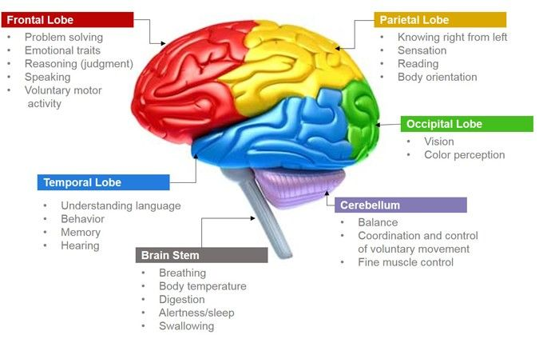
Traumatic or Acquired Brain Injury (1 of 2)
Potential Limitation(s): Bending, Reading, Working, Thinking, Interacting with others, Breathing, Eating, Seeing, Walking, Performing manual tasks, Lifting, Standing, Learning, Reaching, Concentrating, Hearing, Speaking, Sitting, Caring for oneself

Slide 12
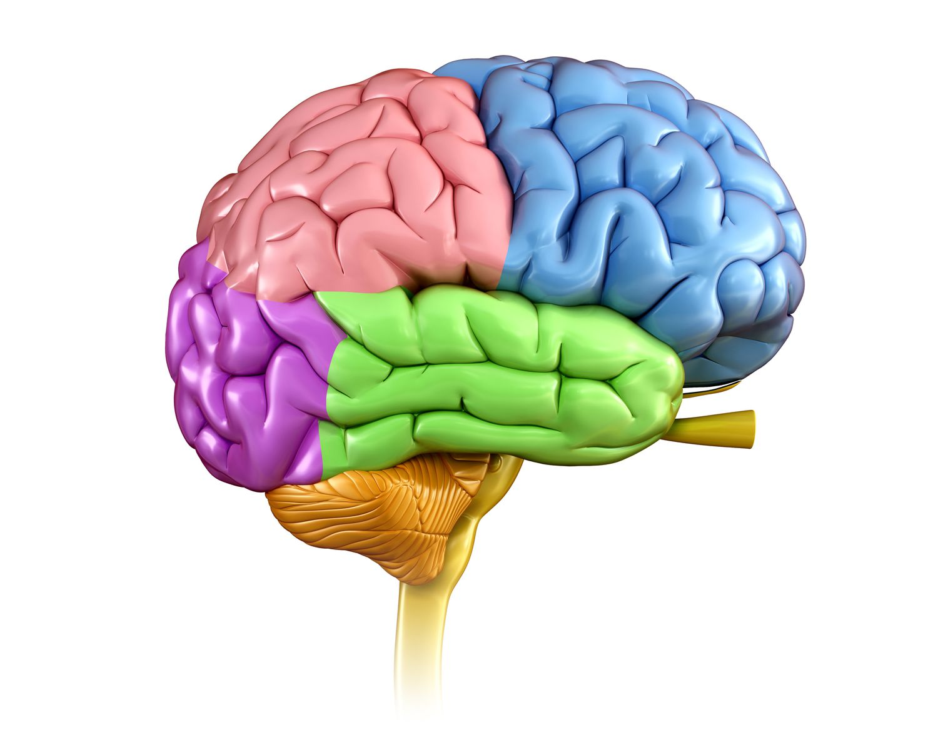
Traumatic or Acquired Brain Injury (2 of 2)
Limitation(s): Thinking, Concentrating, Speaking
Workplace Barrier(s): Completing large projects by deadlines, following instructions provided in meetings, and projecting their voice to give presentations to the department

Slide 13
Environmental Impact on an Individual’s Disability

Slide 14
Interacting with the Environment
What does it mean to adapt and modify the environment for people with disability?
Disability is the interaction between someone's life circumstances and the environment; therefore, it is pertinent to address the interaction between these two factors.

Slide 15
Physical Limitations of the Environment
Physical barriers can take the form of structural or sensory issues in the environment that impede functioning.
Example: Lighting that is too bright or too dim, vague maps that are difficult to interpret directions within buildings, poor ergonomic setup.
Considerations: Parking, wayfinding, entryway thresholds, lighting, sound, scent, and workstation layouts.

Slide 16
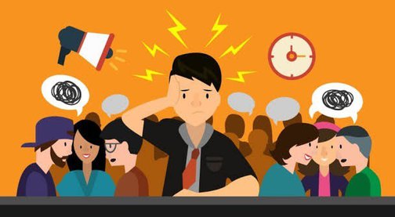
Social Limitations of the Environment
Supports and barriers within a social environment often impact one’s ability to seek resources, tools, or formal accommodations.
Example: Group projects may benefit some individuals who prefer conversation and collaboration, whereas others may be hindered by the distractions of auditory input and perform more effectively when working individually.
Considerations: Learning styles (visual, auditory, hybrid, hands-on), communication (verbal, written, both), interactions (facial expressions, tone, eye contact).

Slide 17
Accommodation Options

Slide 18
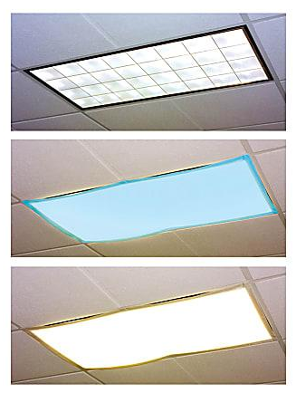
Migraine Accommodations
Bright overhead lighting – Light filters, switch out bulbs in overhead lighting, use of a light canopy, installation of a dimmer switch, ability to turn off lights and use task lighting as an alternative
Increased auditory input – Relocate desk away from HVAC systems and/or heavy traffic areas, noise-reducing headphones, sound absorption panels, use of a private office, hybrid schedule, ability to work from home when there are no in-person essential functions required on a specific day
Heat – Localized climate control, ability to work in alternative spaces
Extended screentime – Rest breaks, alternating work style (layout chunks of the day to switch between computer-based work and other job-related tasks), anti-glare screen filters
Notes:
Please note, not each of these accommodations would be a reasonable solution for any individual who experiences migraines in the workplace. Accommodations are explored based on how this diagnosis presents itself in each individual, what the specific triggers, barriers, and limitations are, what the essential functions of their role are, how the accommodation may impact business operations, and other factors.
- Limitation(s): Thinking, Interacting with others, Seeing, Concentrating

Slide 19
Chronic Pain Accommodations
Frequency and duration of meetings – Breaks, ability to get up and move around throughout, option to participate in meetings virtually (ability to turn off camera during of symptom exacerbation)
Standard workstation setup – Assess postural needs and ergonomic modifications, such as a monitor riser, lumbar chair support, sit-to-stand desk, walking pad, location of supplies on desk
Storage location of office supplies – Relocate frequently used items to chest or eye-level heights, such that they are easily able to obtain without extended reaching or bending
Repetitive movements– Rest breaks, alternating work style (format day to plan for transitional tasks to reduce the duration of repetitive movements in the same planes of motion), ergonomic equipment for improved posture (keyboards, mouse, wrist pad)
Transport heavy materials – Use of a dolly or rolling cart
Notes:
Limitation(s): Bending, Working, Walking, Performing manual tasks, Lifting, Standing, Sitting

Slide 20
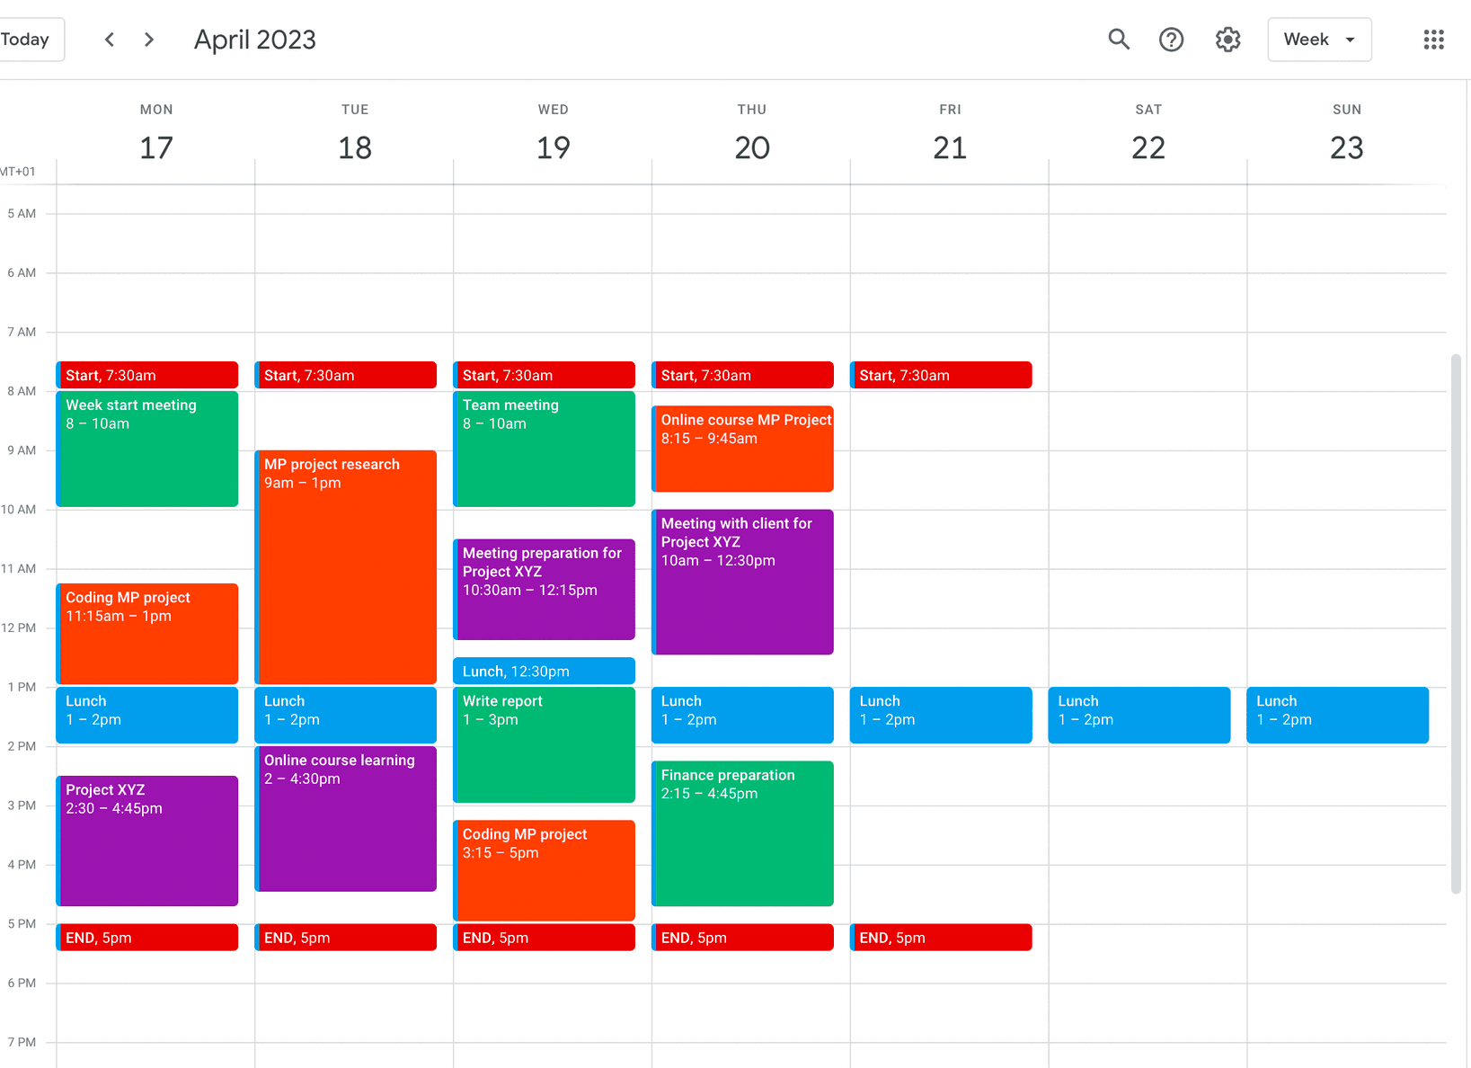
Brain Injury Accommodations
Completion of Large Projects – Project management software to assist with breaking large projects down into smaller and more manageable tasks, visual calendars to depict task-by-task deadlines to remain on pace for completion, 1:1 supervisory meetings to discuss plans and next steps
Following Instructions provided in Meetings – Include meeting agendas/action items, provide instructions in written format, assign a designated note-taker
Speaking at Department Presentations – Provide voice- amplification devices, such as a microphone, practice in advance and arrange setup with ITS for proper utilization
Notes:
- Limitation(s): Thinking, Concentrating, Speaking

Slide 21
Disclosure and Requesting Accommodations

Slide 22
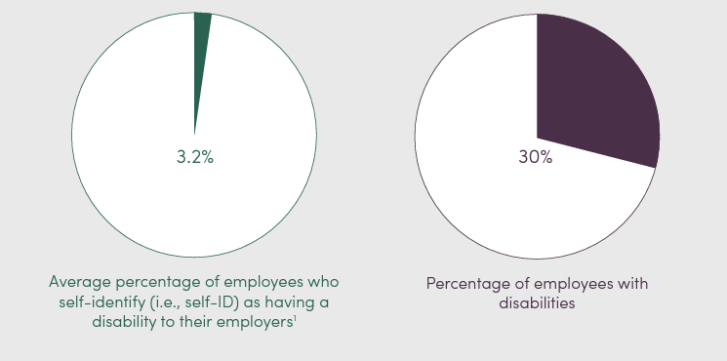
Disclosing to an Employer
Notes:
This tells us a substantial number of people have disabilities but are not disclosing. This could be for positive reasons like not experiencing barriers in the workplace

Slide 23
Top Factors Considered Before Disclosing Disabilities
Anxiety about the process: Not sure what to say or what could help.
Medical documentation: Concerns of it not being sufficient.
Fear: Concerns about losing their job, being treated differently, discrimination, and retaliation.
Overwhelmed by options: Where to go for access and support?
Exhaustion: Redirected too many times or disclosed without a resolution.
Negative experiences: From their past or of others that impact choices.

Slide 24
Advantages and Disadvantages of Disclosure
Advantages
Disadvantages
Receiving support and pursuing reasonable workplace accommodations.
Legal protections against discrimination as specified in the ADA.
Reduction of stress.
Protecting private information can take a lot of energy!
Improves self-image through self-advocacy.
May receive different, unfair, or unwelcome treatment.
Can experience exclusion.
May be blamed for issues or problems.
Can result in conflicting feelings about self-image.
May be seen as needy or not self-sufficient.
Can be overlooked for team activities.
Notes:
Some ways that UM works to prevent these things from happening are university-based policies, Standard Practice Guidelines (SPGs), Equity, Civil Rights, and Title IX (ECRT) office services, and through various trainings, such as this workshop.

Slide 25
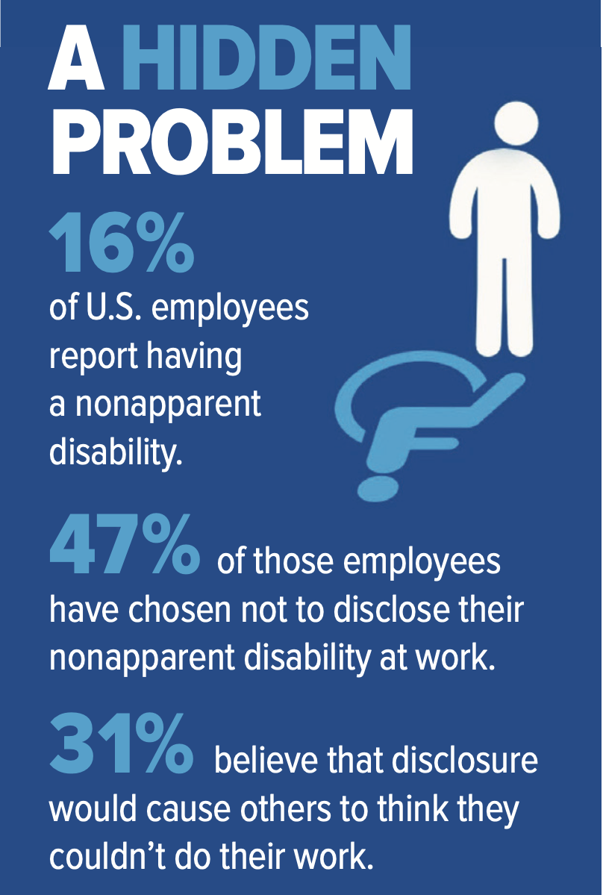
How to Disclose
A common misconception is that employees are required to share their diagnosis with their supervisor.
Supervisors will need to know about an accommodation and the limitations or barriers the employee is experiencing, but they DO NOT need to know the specific condition or diagnosis of the employee.
Medical information is only shared privately and confidentially with the Disability Equity Office when an employee requests an accommodation.

Slide 26
Who to Disclose to
University of Michigan offers many avenues to pursue accommodations!
Your unit HR representative
Your immediate supervisor
Disability Equity Office
Work Connections (if temporary, short/long term disability, etc.)
Notes:
This disclosure to the supervisor should be the need for accommodations, but not include medical information or the specific diagnosis.

Slide 27
Manager’s Steps to Take When an Accommodation Request is Received
Implement the requested accommodation, if you can.
Consult with the Disability Equity Office – we are here to help!
Staff have specialized training and access to resources.
Centralized storage for medical documentation and accommodation documents.
Follow up with the requestor to ensure needs are met.
Maintain privacy.

Slide 28
Strategies for Self-Advocacy

Slide 29
Self-Advocacy
Assess your own comfort level and needs.
Contact affinity groups.
Engage resources.
Provide yourself with the right to utilize benefits.
Consider your lived experience and circumstances.
Do not stigmatize your diagnosis by acting based on fears of others’ perspectives.

Slide 30
Affinity Groups
Employee Resource Groups
LSA Affinity Groups (open to all U-M employees)
ADHD - This group is for employees who have ADD/ADHD and are looking to connect with others for the purposes of mutual support and sharing resources/techniques/strategies.
Frequency: Meet monthly or however often members feel would be worthwhile.
Communication: Group email to connect electronically between meetings.
Point of Contact: Jesse Miller (he/they)

Slide 31
Thank You from DEO

