Slide 1
Everything You Need to Know About Service Animals at U-M
Erin Metz
Senior Accessibility Specialist
May 6, 2025
Notes:
Hello, I’m Erin Metz, a Senior Accessibility Specialist with the Disability Equity Office and I’m joined by Katrina Johnson who is providing ASL Interpretation. We’re here today to go over everything you need to know about service animals at University of Michigan.

Slide 2
Agenda
The University of Michigan is committed to fostering an inclusive environment where accessibility and the needs of individuals with disabilities are prioritized, ensuring equitable opportunities for all members of our diverse community. This workshop will cover:
ADA Basics
Differences between service animals, service animals in training, and emotional support animals
Handler rights and responsibilities
Service animal etiquette
FAQs
Notes:
The University of Michigan is committed to fostering an inclusive environment where accessibility and the needs of individuals with disabilities are prioritized, ensuring equitable opportunities for all members of our diverse community. This workshop will cover some ADA basics, discuss the difference between service animals, those in training, and emotional support animals. We’ll go over some handler rights and responsibilities, service animal etiquette, and then cover the most frequently asked questions.

Slide 3
Legal Framework & Basics
A Brief Introduction
Notes:
Because we are discussing service animals in both the employment and educational context, it is important to remember that service animals as reasonable accommodations may be covered by multiple legal frameworks, including the Fair Housing Act (FHA), Rehabilitation Act of 1973, and Michigan Public Act 75 of 2022

Slide 4
What Is the ADA? The Americans with Disabilities Act (1990) and the Amendments Act (2008)
Prohibits discrimination and harassment against an individual with a disability.
Protects from discrimination based on association with an individual with a disability.
Creates an affirmative duty to provide a reasonable accommodation.
Notes:
The Americans with Disabilities Act of 1990, updated in 2008, is a key piece of legislation that prohibits discrimination against individuals with disabilities across various domains like employment, places of public education, and public spaces. It is important to note that for the purposes of the ADA service animals are not covered under employment or Title I. This will become important later on as we discuss the need for reasonable accommodations to bring a service animal into a workplace.

Slide 5
Physical, Neurological & Psychological Disabilities
Neurological conditions cover a vast range of psychological or mental health diagnoses, as well as cognitive conditions, including learning, executive functioning, and behavioral conditions.
Physiological conditions, cosmetic disfigurement, or anatomical loss affecting the body or a body function:
Neurological, musculoskeletal, special sense organs, respiratory (including speech organs), cardiovascular, reproductive, digestive, genito-urinary, hemic and lymphatic, skin, and endocrine.
Notes:
The ADA is very clear in the intent to consider disability broadly to ensure the greatest protections for individuals with disabilities to enable them to receive equal access and to prevent discriminatory treatment. This means that there is no exhaustive list of conditions and an individualized assessment of a person’s condition is required when making a disability determination. Service animals can be used as an accommodation for people with physical, neurological, psychological, and physiological disabilities

Slide 6
Student Academic Modifications and Adjustments
The University is required to:
The University is not required to:
Provide appropriate academic adjustments and auxiliary aids and services that are necessary
Afford an equal opportunity to participate in a school's programs or services
Make adjustments or provide aids or services that would result in a fundamental alteration of a recipient's program or impose an undue burden
Provide reasonable accommodations to individuals who are not qualified
Notes:
The university is required to provide academic adjustments and auxiliary aids and services to students when they are necessary. They are also required to afford a student with an equal opportunity to participate in programs and services offered by the school.
The university, however, is not required to make an adjustment that results in a fundamental alteration of a program or service, or one that imposes an undue burden. The university also does not need to provide an accommodation to an individual who is not qualified. Qualified individuals are those who meet the requirements for the position or the academic program, with or without reasonable accommodation

Slide 7
Workplace Accommodations
Employers, such as U-M, are required to provide modifications or adjustments to a job or the work environment that will enable an applicant or employee with a disability to participate in the application process or to perform essential job functions.
This also includes adjustments to assure that an individual with a disability has rights and privileges in employment equal to those of employees without disabilities.
Notes:
Employers are required to provide modifications or adjustments to a job or the work environment that will enable an applicant or employee with a disability to participate in the application process or to perform essential job functions to ensure that the individual has the same rights and privileges in employment as those without disabilities.

Slide 8
Service Animals, Service Animals in Training, and Emotional Support Animals
What’s the difference?
Notes:
Now let’s talk about service animals, service animals in training, and emotional support animals so we can understand the difference.

Slide 9
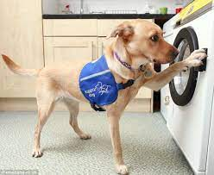
Service Animals
Any dog or miniature horse that is individually trained to do work or perform tasks for the benefit of an individual with a disability.
The work or tasks performed by a service animal must be directly related to the individual’s disability.
Service animals are working animals, not pets, and are not emotional support animals.
Notes:
Read slide

Slide 10
Types of Service Animals (1 of 2)
Guide Dog: serves as a travel tool for persons who have visual limitations or are blind.
Psychiatric Service Dog: performs tasks that assist in detecting the onset of psychiatric episodes and lessen their effects.
Tasks may include reminding the handler to take medicine, providing safety checks or room searches, turning on lights for persons with PTSD, interrupting self-harm, and keeping disoriented individuals from danger.
Notes:
Some of the most common types of service animals are guide dogs who serve as travel tools and psychiatric service dogs that can detect the onset of episodes and lessen their effects. This could include performing tasks like providing reminders to take medicine, perform room safety checks, and turning on lights.

Slide 11
Types of Service Animals (2 of 2)
Sensory Signal Dog or Social Signal Dog (SSigDOG): trained to assist an autistic person or their caregiver. These dogs are trained to do a variety of social or sensory tasks based on the needs of the individual.
Seizure Response Dog: may be trained to stand guard during a seizure or may go for help.
Hearing or Signal Dog: alerts someone who is deaf or hard of hearing when a sound occurs, such as a knock on the door.
Notes:
Other common service animals are Sensory SSigDogs that can cue a person to pay attention to street crossings and crosswalks when walking to their job. Or a dog might listen for a parent calling a child’s name and guide the parent to the child.
Seizure response dogs that can predict a seizure and warn the person in advance to sit down or move to a safe place.
And hearing dogs that can alert their handler to a sound, such as a knock at the door
Please note that there are many types of service animals and this list is just a very small glimpse into some of the tasks that service dogs can be trained to perform.

Slide 12
Where Are Service Animals Allowed?
Anywhere their handler is allowed to go in places of public accommodation:
Anywhere that is inviting someone in.
Anywhere that is charging for goods, services, and lodging.
Medical facilities.
In public places owned or operated by federal or state government or that accept federal or state funds:
Public schools, town halls, state agencies, etc.
Notes:
Service animals are allowed anywhere their handler is allowed in places of public accommodation, and in places that are owned or operated by federal or state governments that accept funding. This includes the University of Michigan.

Slide 13
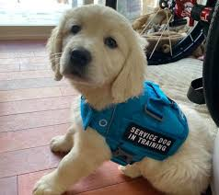
Service Animals in Training
A dog or miniature horse accompanied by an animal raiser or trainer with the intent that the animal is being raised, socialized, and trained to become a service animal
In Michigan, service animals in training are considered equivalent to service animals for the purpose of training in public spaces.
Notes:
Service animals in training are covered under Michigan Public Act 75 of 2022, and are considered equivalent to service animals for the purpose of training in public spaces.
Michigan Public Act 75, 2022: https://legislature.mi.gov/documents/2021-2022/publicact/htm/2022-PA-0075.htm

Slide 14
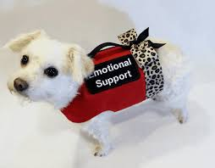
Emotional Support Animals or Comfort Animals
Not covered by the ADA or by Michigan state law.
Provide companionship, relieve loneliness, and sometimes help with depression, anxiety, and certain phobias.
Do not have special training to perform tasks to assist people with disabilities.
Can be any type of animal.
Under the Fair Housing Act (FHA), may be allowed in housing as an accommodation.
Notes:
Emotional support animals, sometimes referred to as comfort animals, are NOT service animals. They are not covered by the ADA or by Michigan state law.
Emotional support animals differ from service animals in that they do not have any special training to perform specific tasks to assist a person with a disability. ESAs instead provide comfort or companionship, help with loneliness, and can sometimes help with depression and anxiety.
ESAs can be any type of animal, like the pig in the image here, and under the Fair Housing Act, they may be allowed in housing as an accommodation.

Slide 15
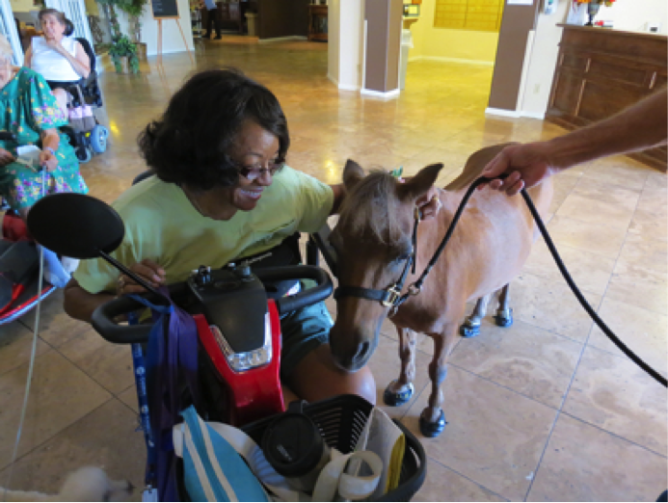
Therapy Animals
Provide people with therapeutic contact, usually in a clinical setting, to improve their physical, social, emotional, and/or cognitive functioning.
Are not covered under the ADA.
Are not provided as reasonable accommodations.
Notes:
Therapy animals are similar to ESAs. They are used to provide therapeutic contact in clinical settings to improve physical, emotional, and cognitive functioning. They are not covered under the ADA and are not provided as reasonable accommodations.

Slide 16
Service Animal Handler Rights and Responsibilities
Notes:
For the purposes of the remainder of this presentation, we will be focusing on individuals with disabilities that utilize service animals or service animals in training. Let’s discuss service animal handler rights and responsibilities.

Slide 17
What Can Be Asked of a Handler?
Is this dog (or mini horse) a service animal required because of disability?*
Or service animal in training in Michigan.
What work or task is the service animal trained to perform?
It must be trained to perform something specific - providing comfort or support is not a specific task.
You should never request an animal to display its task.
Best practice: If the answer to #1 is yes, unless there is a specific reason, you should not ask #2.
Notes:
The laws regarding the rights of owners and handlers of service animals are very prescriptive, including the questions that can be asked of a handler or owner of a service animal.
Keep in mind that these questions are only appropriate if the reason for the service animal is non-obvious. For example, an employee should not ask these questions to an individual who is using a guide dog and can be identified as blind or low vision
The first question is: “Is this dog or miniature horse a service animal required because of a disability?”
A best practice is to not ask question #2 if the answer to this question is yes, unless you have a very specific reason to ask.
Question #2 is: “What work or task is the service animal trained to perform”. Remember, the task needs to be something specific, related to the individual’s disability. Providing comfort is not a specific task. Something to note: the task the service animal is trained to perform does NOT need to be tied to the essential job functions of the employee’s position.
Also, it is never appropriate to ask an animal to display or perform its task.

Slide 18
Handler Responsibilities
A service animal or service animal in training must be housebroken.
A service animal must be under the “care and control” of a handler at all times:
Harnessed, leashed, or tethered in public unless these devices interfere with the service animal’s work or the individual cannot utilize these items due to disability.
Can be by voice, signal, or other effective means to control.
Control also means the service animal should not bark repeatedly in public places.
Barking 1-2 times or because it has been provoked or scared does not mean a dog is out of control.
Notes:
Handlers must ensure their service animal is housebroken. Service animals must also be under the care and control of their handler at all times. However, care and control can mean different things.
Service animals can be leashed, or tethered in public unless these devices interfere with the service animal’s work or the individual cannot utilize these items due to disability, but they can also be under control by voice or signal.
Control also means that the animal is not repeatedly barking or causing a disturbance in public spaces.

Slide 19
Under Care & Control Examples
A person who uses a wheelchair using a retractable leash so the animal can pick up or retrieve items. Even if it is far away, it must remain under the control of the handler at all times.
A person with PTSD has a service animal that enters spaces, reviews for threats, and then goes directly back to its handler to signal it is safe to enter. The animal may be off-leash to perform this task but on the leash at other times.
A nurse who uses a service animal for seizure signaling leaves their service animal under their desk while they escort a patient to a room. The animal may be either tethered under the desk or can be signaled using voice commands.
Notes:
Read slide

Slide 20
Excluding Service Animals
May generally only be excluded when the presence fundamentally alters the “nature of the goods, services, or program.”
May also be excluded if a service animal is out of control, the handler cannot regain control, or if it is not housebroken.
Notes:
The ADA does not require covered entities to modify policies, practices, or procedures if it would “fundamentally alter” the nature of the goods, services, programs, or activities provided to the public. Nor does it overrule legitimate safety requirements. If admitting service animals would fundamentally alter the nature of a service or program, service animals may be prohibited. In addition, if a particular service animal is out of control and the handler does not take effective action to control it, or if it is not housebroken, that animal may be excluded.

Slide 21
Examples of Reasons to Exclude Service Animals
In a residential hall, specific rooms may be reserved solely for individuals with allergies to dogs.
In a research lab, service animals may be restricted from rooms where research animals are the natural prey or predator of dogs – where their presence could be disruptive, causing the lab animals to become aggressive or agitated.
A burn unit where sterilization is critical to the care of patients.
A public pool, though a service animal may only be excluded from entry to the water.
Notes:
Read slide

Slide 22
Handler Rights
Handlers and service animals are allowed in any place generally that the public is invited in or able to go such as museums, restaurants, stores, theatres, schools, and events.
To address the behavior of the service animal if it is not under control.
To enter a public space without the service animal if the animal is denied entry due to out-of-control behavior or direct threat purposes.
Notes:
Read slide, then
Please be aware that the decision to deny entry of a service animal due to the reasons above should be made in consultation with the ADA Coordinator or legal counsel for the university and is a rare occurrence in public settings.

Slide 23
Service Animals in the Workplace
Service animals are not specifically mentioned in Title I of the ADA, which covers employment.
Individuals seeking to bring a service animal into their place of employment beyond the spaces typically open to the public are required to request a reasonable accommodation to bring their service animal with them to work.
A reasonable accommodation is any modification or adjustment to a job or the work environment that will enable an applicant or employee with a disability to participate in the application process or to perform essential job functions.
Notes:
Service animals are not specifically mentioned in Title I of the ADA, which covers employment. This means that disabled people who are seeking to bring their service animals to work must request an accommodation to do so.

Slide 24
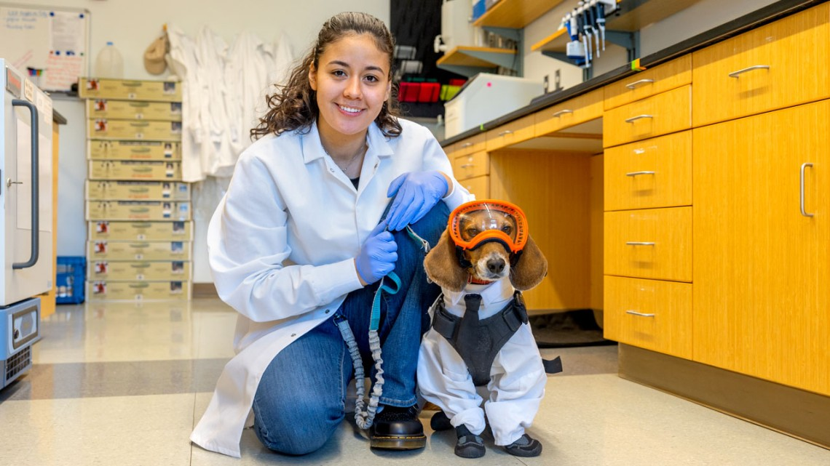
What Does This Mean for the Employer?
As the employer, a service animal needs to be evaluated just as any other reasonable accommodations are evaluated:
Cannot create an undue burden on unit operations.
The presence of the service animal cannot pose a direct threat to the health or safety of others.
Notes:
This means that an employer must engage in the interactive process and evaluate the accommodation, just like any other type of accommodation would be evaluated.
There may be some spaces where a service animal cannot go, for example: if an employee is a food handler, the service animal may be restricted to specific areas where other regulations may apply. However, this likely would not exclude the animal from admittance to break rooms or cafeterias where food may be.

Slide 25
Request a Service Animal Accommodation
An employee requesting to bring their service animal into their workspace is required to request an accommodation.
Submit a request to the Disability Equity Office via the ADA Initial Contact Form or directly request accommodation from their unit.
We strongly advise contacting the Disability Equity Office to discuss requests or concerns. We are trained to assist with the nuances regarding service animal accommodations.
Notes:
We strongly encourage employees to submit their request for accommodation to the Disability Equity office as we are trained to assist with the nuances regarding service animal accommodations.
If the service animal is not possible as an accommodation, the employee should be provided alternate accommodations that provide equally effective access to their essential job functions.

Slide 26
Possible Additional Accommodations Related to Service Animals at Work
Allow the employee to participate in individualized service animal training.
Provide the employee with a private/enclosed workspace, or a larger workspace.
Provide the employee with office space near a door and/or out of high-traffic areas.
Provide additional break periods for use of animal relief areas.
Establish an accessible path of travel that is barrier-free.
Allow equal access to employee break rooms, lunchrooms, restrooms, meeting rooms, and services provided/sponsored by the employer.
Notes:
In addition to bringing a service animal to work as an accommodation, other accommodations may also be needed. Examples include allowing the employee to participate in the training of the service animal, providing a private or dedicated workspace, providing additional break periods, and providing animal relief areas.

Slide 27
Caring for a Service Animal at Work
Service animals and service animals in training must be housebroken.
Provide a designated area where the employee can tend to the service animal’s basic daily needs, e.g., eating or bodily functions.
Consider general disability awareness training on the use of service animals in the workplace.
Notes:
Please remember they are animals and just like us we can be nervous in new spaces allow for grace and understanding keeping in mind that the handler must have control of their animal.
As mentioned before, service animals must be housebroken. There should also be a designated area provided for the employee to tend to the animal’s basic needs. We also recommend offering disability awareness training for departments if a service animal may be in the workplace.

Slide 28
Service Animal Etiquette

Slide 29
Dos and Don’ts: Etiquette
Dos
Don’ts
Address the person – not the service animal.
Treat the handler with respect, giving them as much space and time as they need.
Remember that identifying gear is not required.
Be on the lookout for a service animal without a handler – this could indicate an emergency needing attention.
Interact (distract, feed, approach, speak) with a service animal without permission from the handler.
Ask any questions about the handler’s disability upon seeing their service animal.
Engage with the animal even if it appears to be “off work” or resting.
Notes:
When it comes to service animals in the workplace, we’ve broken some tips down into dos and don’ts.
Do make sure you are addressing the person, not the animal. Give the handler time and space, and be on the lookout for a service animal without a handler as this could indicate a need for assistance.
Don’t interact with the service animal in any way. This means we are not feeding, approaching, petting, or otherwise distracting the animal from its work. Do not ask questions about the handler’s disability.
Make sure to acknowledge that a service animal is a needed piece of the owner’s medical assistance and daily life, and their need for a service animal should not be frowned upon, cause frustration, or lead to judgment.
Any interference with their job can be dangerous for the owner. Be sure to give service animal teams the space they need to go about their daily lives.
The most frequent issue that occurs is people talking to the animal.

Slide 30
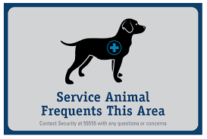
Communication Tips for Supervisors
Always discuss the use of a service animal with the handler first.
Have an open dialogue about the communication plan to those in the building/unit about the presence of a service animal.
Let the employee lead - if they want to educate their coworkers that is OK; just go over information together before presenting to others.
Remember confidentiality first: Ask whether the employee prefers the term “service animal” or only “animal in the workplace.”
Notes:
So now that an accommodation for a service animal is in place, how do you as a supervisor address questions or communication about the presence of a service animal in the workplace? You may be concerned about how to address questions from other occupants of the building and/or from other employees.
A sign may be one option, but it should be discussed with the employee their preferences to determine if it is appropriate.
Perhaps the employee wants to educate coworkers and is willing to do so. If not, you may want to simply let coworkers know that a dog will be present in the workplace and that they are not to interact with it. If a coworker indicates that they have an allergy or phobia related to the service animal, you should try to accommodate that other employee as well

Slide 31
Crafting Communications to a Team
Remember confidentiality - no names.
Email is preferred instead of open discussion at a staff meeting.
Email contents:
Animal/s are in the building for a specific purpose, and they are not to be interacted with for any reason.
Explain what interacting means: talking, whistling, cooing, barking, petting or asking to pet, praising, tapping or clapping, or giving the animal food or treats.
Encourage employees with questions or concerns to reach out to the supervisor directly.
Notes:
When crafting communications to a team, remember that disability is confidential. We recommend sending an email rather than engaging in open discussion during meetings to maintain privacy.
You can share that animal is in the workspace for a specific purpose and to not interact with it for any reason. Encourage employees who have questions to reach out directly to the supervisor.

Slide 32
Frequently Asked Question
Notes:
Moving now to our most frequently asked questions

Slide 33
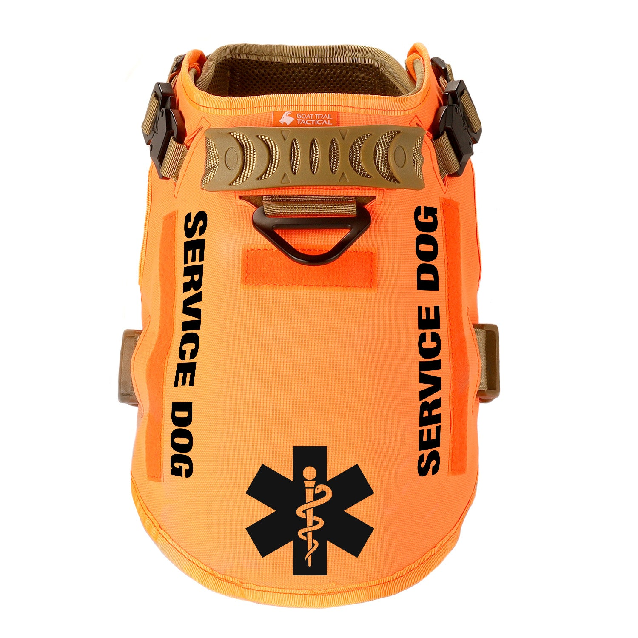
Do service animals need to wear identifying vests or harnesses?
No.
Service animals are not required to be marked in any way to indicate their designation as a service animal.
Notes:
Some individuals use a vest or other identifying patch to assist with identification, but it is not required. Many states will provide a free patch if someone does wish to use it.

Slide 34
Do service animals need to be certified, registered, or show proof of training?
No.
Service animals must only be individually trained to provide a specific task for the individual with a disability.
Mandatory registration is not allowed under the ADA or Michigan law.
Notes:
While some service animals undergo extensive and very specific training through programs, others are trained by their owners or handlers to meet their disability needs.

Slide 35
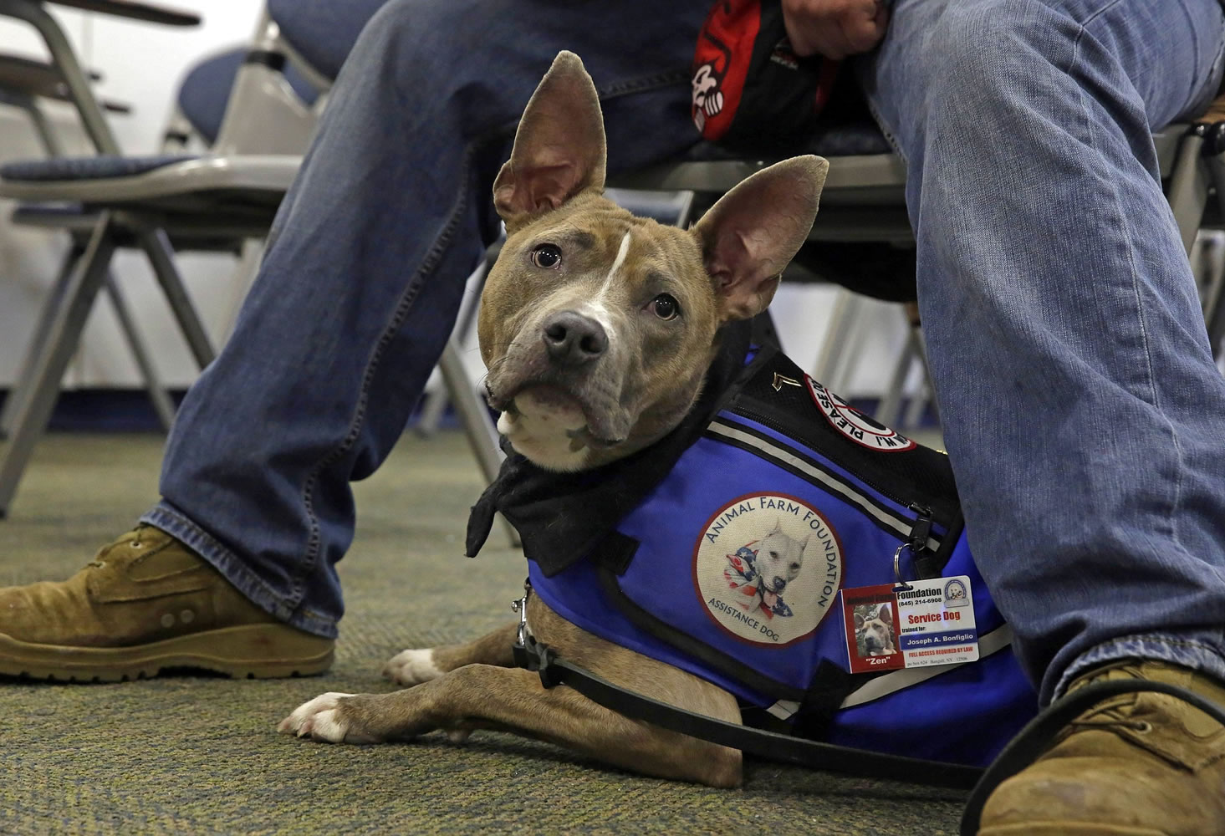
Are there breed restrictions or size restrictions for service animals?
No.
Service animals may be any dog (or mini horse), even if there are breed restrictions in a location, apartment, or housing complex.

Slide 36
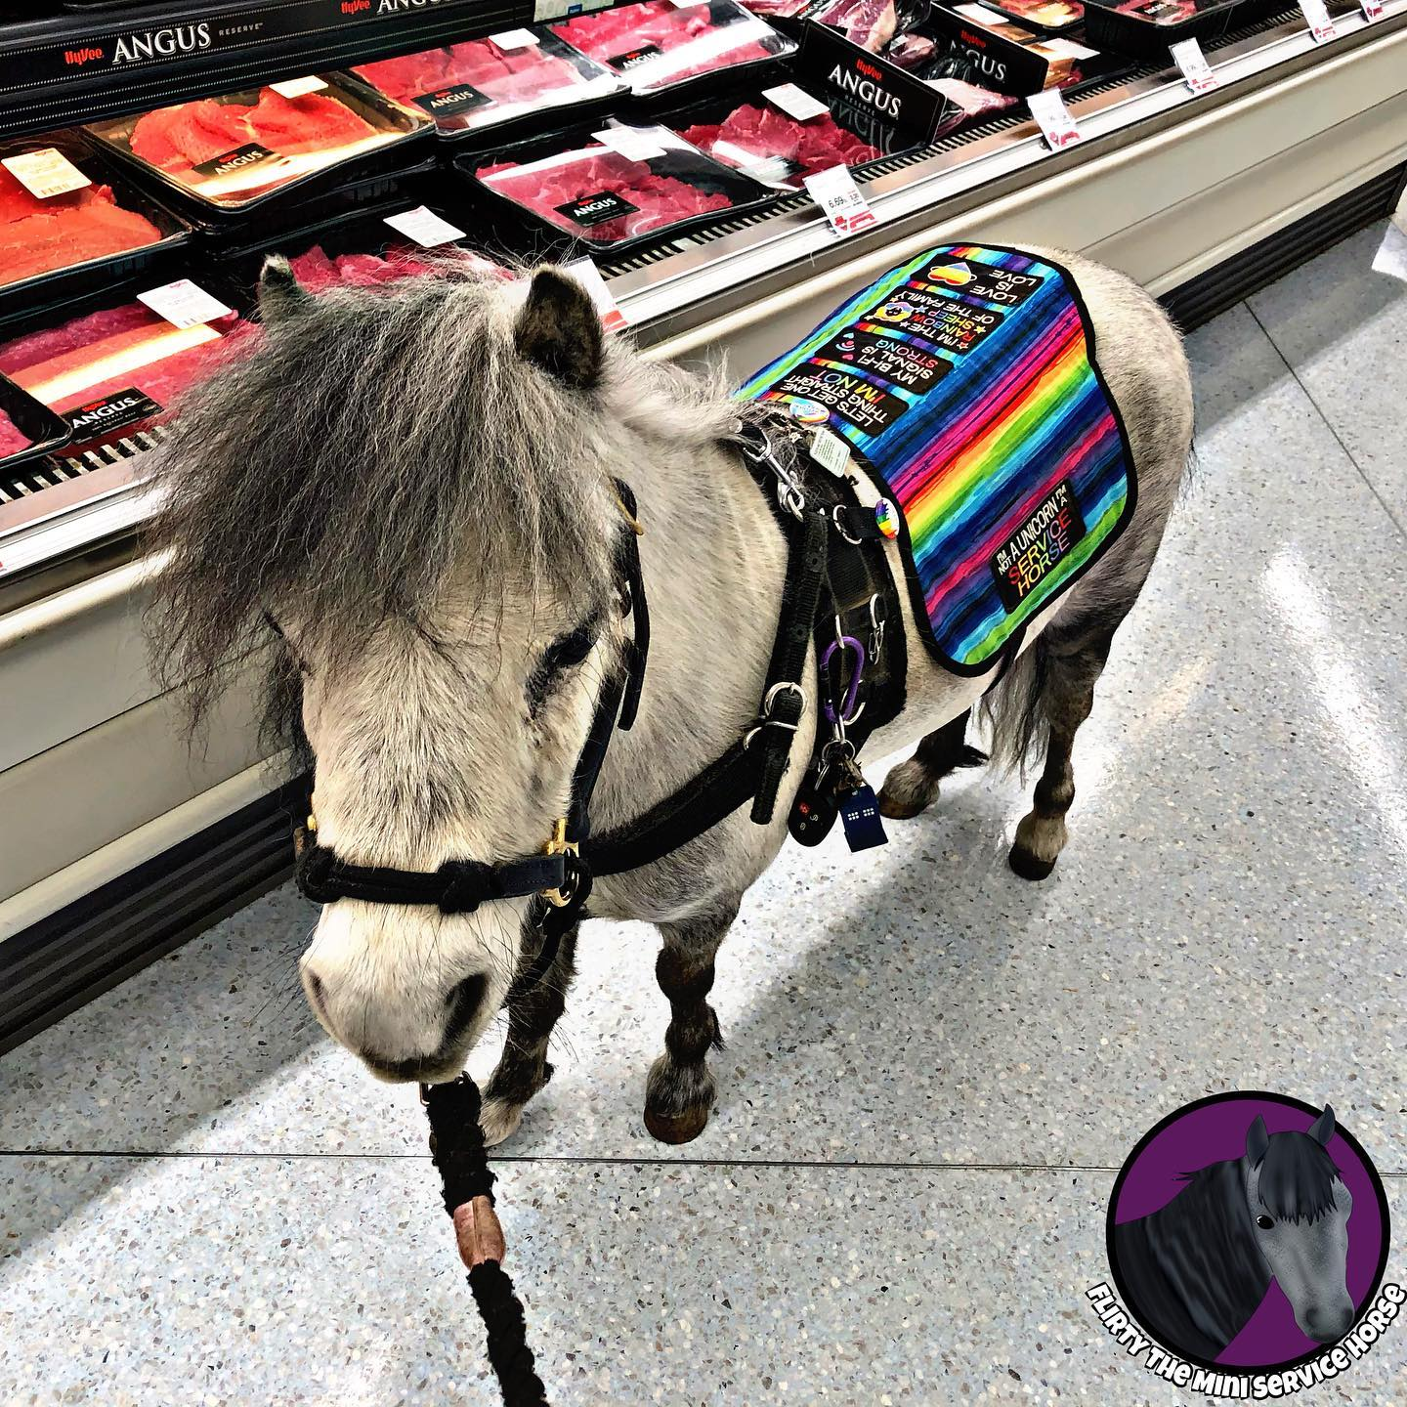
Are there specific requirements for service mini horses?
The requirements are the same as for service dogs with the added requirement that:
The establishment can safely accommodate the miniature horse’s type, size, and weight; and
Whether the miniature horse’s presence will compromise legitimate safety requirements necessary for the safe operation of a facility.
Notes:
Unfortunately, it is unlikely we will have mini horses in most restaurants anytime soon.

Slide 37
Can service animals be denied entry because of fear or allergies?
No.
Fear of animals or allergies is not a reason to deny an IWD the use of a service animal in a public place or workspace.
We will need to find a way to accommodate both the individual using the service animal and the individual with the allergy.
This may mean separated spaces or reassignment to a specific area/cube/office for either the individual with the service animal or allergy.
Notes:
In cases where an individual has a documented allergy-related disability, the employer would work to identify accommodations that work for both parties. This would not be in the case of an individual with slight allergies to animals, but would instead be in cases of substantial limitation, as defined by the ADA.

Slide 38
Is proof of vaccination required for service animals?
Maybe.
If local ordinances or state law requires the vaccination or registration of animals, the same rules apply to service animals.
However, unless there is a requirement to provide vaccination information for other animals on campus (housing), an employer should not ask for vaccination documentation for service animals.
Notes:
https://www.michigan.gov/mdcr/-/media/Project/Websites/mdcr/service-animals/documents/faq.pdf?rev=e946e4e0c2f54260ab503e42c22883f4

Slide 39
If I have a disability and register my dog, is it now a service animal?
No.
The dog must be individually trained to perform a task related to the individual’s disability.
A person voluntarily registering the untrained dog (ESA or pet) with the state of Michigan to receive a service animal “patch” may be guilty of a misdemeanor.
It is also a misdemeanor for any individual without a disability to represent a pet, ESA, or therapy animal as a service animal.

Slide 40
What documentation may employers request related to service animals?
Employers may only request medical documentation when the need is not obvious.
Documentation to support the employee has a disability and their functional limitations.
May rely on the employee’s explanation of what tasks the service animal does - may not exist in medical documentation.
Can accept training certificates if the employee offers them, but they are not required.

Slide 41
Can a service animal be trained by its handler during work hours?
Yes.
A handler in Michigan can bring their service animal in training to work so the animal can learn to perform its tasks in the different spaces the handler will commonly be in.
Training a service animal for someone else?
May be permitted with the approval of the employer, but under the ADA, only employees with disabilities are entitled to reasonable workplace accommodations.
Notes:
What if the training interferes with work obligations? The employee still must adhere to the performance standards of any other employee, regardless of their accommodation. If training interferes with the employee’s ability to complete their work, the accommodation may need to be reassessed.

Slide 42
If a service animal is out of control and the handler needs to leave, what happens next?
If the handler cannot bring their animal back under control, the animal may need to be removed.
The handler should be allowed to leave the work environment or event in order to bring the animal home, to its crate, etc.
Best practice: discuss with the handler what should occur if there is an emergency; create a plan
Notes:
If the handler needs to be gone for an extended period of time and cannot complete their work tasks, misses information from a meeting, etc, the employee should speak with their supervisor on how to make up their time or obtain missed information in another means (meeting notes, additional meeting, etc). Keep in mind that the individual should be able to come back into the space without the animal and the employer may need to consider alternative accommodations at that time.
It is a best practice for covered entities to record important details when a service animal is removed, such as in an incident report. This can be helpful in cases where it is determined that a specific animal must be banned or reported due to repeated behavioral issues or other concerns.

Slide 43
Where can I find more information and FAQs about service animals?
ADA.gov
JAN (Job Accommodation Network)
Michigan Department of Civil Rights
Notes:
If you are seeking additional information regarding service animals, you can visit ADA.gov, JAN, or the Michigan Department of Civil Rights.
We hope you’ve found this information helpful, but please contact the Disability Equity Office if you have further questions.

