Slide 1
Title II and You: What Do the Updated Digital Accessibility Rules Mean to You?
Allison Kushner, ADA Coordinator & Director
Phil Deaton, Digital Information Accessibility Coordinator

Slide 2
Zoom Webinar Tips
Use the Q&A feature to submit your questions.
ASL interpretation can be utilized by clicking Interpretation and selecting American Sign Language.
CART transcription can be turned on by selecting Show Captions.
Notes:
This workshop is also being recorded and will be made available on ECRT’s YouTube channel: https://www.youtube.com/@ECRTumich as soon as possible. The slides will be emailed to all registered participants within the coming days along with an anonymous survey. We do really hope you’ll complete the short survey, as this helps us determine how we can best assist you with your learning goals.

Slide 3
Agenda
The University of Michigan is committed to fostering an inclusive environment where accessibility and the needs of individuals with disabilities are prioritized, ensuring equitable opportunities for all members of our diverse community. This workshop will cover:
DEO role in Digital Accessibility
Brief legal framework of Title II
What does digital accessibility mean?
What do the new regulations cover and what exceptions exist?
Title II & U-M
Common questions

Slide 4
Please Engage
We are modeling a comfortable, inclusive, brave, and safe space.
Questions are encouraged – we’re all learning together.
We don’t know what we don’t know.
Respect the experiences of others.
Opportunity for growth and learning.

Slide 5
Why Digital Inclusion Matters

Slide 6
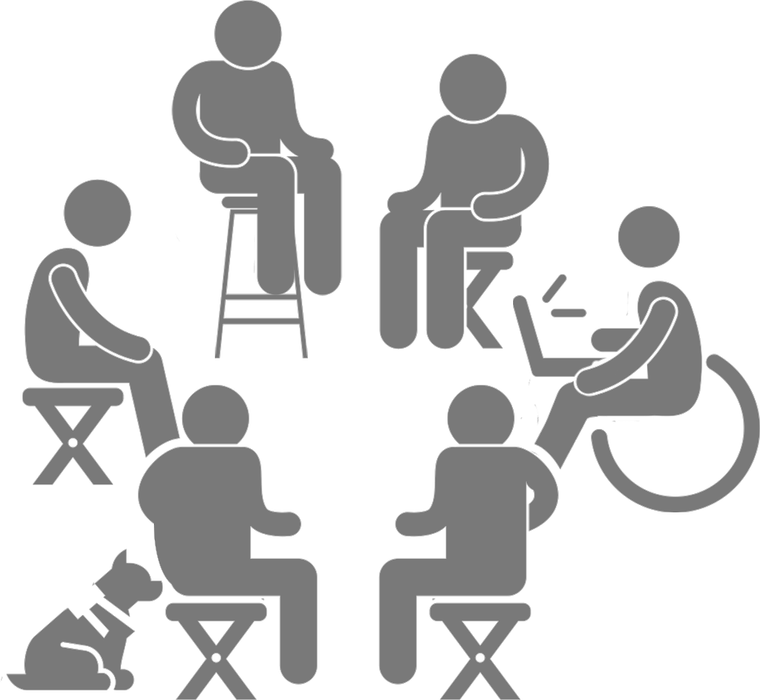
Digital Inclusion
Digital inclusion is the enterprising goal of providing equivalent access to a digital interface to all users, regardless of disability
Goes beyond accessibility, considering efficiency and usability as part of the user experience
Digital inclusion is more than meeting a requirement
Digital inclusion for a wide variety of individuals with auditory, visual, neurological, physical and cognitive limitations

Slide 7
Digital Divide
The gap between those who have access to digital technologies and those who do not
For IWD’s the digital divide contributes to the education gap, employment gap, and information gap
According to the 2024 WebAIM Million report, only 3% of the top one million websites are accessible
92% have WCAG 2 failures

Slide 8
DEO Role in Digital Accessibility Compliance

Slide 9
ADA Coordinator and Digital Information Accessibility Coordinator
ADA Coordinator
DIAC
Statutorily responsible for oversight of disability-related complaints and grievance processes
Coordination of efforts and compliance across an organization with the ADA and disability-related federal and state laws
Subject matter expert
Provides digital accessibility training, accessibility review, and guidance for procuring accessible software and apps
Oversight of Electronic Information and Technology Accessibility Policy (SPG 601.20)
Subject matter expert on digital information accessibility
Responds to reported digital accessibility barriers

Slide 10
Brief Legal Framework

Slide 11
What Is the ADA? The Americans with Disabilities Act (1990) and the Amendments Act (2008)
A federal law prohibits discrimination and harassment against individuals with a disability (IWD) in employment, public places, public education, etc.
ADA has 4 titles (or sections) that cover various aspects of access
Title I: Employment
Title II: State and local governments including schools at all levels
Title III: Public places
Title IV: Telecommunications
Keep in mind additional federal and state laws protect IWD’s from discrimination and provide for equal access
Rehabilitation Act of 1973, Fair Housing Act, Michigan Persons with Disabilities Civil Rights Act, etc.

Slide 12
Disability Definition
A physical or mental impairment that substantially limits one or more major life activity
Substantial limitation is determined by comparison to an average person in the general population
Major life activities include: bending, breathing, caring for self, concentrating, hearing, interacting with others, learning, lifting, sitting, speaking, standing, thinking, walking, working, etc.
This includes people who have a record of such an impairment, even if they do not currently have a disability
It also includes individuals who do not have a disability, but are regarded as such

Slide 13
A Few Basic Definitions
IWD: Individual with a Disability
EIT: Electronic Information Technology
WCAG: Web Content Accessibility Guidelines
International digital guidelines that inform digital accessibility requirements

Slide 14
What Does Title II Cover?
Designed to ensure that state and local government services, including public universities, are accessible to people with disabilities
Requires digital content, apps, software, etc. be designed so that everyone can access them regardless of ability, disability, or use of assistive technology
Subpart H: defines obligations for web and mobile accessibility
Updated regulations apply specifically to Subpart H

Slide 15
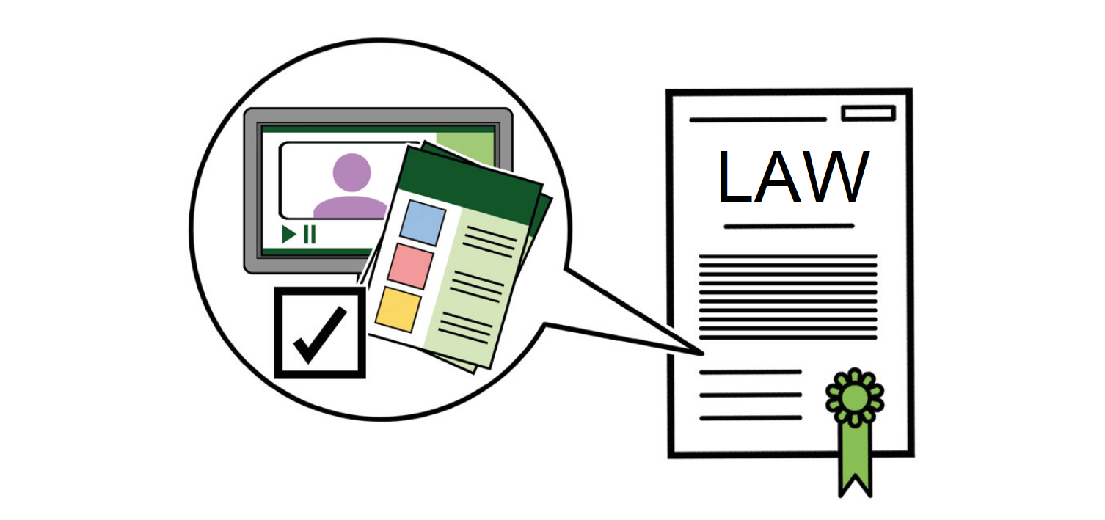
Purpose of the Title II Updates
To ensure that state and local government services, including public schools and university websites, mobile apps, and digital information, are accessible to IWDs
By providing clearer guidelines and technical standards for making digital content accessible to everyone

Slide 16
Major Title II Changes
Uses the WCAG 2.1 AA standard
Includes web content and mobile apps that a public entity “provides or makes available, directly or through contractual, licensing, or other arrangements"
Software and desktop applications that support services, programs, and activities still need to be accessible
Compliance by April 24, 2026, for U-M and similar entities

Slide 17
Digital Accessibility

Slide 18
What Does Digital Accessibility Mean?
Digital information and experiences can be accessed, participated in, understood, and made use of by all
Not just availability, but equitable access, without barriers or burdens placed on any individuals or communities
Achieved by implementing standards and practices that center the needs of users with disabilities

Slide 19
What Does WCAG 2.1AA Mean?
WCAG 2.1 AA is a standard promoted by the W3C, an international standards org for stewardship of the web
Designed with a broad range of accessibility needs in mind
Widely-used standard for meeting accessibility, does require some interpretation
Includes design principles and guidelines, and specific, testable success criteria to meet to make a statement of compliance

Slide 20
What’s New with Title II and You?
Accelerated rate to comply with the regs
Password-protected course materials must be made accessible
Continuing obligation to provide accommodations and access unless unreasonable- prior to making any decision something is unreasonable contact the DEO
Responsible for software purchased and disseminated by third party vendors

Slide 21
What’s Covered?

Slide 22
Websites, Web Applications, and Web Content
Includes web-delivered content (e.g., documents you post to your website)
Consider template accessibility
Consider content accessibility - how will you train content creators and maintain accessibility in new pages?
Conduct an accessibility review of your website
Web accessibility scanning tool - working to promote
Web Accessibility Scanning Service Relaunch
Web Accessibility Scanning

Slide 23
Top WCAG Failures
Low contrast text
Missing alternative text for images
Missing form input labels
Empty links
Empty buttons
Missing document language

Slide 24
Documents
Documents should be accessible
Unless an exception applies (more on this later)
Use common accessibility checkers
This means documents attached to email and disseminated whether you created them or not
Remember - when transferring some documents to PDF, you may lose accessibility work
Consider using original format docs and marking them as final, password-protecting, and dating
We are investigating more resources for PDF accessibility remediation

Slide 25
Course Content
Course content materials are required to be accessible
Even if password-protected
Forthcoming tool to assist with Canvas accessibility scanning and improvements
Canvas Accessibility Launch | accessibility.umich.edu
Documents in courses may also need work
STEM content and other types of content may be more complex

Slide 26
Media (e.g., Videos and Podcasts)
Live events/Streamed media
Pre-recorded media
DEO services
CART fund
ASL interpreters
To submit requests, employees can log in using the single sign-on portal or email DisabilityEquity@umich.edu

Slide 27
Digital Applications
Programs, services, and activities
Online ticket purchase
Record searches
Online mobile payments, parking apps
Employment services/applications
Educational services, libraries, etc.
Appointment apps, reservations, etc.
Health service platforms and services

Slide 28
Archived Materials
Assume materials are not archival in nature unless you can work through the archival analysis
If you have large batches of material that you think may be applicable for this exception and are not sure, reach out
These regulations ask us to consider complex issues around web governance in higher education

Slide 29
Exceptions

Slide 30
ADA Title II Subpart H Exception Categories
Archived web content
Preexisting conventional electronic documents
Content posted by a third party
Individualized, password-protected or otherwise secured conventional electronic documents
Preexisting social media posts
For assistance understanding whether an exception applies, contact the DEO

Slide 31
Exceptions: Archived Web Content
Archived web content
Content created before the effective date of compliance, or reproduces paper documents, or the contents of physical media*, that were created before compliance effective date; AND
The content is kept only for reference, research, or recordkeeping, AND;
it is kept in a special area for archived content, AND;
it has not been changed since it was archived.

Slide 32
Exceptions: Pre-existing Conventional Electronic Documents
Preexisting conventional electronic documents
Created prior to April 24, 2026, that are not used to apply for, gain access to, or participate in U-M services, programs, or activities

Slide 33
Exceptions: Individualized, Secured Documents
Individualized, password-protected, or otherwise secured conventional electronic documents
About a specific individual, their property, or their account; and
Password-protected or otherwise secured
Even when content may meet this, design ways to provide accessibility upon request in advance of those requests, so that access can be provided in a reasonable timeframe

Slide 34
Exceptions: Third party content
Unless the third party is posting due to contractual, licensing, or other arrangements
Generally, external individual providing comments/message on a U-M Record
Individualized, password-protected, or otherwise secured conventional electronic documents
About a specific individual, their property, or their account; and
Password-protected or otherwise secured
Still required to provide accommodations and access to these documents when IWD requests them
Even if exception is available, designing with accessibility will provide easier access if/when items are requested by an IWD

Slide 35
Exceptions: Pre-existing Social Media Posts
Pre-existing social media posts
If you re-post, "new” post likely needs to be compliant
If you utilize old posts for current services, programs, or activities, they are likely still covered by Title II
Social media apps have some unfortunate limits in how accessible they are
Work toward maximizing accessibility within the tool used

Slide 36
General ADA Title II Exceptions
For these types of exceptions, you will need to reach out to the DEO to work through the ADA analysis
Fundamental alteration
A change that is so significant, it would alter the essential nature of the care, service, or experience being provided, significantly interferes with health or safety, invalidates the objective of service or program
Undue Hardship
Action requiring significant difficulty of expense to the overall resources of an entity or unduly burdensome on unit operations when considering several factors, on an individualized basis

Slide 37
Title II Subpart H: Additional Analyses
Conforming alternate version: only when “it is impossible to make web content directly accessible due to technical or legal limitations"
Equivalent facilitation: can exceed or use alternative standards provided they demonstrably provide greater accessibility

Slide 38
Exception Analyses Impact
Non-compliance that has a minimal impact on access issues; must demonstrate websites can be used to:
Access the same information as individuals without disabilities;
Engage in same interactions as individuals without disabilities;
Conduct same transactions as individuals without disabilities; and
Participate in or benefit from the same services, programs, and activities as individuals without disabilities

Slide 39
Frequently Asked Questions

Slide 40
Do documents posted to my website or provided via email/digitally need to be made accessible?
Yes!
Unless an exception is met
This includes flyers, invitations attached via PDF, event announcements, surveys, forms, etc.
Anything attached to an email or forwarded must first be checked for accessibility

Slide 41
What standards should I use for documents?
WCAG 2.1 includes helpful standards for PDFs
Built-in checkers for Microsoft products help
Create accessible templates for all your frequently used document types to reduce time;
PowerPoints, presentations, and guidance provided by the DEO
Be sure to subscribe to the newsletter to receive information about presentations, tips, and resources on accessible documentation

Slide 42
How do I prioritize which materials to start on?
Size of audience
Essential nature for programs, services, activities
Related to safety or security
Lifecycle - how long is the product’s expected use in your programs, services, activities

Slide 43
Who needs to do digital accessibility work?
We all have a shared responsibility to create or procure accessible content and technology
Ultimately responsible for ensuring access
Not the responsibility of the IWD to remediate or request fixes

Slide 44
What if my content is covered under an exception, but I receive an accommodation request?
Content must be made accessible to the individual who has requested this content
If you believe it is a fundamental alteration or undue burden under the ADA, contact the DEO to ensure the appropriate analysis is done

Slide 45
I use Instagram to create social media posts. How do I ensure Instagram is accessible?
The university is not responsible for the social media platform’s accessibility
We should however, maximize the accessibility of content
The university is not responsible for the accessibility of content posted by communities outside the university
In response to our social content (unless we have a contract, license, or other arrangement)

Slide 46
Do quick-fix accessibility fixes or widgets make my website accessible?
No
Widgets and quick fixes may actually create additional barriers and are routinely subject to accessibility lawsuits

Slide 47
How do I achieve compliance with the updated regs?
Conduct an accessibility audit of documents, materials, etc.
Request training and educate yourself and your teams
Embed accessibility in all design and development
Partner with DEO and ITS to learn more
Monitor and maintain accessible sites and materials

Slide 48
Wrap Up
Notes:
Allison 47-end

Slide 49
Key Takeaways
Do
Don’t
Continue to educate yourself and learn more
Use built-in accessibility tools
Contact DEO for training and questions
Consider digital inclusion in your daily work
Disseminate digital materials and documents you have not checked for accessibility
Convert documents to PDF if you can avoid it
Don’t make accessibility compliance decisions without DEO guidance

Slide 50
Questions?

Slide 51
Disability Equity Office
Contact Information and Resources

Slide 52
Happening @ Michigan
Check out the Disability Equity Office’s upcoming presentations and interactive workshops by scanning this QR code or by visiting the upcoming events page!

Slide 53
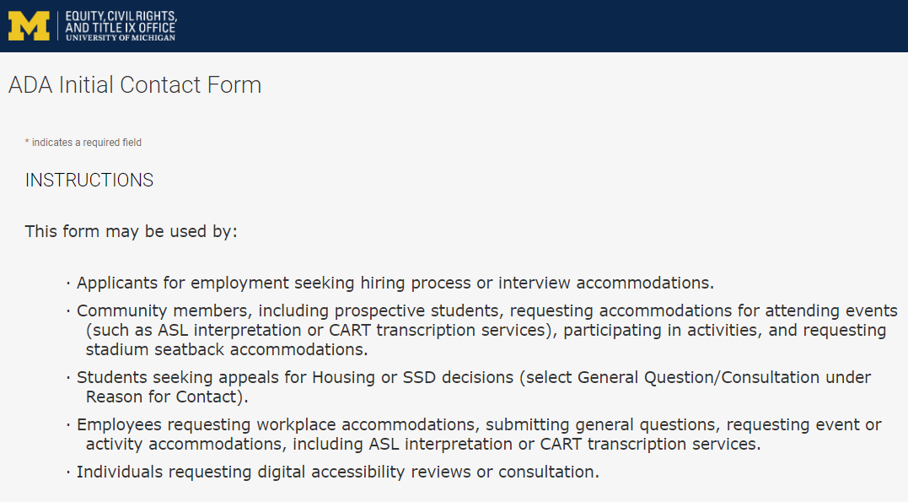
Contact the Disability Equity Office https://ecrt-umich-accommodate.symplicity.com/public_accommodation/
Use the ADA Initial Contact Form to request:
Workplace accommodation
Hiring process accommodation
Consultation with the Disability Equity Office staff
ASL or CART services
Digital accessibility review or consultation
Stadium seatback accommodations
Notes:
Employee login: https://ecrt-umich-accommodate.symplicity.com
ADA Initial Contact Form: https://ecrt-umich-accommodate.symplicity.com/public_accommodation/

Slide 54
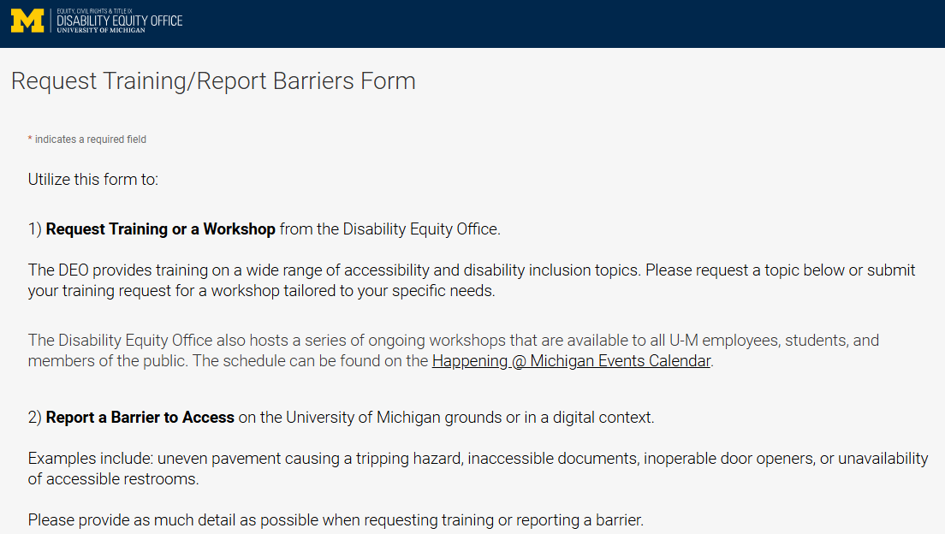
Request Training or Workshops https://ecrt-umich-accommodate.symplicity.com/activity_provider_request/
Use the Request Training/Report Barriers form to request training for your department or group. Topics include:
Ableism Awareness
Creating Accessible Digital Documents
Creating Inclusive Environments
Disability Awareness
Reasonable Accommodations and the Interactive Process
Service Animals
Notes:
Request Training/Report Barriers Form: https://ecrt-umich-accommodate.symplicity.com/activity_provider_request/
Happening @ Michigan Events Calendar for DEO : https://events.umich.edu/group/5177

Slide 55
Report Barriers to Access https://ecrt-umich-accommodate.symplicity.com/activity_provider_request/
Use the Request Training/Report Barriers form to report physical or digital barriers to access
Examples:
Inoperable door openers or elevators
Cracked pavement causing tripping hazards
Inaccessible software or documents
Notes:
Request Training/Report Barriers Form: https://ecrt-umich-accommodate.symplicity.com/activity_provider_request/

Slide 56
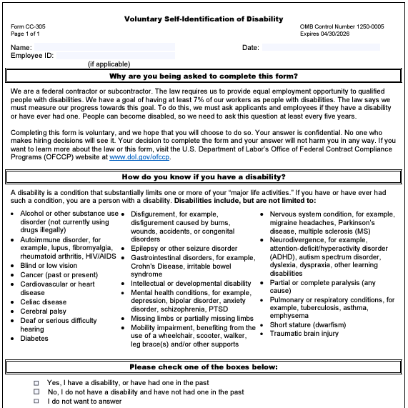
Voluntary Self-Identification of Disability
Update your information through Wolverine Access
Click on Employee Self Service
Go to Campus Personal Information
Select Disability Status
Notes:
Updating your voluntary self-id information plays a pivotal role in creating inclusive workplaces. It helps provide a better understanding of the diversity of our organization and helps to identify opportunities for improvement.
This information is used to measure the university’s commitment to accessibility and is never shared with your supervisor.

Slide 57
More Learning Opportunities from the DEO
Filterable list of resources on the ECRT website
ECRT's YouTube Channel
DEO's Happening @ Michigan event list
Recorded Presentations & Trainings
Sign up for the DEO Newsletter
Notes:
Filterable list of resources on the ECRT website: https://ecrt.umich.edu/get-help-support/resources/
ECRT’s YouTube Channel: https://www.youtube.com/@ECRTumich
DEO’s Upcoming Events are listed on the Happening @ Michigan website: https://events.umich.edu/group/5177
Recorded Presentations & Trainings website: https://ecrt.umich.edu/disability-accessibility/presentations-trainings/
DEO Newsletter sign up form: https://umich.us18.list-manage.com/subscribe?u=155e051009a7f5441a41bef64&id=6c9fbf9d2c

Slide 58
Thank You from the DEO!

